Slide 1

April

Slide 2
Agenda
Store Traffic Report
Needed Vehicle Report
SMS History Report
Stopping the Clock on OEM Leads
Deleted Customer Report

Slide 3
Store Traffic Report
This is our newest report in ProMax. It shows you an overview of all the traffic in your store with the ability to drill down any way you want to see or manipulate the data

Slide 4
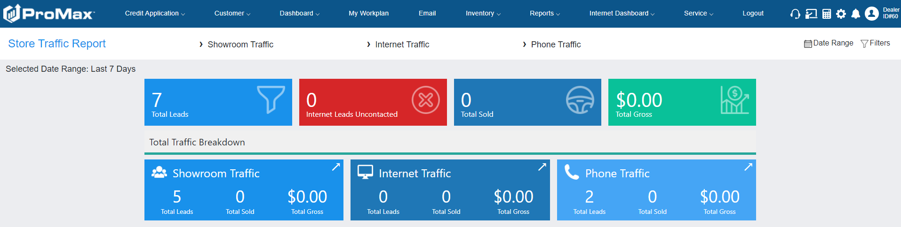
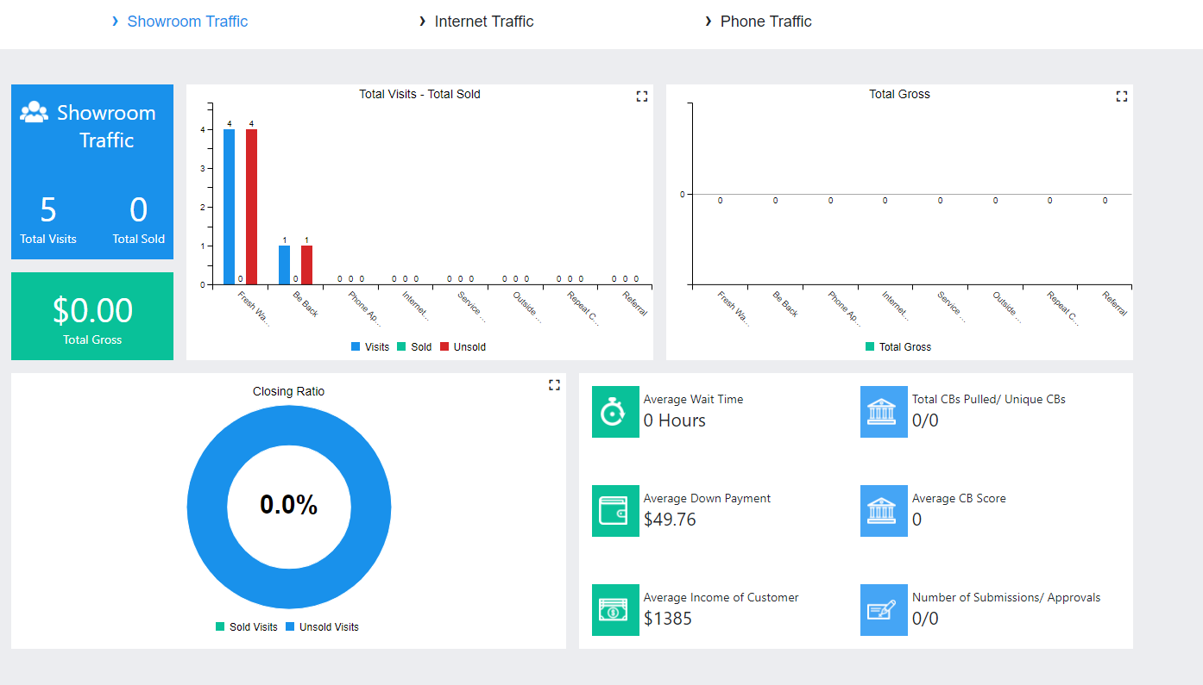
Store Traffic Report
Reports > Store Traffic

Slide 5
Deleted Customer Report
If you accidently delete a customer or delete some information during a merge on accident, this is how you can reinstate that person/missing information.

Slide 6
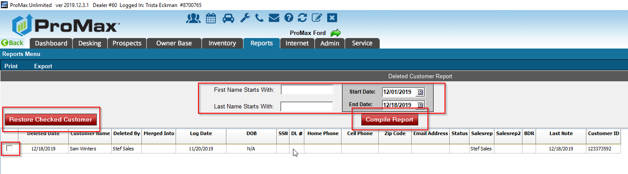
Deleted Customer Report
Reports > Deleted Customer Report > Choose date range > Compile > Check box for the customer > hit restore checked customer
When you merge a customer, everything that you choose not to keep is put on to a record that is deleted. If you deleted a piece of information by mistake, it can be reinstated here as well as customers that were deleted through an automatic merge process or a manual mistake.

Slide 7
Needed Vehicle Report
If you are regularly using the desired vehicle section of the Customer Workscreen, you can have a report automatically created for you about the vehicles that you already have a buyer for.

Slide 8
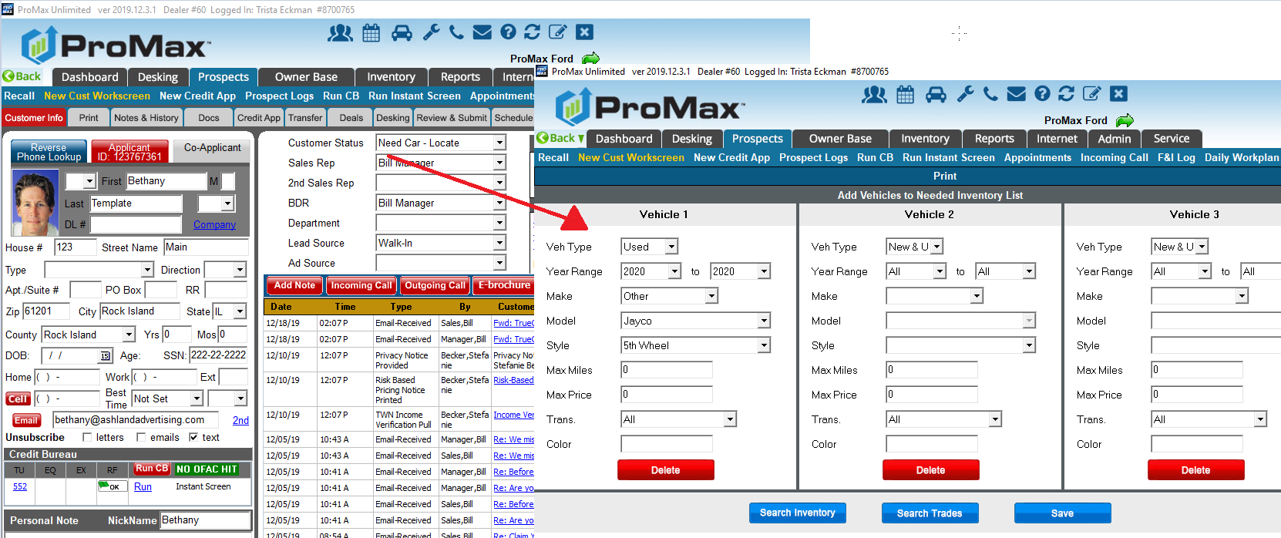
Needed Vehicle Report
Use the customer status of “Need Car Locate” and fill out the vehicles the customer is interested in.
With this status, you can trigger follow up for the customer, but also this will create a report for needed vehicles that you can take to auction with you. It will also alert you in the trade in if there is a customer interested in the vehicle you are getting ready to take in on trade.

Slide 9
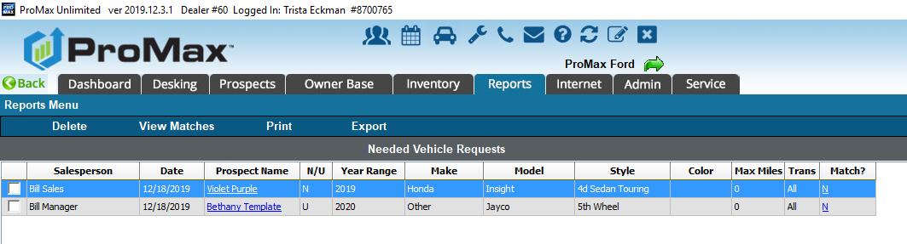

Slide 10
SMS History Report
This report will show you all of the texts coming in and out of your system.

Slide 11
SMS History Report
You can find this report under Reports > SMS History Report. This report will open up for you in your default web browser and is also accessible from the Promax Mobile App.
From the advanced filter option you will be able to customize what kind of messages you would like to see.
Please note the error code column. You can keep an eye on this to see if you are being blocked by any phone carriers. In order to avoid this, you will want to be sure to update your templates on a regular basis or type out different messages to your customers each time.
There is also a summary onthis report that will help you visualize trends.

Slide 12
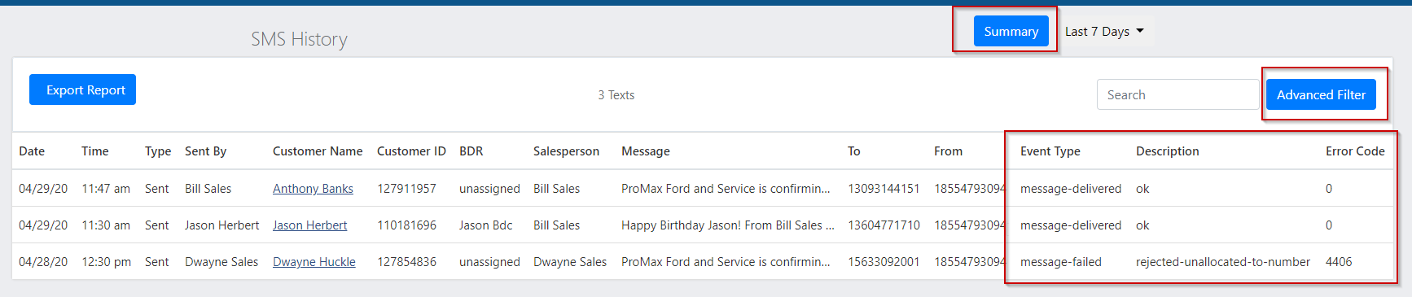
SMS History Report

Slide 13
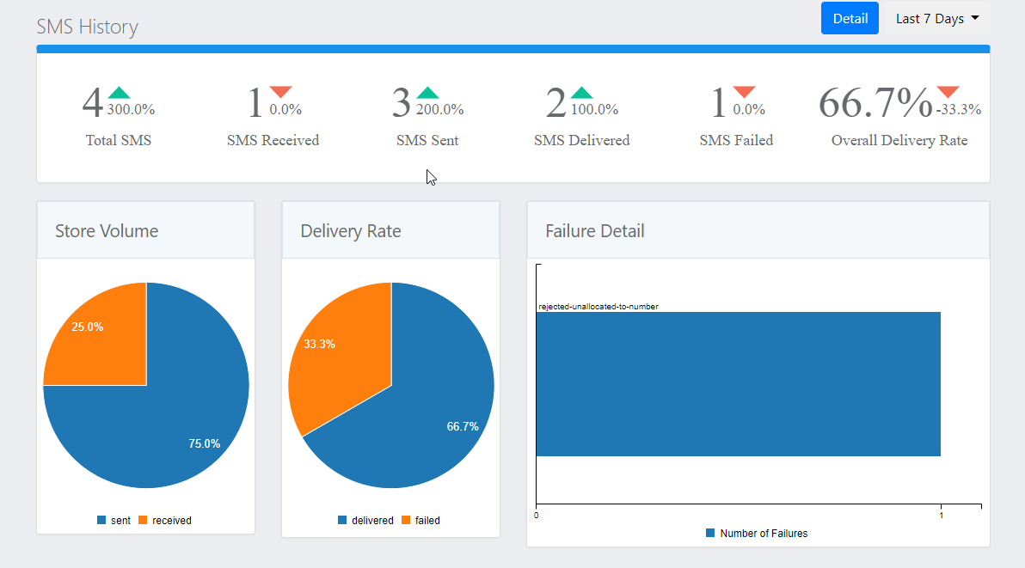
SMS History Report
The comparisons with the arrows are comparing the same date range from the previous month.

Slide 14
SMS History Report
Rejected- Unallocated Number
  This number is a valid number, but is not assigned to a carrier because this number is not available for public consumption in North America.
Invalid Destination Address
  This message is being sent to a user that has a prepaid account, but does not have sufficient funds to receive the message.
  The phone number has been deactivated.
  The phone number is transferring to a different carrier and the change has not been completed yet.
Destination Rejected Message
  Carrier rejected the message because the number is invalid or the customer does not have the SMS service enabled.
Destination Failed
  General delivery failure. Something got in the way of delivering this message. Usually this is due to the recipient’s carrier having issues.
Delivery Receipt Expired
  The message tried to be delivered and failed. When resent several times it still could not be delivered so it timed out. This usually happens when the carrier is down or the recipient is in an area where messages cannot be received.
Here is a list of definitions for the different errors you can see in the SMS History Report

Slide 15
BDC After Hours
ProMax offers a service through our BDC to stop the clock on any after hour leads on your behalf.

Slide 16
BDC After Hours
Hyundai
  6 hour response time using set hours of 10-8 Monday – Saturday. Time Zone Specific
  Email, ebrochure, email received, completed call, incoming call, or text recorded/completed in ProMax will stop the clock
Nissan/ Infinity
  24 hour response time during business hours
  Email, ebrochure, email received, completed call,or incoming call recorded/completed in ProMax will stop the clock
Ford
  1 hour response time during business hours
  Email or ebrochure sent out of ProMax will stop the clock
Toyota/Scion/Lexus
  3 hour response time during business hours (holidays are excluded)
  Dealers are given a grade based on the responses for each lead
    Under 1 hour is green
    1-3 hours is yellow
    3+ hours is red
    Email, ebrochure, email received, completed call, incoming call, or text recorded/completed in ProMax will stop the clock
Here are the different requirements by the OEMs for stopping the clock

Slide 17
BDC After Hours
VW
  3 hour response using business hours, as provided by Cobalt, in their native time zone
  Under a 30 minute response time will result in a discount for the lead price
  Contact time over 3 hours will send the lead to a different dealership
  Email, ebrochure, email received, completed call, incoming call, or text recorded/completed in ProMax will stop the clock
Mitsubishi
  24 hour response time during business hours
  Email, ebrochure, email received, completed call, or incoming call recorded/completed in ProMax will stop the clock
Chrysler/Fiat
  24 hour response time during business hours
  Email, ebrochure, email received, completed call, incoming call, or text recorded/completed in ProMax will stop the clock
OEM requirements for stopping the clock continued

Slide 18
BDC After Hours
Volvo
  24 hour response time during business hours
  Email, ebrochure, email received, completed call, incoming call, or text recorded/completed in ProMax will stop the clock
Honda
  2 hour response time using business hours
  Email, ebrochure, email received, completed call, or incoming call recorded/completed in ProMax will stop the clock
Subaru
  24 hour response time during business hours
  Email, ebrochure, email received, completed call, or incoming call recorded/completed in ProMax will stop the clock
Mazda
  90% responded to within 1 hour using set business hours
    M-F 9-6, Sat 10-6, Sundays and holidays are considered closed
  Email, ebrochure, or a call completed in ProMax will stop the clock
GM
  99% of leads within 5 hours, overall of 1 hour or less in real time
  Email, ebrochure, email received, or completed call will stop the clock
Kia
  Respond in an hour or less during business hours
  Emial sent, ebrochure, and completed calls will stop the clock
OEM requirements for stopping the clock continued

Slide 19
BDC After Hours
Stops the clock for you on all leads that include an email address
Keeps you in compliance with the OEMs
Custom Email Templates that includes the ability for the customer to schedule their own appointment
Different Emails can be used for different lead sources
Email can be sent by a specific employee or through a round robin
Can be run 24/7 or only during certain hours
This is not CRM functionality – this is completed through our BDC as a service. The OEMs do not recognize auto responders as an activity to stop the clock.
Dealer can choose when the response goes out (anywhere from 3-16 minutes)
Benefits of using our solution

Slide 20
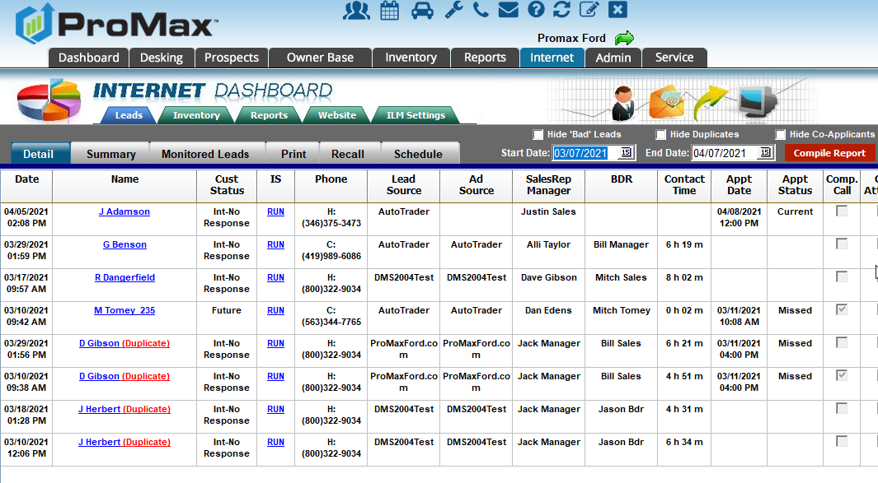
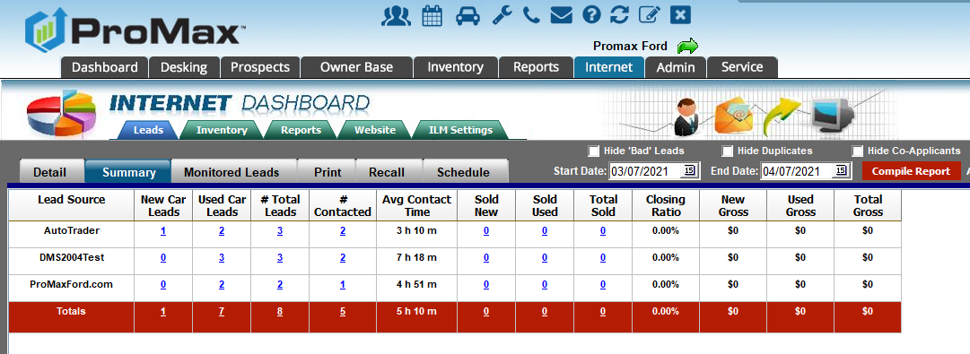
BDC After Hours
What is my current contact time?
Internet > Detail
&
Internet > Summary

Slide 21
Questions?
Contact our Dealer Support Line at 844-322-9034
Contact me directly at 563-344-7618 or Trista@ProMaxUnlimited.com
PromaxUnlimited.com
Facebook.com/ProMaxUnlimited
Twitter.com/ProMaxUnlimited
LinkedIn.com/Company/ProMax-Automotive-Software/
DealerUpdates.TypePad.com/Blog/

