Slide 1
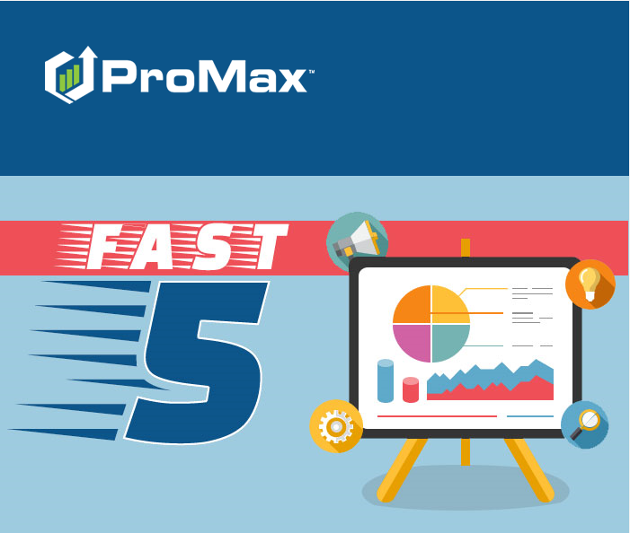
AUGUST

Slide 2
Agenda
Free Online Training
Texting Best Practices
Recent Customers
Outbound Call Tracking
Download Templates

Slide 3
Free Online Training
Access our online tutorial library 24/7 for any training needs you have.

Slide 4
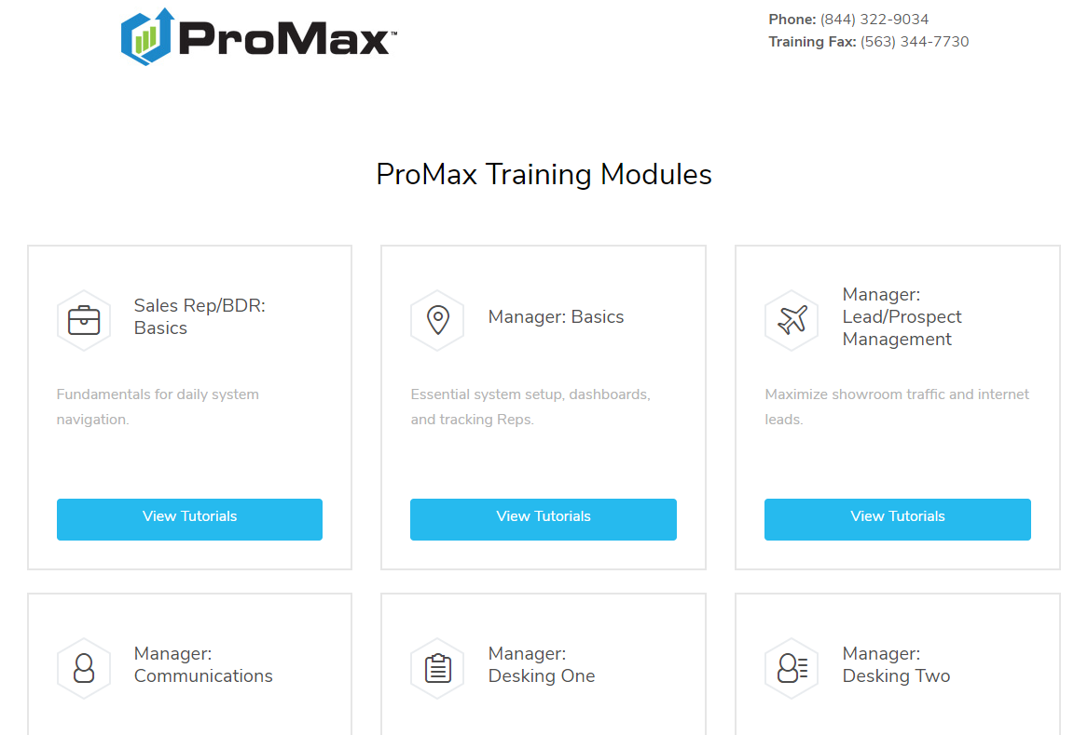
Free Online Training
To access our tutorials, go to the question mark icon at the very top of your ProMax screen.
We walk you through step by step on what trainings need to be completed for your position in the dealership with a combination of prerecorded videos and online/webinar style classes.

Slide 5
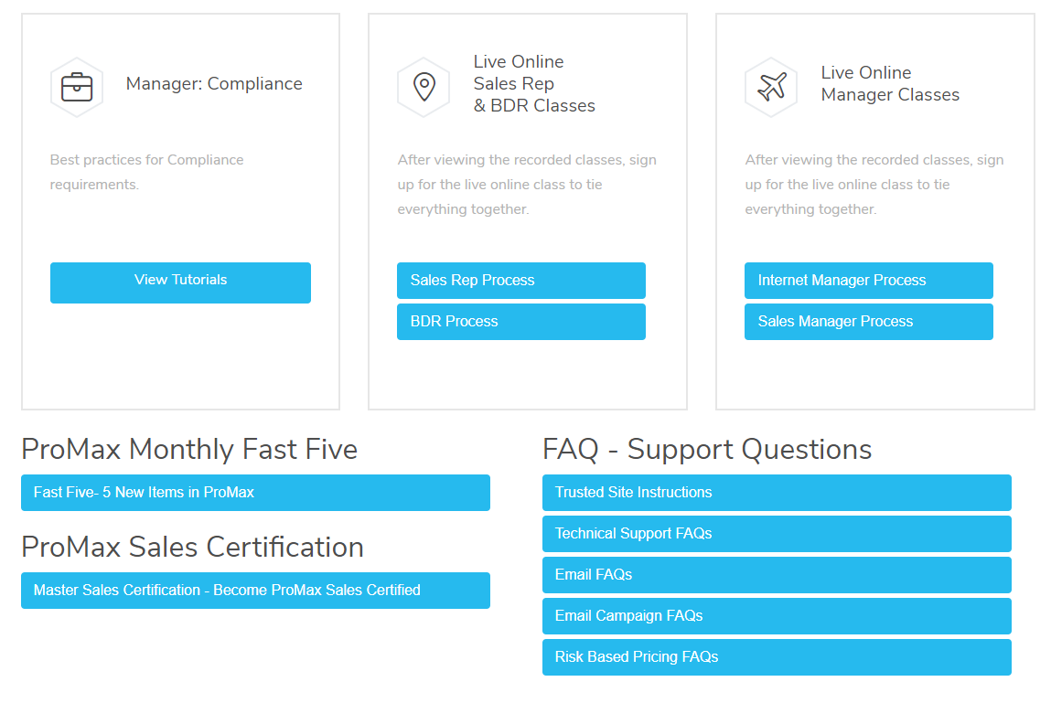
Free Online Training
You can also find the links to our previous Fast Five classes and Frequently Asked Questions from this page.
After completing the sales tutorials and online webinar – take the ProMax Sales Certification test to become ProMax Certified!

Slide 6
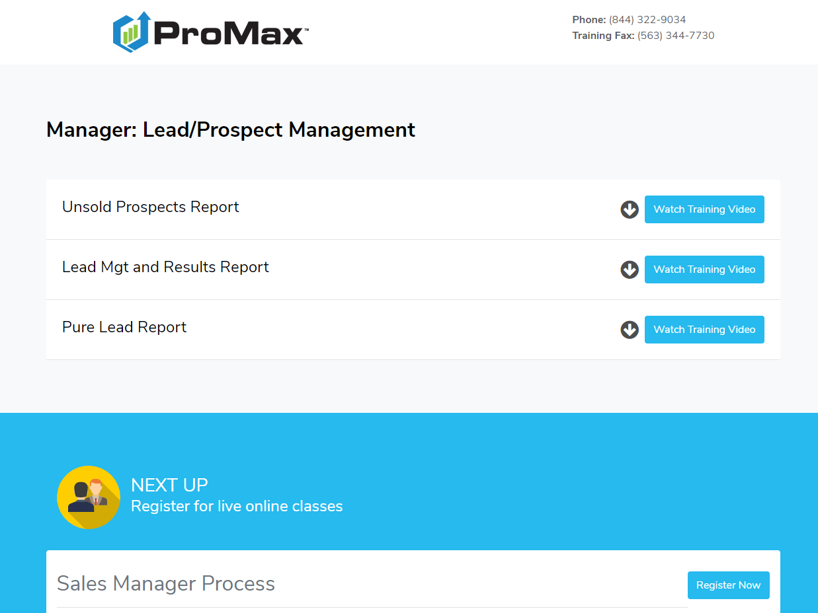
Free Online Training
We are also always available by phone. Our Dealer Support Line is managed by all of the Training Department Staff to help you with any questions or training needs. We are here from 7:30 -5:30 central time, Monday through Friday.
After choosing the Module you are interested in, we will list the videos you should watch in order. Once that is completed you are ready for the in person training class listed under “Next Up”

Slide 7
Download Templates
We have templates created by our graphic designers that are available to download and use in your ProMax system at no charge.

Slide 8

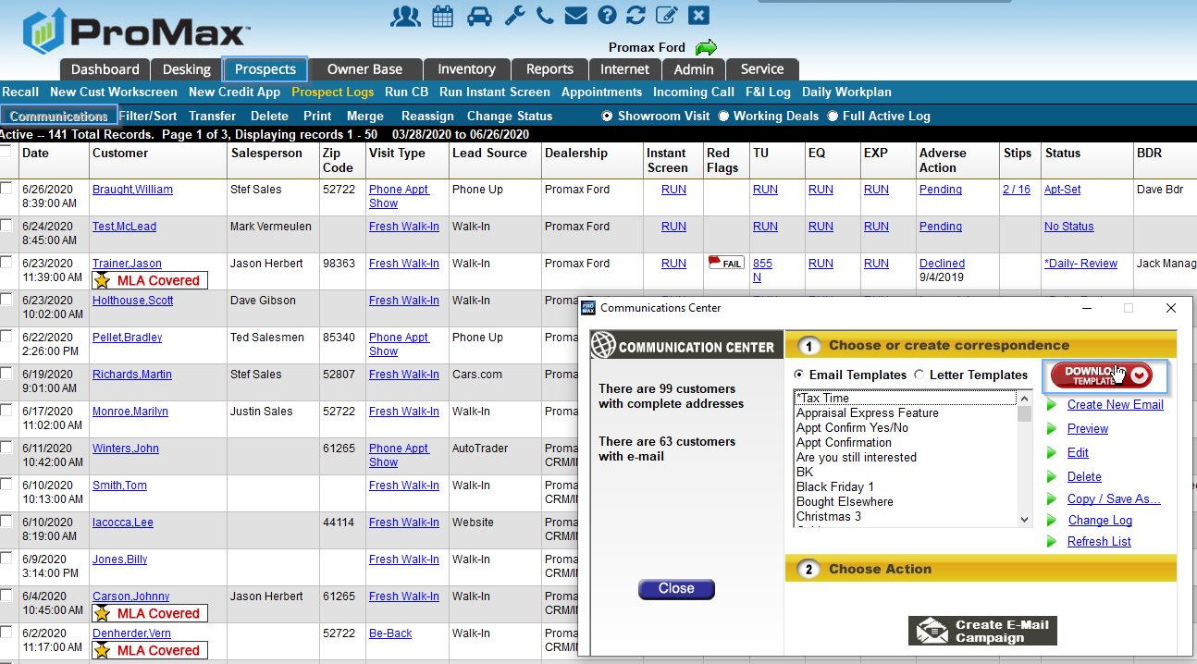


Download Templates
To access our Template library go to Prospects > Communications > Download Templates.

Slide 9
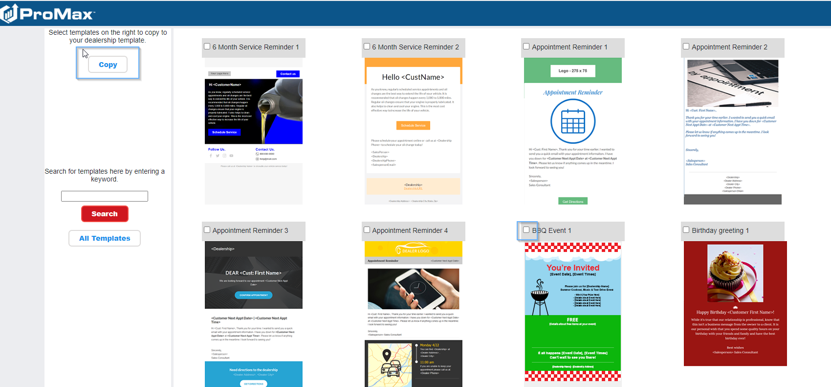

Download Templates
Once you find the template(s) you want you with just check the box by the template and hit copy.
Now it will be in your list of templates in the Communications Center.
Note: All of these templates are responsive templates, so they will automatically fit appropriately to whatever device it is viewed on.
Have an idea on a template to have added here? Let us know and we will put in a request to have one created and added.

Slide 10
Texting Best Practices
Ensure your store is maintaining a good SMS reputation to enable the best deliverability possible

Slide 11
ProMax only offers texting through an 800 number
  This is because you get better insight and deliverability with this kind of number.
  DLRs are receipts for delivery. There are carrier DLRs and Handset DLRs. With local numbers you are only able to receive carrier DLRs, while 800 numbers can provide handset DLRs to let you know if you actually reached your intended recipient. It is very unlikely for a carrier to ever not get a message, the breakdown is usually between the carrier and the handset.
  The reason that local numbers cannot receive hanset DLRs are two fold – one is because DLRs take up the same amount of space as the actual message and since there are more local numbers than 800 numbers, carriers just don’t have the storage capacity to enable both kinds of receipts for those kinds of messages. Also, local numbers don’t request that information, so they don’t have much reason to store it.

Slide 12
If a customer is not receiving your messages it is likely because either the customer or the carrier is blocking you due to spam. Here are some important steps to limit being marked as spam
  Use opt in practices. Promax has the ability to force the first message that goes out to a customer to be an opt in message. Promax will make it so that you cannot send any other messages until you manually override or the customer opts in. This makes it more obvious to the end user that they have authorized getting texts from you. Putting this in the fine print of a credit application increases your risk of people blocking you or reporting you as spam because they do not realize they opted in.
  Remember that behind each spam complaint is a person who did not want to receive your messages. This information is something that will reflect on your reputation in the community as a business. Use this information to reflect on what you are sending, the frequency, and why. Make changes to ensure that customers are happy to keep receiving your messages
  Remind customers why they want to hear from you and why having texts from you is valuable
  Remind customers that if they ever want you to stop texting they can reply STOP to be unsubscribed.

Slide 13
Templates
  The ProMax texting feature is designed to emulate what you would manually send from your phone personally. Because of this, make your texts natural and switch up the way you send things on a regular basis.
  If you like using templates, make several templates for each kind of message (appt confirmation for example) so that you can switch up the way that this is communicated each time.
  Sending out the same message with too high of a volume can trigger as spam to a carrier
  Keep an eye on the ProMax SMS History report several times a day. If you see that anything was marked as not deliverable due to spam that means that either the carrier or customer blocked your message and it was not received to the end user. Immediately delete that template and create a new one that conveys your message in a different way.
Do not use free link shortners
  Free link shortners like bit.ly are notorious for beingused by spammers because the link that you receive sends you somewhere different than what the link says. This makes it ideal for nefarious purposes – like sending viruses. Since there is a high association with people that use link shortners being fraudulent, it is best to avoid them.

Slide 14
Additional Notes
  Every carrier runs different algorithms, filters, and philiosophies to decide what is spam. Because of this there is not a strict list of words or phrases to be avoided. However, the kinds of messages that are most likely to be blocked are ones that include sex, hate, alcohol, tobacco, debt consolidation, pay day loans, short term loans, high interest loans, or get rich quick schemes.
  If you are getting a lot of spam complaints, you should consider changing your opt in strategy to make sure that customers realize they are authorizing your text messages. Remind them how to opt out, and why your messages are valuable. Consider your reputation in the community – and how you may want to enhance or strengthen that with your messaging.

Slide 15
Recent Customers
This feature allows you to quickly and easily access the last 5 customers you have viewed

Slide 16
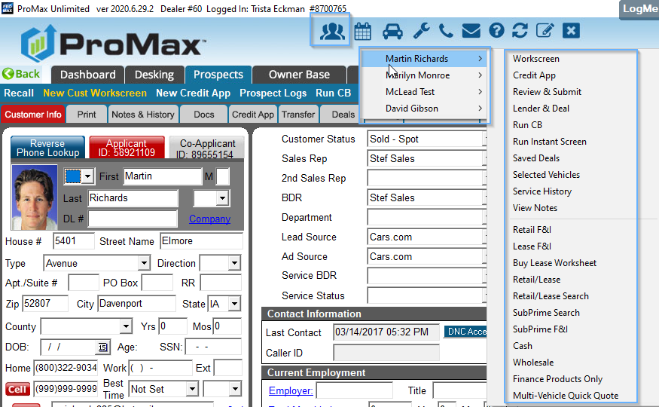



Recent Customers
When you click on the people icon at the top of the screen it will show the last 5 customers that you accessed. From here you can access whatever screen needed for these customers.

Slide 17
Outbound Call Tracking
We have the ability to track and record outgoing calls for you in ProMax. This way you can ensure the quality and actual quantity of calls your staff is making. We also no longer require dealerships to have direct lines in order to use this product.

Slide 18
Outbound Call Tracking
With our outbound call tracking feature in ProMax you can easily see the volume, duration, and quality of the calls that are being made for your dealership beyond what is manually typed into the notes
All calls are recorded in a voice file
Calls can be accessed from the Outbound call tracking report or any customer workscreen
Calls can easily be made from the customer workscreen or daily work plan straight from ProMax
We used to require direct numbers in order to use the Click to Call portion of this feature, but that is no longer necessary.
Easy to set up and easy to use

Slide 19
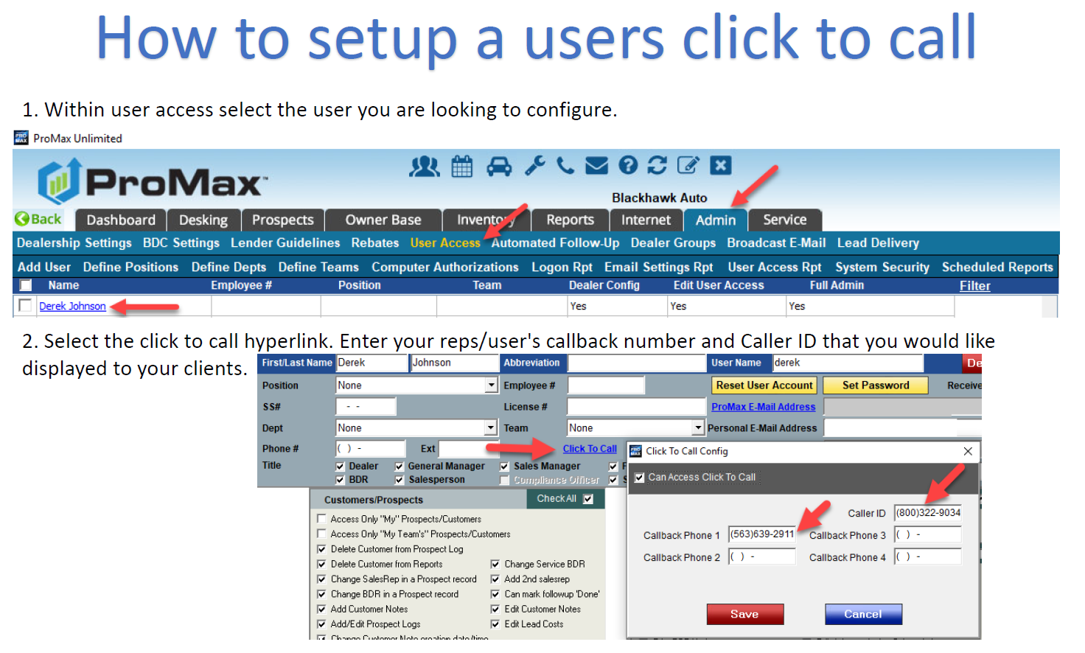

Slide 20
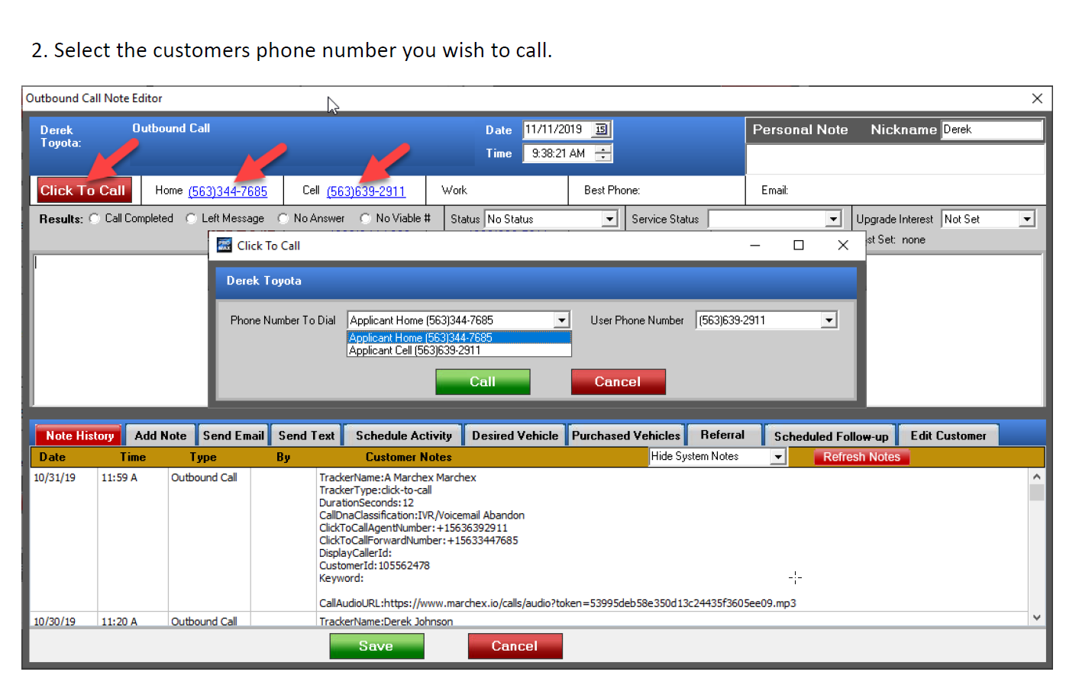

Slide 21
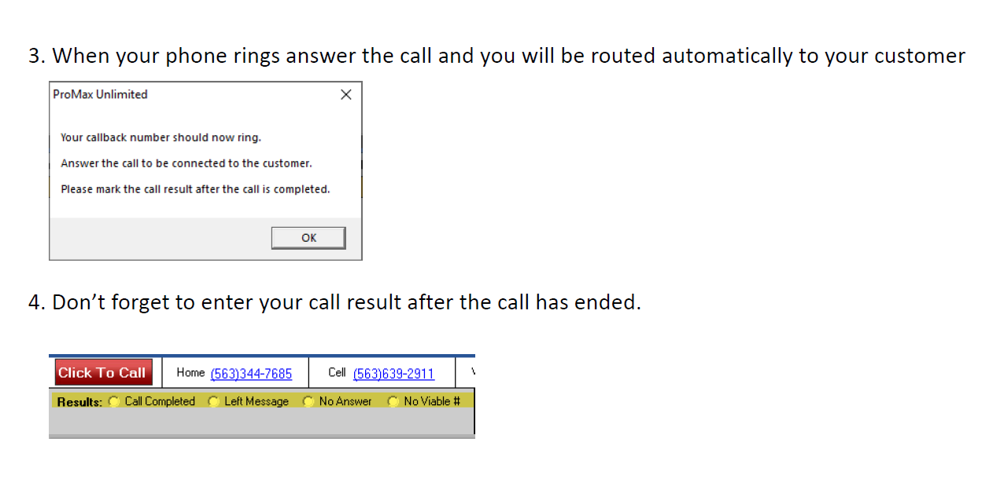

Slide 22
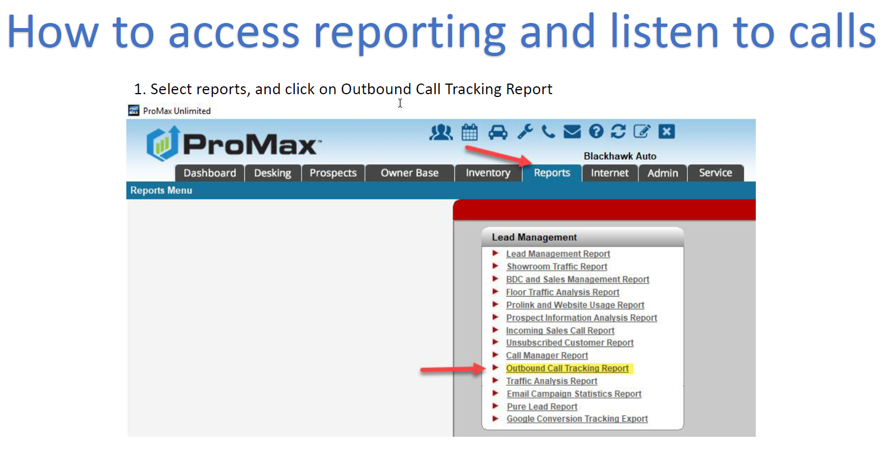

Slide 23
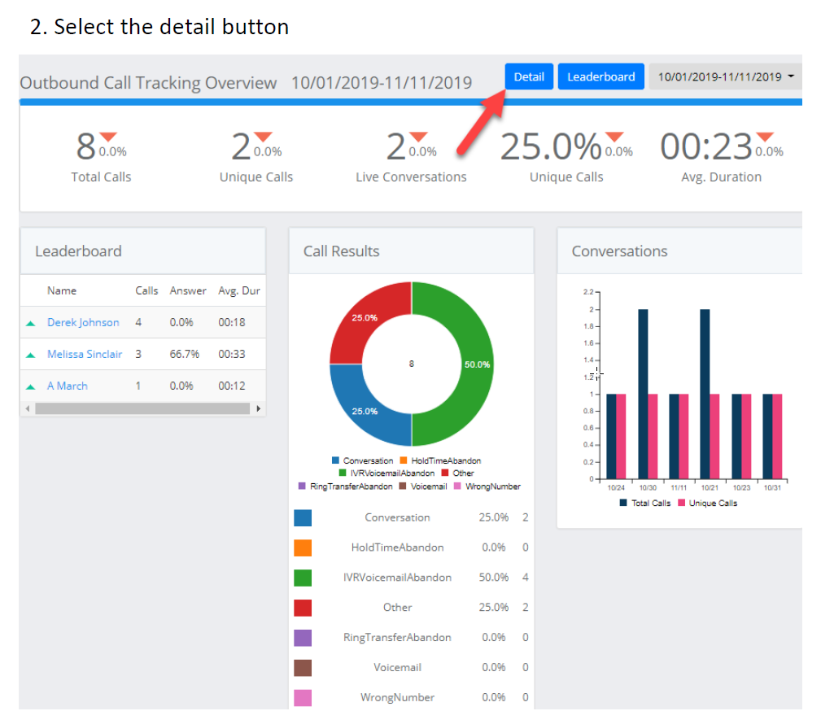

Slide 24
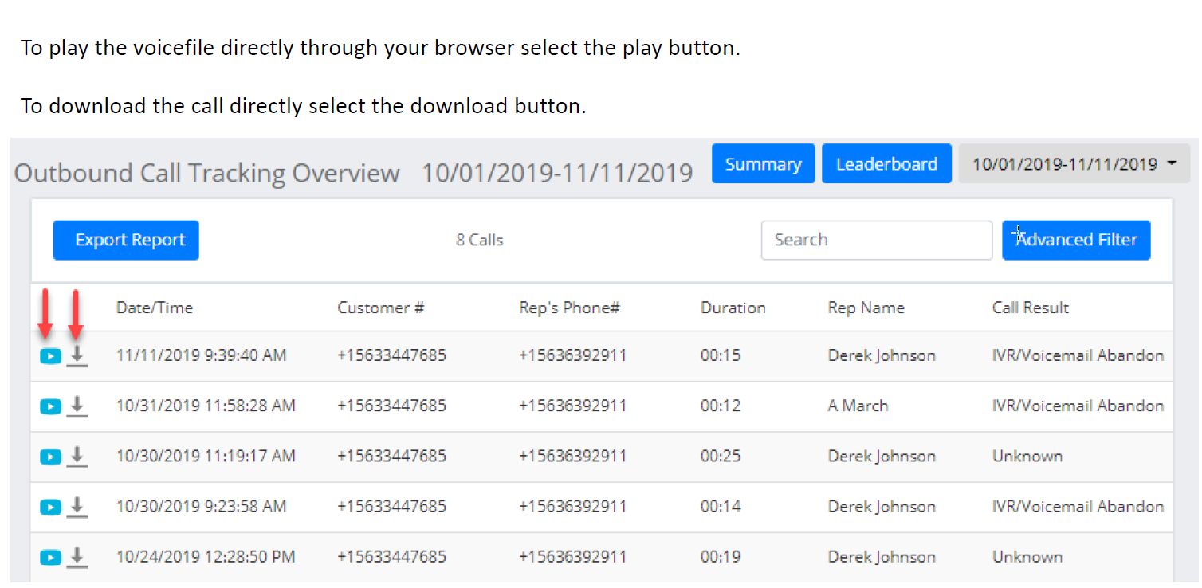

Slide 25
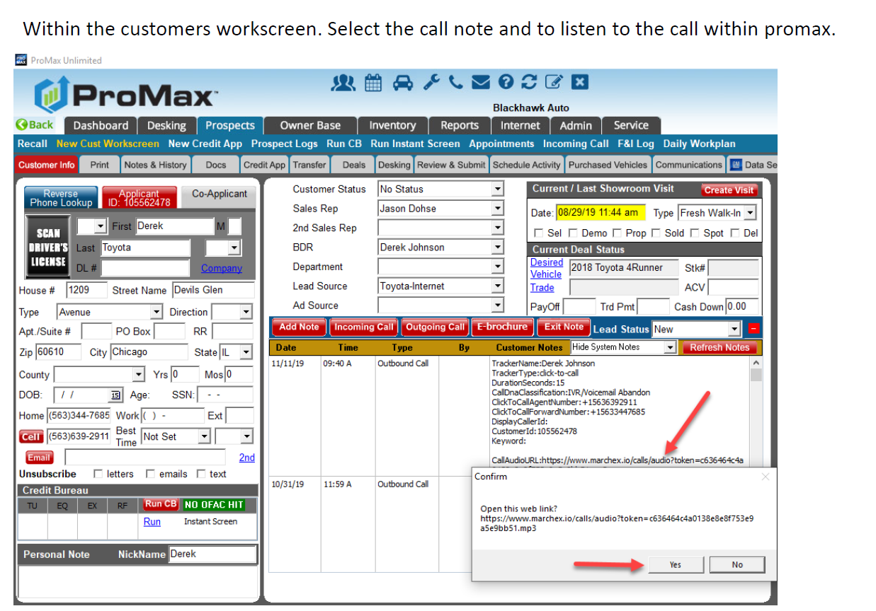

Slide 26
Questions?
Contact our Dealer Support Line at 844-322-9034
Contact me directly at 563-344-7618 or Trista@ProMaxUnlimited.com
PromaxUnlimited.com
Facebook.com/ProMaxUnlimited
Twitter.com/ProMaxUnlimited
LinkedIn.com/Company/ProMax-Automotive-Software/
DealerUpdates.TypePad.com/Blog/

