Slide 1
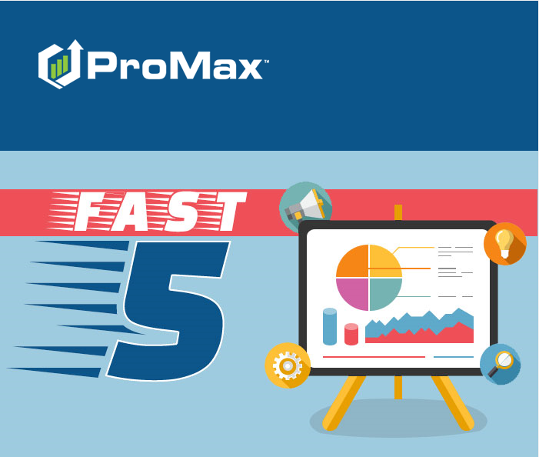
August

Slide 2
Agenda
Booking Out Inventory
Store Traffic Report
Data Mining
Deal Searches
Trade Alerts

Slide 3
Booking Out Inventory

Slide 4
Booking Out Inventory
Which vehicles do I need to book out?
  Inventory > Unbooked Inventory
How do I book out inventory?
  Go into the vehicle record and complete anything that is yellow
Why do I have to book my inventory out in ProMax?
  Deal Searches
  Deal Calculations
  Feeds to your Website
  Correct Book Values

Slide 5
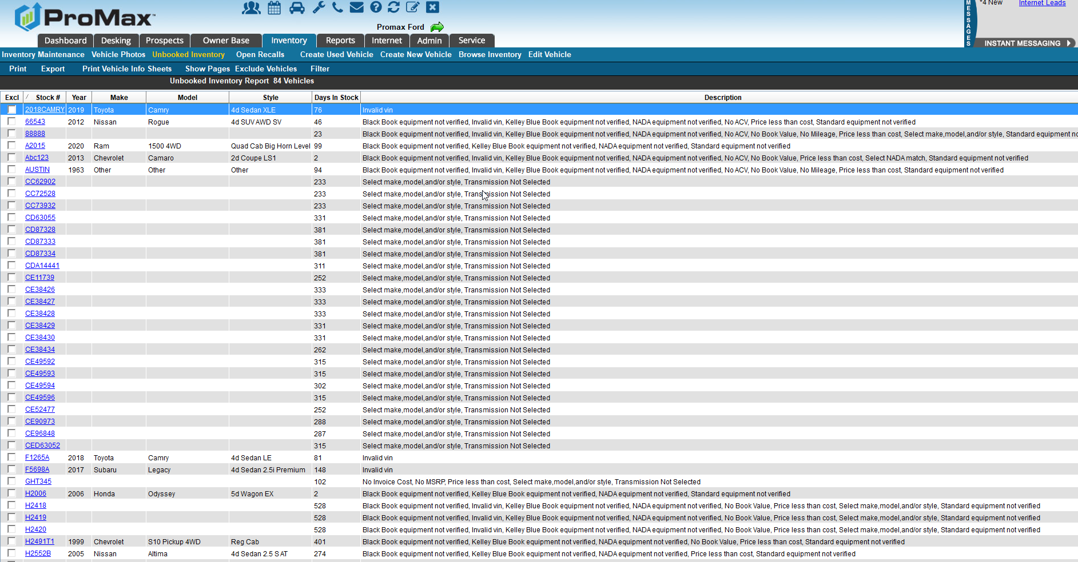
Booking Out Inventory
Unbooked Inventory Report
Inventory > Unbooked Inventory
The Description Column will tell you what is missing

Slide 6
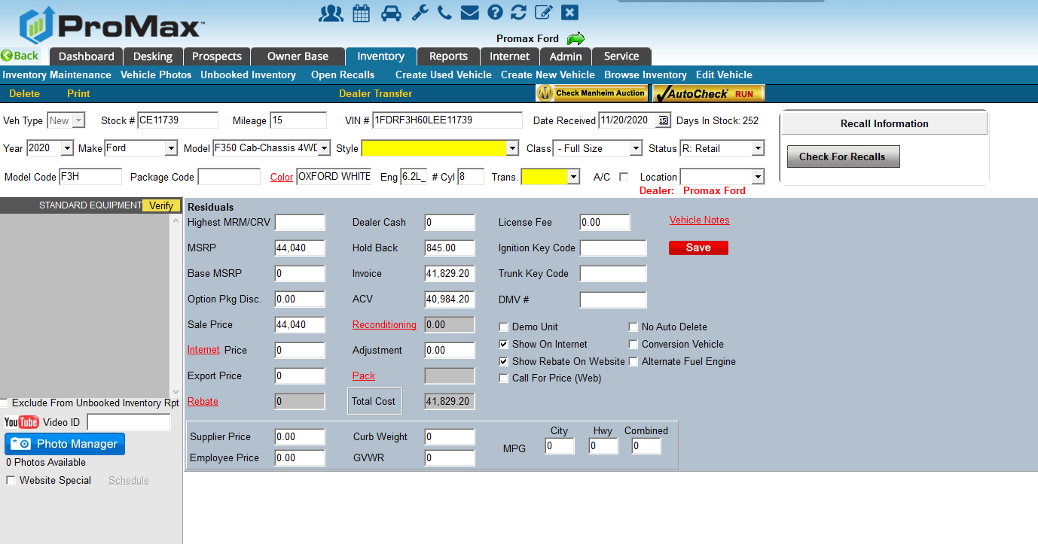
Booking Out Inventory
Inventory Record
Complete anything that is highlighted in yellow
A style will need to be selected before the equipment list will show

Slide 7
Deal Searches
Let ProMax find the best deals for you!

Slide 8
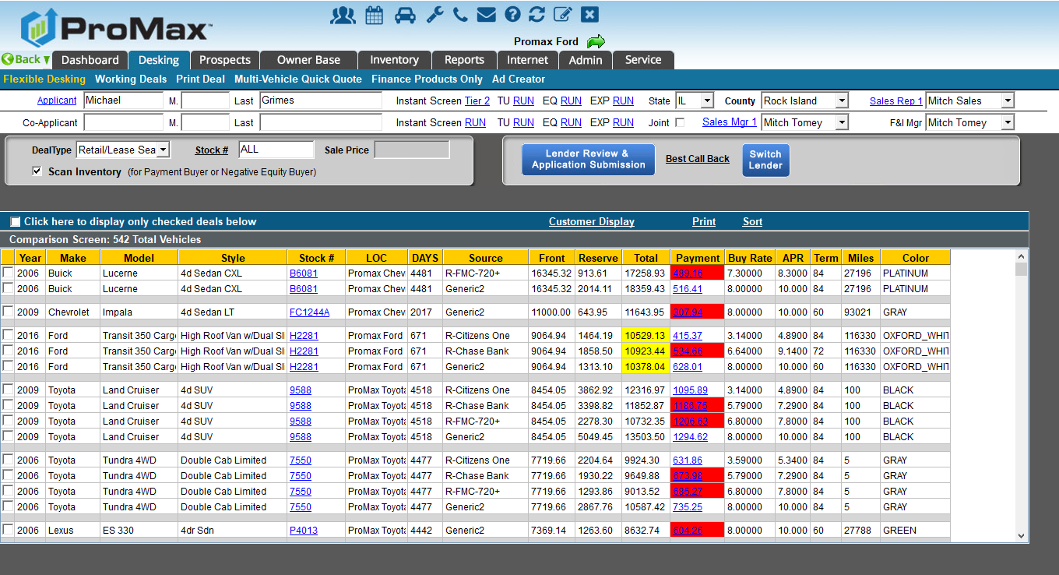
Deal Searches
Retail/Lease Search
  Customer’s Name > Retail/Lease Search
  Enter in the info for what the customer is looking for
  Choose what lenders you want to use
  Calculate Deals
  Sort by profit or days in stock
  Remove the profit info in order to show the customer the options or print to give to a list of vehicles for the salesrep to show
  Click on the payment to see the deal screen
Let ProMax do the work for you on choosing the best deals to show your customers.

Slide 9
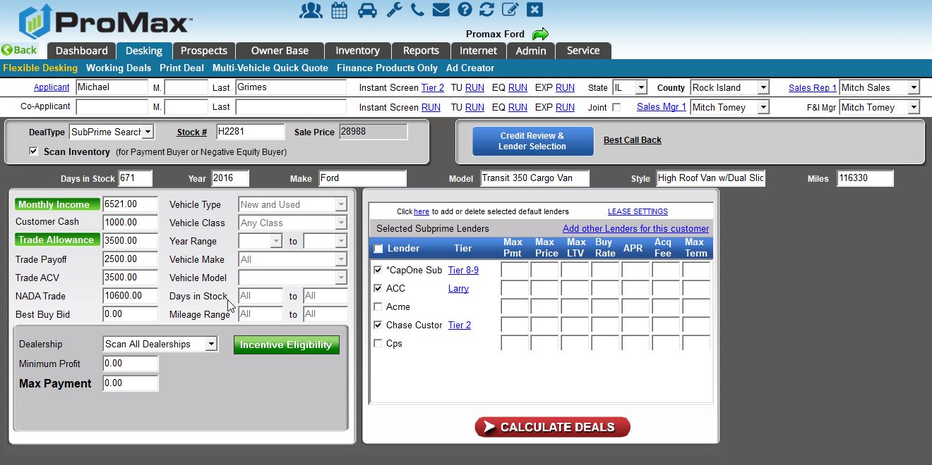
Deal Searches
SubPrime Search
  Customer’s Name > SubPrime Search
  Fill out the data for what the customer is looking for
  Choose your lenders
  Calculate Deals
  Sort on Profit or Days in Stock
  Remove the profit info in order to show the customer the options or print to give to a list of vehicles for the salesrep to show
  Click on the Payment to see the deal
Let ProMax do the work for you on choosing the best deals to show to your customers.

Slide 10
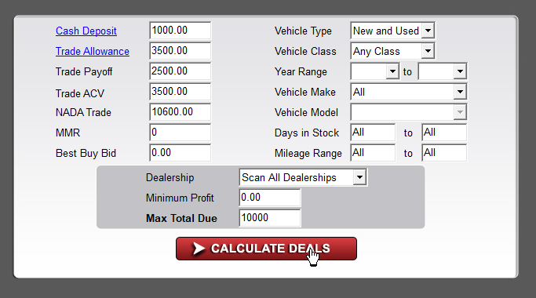
Cash Search
Cash Search
  Go to any deal search and change the deal type to cash
  Put in the amount the customer has to spend for their cash deal
  Calculate Deals
Let ProMax do the work for you on choosing the best deals to show to your customers.

Slide 11
Store Traffic Report
Check out one of the newest reporting tools in ProMax

Slide 12
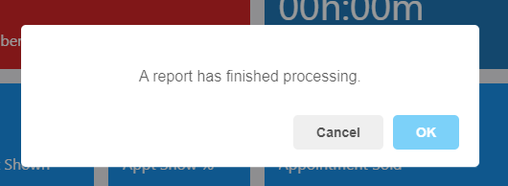
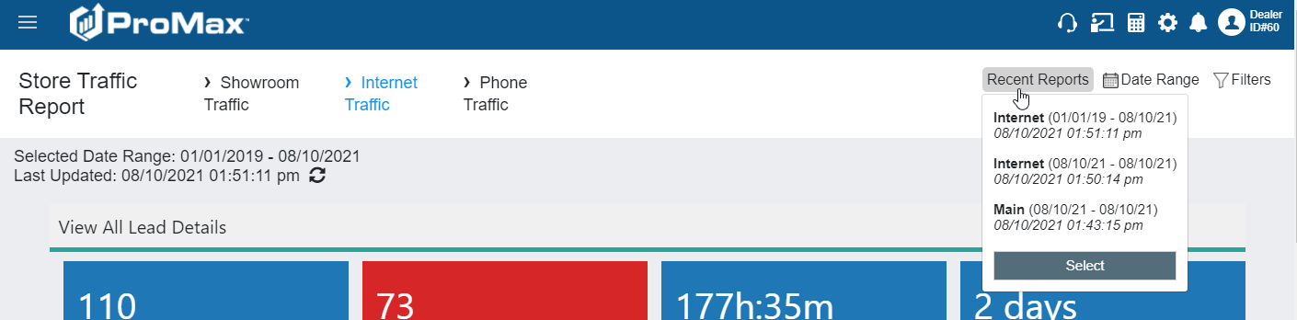
Store Traffic Report
When running a large report, we will now cache the report. This allows you to continue working in the system while the report is pulling in the background. We will give you a heads up when the report is done. To find the completed reports you will want to click on the “Recent Reports” button.
Reports > Store Traffic Report

Slide 13
Data Mining

Slide 14
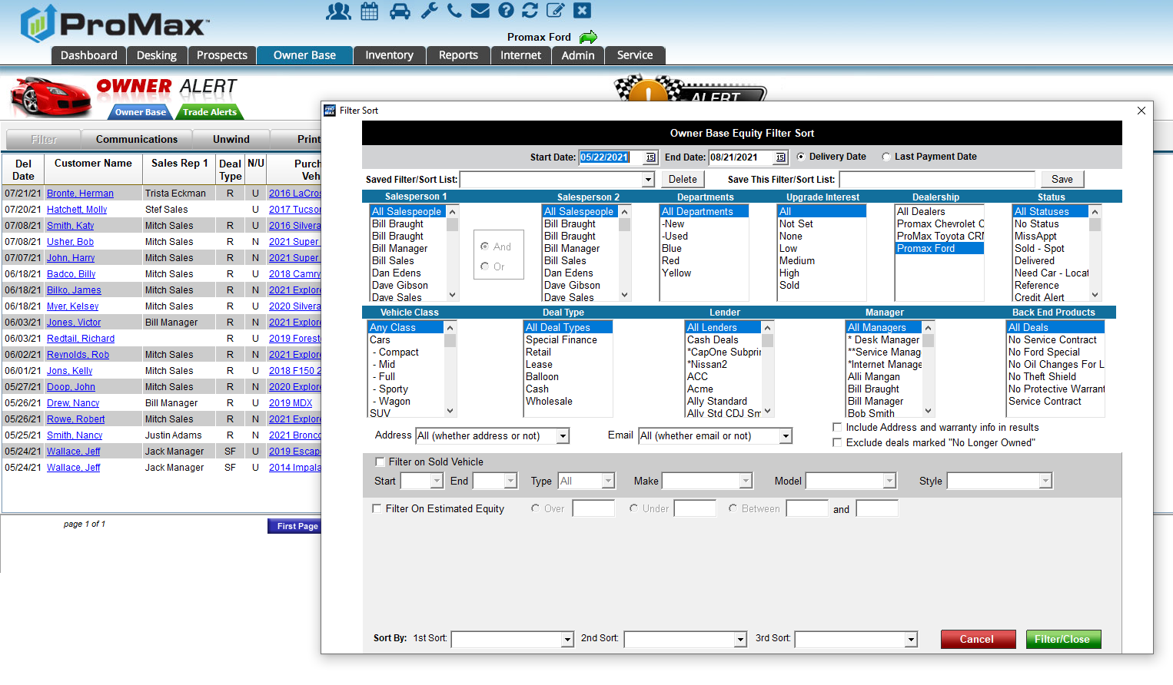
Data Mining
Sold Customers
ProMax makes it easy to filter on sold customers to encourage repeat customers.
Use ProMax to restock your inventory. Find customers through the Ownerbase Filter and target them for a buy back campaign or an early lease trade in.

Slide 15
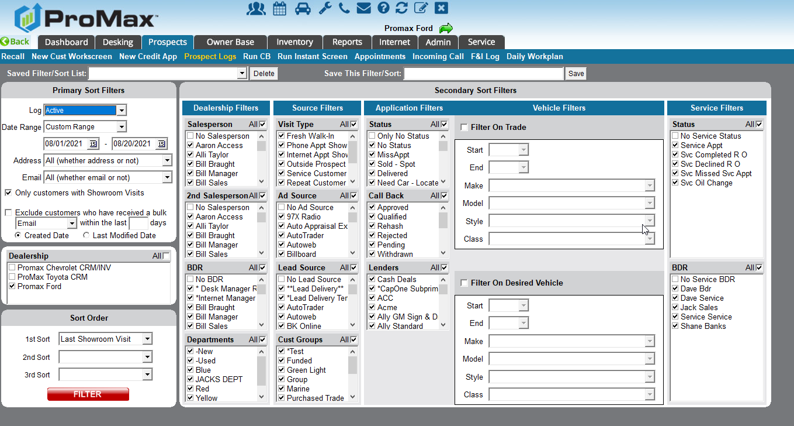
Data Mining
Unsold Customers
Use ProMax to do your prime or subprime targeted campaigns
Find customers with a particular trade in
Locate customers interested in a specific desired vehcile

Slide 16
Trade Alerts

Slide 17
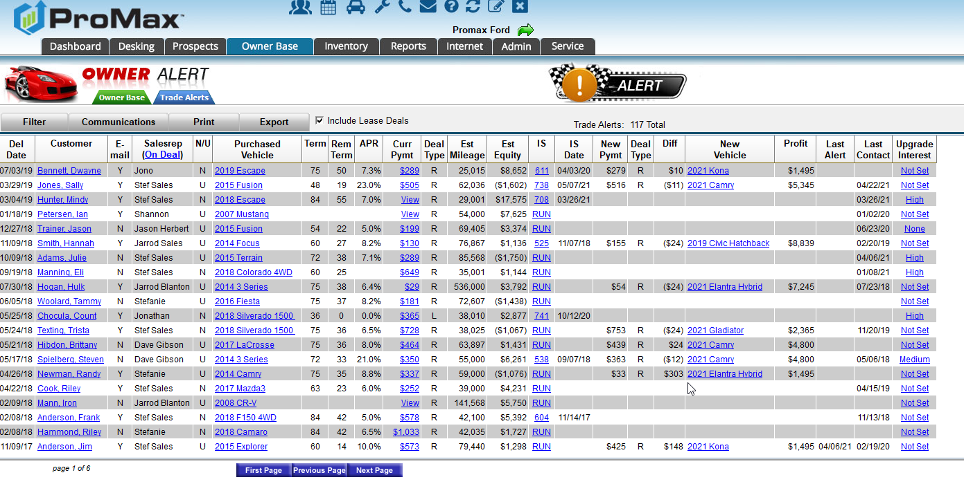
Trade Alerts
Let ProMax do all that data mining for you automatically. We will find your customers that are in an equity position (or close to it), show you similar, but newer vehicle in your inventory that you can sell to the customer for a similar payment.

Slide 18
Questions?
Contact our Dealer Support Line at 844-322-9034
Contact me directly at 563-344-7618 or Trista@ProMaxUnlimited.com
PromaxUnlimited.com
Facebook.com/ProMaxUnlimited
Twitter.com/ProMaxUnlimited
LinkedIn.com/Company/ProMax-Automotive-Software/
DealerUpdates.TypePad.com/Blog/

