Slide 1
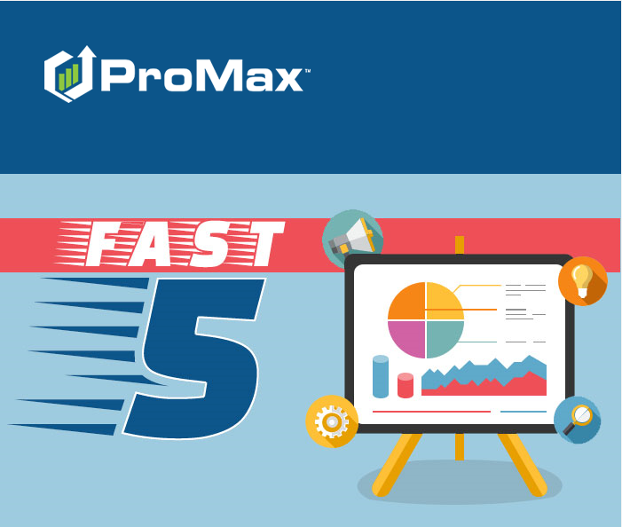
December

Slide 2
Agenda
Updating Vehicle Book Values
Customer-Initiated Online Deal Start with Website Plug-In
Missing Package Codes
Needed Vehicles Report
Inventory Report Builder

Slide 3
Updating Vehicle Book Values
Over the past several months, ProMax has changed the way vehicle equipment (adds) must be selected in order to update book values for current inventory and customer trades.

Slide 4
Updating Vehicle Book Values
Equipment for NADA, Kelley Blue Book, and Black Book must now be selected separately; different columns display for each book value, and each column contains a specific list of equipment which affects the vehicle values.
This adjustment was required because NADA, Kelley Blue Book, and Black Book changed the way book value information is sent to ProMax, which then necessitated a change in the way this information is presented to our dealerships.

Slide 5
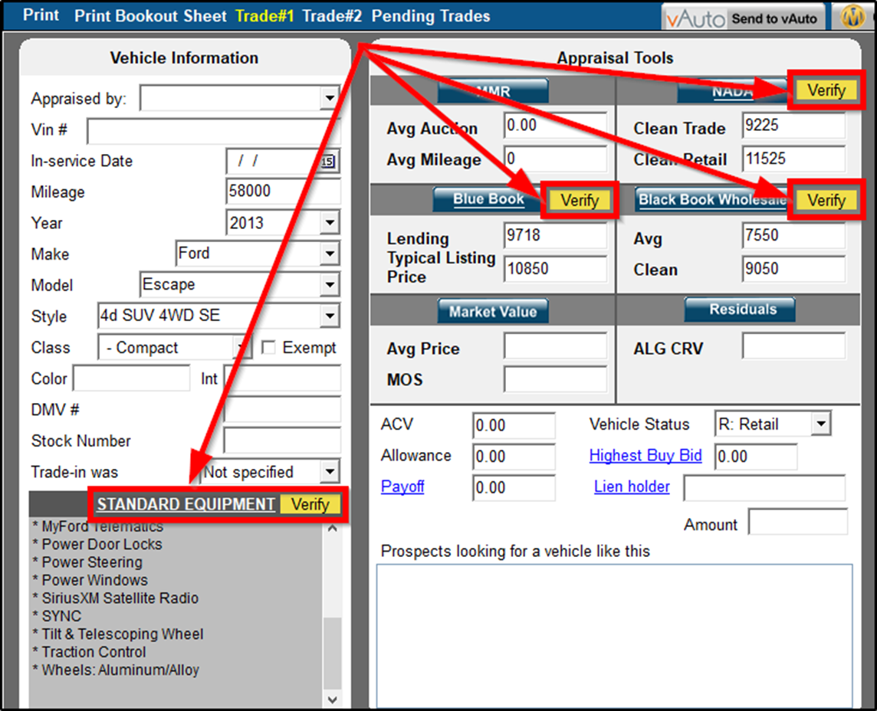
Updating Vehicle Book Values
For customer trades, within the trade screen, select “Standard Equipment” link or “Verify” buttons to access vehicle equipment lists.

Slide 6
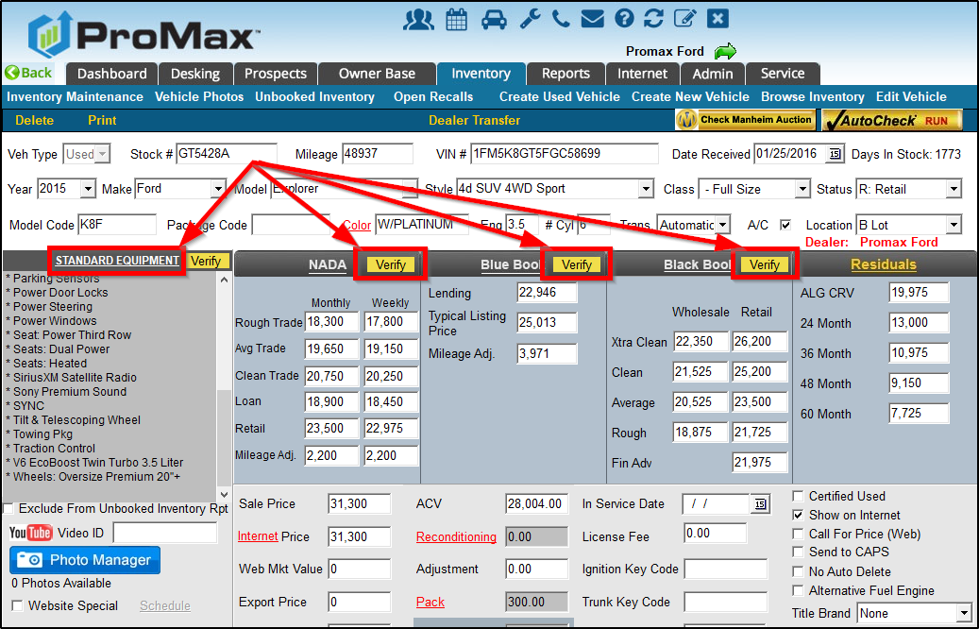
Updating Vehicle Book Values
For current inventory, within the inventory record, select “Standard Equipment” link or “Verify” buttons to access vehicle equipment lists.

Slide 7
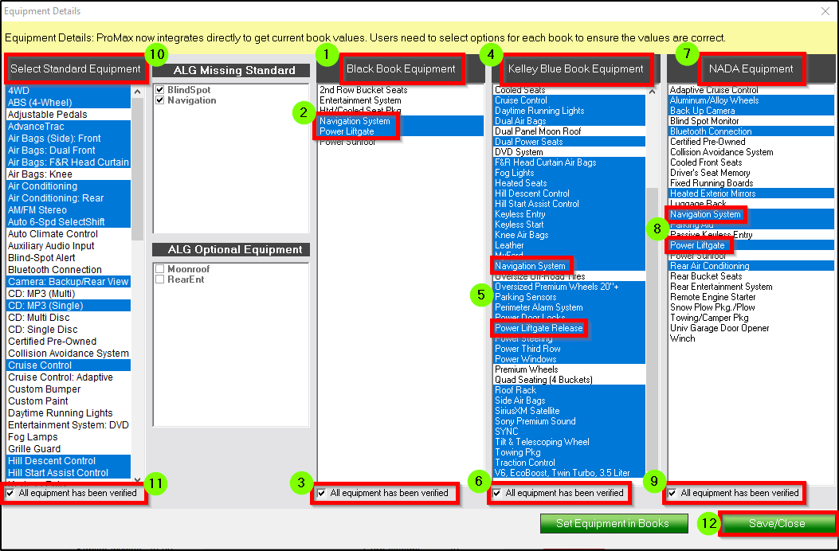
Updating Vehicle Book Values
1 – 9. Within each column (BB, KBB, and NADA), select all applicable equipment, then check box below to indicate “All equipment has been verified” for column.
10 – 11. Within Standard Equipment column, if necessary, select equipment to populate window stickers and certain desking proposals, then “All equipment has been verified.” NOTE: Standard Equipment selection does not affect/update book values.
12. Save/Close

Slide 8
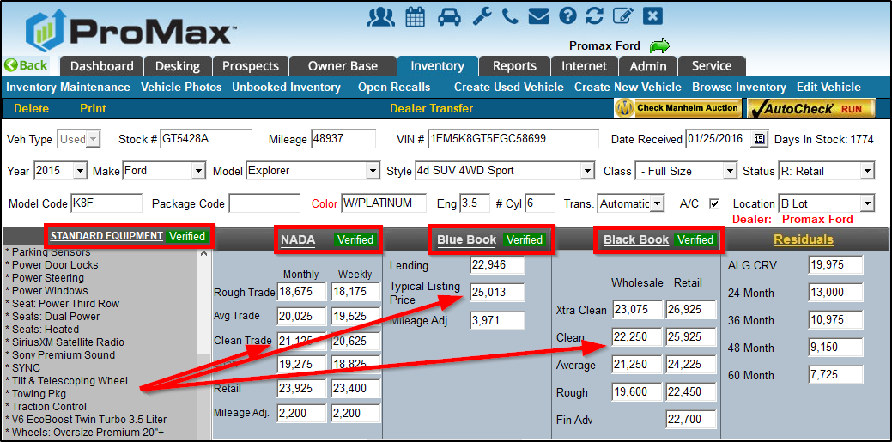
Updating Vehicle Book Values
All columns now show “Verified” and book values have been updated accordingly.

Slide 9
Inventory Report Builder
Users may build custom inventory reports, using a variety of variables and filters.

Slide 10
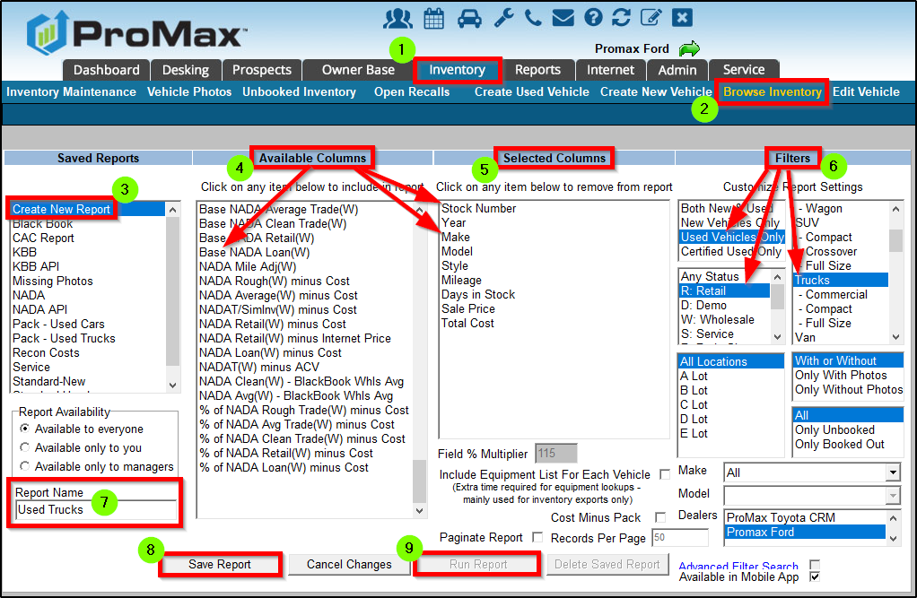
Inventory Report Builder
1 – 2. Inventory => Browse Inventory => select “Report Builder” from menu drop-down
3. Create New Report
4 – 5. Choose any variables from “Available Columns” (click to select) and variables will then display in “Selected Columns” (click to remove, if needed).
6. Apply desired “Filters” such as New/Used, Vehicle Status, Vehicle Class, Location, etc.
7 – 9. Input “Report Name” => “Save Report” => “Run Report”

Slide 11
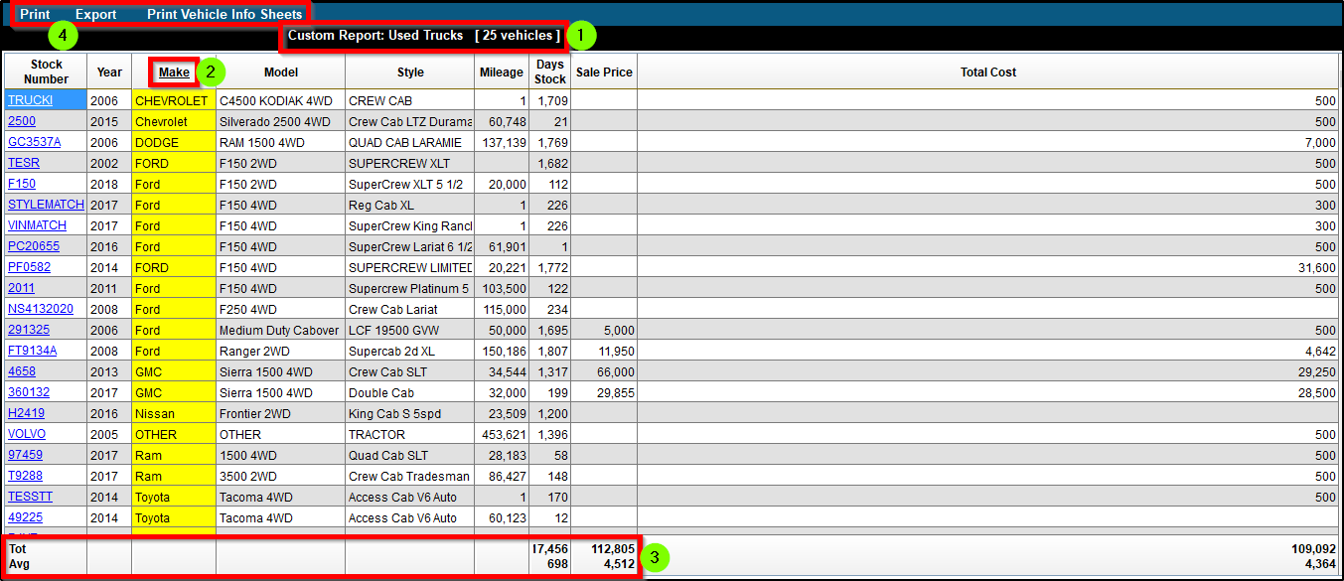
Inventory Report Builder
1. Report name displays, along with a vehicle count.
2. Columns can be sorted by clicking column headers.
3. Totals and Averages are available for applicable columns.
4. Report can be printed or exported; Vehicle Info Sheets and Bookout Sheets can be printed, too.

Slide 12
Needed Vehicles Report
Needed Vehicles Report allows users to view a list of requested vehicles, then perform a search of current inventory to identify possible matches.

Slide 13
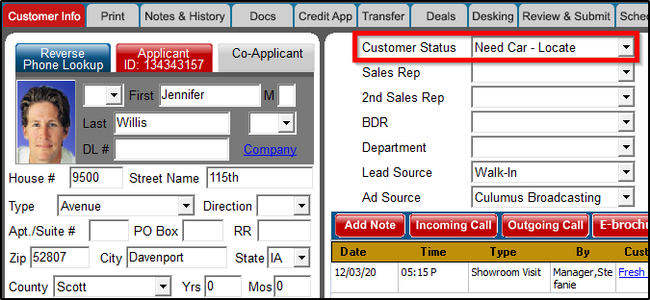
Needed Vehicles Report
To input needed vehicles, users select the customer status “Need Car - Locate.”

Slide 14
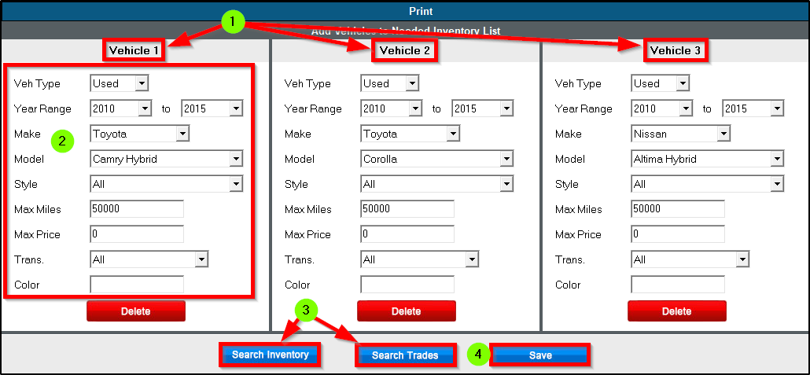
Needed Vehicles Report
1. Input up to three different vehicle requests.
2. Enter vehicle specifications.
3. “Search Inventory” and “Search Trades” allows users to check the requests against current inventory and other customer trades.
4. “Save”

Slide 15
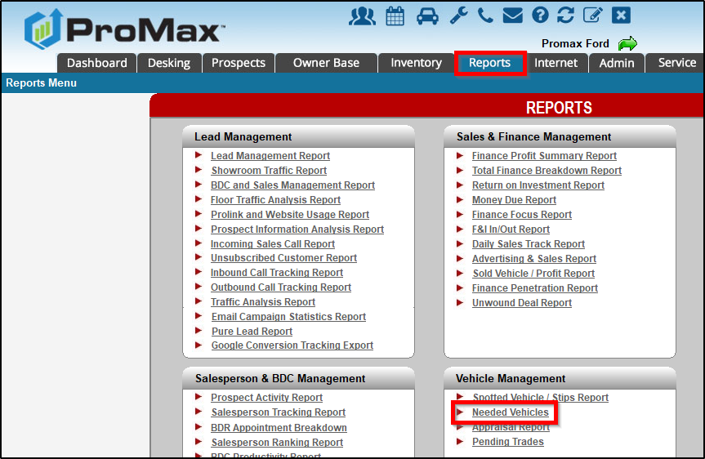
Needed Vehicles Report
Reports => Needed Vehicles
Managers should review this report at least once per week.

Slide 16
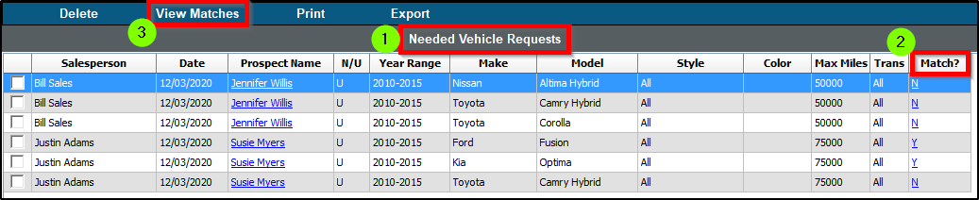
Needed Vehicles Report
1. All needed vehicle requests are listed, along with assigned Sales Rep and link to Customer Workscreen.
2. Individual matches can be viewed by clicking “Y” in “Match” column.
3. All matches can be viewed by clicking “View Matches.”

Slide 17
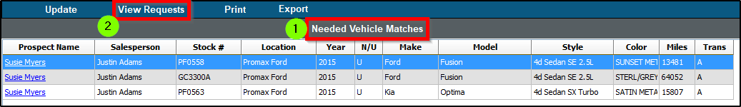
Needed Vehicles Report
1. All needed vehicle matches are displayed.
2. Users can toggle back to Needed Vehicle Requests by clicking “View Requests.”

Slide 18
Missing Package Codes
ProMax recently added an option/setting which would designate new vehicles without a Package Code as “unbooked,” allowing vehicles to then appear on the Unbooked Inventory Report.

Slide 19
Missing Package Codes
Package Code—displayed within the inventory record—is necessary to indicate different options and trim level for a new vehicle, which can affect vehicle value, incentives, APR on deal, and rate of residual for leases.

Slide 20
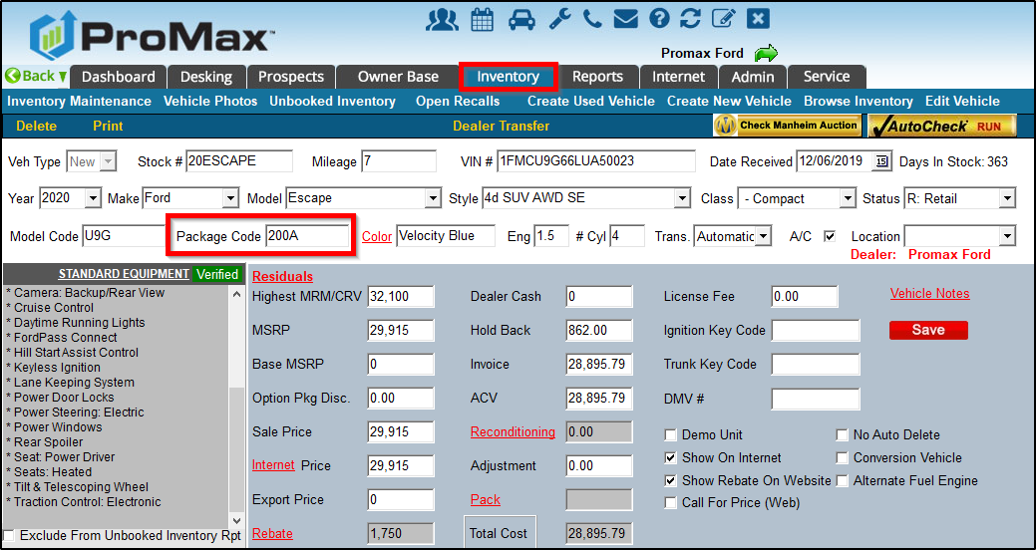
Missing Package Codes
Package Codes can be imported into ProMax through the inventory feed (often coming from dealership’s DMS).
If Package Code is not imported, it should be manually entered into ProMax within the inventory record.

Slide 21
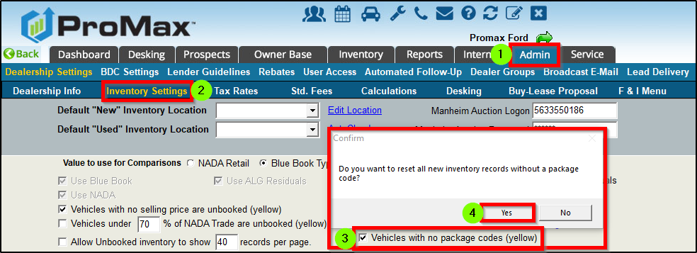
Missing Package Codes
To enable new setting:
1 – 2. Admin => Inventory Settings
3. Check box for “Vehicles with no package codes (yellow)” [unbooked]
4. Select “Yes” for pop-up question “Do you want to reset all new inventory records without a package code?”

Slide 22
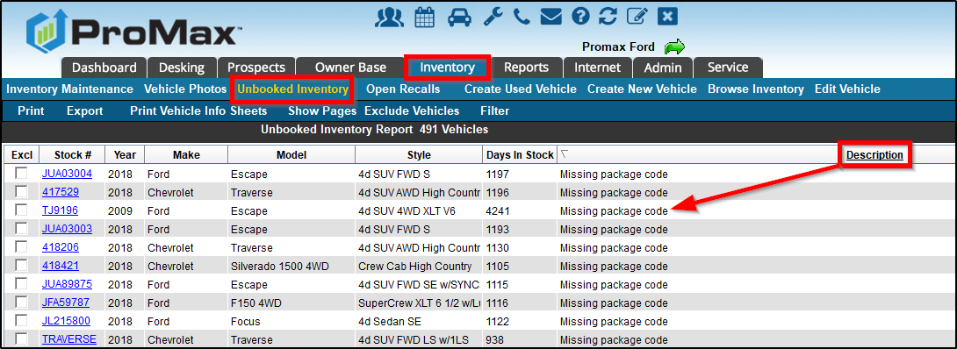
Missing Package Codes
After setting is enabled, all new vehicles without Package Codes will be listed on the Unbooked Inventory Report with a proper “Description,” allowing users to easily identify flagged vehicles, access the inventory record, and input the needed Package Code.

Slide 23
Customer-Initiated Online Deal Start with Website Plug-In
Appraisal Express Plus now offers enhanced functionality to assist with the online buying experience.

Slide 24
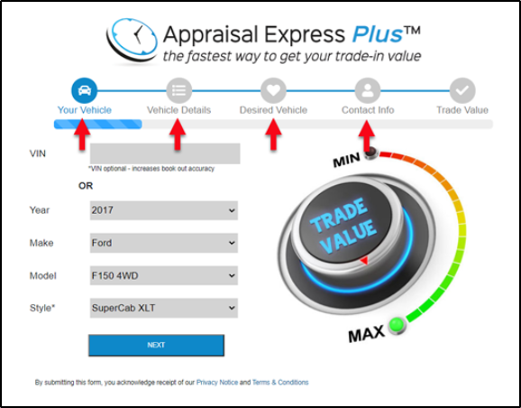
Customer-Initiated Online Deal Start
First, the customer enters basic information for trade vehicle, contact information, and desired vehicle information (if applicable).

Slide 25
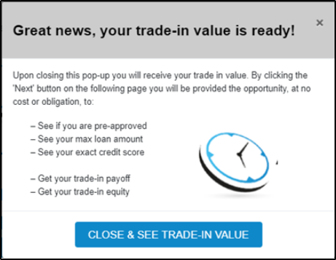
Customer-Initiated Online Deal Start
The customer is alerted of the option (via pop-up) to continue with the online buying process after trade value is received.

Slide 26
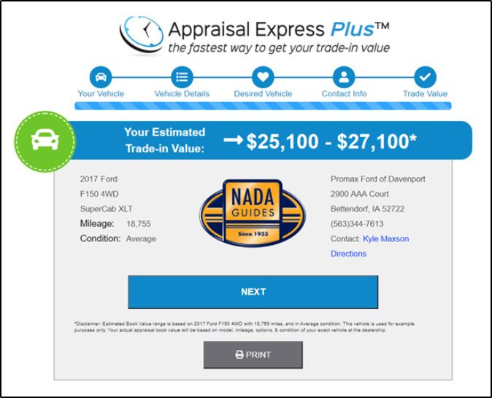
Customer-Initiated Online Deal Start
The customer receives valuable information regarding trade value and the dealership receives valuable lead information for a prospective buyer/seller.

Slide 27
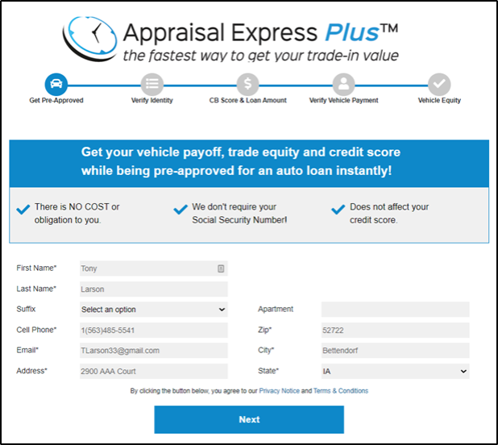
Customer-Initiated Online Deal Start
The customer is enticed to continue with the online buying process to get pre-approved, see max loan amount, and credit bureau score INSTANTLY!

Slide 28
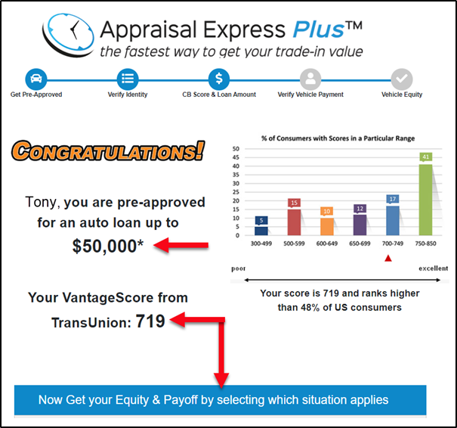
Customer-Initiated Online Deal Start
The customer then receives exact credit score and pre-approval amount for auto loan.
Then, after verifying current vehicle payment amount, the customer receives equity and payoff amount, too.
All this information is sent to the dealership to update the existing lead/customer record.

Slide 29
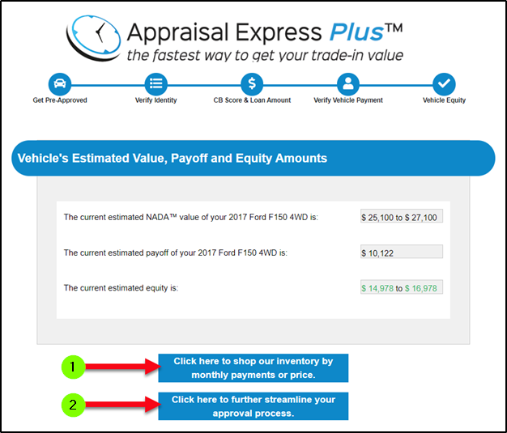
Customer-Initiated Online Deal Start
1. Directs customer to dealership’s website inventory module.
2. Directs customer to a full credit application first, and then to the dealership’s website inventory module.
BOTH options integrate the customer’s information (trade value, payoff and equity amounts, and credit bureau score) to display more accurate (and often more attractive) monthly payment amounts on inventory vehicles.

Slide 30
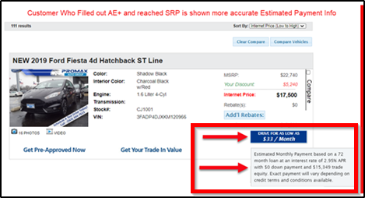
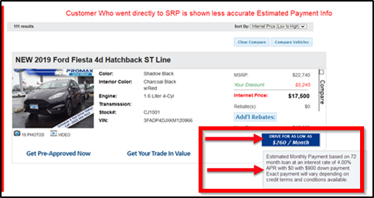
Customer-Initiated Online Deal Start
Notice the difference in monthly payment amounts (same vehicle) between a customer who completed the Appraisal Express Plus process versus a customer who went directly to the dealership’s website inventory:
$33/month versus $260/month

Slide 31
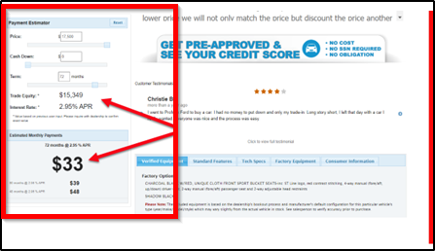
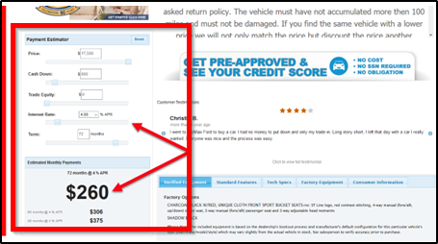
Customer-Initiated Online Deal Start
Notice the difference in deal information (same vehicle) on the Vehicle Details Page between a customer who completed the Appraisal Express Plus process versus a customer who went directly to the dealership’s website inventory.
Trade Equity, Interest Rate, and Monthly Payment

Slide 32
Customer-Initiated Online Deal Start
Appraisal Express Plus—complete with recent enhancements available with a ProMax-hosted website—allows customers to complete much of the buying process online, from the comfort of home. Now, more than ever, dealerships must offer some form of online buying experience to remain competitive, and with our various products and services along with vast industry knowledge, ProMax can help!

Slide 33
Questions?
Contact our Dealer Support Line at 844-322-9034
Contact me directly at 563-344-7687 or Stefanie@ProMaxUnlimited.com
PromaxUnlimited.com
Facebook.com/ProMaxUnlimited
Twitter.com/ProMaxUnlimited
LinkedIn.com/Company/ProMax-Automotive-Software/
DealerUpdates.TypePad.com/Blog/

