Slide 1
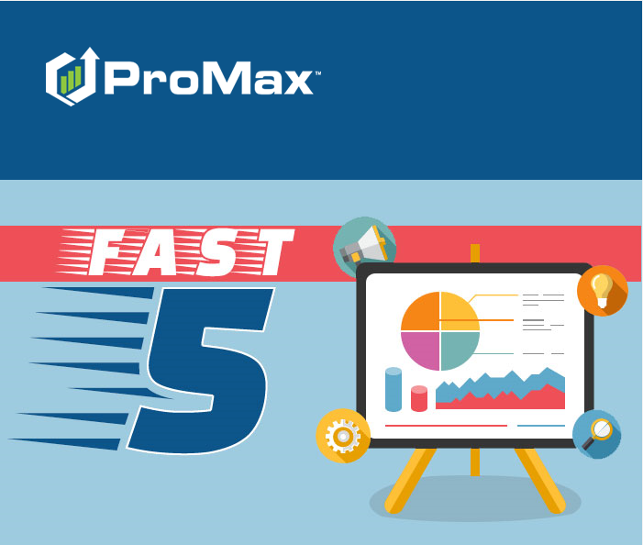
MAY

Slide 2
Agenda
Setting up Email in ProMax
Automated Emails
Sending Texts
Email and Texting Best Practices
Sending an Email Blast

Slide 3
Setting up Email in ProMax
In ProMax you have the ability to add in any email credentials that you would like to use. We can provide this email for you as well if you would like.

Slide 4
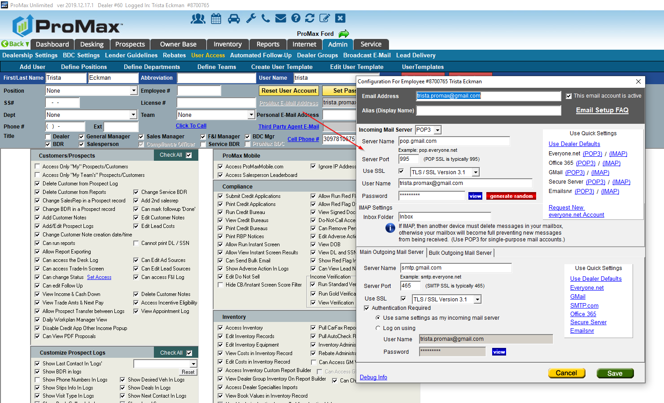
When You Host Your Email
When your dealership takes care of all your email needs on your end, you will just need to plug your credentials into Promax in order to start accessing your email in the system.
Admin > User Access > User’s Name > Promax Email > Fill out all fields > Save

Slide 5
Benefits for Promax Hosting Your Email
Separate email from your website’s domain
Linking employee emails to customer records
Set up forwards to company email
Separate customer emails and contacts from internal emails
We handle all of the technical setup of the email for you
  DNS records, server setup, account creation, troubleshooting, etc
Promax also offers email hosting to our dealerships if you would rather not have to maintain this yourself.

Slide 6
Sending and Email Blast
Send out a message to your customers in bulk

Slide 7
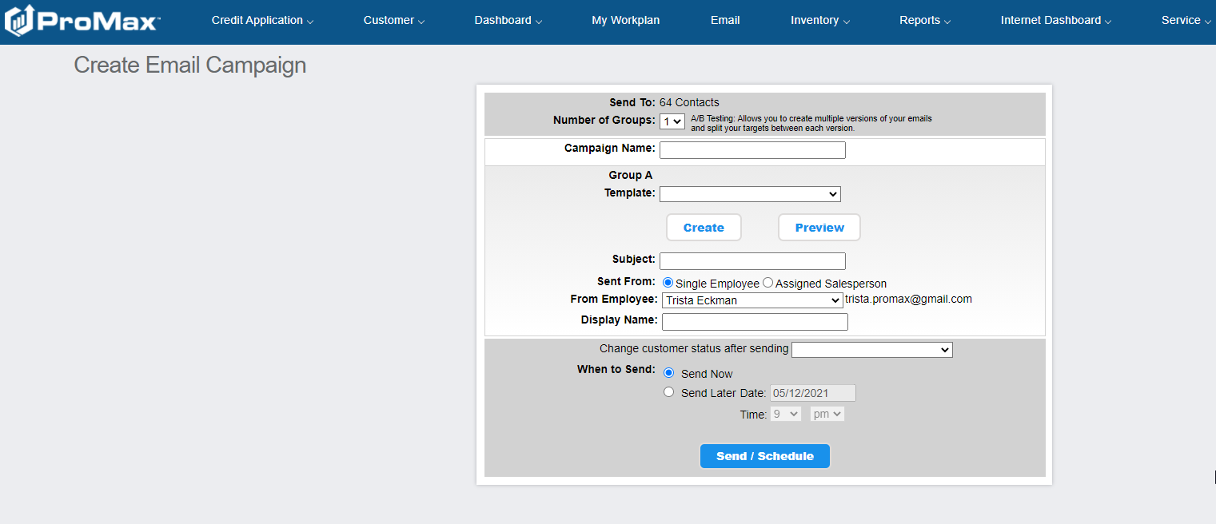
Sending E-Blasts
ProMax makes it easy to send email campaigns out of the system
Step 1 – create you content
Step 2 – Filter Sort to find the customers you want to send to
Step 3 - Send or schedule your email to be sent
Step 4 – monitor your email for any responses and customer engagement. Note that who ever you select that the email is coming from is who will get the responses.

Slide 8
Automated Emails
You can set up emails to be sent out on a schedule through the daily work plan

Slide 9
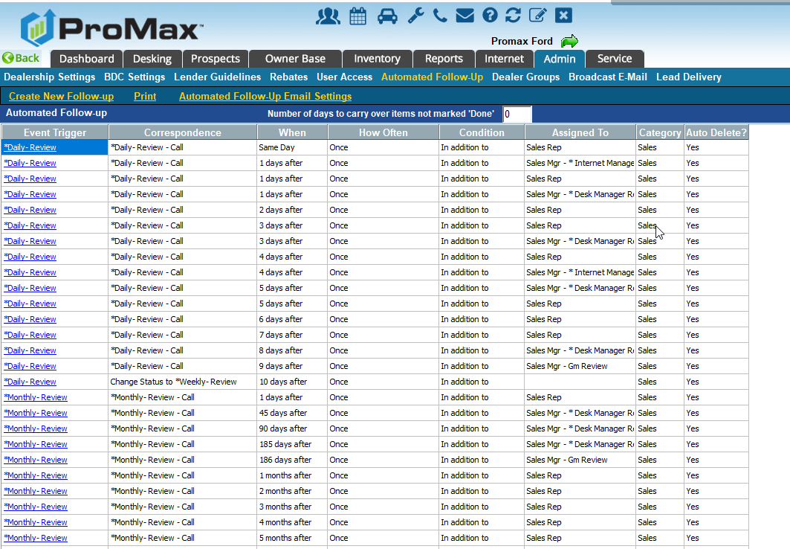
Automated Follow Up
Automated Follow Up in ProMax is triggered off of statuses and events in the system. Once you select those statuses or certain events happen in the system, you can have a follow up cadence triggered. This will trigger into the user’s Daily Work Plan
To set up automated follow up you will want to go to Admin > Automated Follow Up

Slide 10
Sending Text Messages
Sending Text Messages through ProMax is easy!

Slide 11
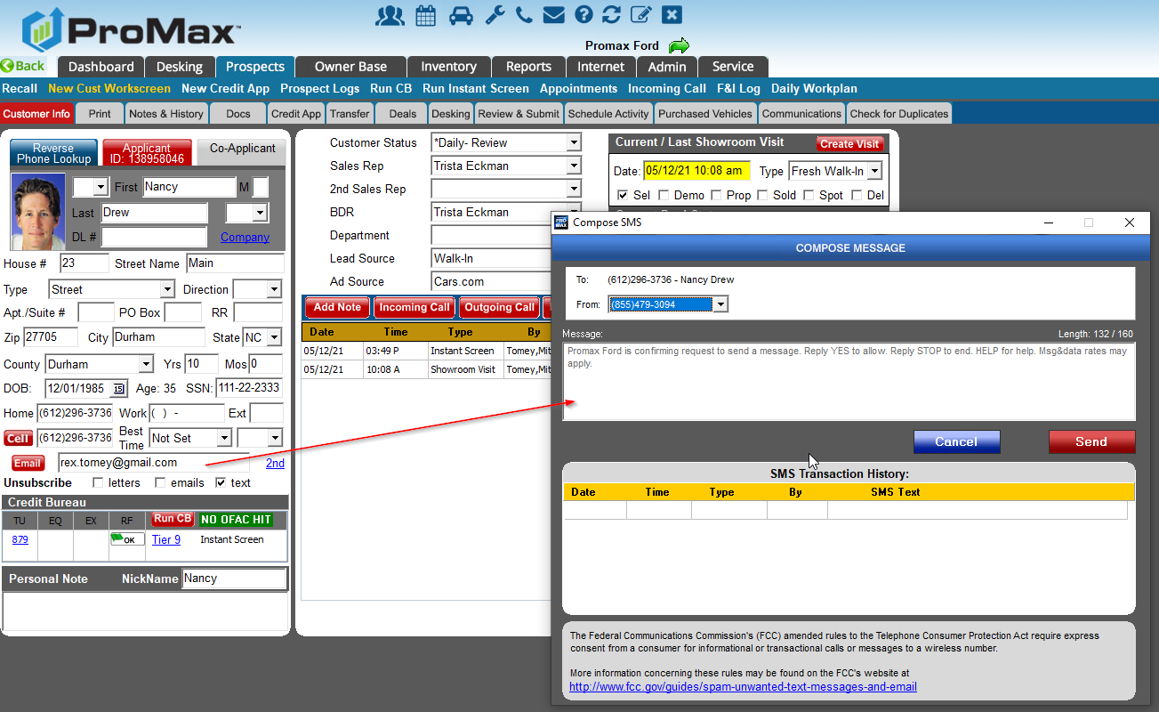
Sending Texts Through ProMax
Why send through Promax?
  It is all tracked in one place
  When salesreps leave they are not leaving with customer info
  Another rep can pick up where the last one left off
  SMS History Report gives you insight as to what is working and what is not
  Handset deliverability receipts – only available through 800 numbers
To send texts through ProMax, go to the customer workscreen and click on the cell button.

Slide 12
Text & Email Best Practices
Some tips on increasing your deliverability rates and creating a positive reputation.

Slide 13
Improve Your Domain Reputation and Deliverability for Emailing
Do not use deceptive subject lines
Use a domain that is separate from your company website
On the back end, set up DKIM, DMARC, and SPF
Use a Bulk Email provider, not just a standard email
Be mindful of your presentation – images to text ratio, capital letters, colors, font changes, text sizes
Do not send attachments in bulk emails
Send email from active accounts

Slide 14
Send to the Right People
Send messages to people who want to hear from you. Poor email engagement will affect future email deliverability to other consumers
Do not overmessage. Most consumers state that they will flag messages as spam if the senders emails too frequently
Do not purchase email lists
Be mindful of honey pots
Respect unsubscribe Requests
Ensure good data collection (squeeze pages & none@none.com)
Send to recent customers in your filter/sorts
  30% of customers change their email addresses each year

Slide 15
Choose Your Words Wisely
Spam filters are constantly changing and every provider sets up their filters in different ways. Here are some words and phrases that are likely to send you to the junk folder.
Click
This isn’t spam
Click here
No catch
Terms and conditions
Prizes
The best rates
Stuff on sale
The best rates
As seen on
Buy
Buy direct
Compete for your business
Subject to credit
Save big money
Free
Cash
Cents on the dollar
Lowest price
No cost
Loans
Acceptance
Dear ____
Subscribe

Slide 16
Texting Best Practices
ProMax only offers texting through an 800 number
  This is because you get better insight and deliverability with this kind of number.
  DLRs are receipts for delivery. There are carrier DLRs and Handset DLRs. With local numbers you are only able to receive carrier DLRs, while 800 numbers can provide handset DLRs to let you know if you actually reached your intended recipient. It is very unlikely for a carrier to ever not get a message, the breakdown is usually between the carrier and the handset.
  The reason that local numbers cannot receive hanset DLRs are two fold – one is because DLRs take up the same amount of space as the actual message and since there are more local numbers than 800 numbers, carriers just don’t have the storage capacity to enable both kinds of receipts for those kinds of messages. Also, local numbers don’t request that information, so they don’t have much reason to store it.

Slide 17
Texting Best Practices
If a customer is not receiving your messages it is likely because either the customer or the carrier is blocking you due to spam. Here are some important steps to limit being marked as spam
  Use opt in practices. Promax has the ability to force the first message that goes out to a customer to be an opt in message. Promax will make it so that you cannot send any other messages until you manually override or the customer opts in. This makes it more obvious to the end user that they have authorized getting texts from you. Putting this in the fine print of a credit application increases your risk of people blocking you or reporting you as spam because they do not realize they opted in.
  Remember that behind each spam complaint is a person who did not want to receive your messages. This information is something that will reflect on your reputation in the community as a business. Use this information to reflect on what you are sending, the frequency, and why. Make changes to ensure that customers are happy to keep receiving your messages
  Remind customers why they want to hear from you and why having texts from you is valuable
  Remind customers that if they ever want you to stop texting they can reply STOP to be unsubscribed.

Slide 18
Texting Best Practices
Templates
  The ProMax texting feature is designed to emulate what you would manually send from your phone personally. Because of this, make your texts natural and switch up the way you send things on a regular basis.
  If you like using templates, make several templates for each kind of message (appt confirmation for example) so that you can switch up the way that this is communicated each time.
  Sending out the same message with too high of a volume can trigger as spam to a carrier
  Keep an eye on the ProMax SMS History report several times a day. If you see that anything was marked as not deliverable due to spam that means that either the carrier or customer blocked your message and it was not received to the end user. Immediately delete that template and create a new one that conveys your message in a different way.
Do not use free link shortners
  Free link shortners like bit.ly are notorious for beingused by spammers because the link that you receive sends you somewhere different than what the link says. This makes it ideal for nefarious purposes – like sending viruses. Since there is a high association with people that use link shortners being fraudulent, it is best to avoid them.

Slide 19
Texting Best Practices
Additional Notes
  Every carrier runs different algorithms, filters, and philiosophies to decide what is spam. Because of this there is not a strict list of words or phrases to be avoided. However, the kinds of messages that are most likely to be blocked are ones that include sex, hate, alcohol, tobacco, debt consolidation, pay day loans, short term loans, high interest loans, or get rich quick schemes.
  If you are getting a lot of spam complaints, you should consider changing your opt in strategy to make sure that customers realize they are authorizing your text messages. Remind them how to opt out, and why your messages are valuable. Consider your reputation in the community – and how you may want to enhance or strengthen that with your messaging.

Slide 20
Questions?
Contact our Dealer Support Line at 844-322-9034
Contact me directly at 563-344-7618 or Trista@ProMaxUnlimited.com
PromaxUnlimited.com
Facebook.com/ProMaxUnlimited
Twitter.com/ProMaxUnlimited
LinkedIn.com/Company/ProMax-Automotive-Software/
DealerUpdates.TypePad.com/Blog/

