Slide 1
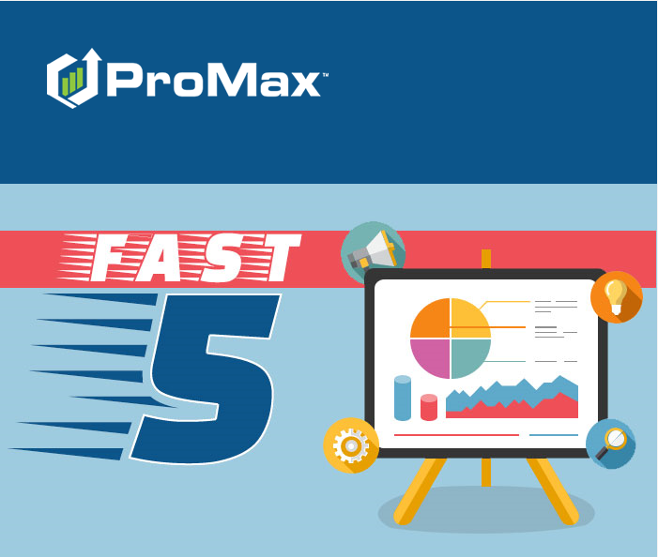
February

Slide 2
Agenda
Email Signature
Ownerbase Filter/Sort
Credit App Options
Running Bureaus
Internet Dashboard: Summary

Slide 3
Email Signatures

Slide 4

Email Signatures
To add an automatic signature to your outgoing emails, click on the letter icon at the top of your ProMax screen.
This will open up a web browser for your ProMax email. In this browser, click “ Signatures”

Slide 5
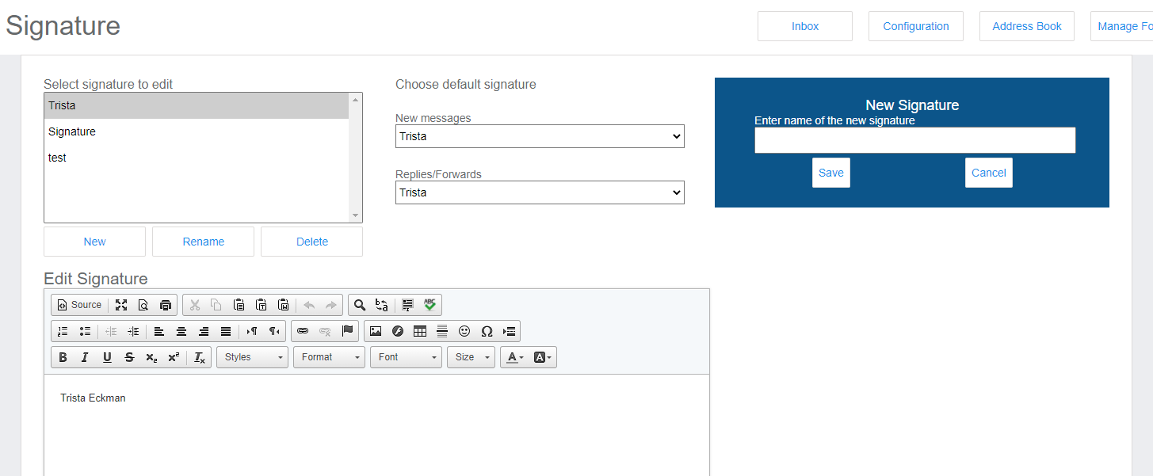





Email Signature
1. Click on new to add a signature
2. Enter what you’d like to name your signature and hit save.
3. Choose your signature from the edit list
4. Create your signature and hit save
5. Choose your defaults

Slide 6
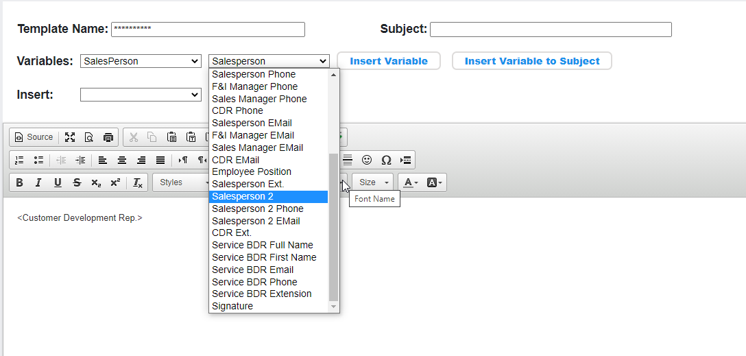
Email Signature
Once your email signature is set up, you can apply this to your templates or use variables for your templates.
Prospects > Communications > Template Name > Edit

Slide 7
Internet Dashboard: Summary
The Internet Dashboard Summary is an easy way to keep a bird’s eye view of the internet traffic

Slide 8
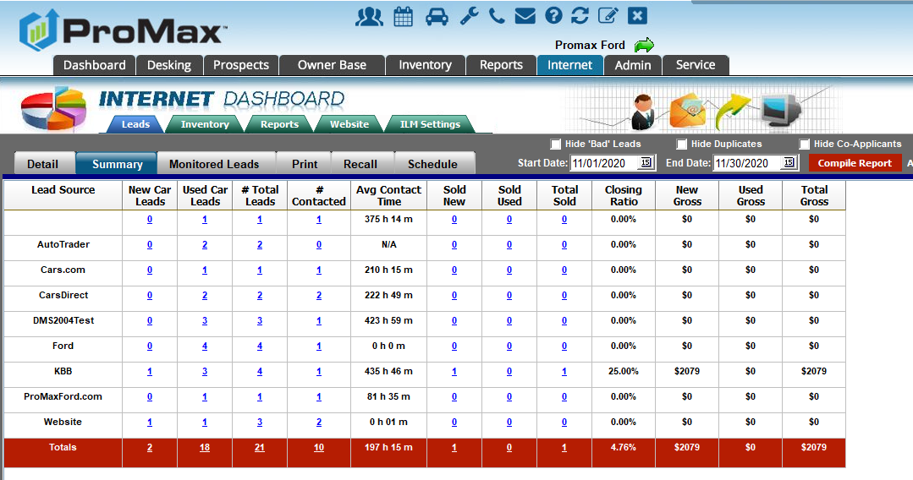
Internet Dashboard Summary
Internet > Summary

Slide 9
Ownerbase Filter/Sort
Use this feature to help data mine your sold customers

Slide 10
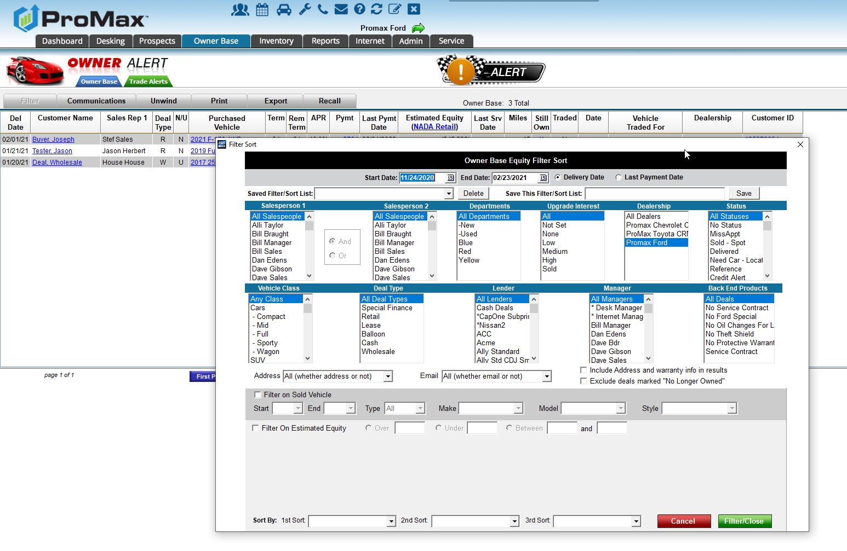
Ownerbase Filter/Sort
This is where you can data mine your sold customers for campaigns. From here you can print a bulk letter, send out an email blast, or create a call list.

Slide 11
Credit App Options
In ProMax we have several different Credit Applications available. You can choose a different view based on what your lenders prefer.

Slide 12
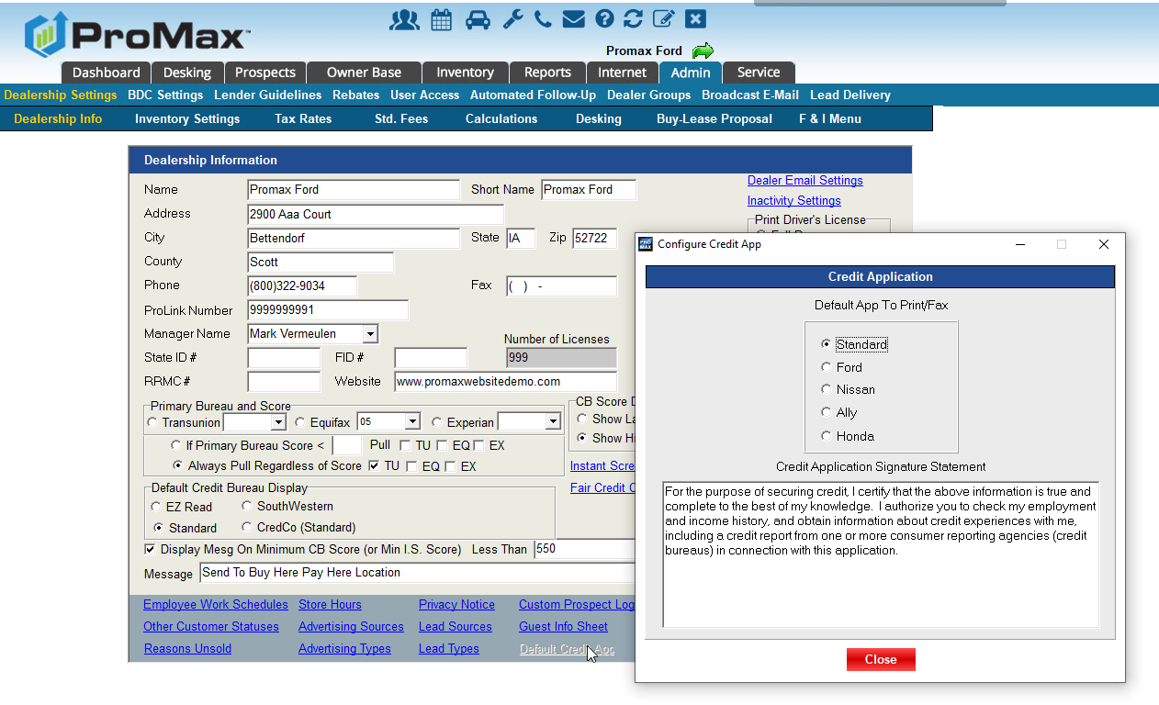
Credit Apps
To change your default go to Admin> Default Credit App
You can also change the verbiage of the credit app’s signature statement from here.

Slide 13
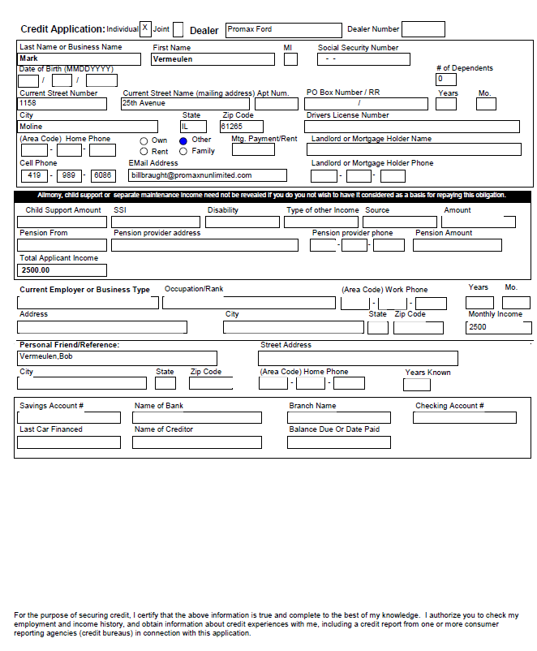
Credit App
Standard

Slide 14
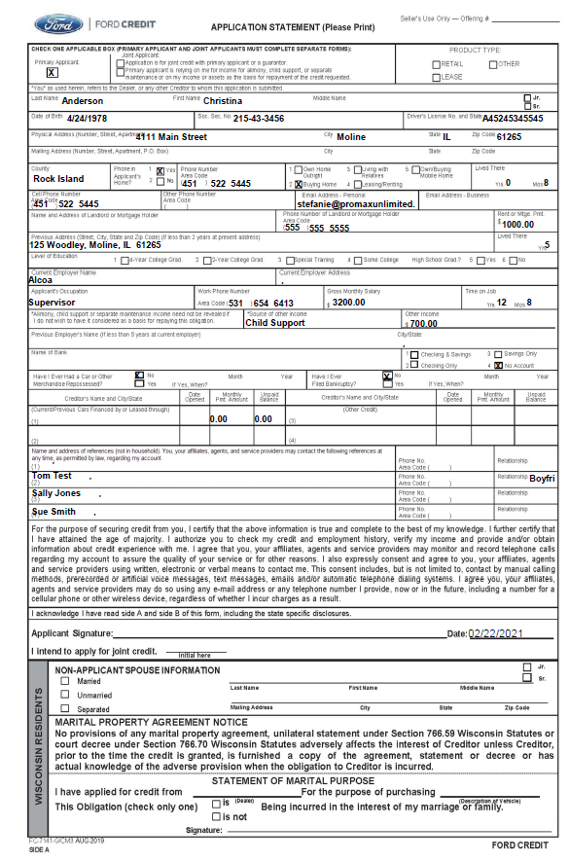
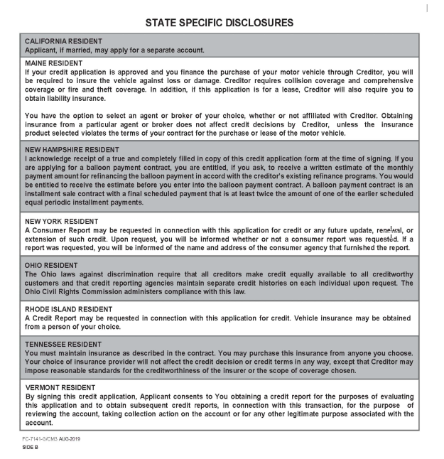
Credit App
Ford

Slide 15
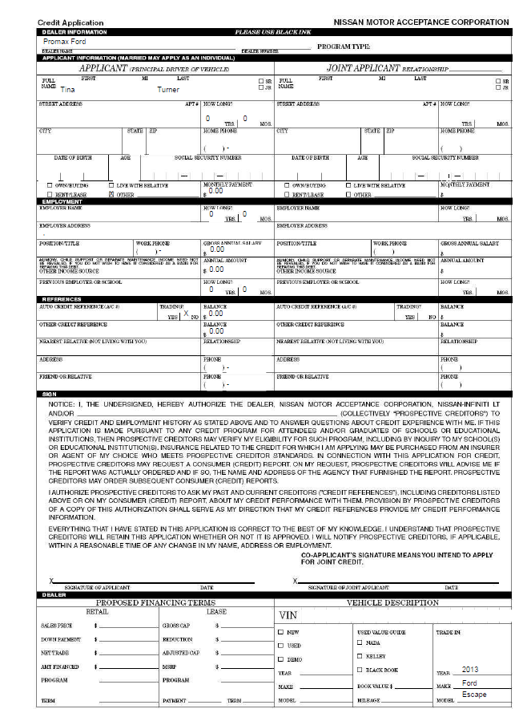
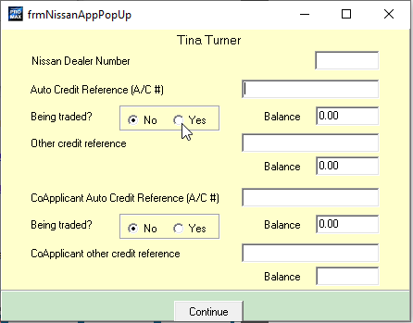
Credit App
Nissan
When using the Nissan Credit App you will receive a pop up before printing for some additional information you can print on the form.

Slide 16
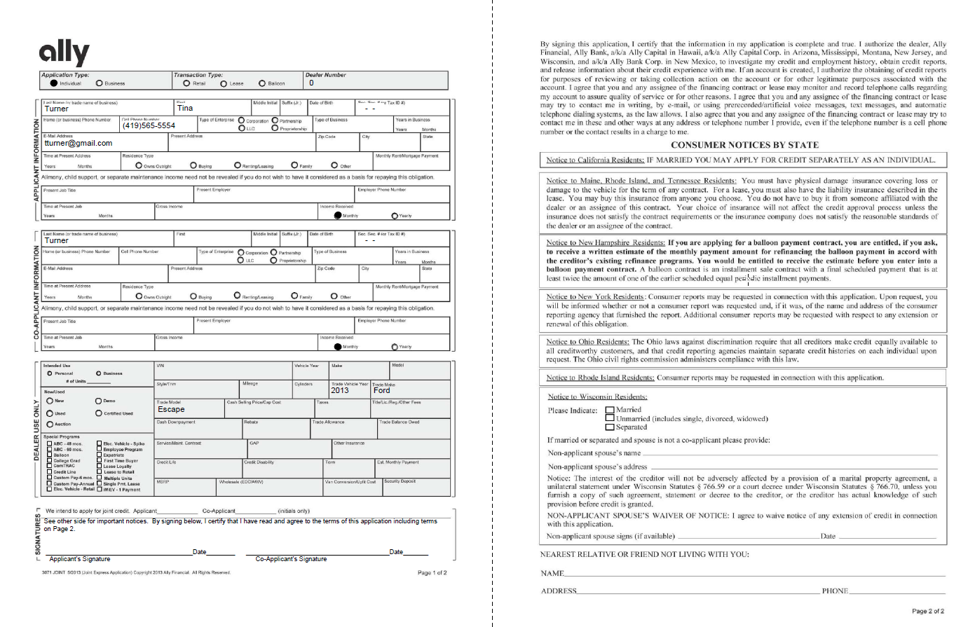
Credit App
Ally
When printing the Ally Form you will be prompted to enter the deal number if a deal structure is not selected.

Slide 17
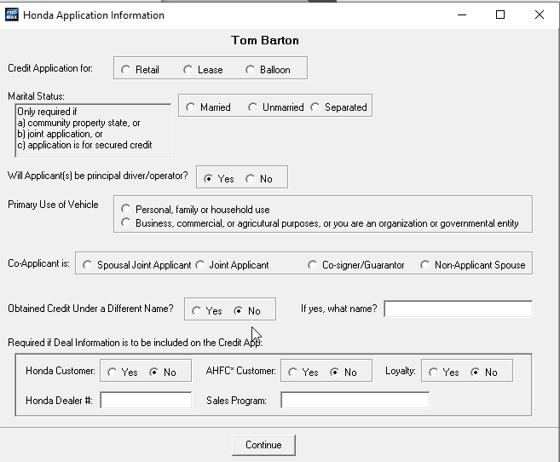
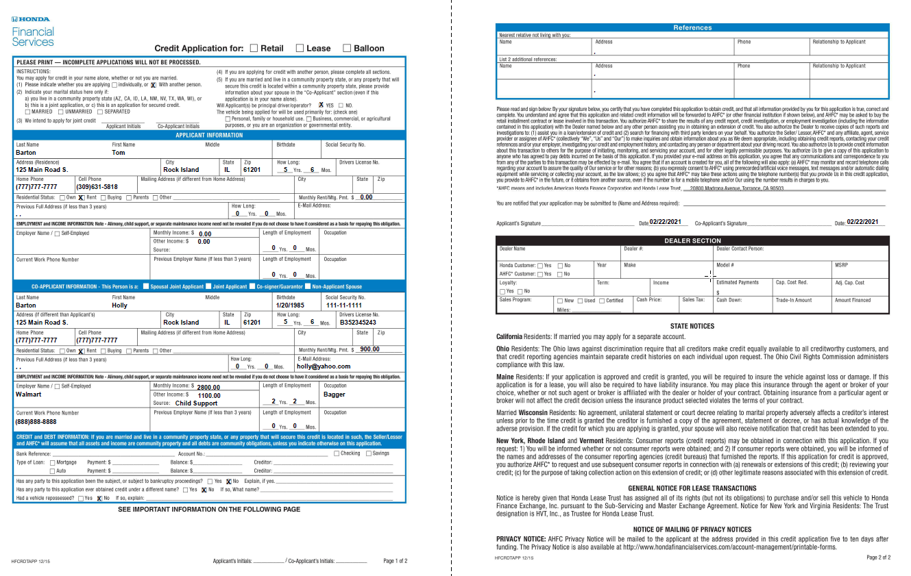
Credit App
Honda
When printing the Honda Credit App you will receive a pop up to print some additional information on the form as well.

Slide 18
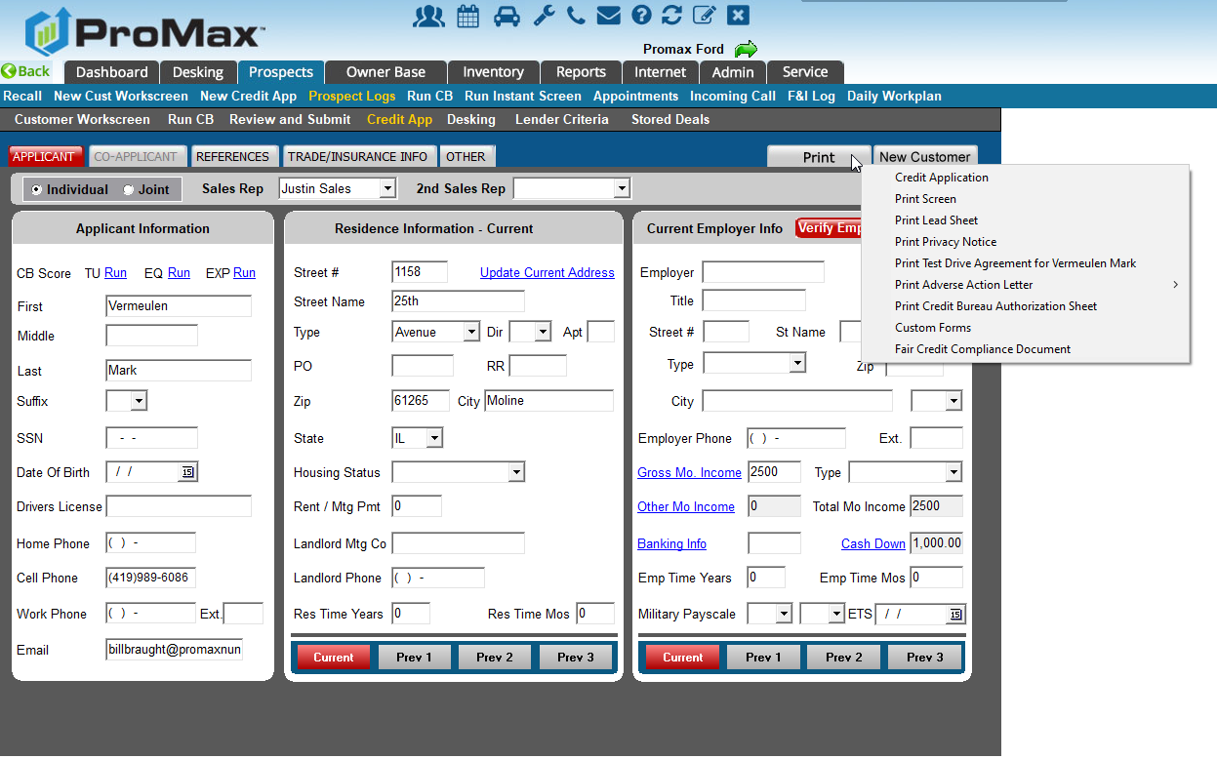
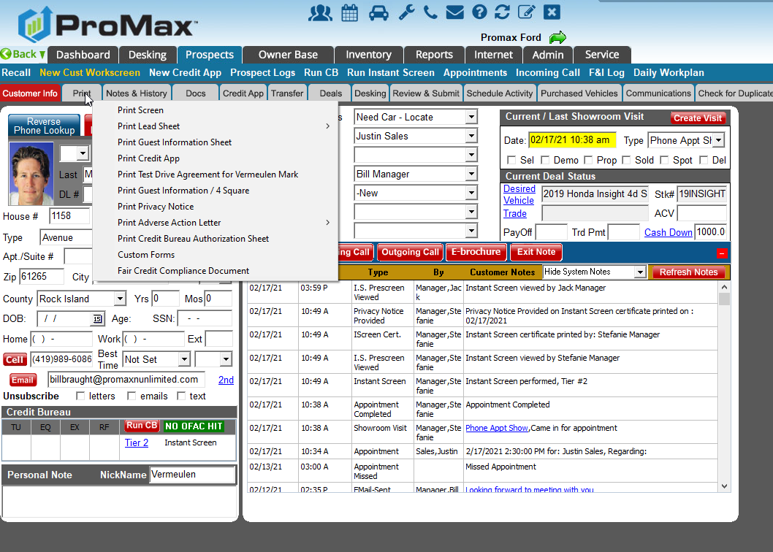
Credit Apps
You can print your credit app from multiple places. Here are a couple of the paths:
Customer Workscreen > Print
Credit App > Print

Slide 19
Running Credit Bureaus
Promax is a reseller of Credit Bureaus and you can pull straight out of the system

Slide 20
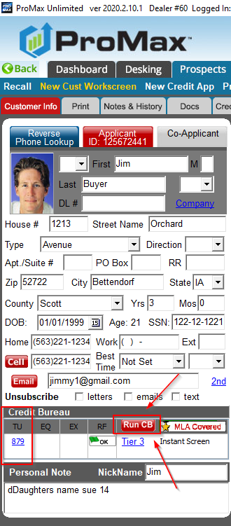
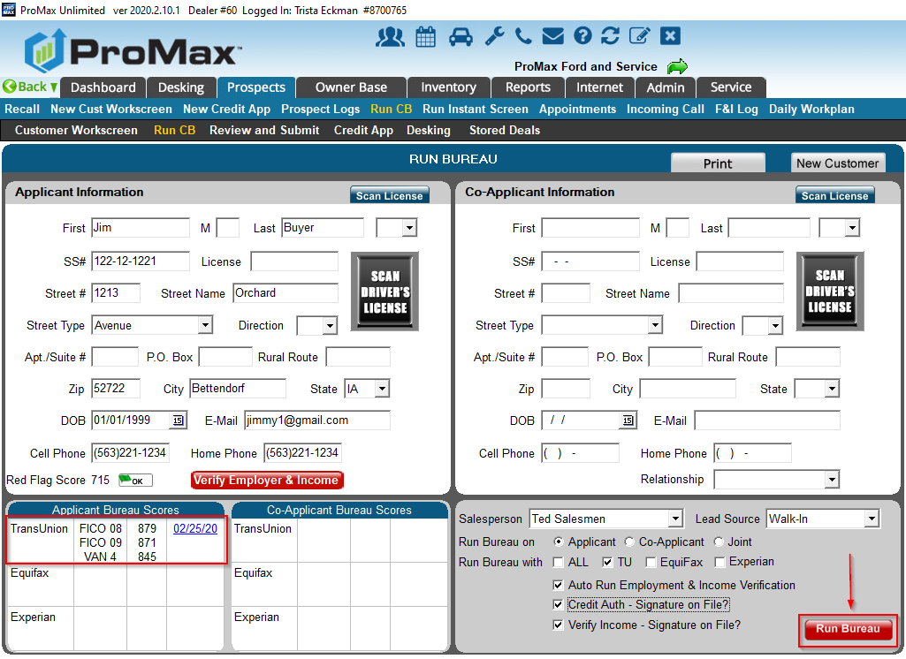
Running Bureaus
You can run bureaus from the “run” hyperlink on the Prospect Log or Dashboard. You can also run this directly from the customer workscreen or credit app.

Slide 21
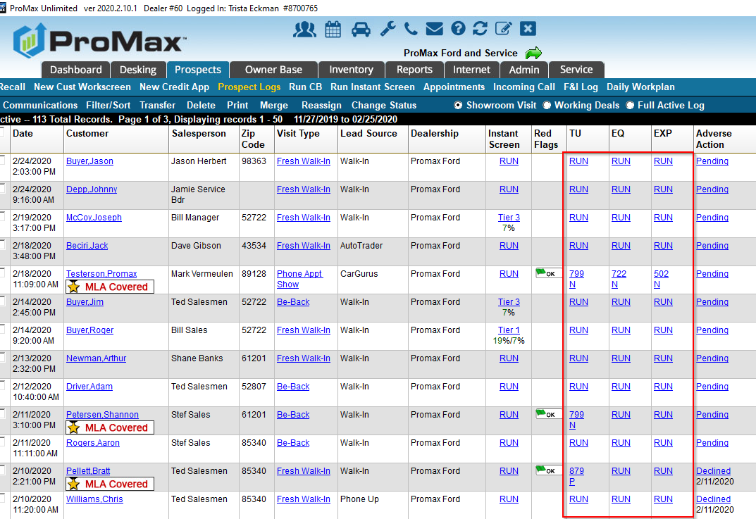
Running Bureaus

Slide 22
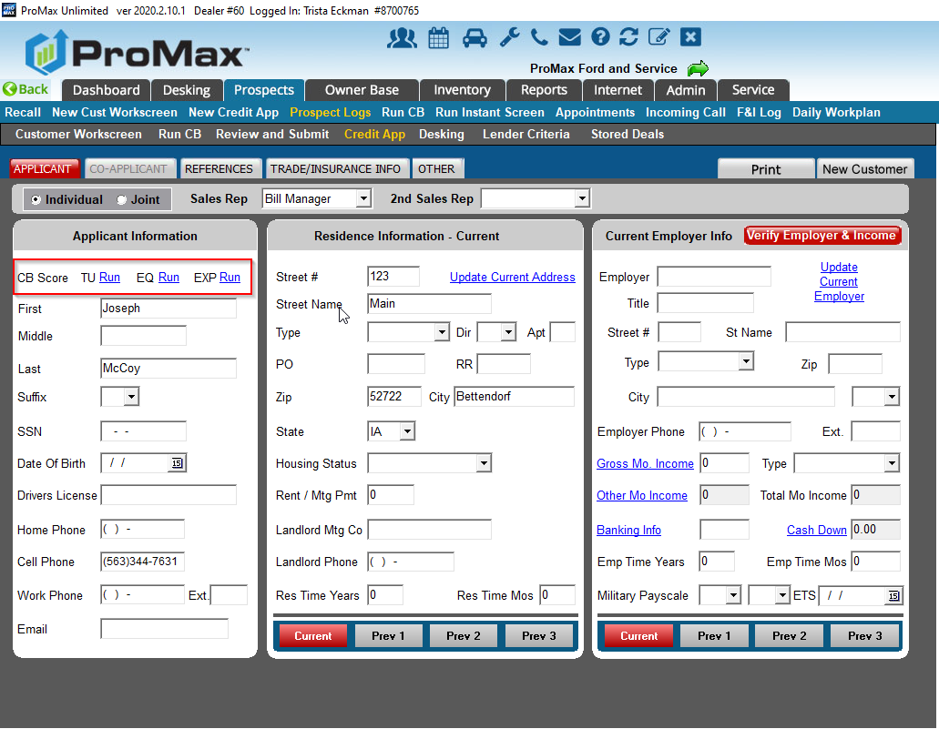
Running Bureaus

Slide 23
Credit Bureau Views

Slide 24
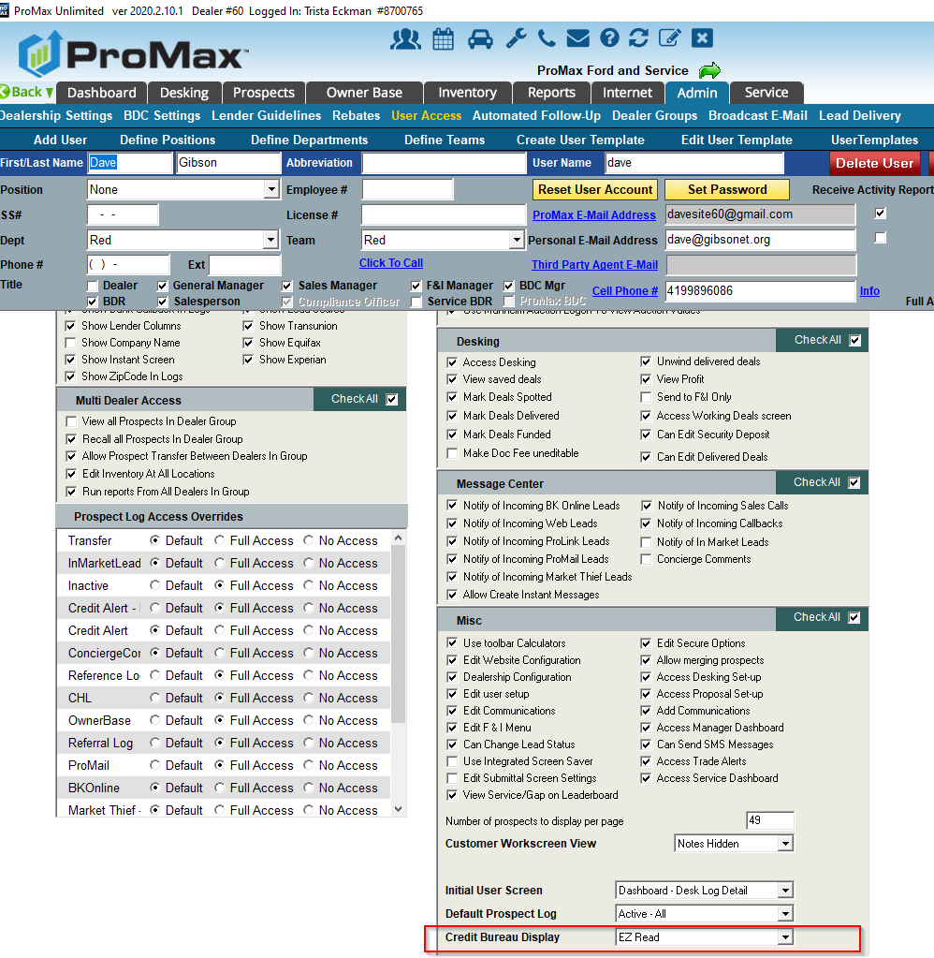
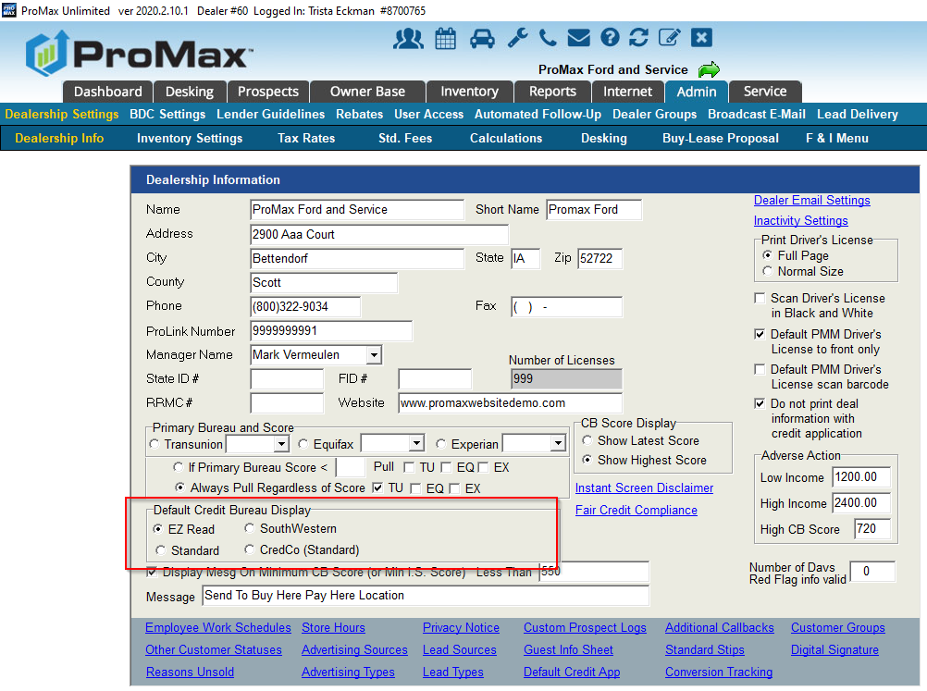
Choosing your Credit Bureau View
We have several different Credit Bureau views available in Promax. These can be changed per user.
Default view: Admin > Dealership Info
User Specific View: Admin > User Access > User’s Name. Scroll all the way down to the bottom under the Misc section to see “Credit Bureau Display.”

Slide 25
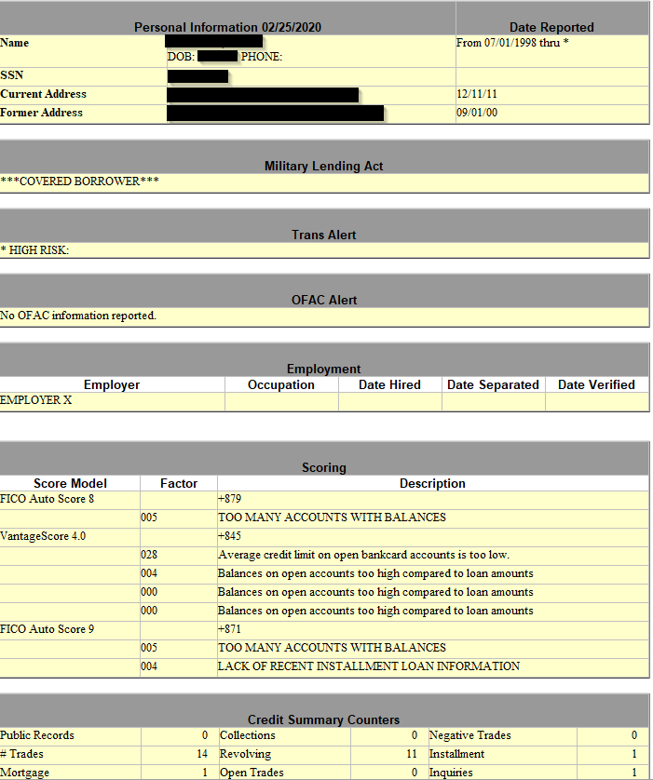
EZ Read

Slide 26
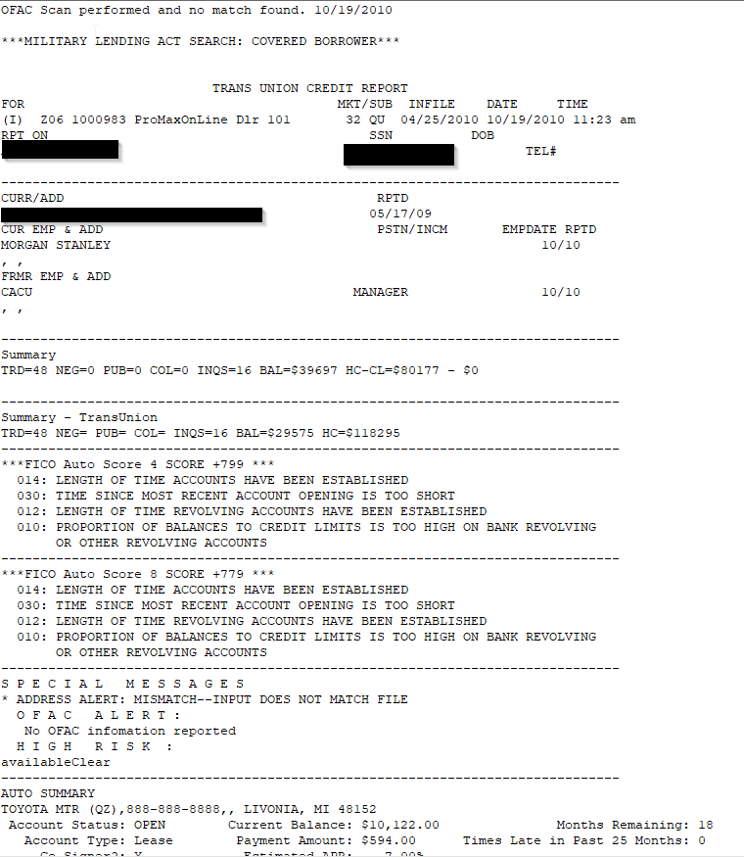
Standard

Slide 27
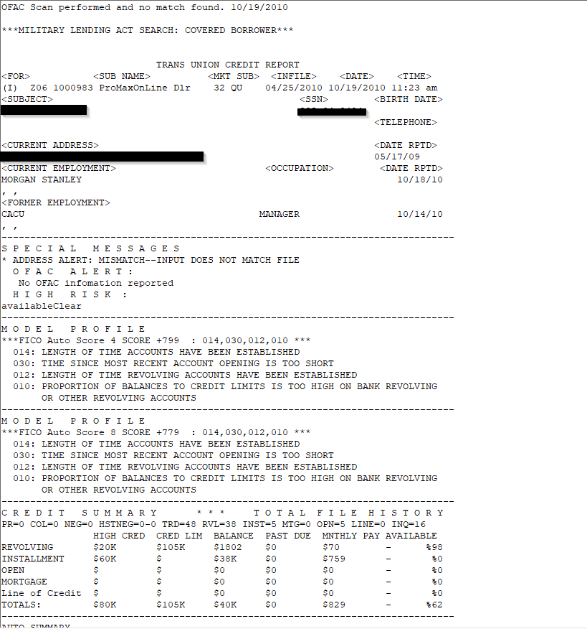
South Western

Slide 28
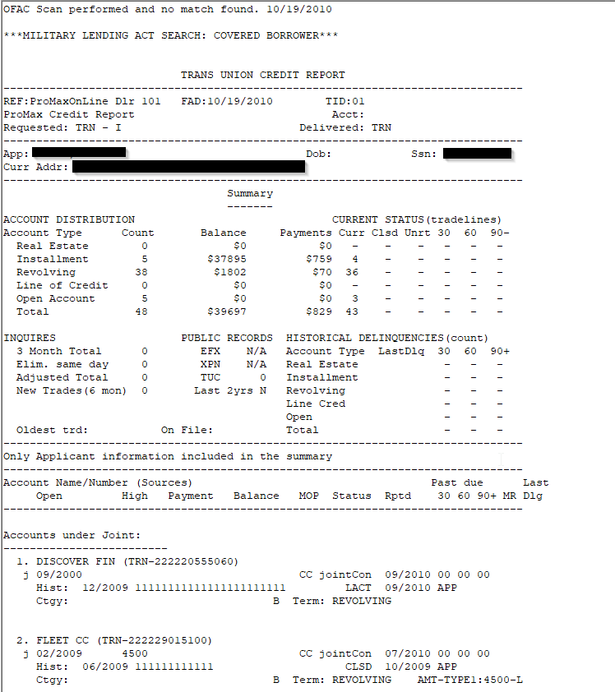
CredCo

Slide 29
How to Read a Bureau
Send me an email to Trista@promaxunlimited.com and I will forward you a cheat sheet from TransUnion, Equifax, and Experian that breaks down how to read a bureau and what the different codes mean.

Slide 30
Questions?
Contact our Dealer Support Line at 844-322-9034
Contact me directly at 563-344-7618 or Trista@ProMaxUnlimited.com
PromaxUnlimited.com
Facebook.com/ProMaxUnlimited
Twitter.com/ProMaxUnlimited
LinkedIn.com/Company/ProMax-Automotive-Software/
DealerUpdates.TypePad.com/Blog/

