Slide 1
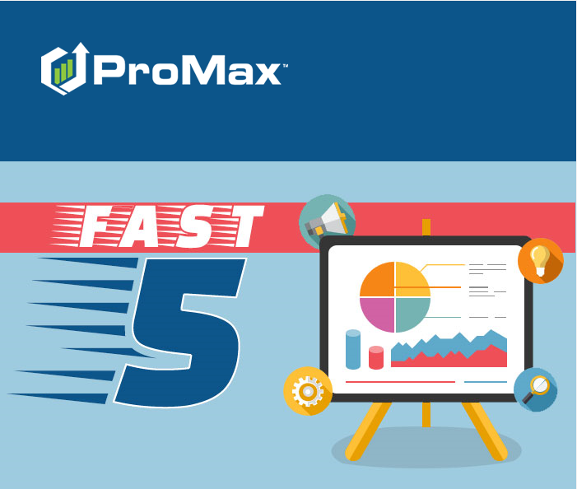
January

Slide 2
Agenda
Creating/Requesting New Lead Sources
Mobile Driver’s License Scanner
Merging Customers with Different Last Names
Creating Text Snippets
Configuring User Access Templates

Slide 3
Creating/ Requesting New Lead Sources
Lead sources can be manually created to track sources for non-imported leads (a mailer, for example), but imported (internet) lead sources must be requested and configured prior to sending such leads.

Slide 4
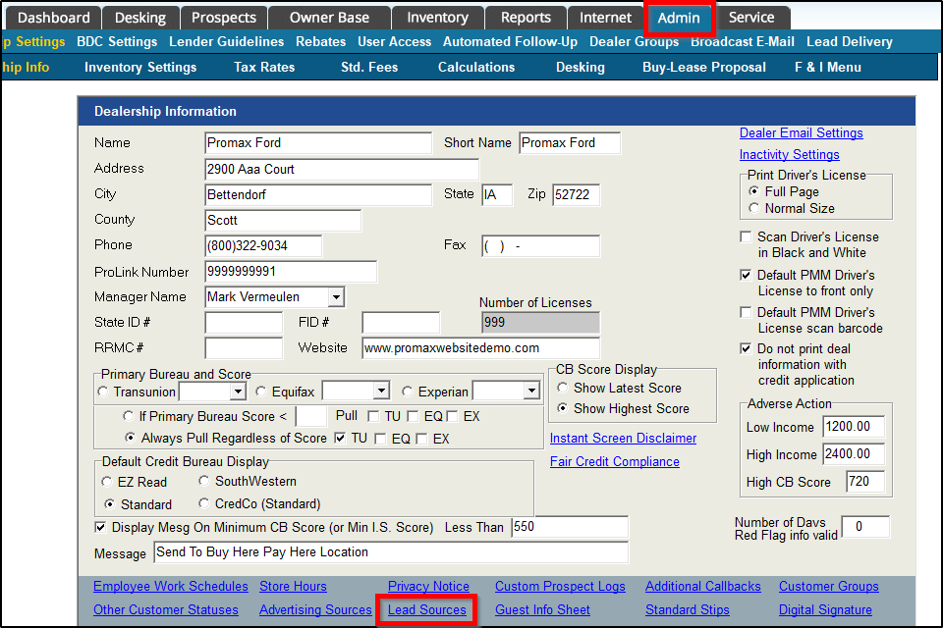
Creating/ Requesting New Lead Sources
To initiate the process, click Admin => Lead Sources.

Slide 5
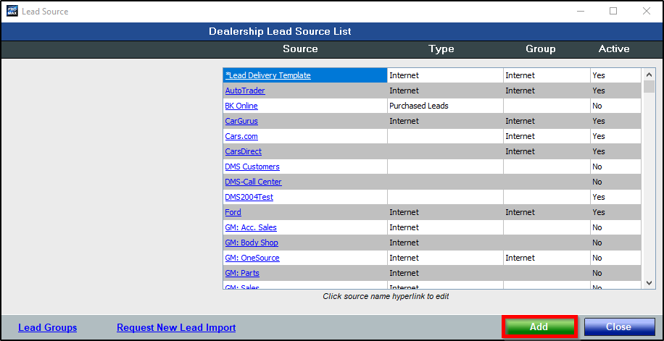
Creating/ Requesting New Lead Sources
To create a lead source manually (to track non-imported leads such as mailers or radio advertising), click Add.

Slide 6
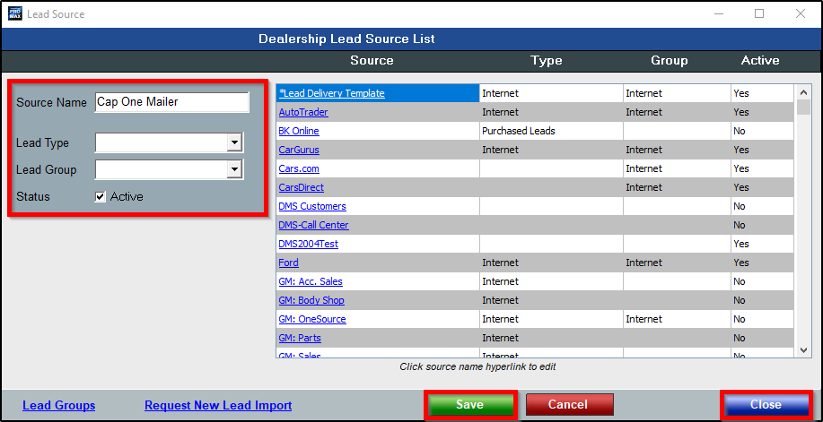
Creating/ Requesting New Lead Sources
Users then input Source Name and ensure Status is Active.
Lead Type and Lead Group are optional entries used for categorization purposes on certain reports.
Then, Save and Close.

Slide 7
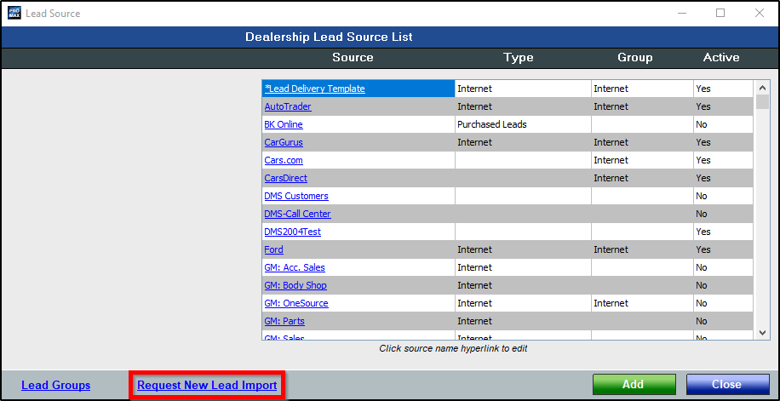
Creating/ Requesting New Lead Sources
To request configuration for a new imported (internet) lead source, click Request New Lead Import.

Slide 8
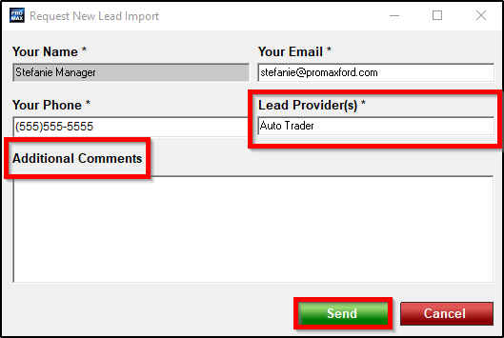
Creating/ Requesting New Lead Sources
Your Name, Your Email, and Your Phone will auto-populate using information contained within your user access profile.
Input name of Lead Provider(s) and add Additional Comments, if necessary; then, Send.
Once set up, you will receive notification via phone or email.

Slide 9
Configuring User Access Templates
User access templates can be configured and applied for various dealership positions, which then ensures all such users are granted the exact same system access.

Slide 10
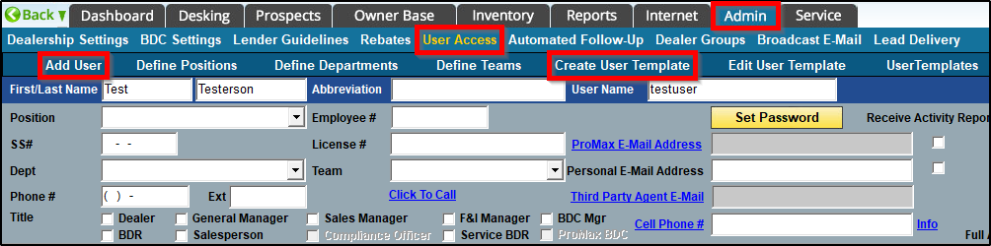
Configuring User Access Templates
To create a user access template, click Admin => User Access => Add User (or click to enter any existing user’s profile) => Create User Template.

Slide 11
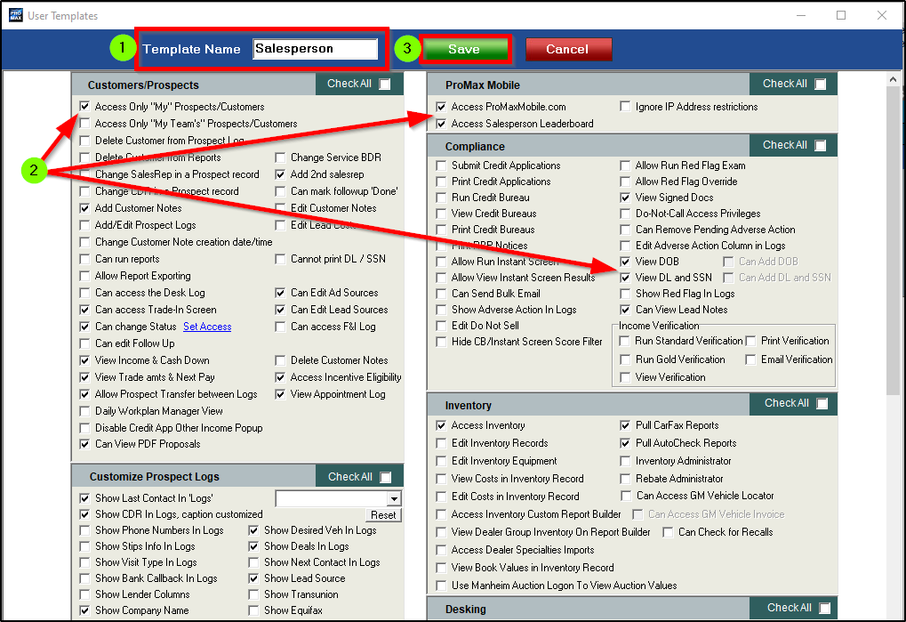
Configuring User Access Templates
1. Name the template based on position/role.
2. Scroll through all sections, checking boxes to grant/restrict access, as needed.
NOTE: Not all check boxes grant access when clicked; some, when enabled, restrict a user’s access.

Slide 12
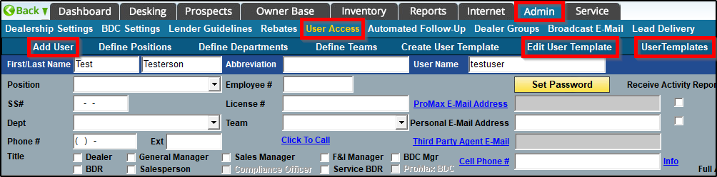
Configuring User Access Templates
Once created, user access templates can be edited by clicking Edit User Template.
To apply a user access template, select the desired position from the User Templates option while within the intended user’s profile.

Slide 13
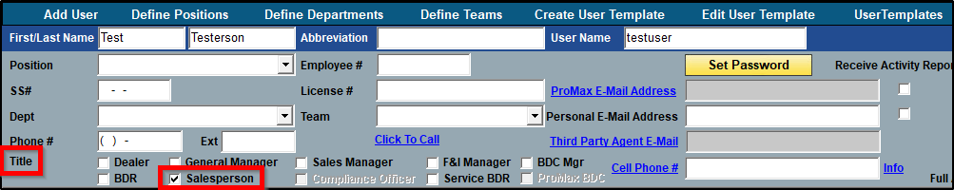
Configuring User Access Templates
Also, when creating a new user, simply clicking the desired position within the Title section will also apply the user access template.

Slide 14
Creating Text Snippets
Text snippets are short, pre-formatted text messages which can be selected and sent to customers to save time and reduce potential errors (typos).

Slide 15
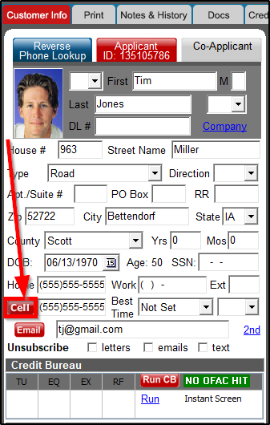
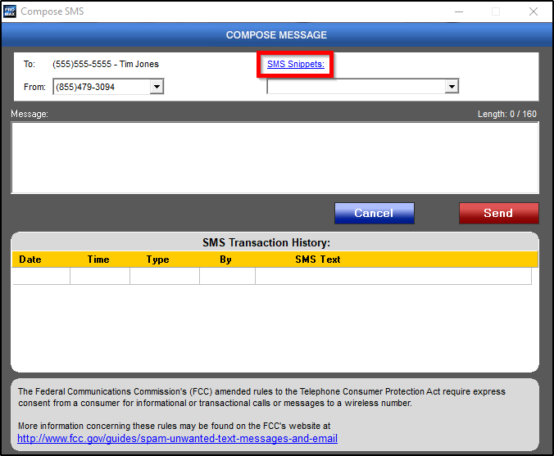
Creating Text Snippets
To create a text snippet, simply enter any Customer Workscreen with a cell phone number present and click Cell.
Then, within the pop-up, click SMS Snippets hyperlink.
NOTE: Users must have access to “Add Templates” and “Edit Templates” in order to see the SMS Snippets hyperlink.

Slide 16
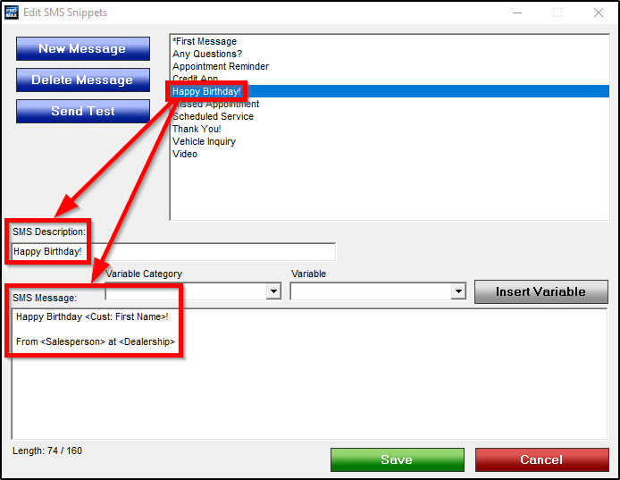
Creating Text Snippets
All existing text snippets can be seen above in the list of descriptions; when selected, description and content populate below.

Slide 17
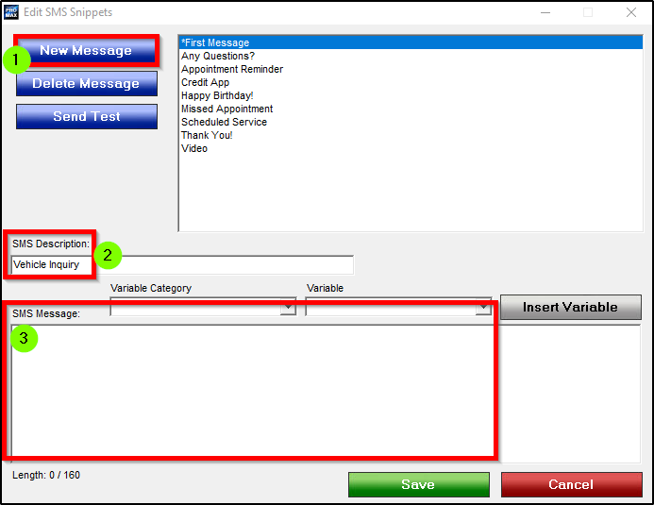
Creating Text Snippets
To create a new snippet:
1. New Message
2. SMS Description: name the snippet
3. SMS Message: format the snippet content

Slide 18
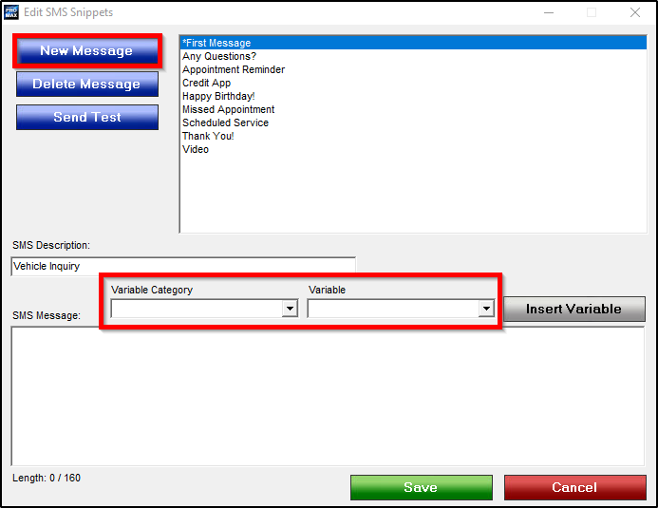
Creating Text Snippets
Variables are placeholders used in text snippets and email templates to populate information which varies based on customer, assigned Rep, and dealership.
For example, users can input a variable for the customer’s first name, which will then pull the correct name from the field within Customer Workscreen and populate the variable accordingly.

Slide 19
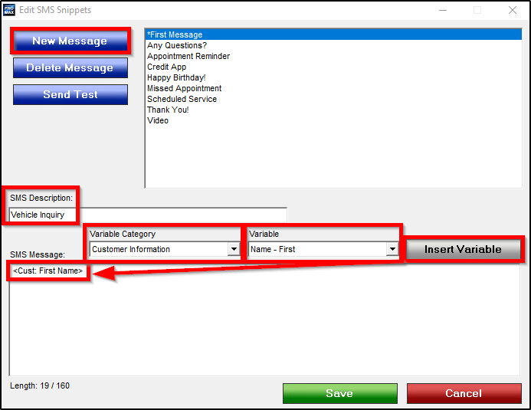
Creating Text Snippets
To use variables, first select from the Variable Category drop-down (broad category), select the desired Variable (intended piece of information), then Insert Variable.
For the customer name example, Variable Category would be Customer Information and Variable would be Name – First.

Slide 20
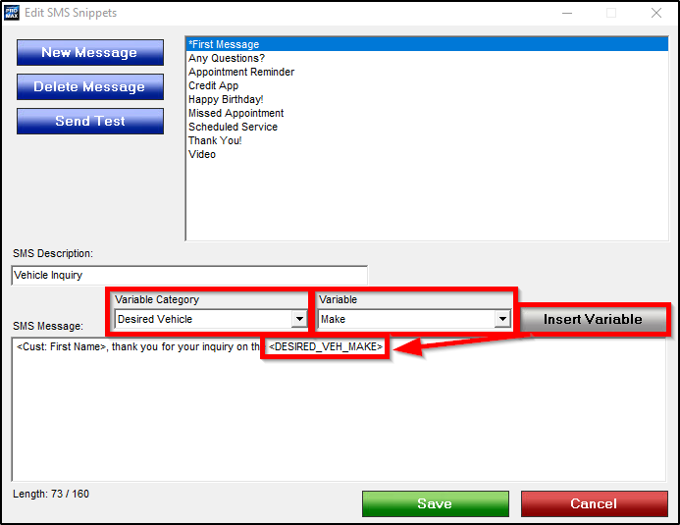
Creating Text Snippets
To input a variable for the customer’s desired vehicle, Variable Category would be Desired Vehicle and Variable would be one or more selections of Year, Make, Model, and Style (each inserted separately).
In this example, we begin with the Variable of Make, then Insert Variable…

Slide 21
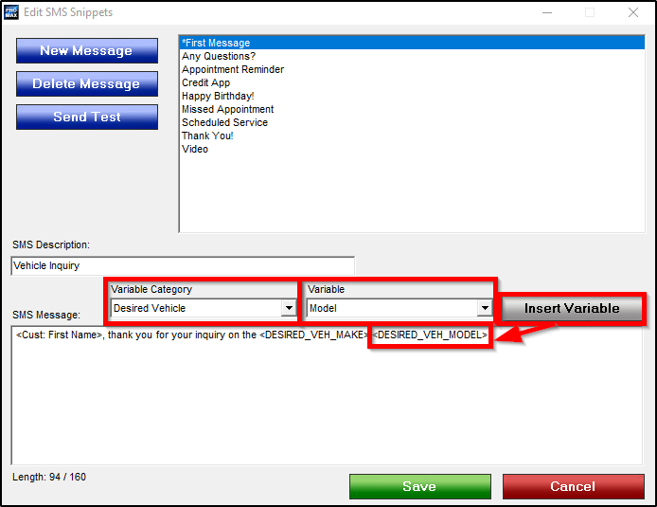
Creating Text Snippets
…then Variable of Model, and Insert Variable.
NOTE: Be mindful of proper spacing between variables.

Slide 22
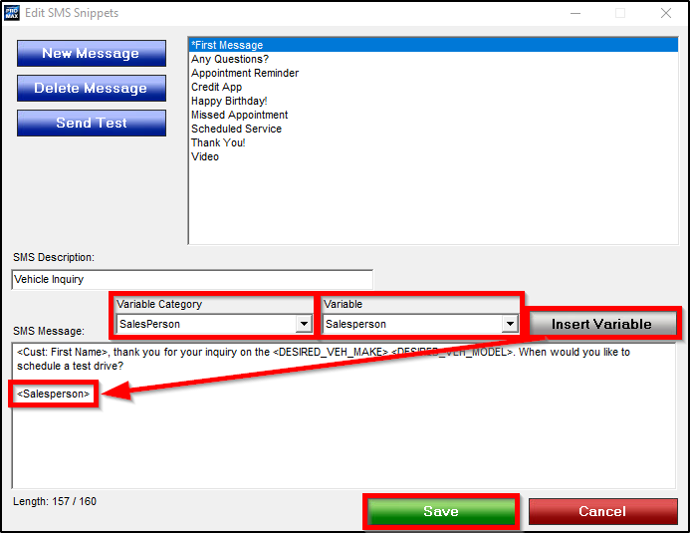
Creating Text Snippets
To close, users can input variables associated with the assigned Rep (Salesperson, CDR, etc.), such as name, phone number, and email address.
To input a variable for the assigned Salesperson’s name, Variable Category would be Salesperson, then Variable would also be Salesperson.
NOTE: All variables pertaining to assigned Reps are contained within the Variable Category of Salesperson.
Once finished, click Save.

Slide 23
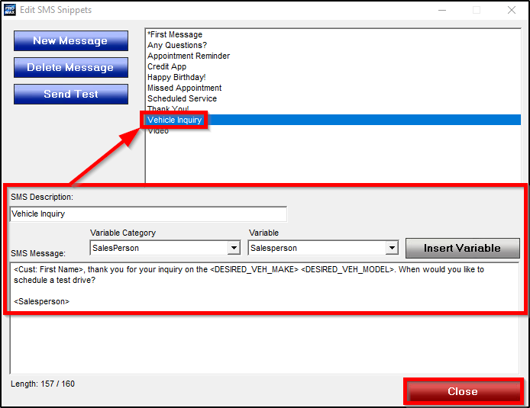
Creating Text Snippets
Once saved, the description can be seen above in the list of snippets.
Then, to exit the snippet configuration, click Close.

Slide 24
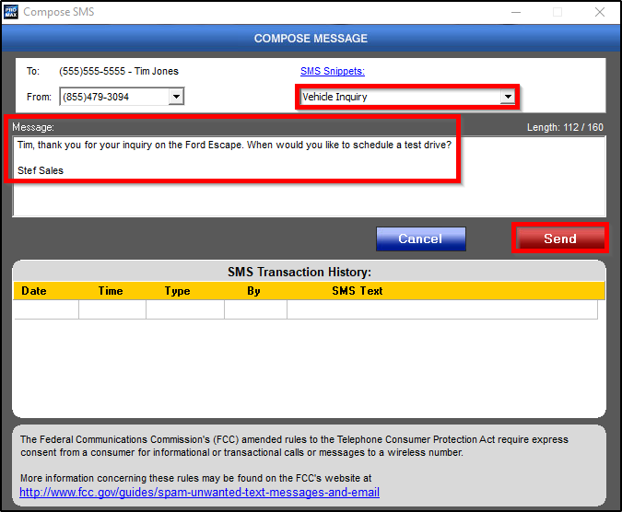
Creating Text Snippets
Once created and saved, the text snippet can be selected from the SMS Snippets drop-down and sent to customers, with all variable information populated as expected.

Slide 25
Merging Customers with Different Last Names
Merging customers records with the same last name is easy, but finding/merging customers with different last names can be challenging; follow our recommended process.

Slide 26
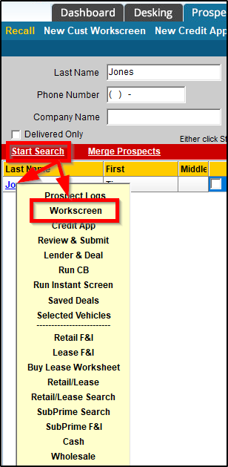
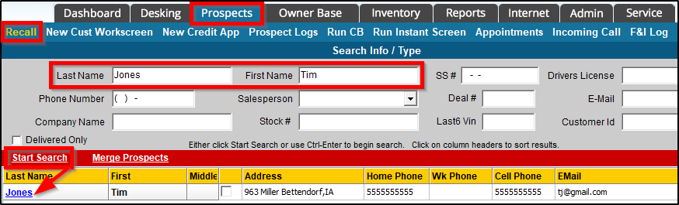
Merging Customers with Different Last Names
First, begin by finding the first customer through Prospects => Recall.
Enter Last Name and First Name, then click Start Search.
Then, click the customer name hyperlink to access the Workscreen.

Slide 27
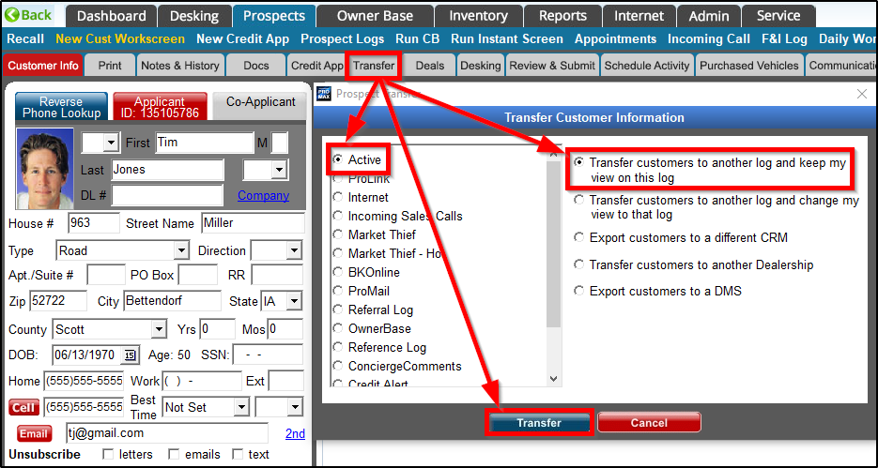
Merging Customers with Different Last Names
Within the Customer Workscreen, click Transfer.
Select the Active prospect log along with the first option shown, then click Transfer.

Slide 28
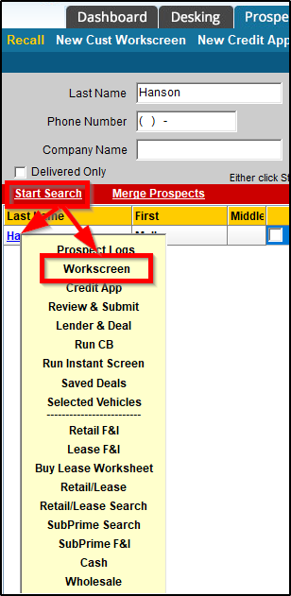
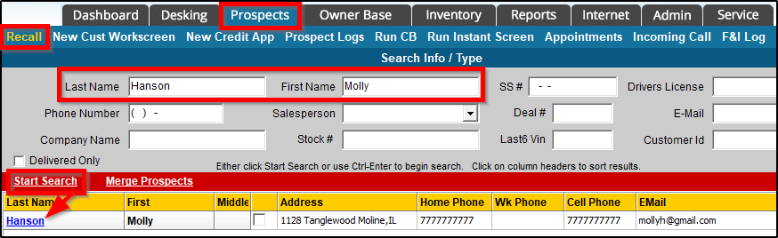
Merging Customers with Different Last Names
Next, complete the same process to find the second customer through Prospects => Recall; enter Last Name and First Name, then click Start Search.
Then, click the customer name hyperlink to access the Workscreen.

Slide 29
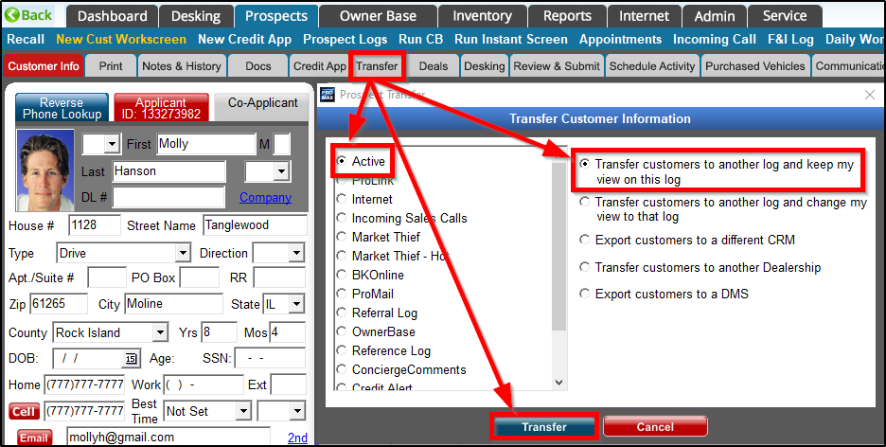
Merging Customers with Different Last Names
Again, within the Customer Workscreen, click Transfer.
Select the Active prospect log along with the first option shown, then click Transfer.

Slide 30
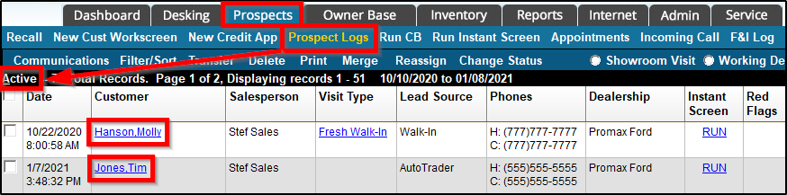
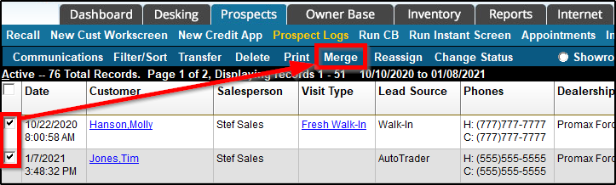
Merging Customers with Different Last Names
After the customers have been transferred, both will be visible under Prospects => Prospect Logs => Active.
Once visible, check both boxes to select, then click Merge.

Slide 31
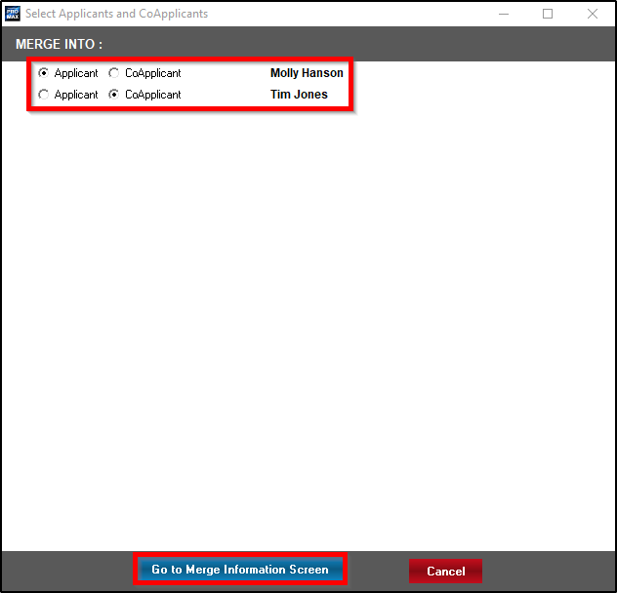
Merging Customers with Different Last Names
On the initial merge screen, select which customer should be the Applicant and which should be the Co-Applicant; then, click Go to Merge Information Screen.

Slide 32
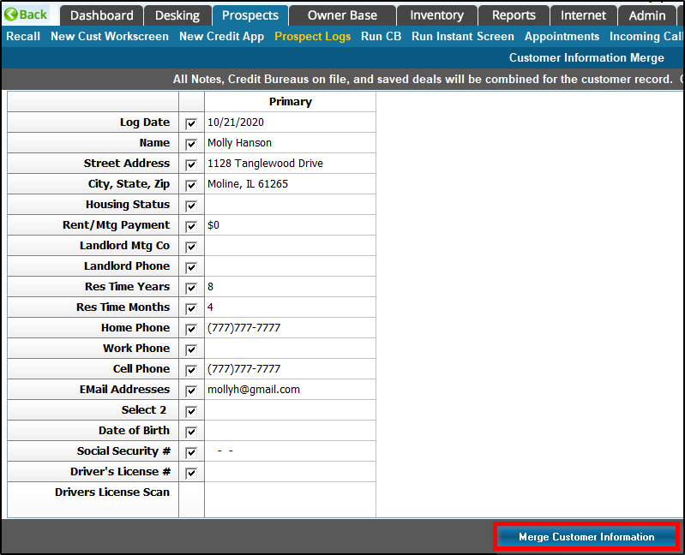
Merging Customers with Different Last Names
Unlike merging two records for the same customer, the process to merge records for two different customers does not require the user to pick and choose information to keep, as all information from both records will be merged into the new record (Applicant/Co-Applicant).
Therefore, simply click Merge Customer Information.

Slide 33
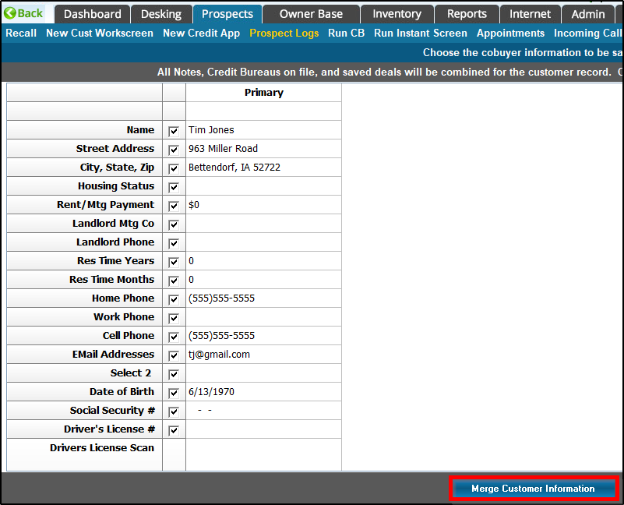
Merging Customers with Different Last Names
Once more, click Merge Customer Information.

Slide 34
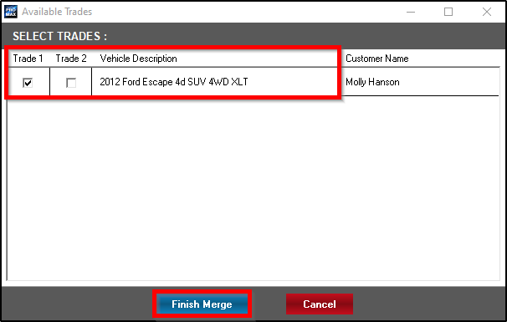
Merging Customers with Different Last Names
Next, select up to two trade vehicles to attach to the final customer record, then Finish Merge.

Slide 35
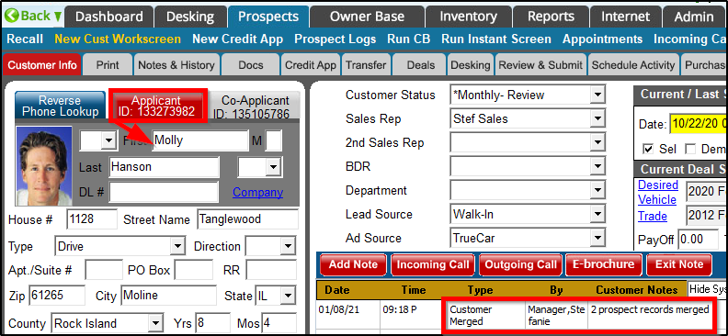
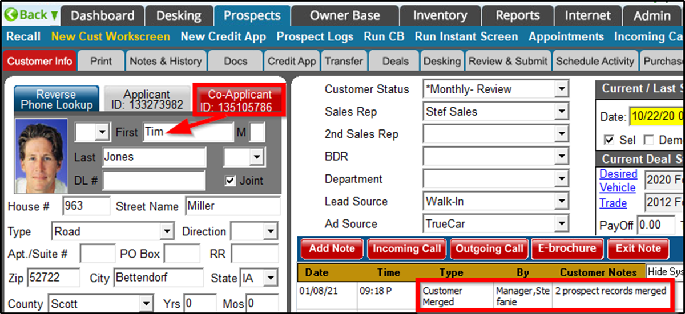
Merging Customers with Different Last Names
Once completed, the user is directed to the newly merged customer record, where Applicant and Co-Applicant information can be seen by clicking the appropriate tabs.

Slide 36
Mobile Driver’s License Scanner
Users can scan a customer’s driver’s license using the ProMax App (on a tablet or smart phone) with the Mobile DL Scanner tool; this is an add-on feature.

Slide 37
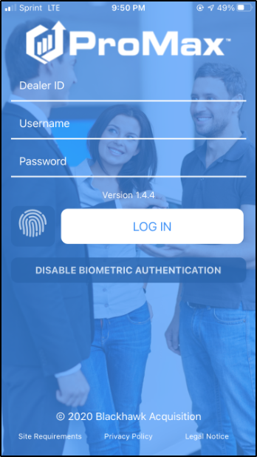
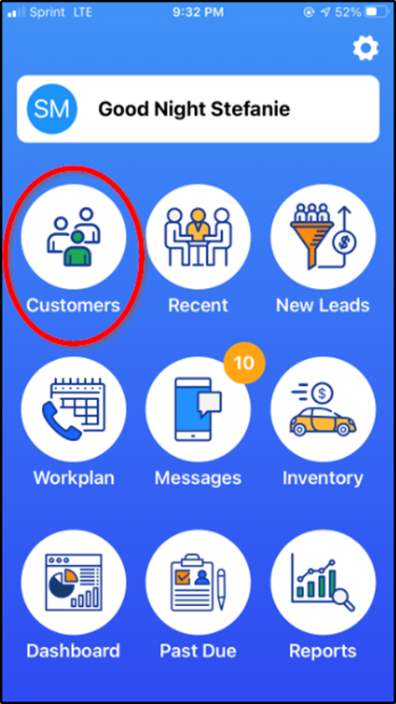
Mobile Driver’s License Scanner
To begin, log into the new ProMax App (manually or using biometrics such as thumb print or face ID scan) and click Customers.

Slide 38
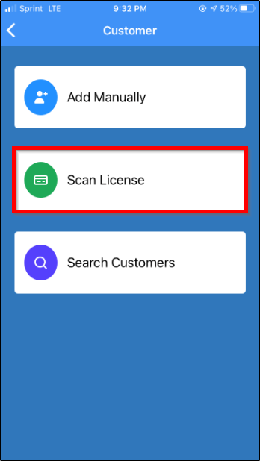
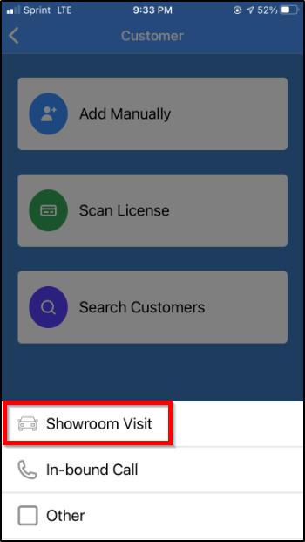
Mobile Driver’s License Scanner
Then, select Scan License and choose Showroom Visit.

Slide 39
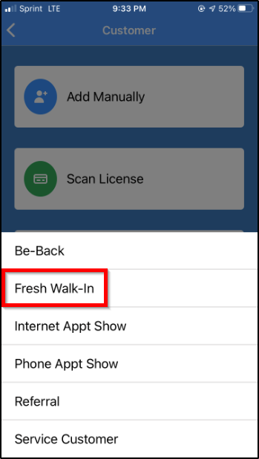
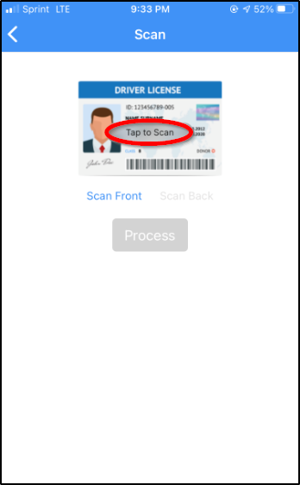
Mobile Driver’s License Scanner
Next, choose the exact type of Showroom Visit, then Tap to Scan.

Slide 40
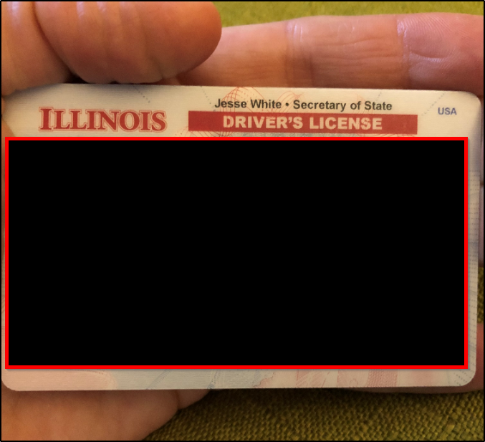
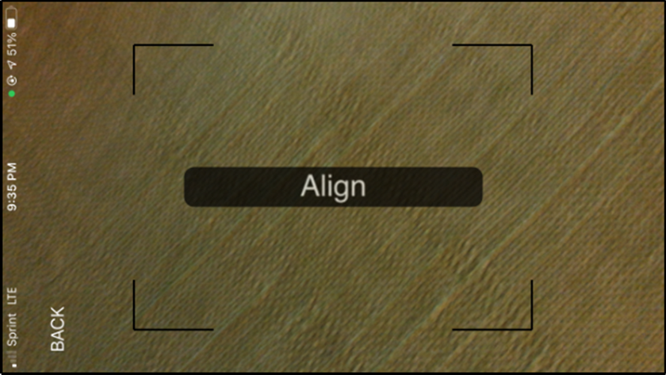
Mobile Driver’s License Scanner
This tool works best when the driver’s license is cupped in the hand at an angle, avoiding glare as much as possible.
Once the driver’s license is aligned properly, the picture will take automatically, without the need to click a button.

Slide 41
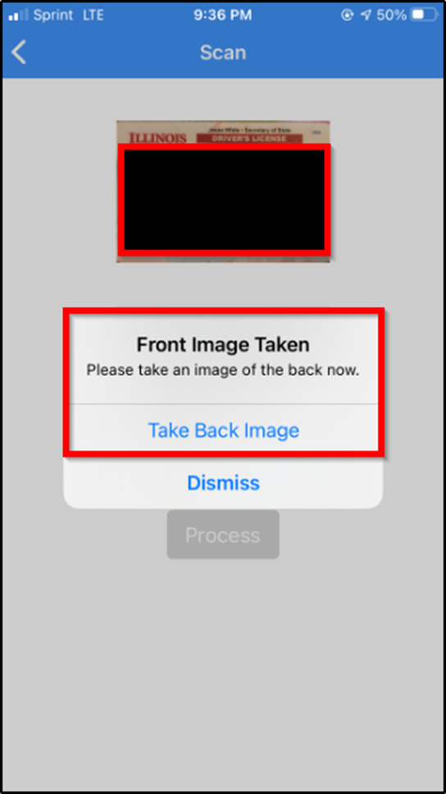
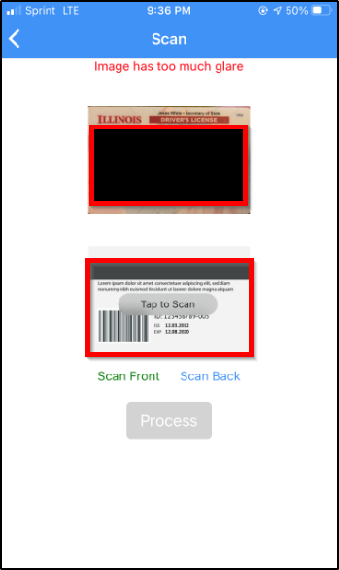
Mobile Driver’s License Scanner
Once the front image has been captured, the user may scan the back of the customer’s driver’s license, too.
Users have the ability to rescan the front or back, as needed.

Slide 42
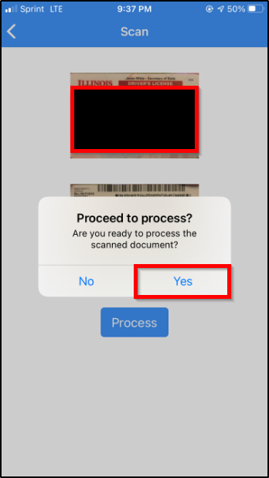
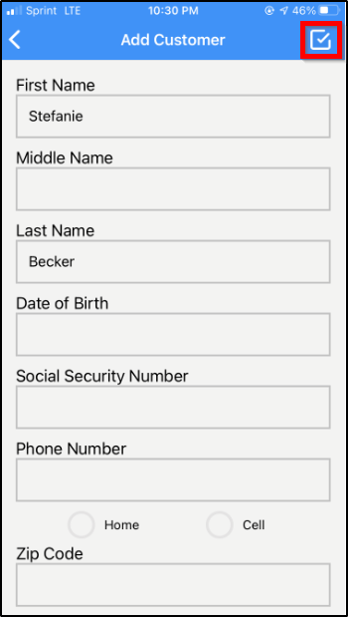
Mobile Driver’s License Scanner
Next, the user is prompted to process the scan(s).
Once processed, the user should review all information captured to ensure accuracy; then, click the check mark to confirm.

Slide 43
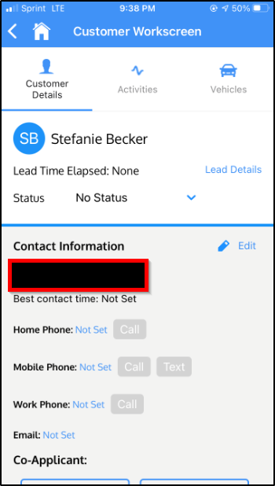
Mobile Driver’s License Scanner
Finally, the user is directed to the Customer Workscreen, where additional information can be entered and various activites completed.

Slide 44
Questions?
Contact our Dealer Support Line at 844-322-9034
Contact me directly at 563-344-7687 or Stefanie@ProMaxUnlimited.com
PromaxUnlimited.com
Facebook.com/ProMaxUnlimited
Twitter.com/ProMaxUnlimited
LinkedIn.com/Company/ProMax-Automotive-Software/
DealerUpdates.TypePad.com/Blog/

