Slide 1
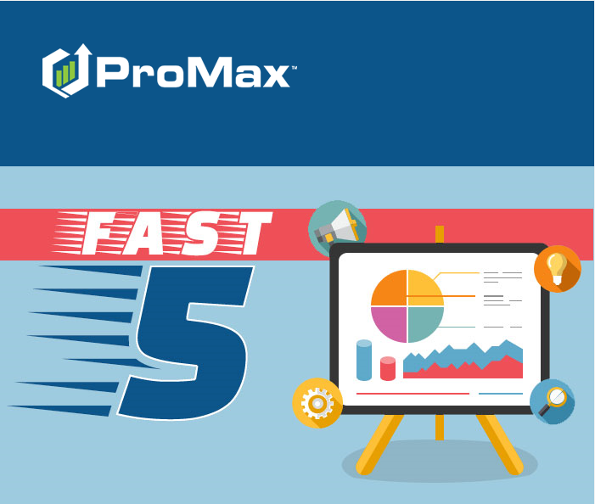
JULY

Slide 2
Agenda
Duplicate Lead Settings
ProMax Launcher
Report Schedulers
ProMax BDC
Booking Out Inventory

Slide 3
Duplicate Lead Settings
In ProMax, you can customize how a duplicate lead is identified and handled in the system

Slide 4
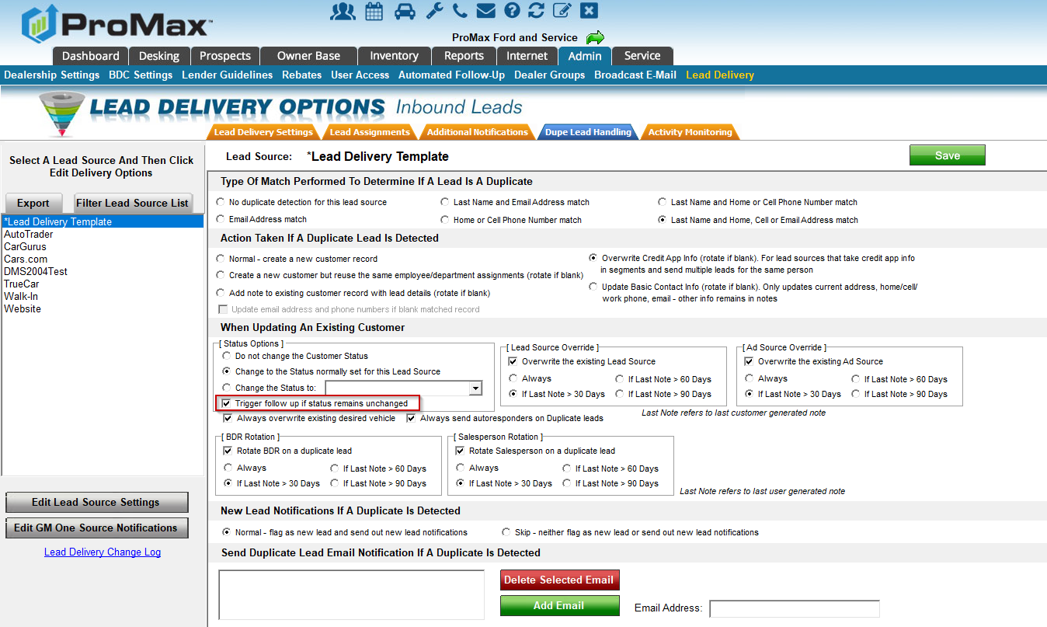
Duplicate Lead Settings
Admin > Lead Delivery > Lead Source > Edit Lead Source Settings > Dupe Lead Handling
The new feature we have added recently is “Trigger follow up if status remains unchanged.” Basically, this means that if the duplicate lead is getting changed to the same status as it was in previously, it will retrigger/restart the follow up schedule for that status.

Slide 5
Booking Out Inventory
A recent change requires that all book values have equipment selected individually now

Slide 6
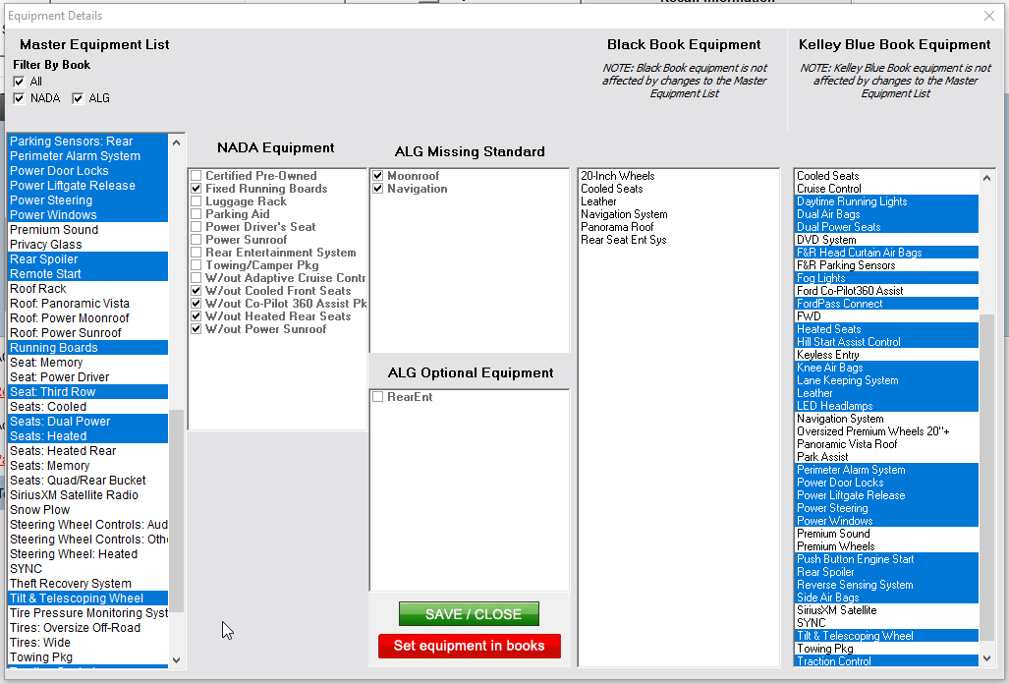
Booking Out Inventory
Inventory > Unbooked Inventory > Stock number > Equipment > Select Equipment under each book > Set Equipment in books > Save Close.
You will also want to select values for anything that is highlighted in yellow in order to get this vehicle fully defined
It is beneficial to book out your inventory to ensure accurate numbers on your desking screen and to get the best results when using our desking searches.

Slide 7
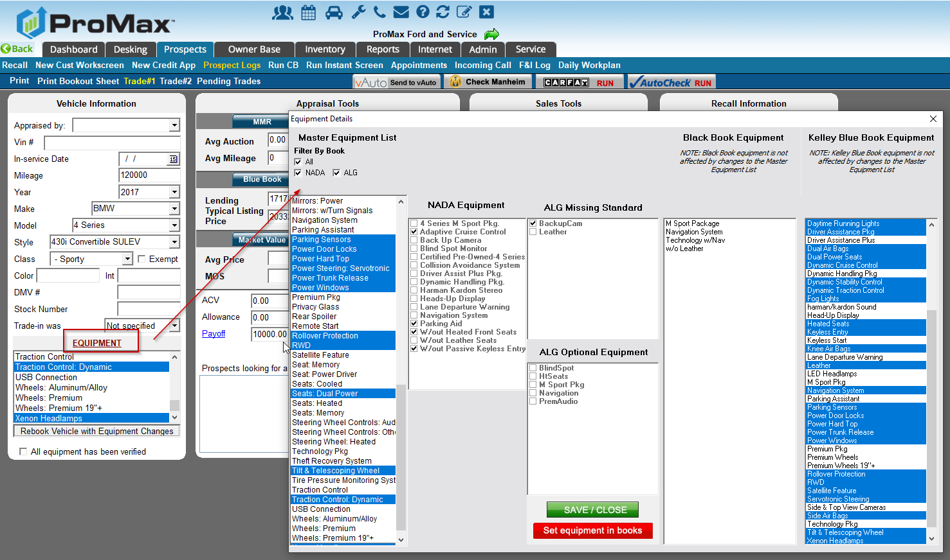
Booking Out Trades
The same process is required on trades to make sure that these are not under valued.

Slide 8
ProMax Launcher
Using our launcher allows you to access the full version of Promax without having to use Internet Explorer. However, a Windows machine is still required.

Slide 9

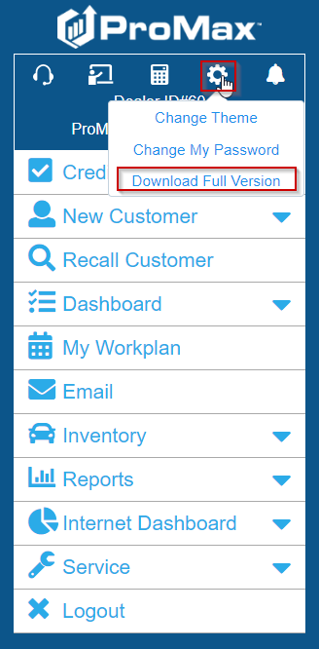

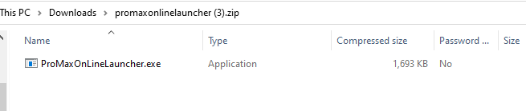

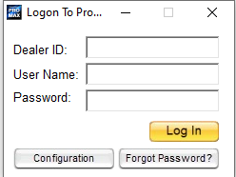
ProMax Launcher
Log into Promax Mobile through any web browser. This uses the same log in credentials that you use for the full ProMax system. You just go to www.promaxmobile.com instead.
Click on the gear icon and then choose download full version. Open the download and save. You will now have a ProMax icon on your desktop that you can use to log in to the full version.

Slide 10
Report Schedulers
ProMax has many reports that you can set up to email out automatically.

Slide 11
Report Schedulers
REPORTS THAT CAN BE SCHEDULED TO AUTO SEND
Leaderboard
Dealer Group Rankings
Finance Profit Summary Report Builder
Sold Vehicle Profit Report Builder
Prospect Activity Report
Salesperson Tracking Report Builder
BDC Productivity Report
Credit Bureau Activity Report (Check Box in User Access)

Slide 12
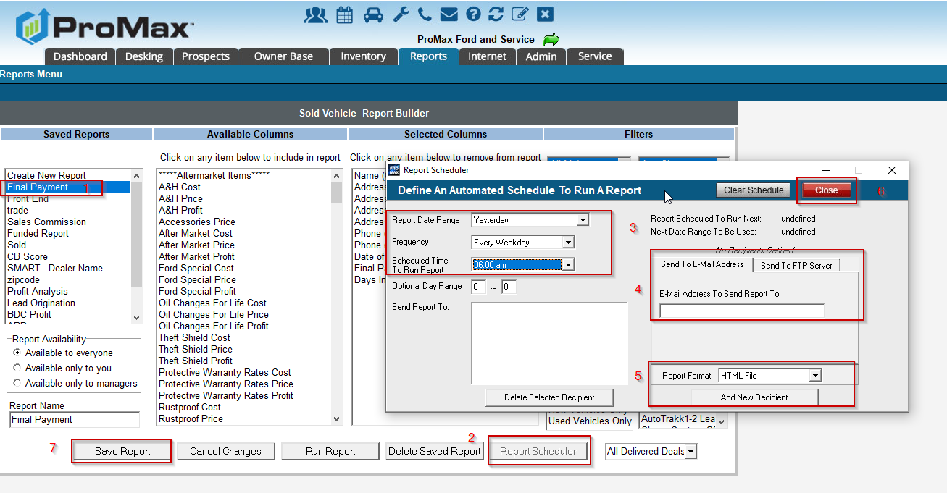
Report Schedulers
There are three kinds of schedulers in the system. One is for the reports that you build, another is for the reports we provide premade for you, and one is set up very uniquely.
For builders go to the report builder, choose the report on the left that you would like to auto send, and choose report scheduler. Choose the report date range, how often it should send, and what time it should send on the left. Then, on the right you will fill in the email or FTP information of where it should be sent. Hit add recipient, close and save and you are all set.

Slide 13
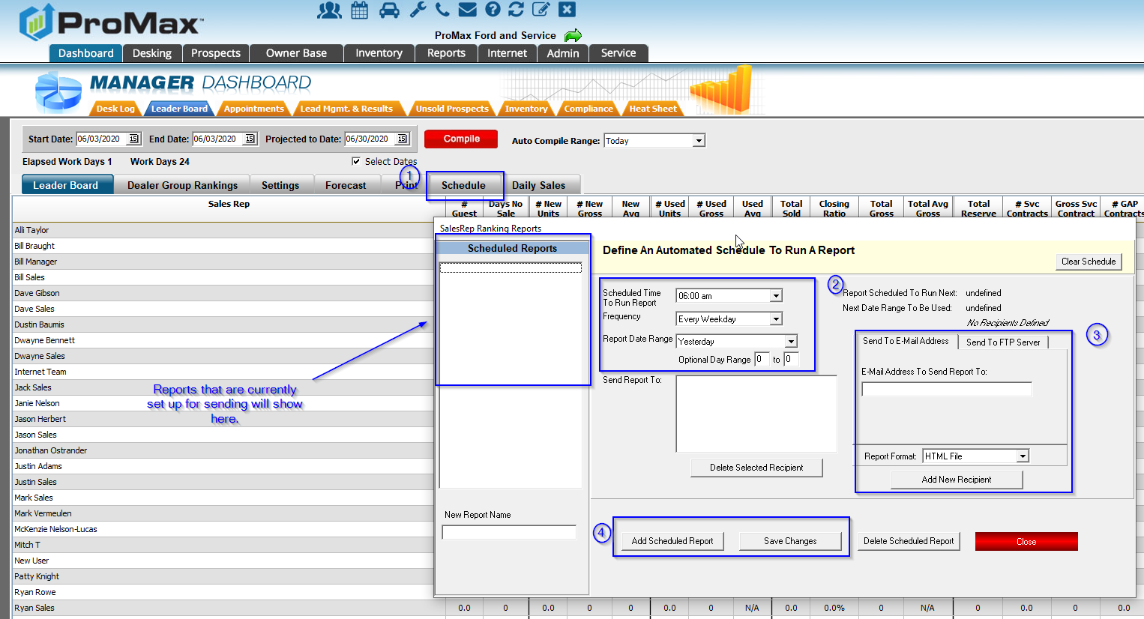
Report Schedulers
For our pre-made reports, setting up the scheduler is a little bit different. When you are on the report, click on the schedule tab or button, then you will see the same scheduler option as you see in the report scheduler.

Slide 14
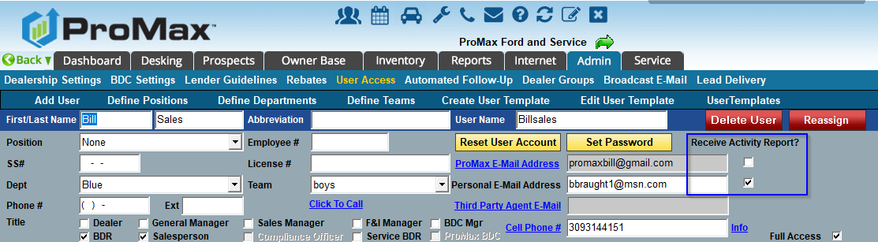
Report Scheduler
There is a Credit Bureau activity Report that can be set up to send automatically. This one is in a unique place – the User’s access screen.
Admin > User Access > User’s Name. check the box for “Receive Activity Report?” for whatever email address you’d like this delivered to.

Slide 15
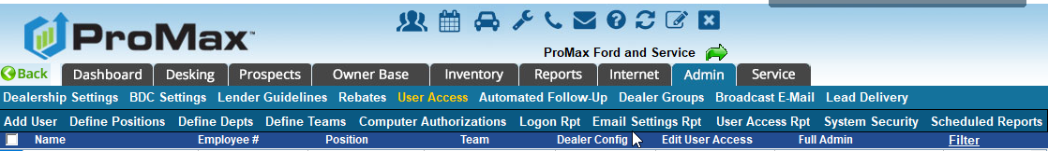
Report Schedulers
To see all automated reports that are sending from your system, go to Admin > User Access Scheduled Reports.
* The activity report will not show here, but everything else will.

Slide 16
ProMax BDC
Put our BDC to work for you. We are flexible with our offerings. We can provide all your BDC needs or compliment your existing team.

Slide 17
Promax BDC
We can help you follow up with the increase in leads that came in through the shutdowns
Treat us as an extension of your dealership – we will help as much or little as you prefer
All contact attempts and notes are added directly into your Promax system
At least 10 contacts per lead worked, but after the lead is engaged we will work until the appointment is set or the lead is dead
If you have an existing BDC, consider having us work your Trade Alerts, a particular lead source, or instead of hiring a new addition add our BDC into the rotation
Cadence is customizable, but generally front heavy with follow up for 14 days

Slide 18
Promax BDC - What You Get
13 reps, team leads, and a BDC Manager
Bilingual staff
Monday – Friday 7am – 8pm Central, Saturday 8am – 5pm Central
Average length of employment is 3 years
Average Contact Time of 7 minutes
After Hour Support to stop the clock on generic and OEM leads
OEM Leads – Guarantee a 5 minute response time
On average we contact 40-60% of leads (variance is due to squeeze page leads), set appointments on 50% of those contacts, and have 50% of those appointments show.
  100 leads ($1,250): 50 contacts, 25 appts, 12 shows = 6 sales ($2,000/copy = $12,000 ) ROI over $10,000!

Slide 19
Questions?
Contact our Dealer Support Line at 844-322-9034
Contact me directly at 563-344-7618 or Trista@ProMaxUnlimited.com
PromaxUnlimited.com
Facebook.com/ProMaxUnlimited
Twitter.com/ProMaxUnlimited
LinkedIn.com/Company/ProMax-Automotive-Software/
DealerUpdates.TypePad.com/Blog/

