Slide 1
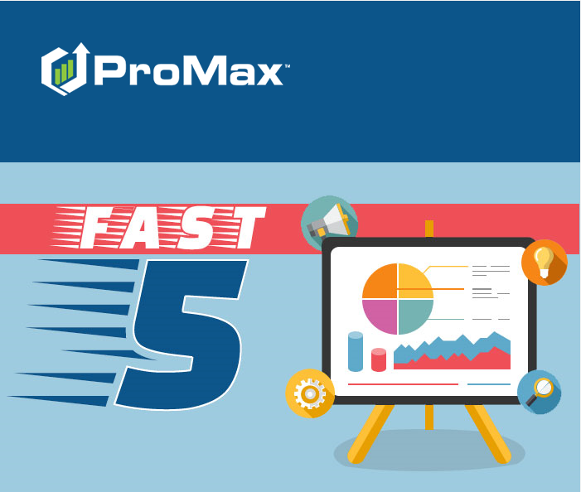
JULY

Slide 2
Agenda
CarFax Integration
Setting Appointments
BDC Settings – Change Log
ProMax BDC
Adding Motorcycles into Inventory

Slide 3
CarFax Integration

Slide 4
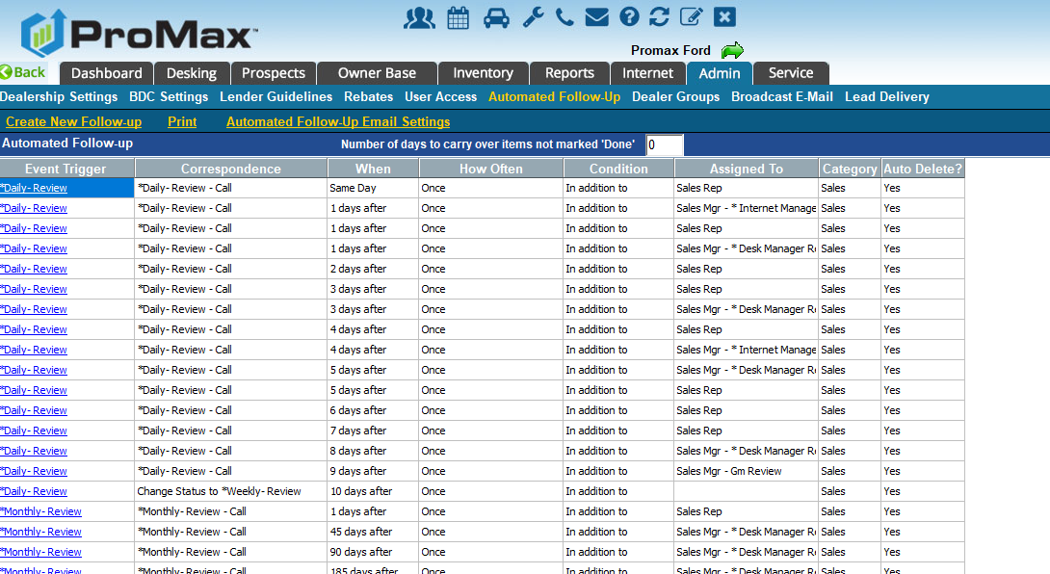
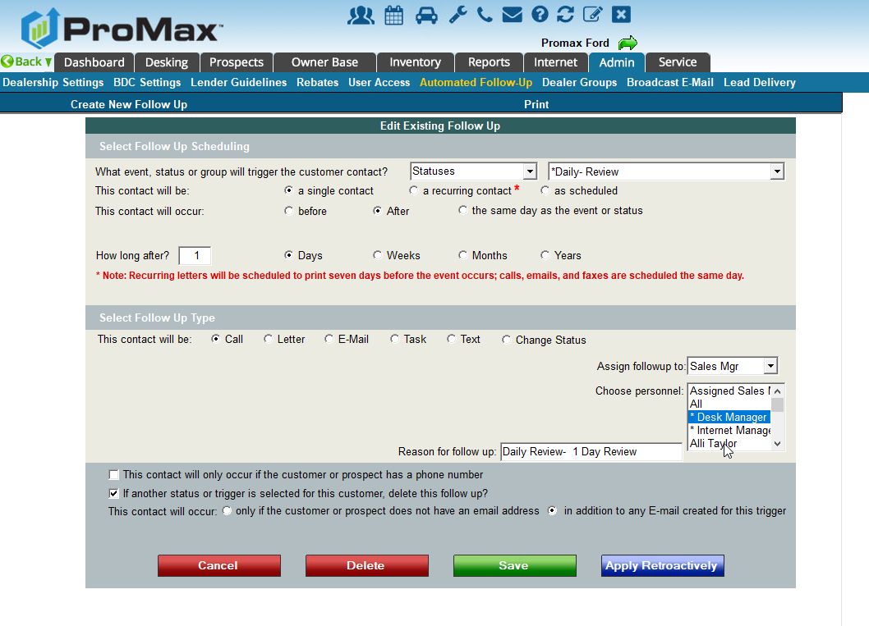
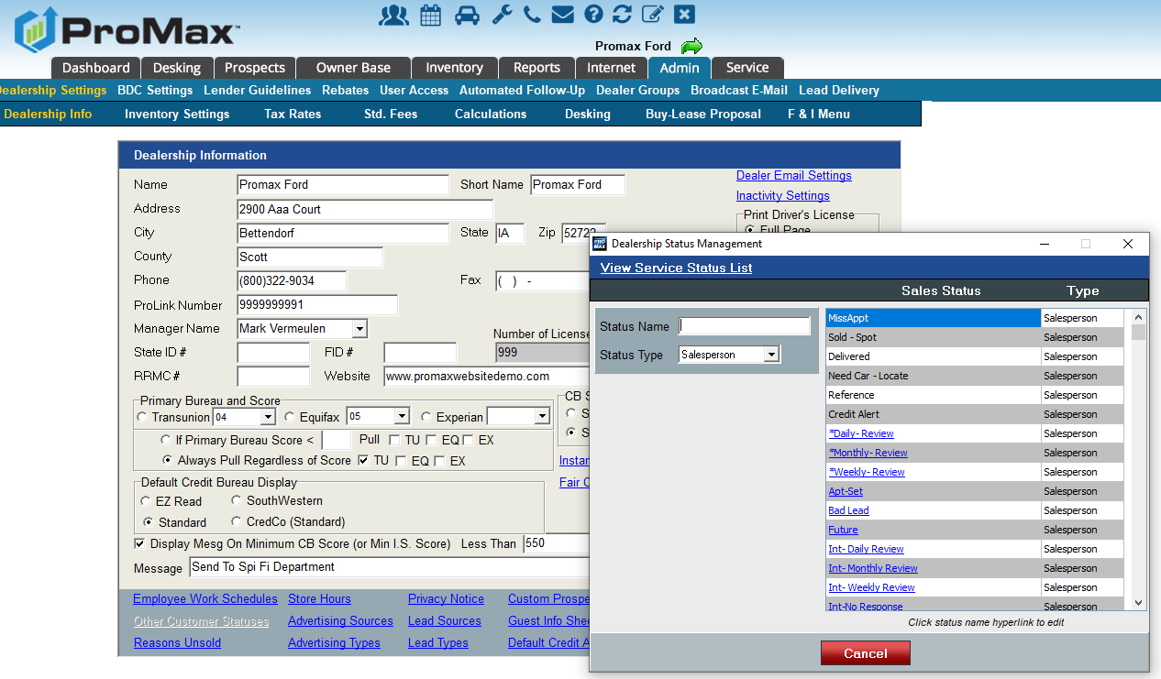
Automated Follow Up
When setting up your follow up cadences in ProMax, you can trigger these to flow from events or statuses.
To create statuses, go to Admin > Dealership settings > Custom Statuses
To create or edit follow up, go to Admin > Automated Follow Up
To set up emails to automatically send, go to Admin > Automated Follow Up > Automated Follow Up Email Settings

Slide 5
Salesperson Daily Work Plan
This is where the cadences that are set up in automated follow up will flow to the person that is scheduled to complete them.

Slide 6
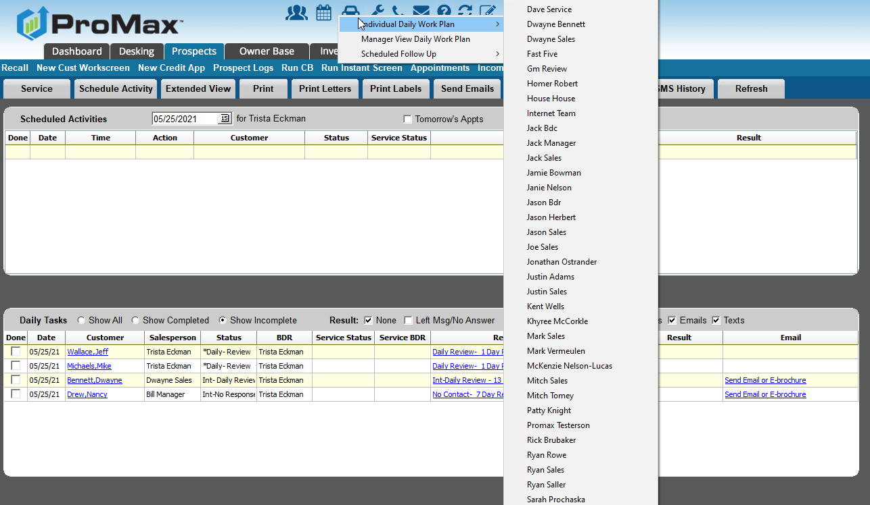
Salesperson DWP
To access your Daily Work Plan, go to the calendar icon at the top of the screen, individual daily work plan, choose your name
In the workplan, click on reason to complete your task.

Slide 7
Manager Daily Work Plan
Managers can use work plans in ProMax to manage their customer interactions as well. You can use it just like a salesrep does, or set up shared manager buckets to ensure your staff is completing the tasks you scheduled for them.

Slide 8
Manager Daily Work Plan
Manager buckets can be shared amongst the management team in order to make sure that your staff is following up with customers appropriately.
These are pho users set up in the system with automated follow up triggered to them every few days. The intention is not for you to actually call the customers for these tasks, but it is a prompt to take a look at the record and jump in if needed.
To add Manager Follow up, first add your user in Admin > User Access. Then assign follow up in Admin > Automated Follow Up every few days to trigger to the Manager Bucket.

Slide 9
Tracking Sales Rep Activity

Slide 10
Tracking Sales Rep Activity
Manager Buckets through the Daily Work Plan
Manager Dashboard
  Easily make sure customers are assigned statuses and not falling through the cracks.
  Use this for your weekly one on ones
Daily Work Plan Management Report
  Use this to see how much of their workplan are they completing
  Do they have too much on their plate? Are we following up too long? Are they trying to follow up on their own outside of the guidelines you set?
BDC Productivity Report
  Very helpful overview of all activity in the system

Slide 11
Store Traffic Report
This is our newest report in ProMax. It shows you an overview of all the traffic in your store with the ability to drill down any way you want to see or manipulate the data

Slide 12
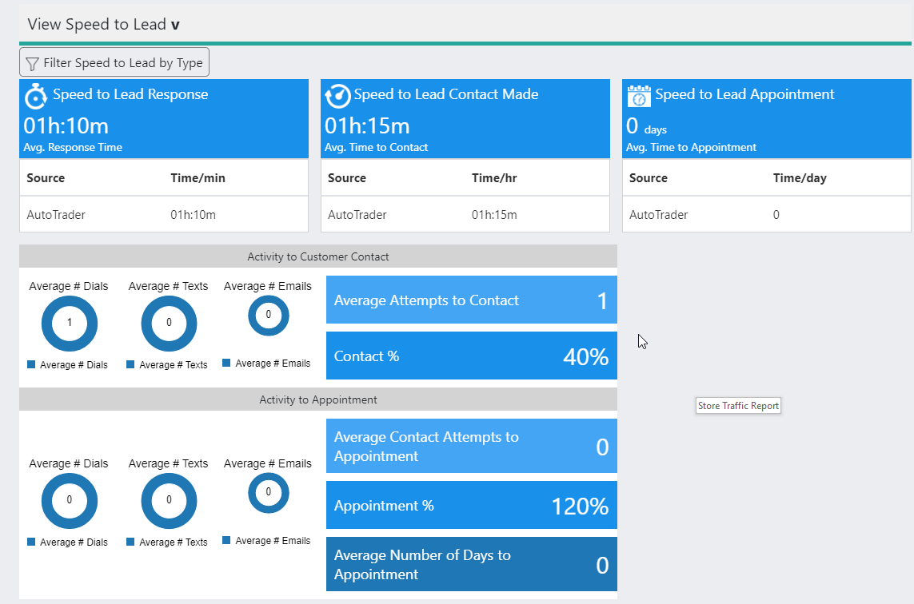
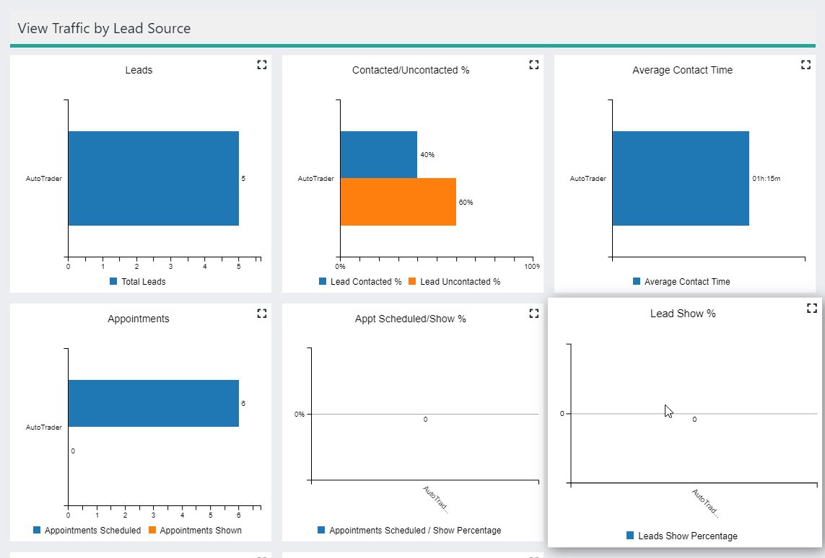
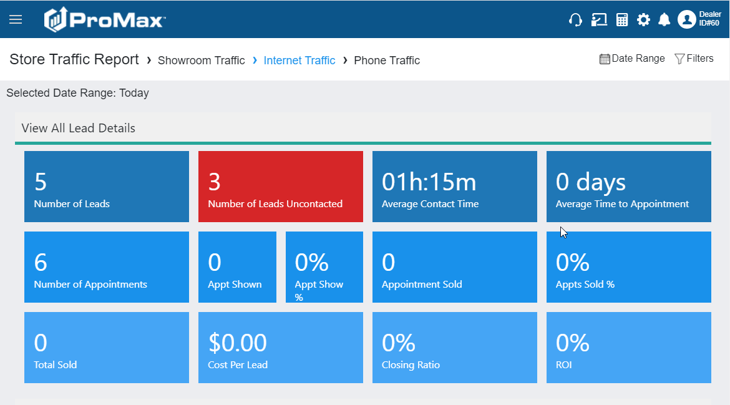
Store Traffic Report
Reports > Store Traffic Report
First choose your filters and date range
Then choose what kind of traffic you’d like to look at
The boxes and graphs will give you a high level view. Click into any of the KPIs to see a detailed breakdown.
Speed to lead is at the very bottom. Scroll down and click the arrow to compile.

Slide 13
Questions?
Contact our Dealer Support Line at 844-322-9034
Contact me directly at 563-344-7618 or Trista@ProMaxUnlimited.com
PromaxUnlimited.com
Facebook.com/ProMaxUnlimited
Twitter.com/ProMaxUnlimited
LinkedIn.com/Company/ProMax-Automotive-Software/
DealerUpdates.TypePad.com/Blog/

