Slide 1
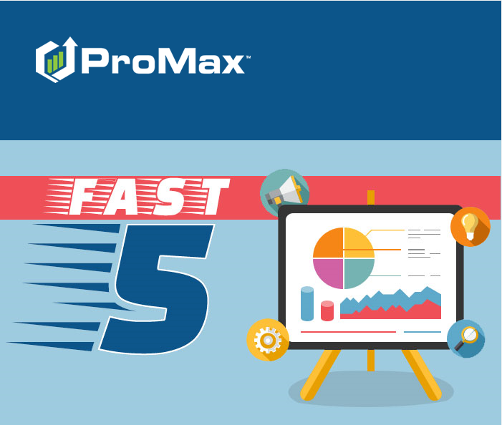
JUNE

Slide 2
Agenda
Conversica
Do Not Sell Feature
CoVideo
Email Cleanse and Append
SMS History Report

Slide 3
Conversica
Conversica is a company that uses AI to work your internet leads for you. If you already have an account with Conversica, this is one of the companies that we have a free integration with.

Slide 4
Conversica
When you are active with the Conversica Integration in Promax you can
  Set up lead delivery to indicate which leads you would like to work yourself and which ones you’d like to send to Conversica
  You can see all of the Conversica activity in the Customer Workscreen in Promax
  You can send leads to Conversica manually or stop Conversica’s interactions for the dealership to take over the follow up with the customer - all from the customer workscreen
If you are a current Conversica dealership, let us know you would like to sign up. We have an agreement to have signed, but there is no charge.
If you are not currently active with Conversica you can reach out to the Conversica VP of Sales for a demo. Please let them know that you heard about them from Promax.
  Micah Burgess
  micahb@conversica.com
  816-214-7916

Slide 5
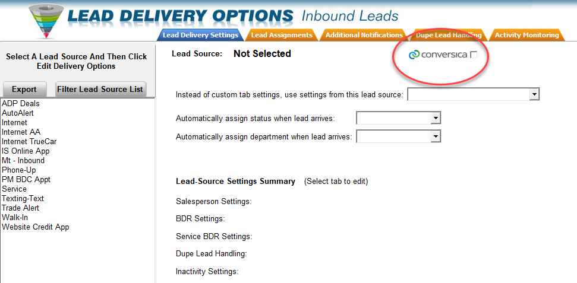
Conversica
Selecting which leads go to Conversica in Admin > Lead Delivery

Slide 6
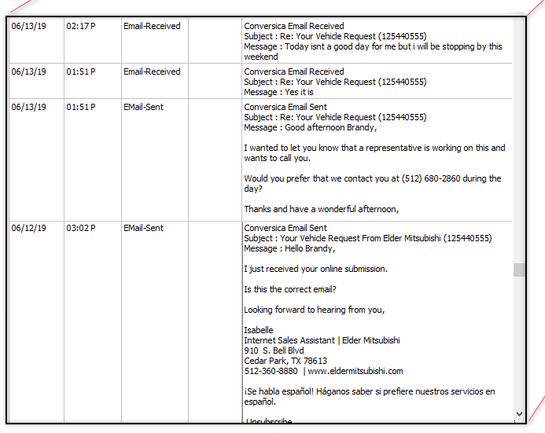
Conversica
Examples of some activities that are created in the customer workscreen from Conversica

Slide 7
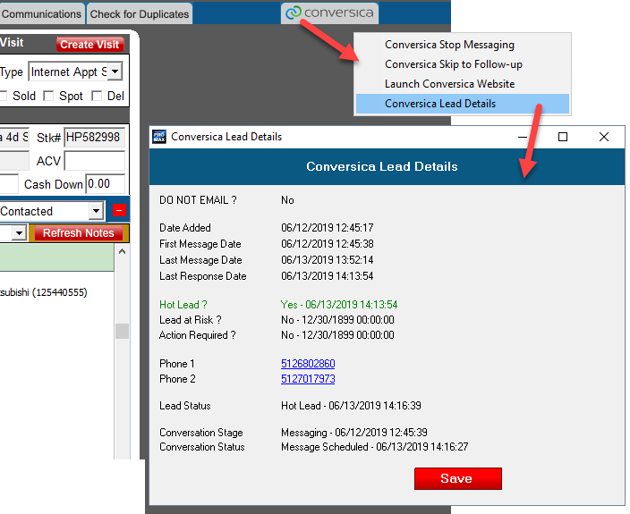
Conversica
Within the customer workscreen you can click on the Conversica tab in order to skip follow up, stop messaging, or take over a Conversica lead without having to log into the Conversica system.

Slide 8
SMS History Report
This report will show you all of the texts coming in and out of your system.

Slide 9
SMS History Report
You can find this report under Reports > SMS History Report. This report will open up for you in your default web browser and is also accessible from the Promax Mobile App.
From the advanced filter option you will be able to customize what kind of messages you would like to see.
Some new additions to this report are the Event Type, Description, and Error Code columns. Since texting is now a primary source of communication for so many people, regulations are being increased by the government and the carriers. These additional columns will help you improve your deliverability rates by giving you the tools to update and review your sending practices and snippets on a regular basis.
Another new addition to this report is the ability to see a summary of the details in graph form to help you more easily identify trends and patterns.

Slide 10
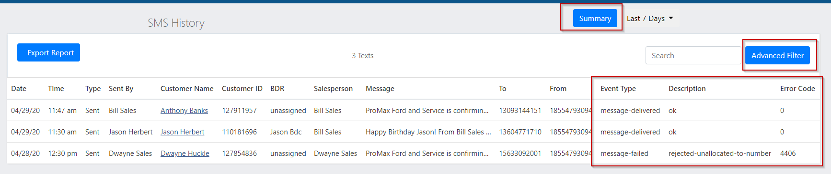
SMS History Report

Slide 11
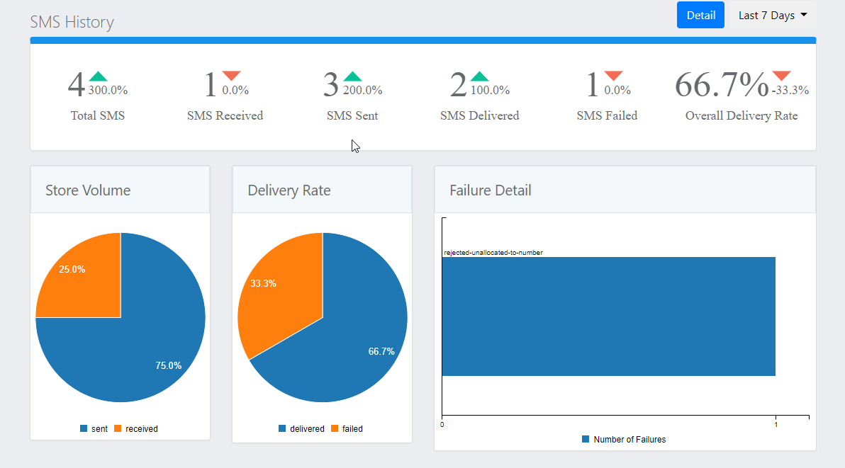
SMS History Report
The comparisons with the arrows are comparing the same date range from the previous month.

Slide 12
SMS History Report
Rejected- Unallocated Number
  This number is a valid number, but is not assigned to a carrier because this number is not available for public consumption in North America.
Invalid Destination Address
  This message is being sent to a user that has a prepaid account, but does not have sufficient funds to receive the message.
  The phone number has been deactivated.
  The phone number is transferring to a different carrier and the change has not been completed yet.
Destination Rejected Message
  Carrier rejected the message because the number is invalid or the customer does not have the SMS service enabled.
Destination Failed
  General delivery failure. Something got in the way of delivering this message. Usually this is due to the recipient’s carrier having issues.
Delivery Receipt Expired
  The message tried to be delivered and failed. When resent several times it still could not be delivered so it timed out. This usually happens when the carrier is down or the recipient is in an area where messages cannot be received.
Here is a list of definitions for the different errors you can see in the SMS History Report

Slide 13
Do Not Sell Feature
This feature allows you to highlight customers or leads that you do not want to sell to. Some dealers like to use this feature for customers that they have had to repo from multiple times or customers that have a red flag or are trying to use someone else’s identity to purchase a car.

Slide 14
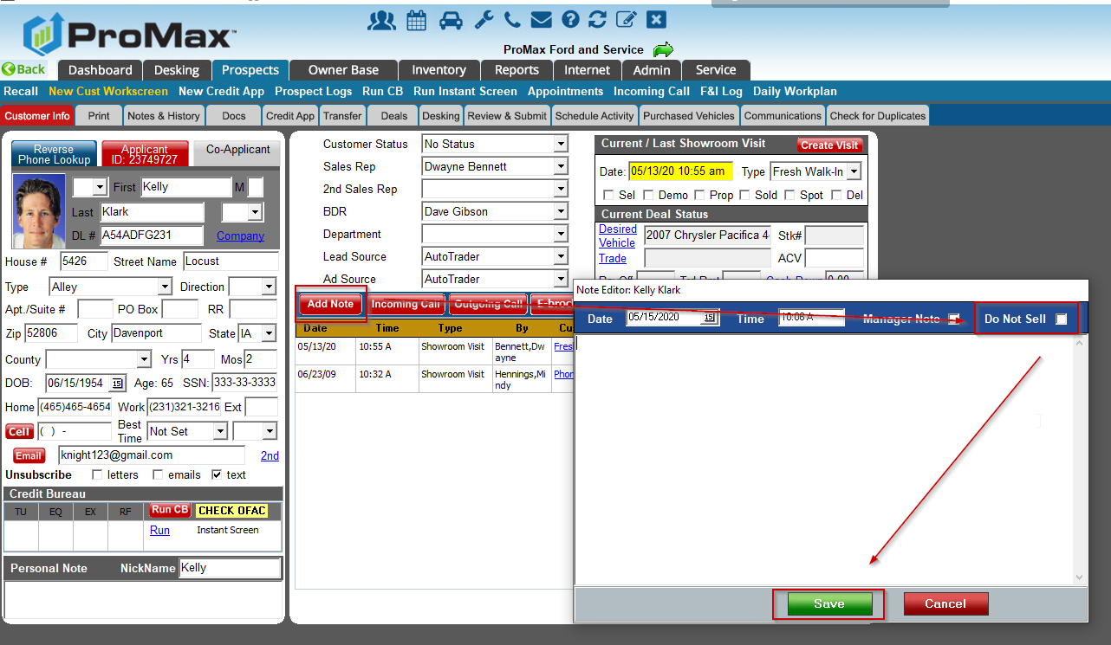
Do Not Sell
In order to mark a customer as “Do Not Sell” you will need to be marked as a manager in the system and the customer will need to have an SSN in their record.
When you are in the customer record, click on the “Add Note” button and check the box for “Do Not Sell.”

Slide 15
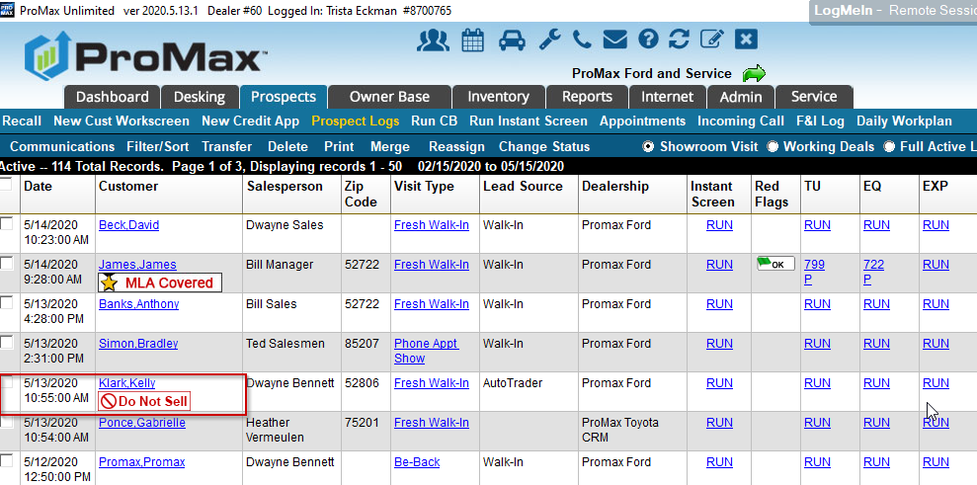
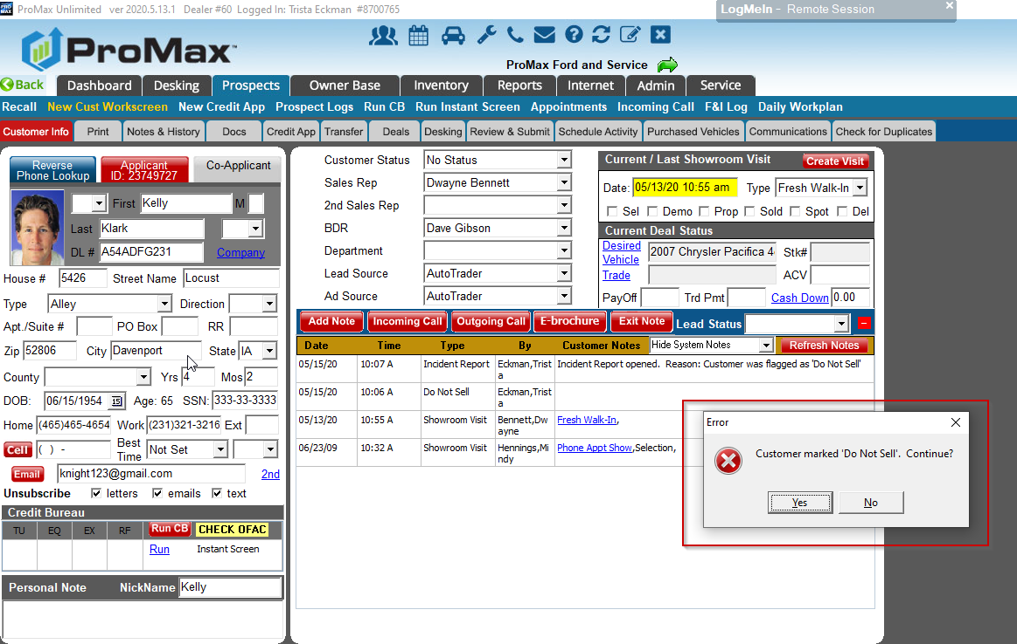
Do Not Sell
Once you have marked a customer as “Do Not Sell” Promax makes it very clear that this customer is not a lead that should be worked. It is highlighted on the Prospect log and you will receive a pop up when you enter the customer record.

Slide 16
CoVideo
CoVideo is a company that helps you send personalized video messages to your customers. If you have a CoVideo account, we have a free integration with them in Promax. There is nothing additional you have to do in Promax to have this set up, just use the links from the videos you create in CoVideo and paste and send through Promax!

Slide 17
CoVideo
https://vidmails.com/v/WPDdZ8h7Df – sending CoVideos from Promax using the Chrome extension
https://vidmails.com/v/tGdtEonfsZ – Promax integration with CoVideo

Slide 18
Email Cleanse & Append
This is a new service that we are offering to our dealers. Our email cleanse will remove bad emails and spam traps from your data base. Additionally, we can add good email addresses to your existing customer base where email addresses are currently missing.

Slide 19
Email Cleanse and Append
Why do an email cleanse?
  Improve domain reputation
  Increase open rates
  Protect your dealership from being blacklisted
What happens during an email cleanse?
  We will check all unique email addresses in your Promax site and remove any bad email addresses or spam traps from your system
  An email address could be bad because it doesn’t exist anymore or because it was entered with a typo
  Spam traps are usually email addresses that used to be accurate but are no longer being used or checked by the owner. Email providers flag anyone sending to email addresses that are not actively being checked anymore as being spammers. Emailing to spam traps diminishes your domain reputation and will eventually send you to junk folders, make your email undeliverable, or cause your domain to be blacklisted.
Why do an email append?
  Increase the number of customers you can market to through a very inexpensive marketing source – email
  On average, we can find good email addresses for 50% of customers in your system without an email address.
Best Practice would be to complete a cleanse either quarterly or annually to keep your database accurate and your domain reputation intact.

Slide 20
Email Cleanse and Append
We can offer free quotes for anyone that is interested in having a cleanse and/or append done in their system.
We are flexible with the packages/quantities we can offer. We can do certain logs only or cap the cleanse or appends to stick within a particular budget.
We also offer free scans that will tell you the number of bad emails and spam traps you currently have in your system.

Slide 21
Questions?
Contact our Dealer Support Line at 844-322-9034
Contact me directly at 563-344-7618 or Trista@ProMaxUnlimited.com
PromaxUnlimited.com
Facebook.com/ProMaxUnlimited
Twitter.com/ProMaxUnlimited
LinkedIn.com/Company/ProMax-Automotive-Software/
DealerUpdates.TypePad.com/Blog/

