Slide 1
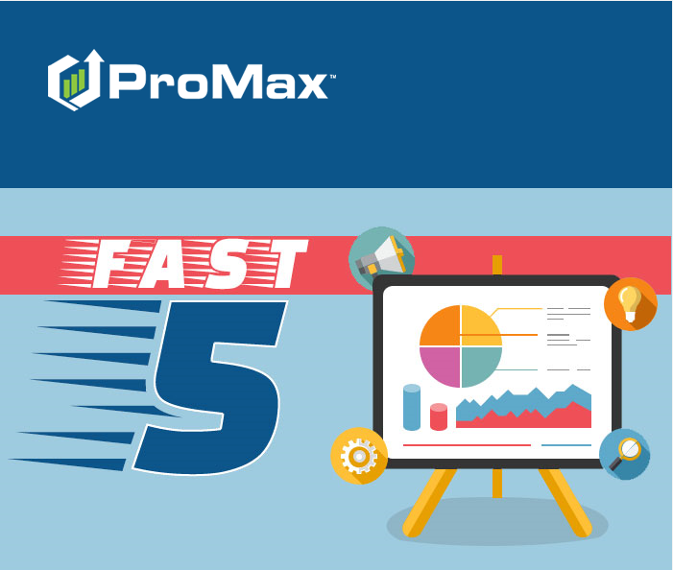
March

Slide 2
Agenda
Days in Stock Report
Adverse Action
Setting Up Security Questions
ProMax Mail Options
Risk Based Pricing

Slide 3
Days in Stock Report
This is an easy way to see if you have a similar vehicle to one that you are currently desking that is older and need to be moved off the lot.

Slide 4
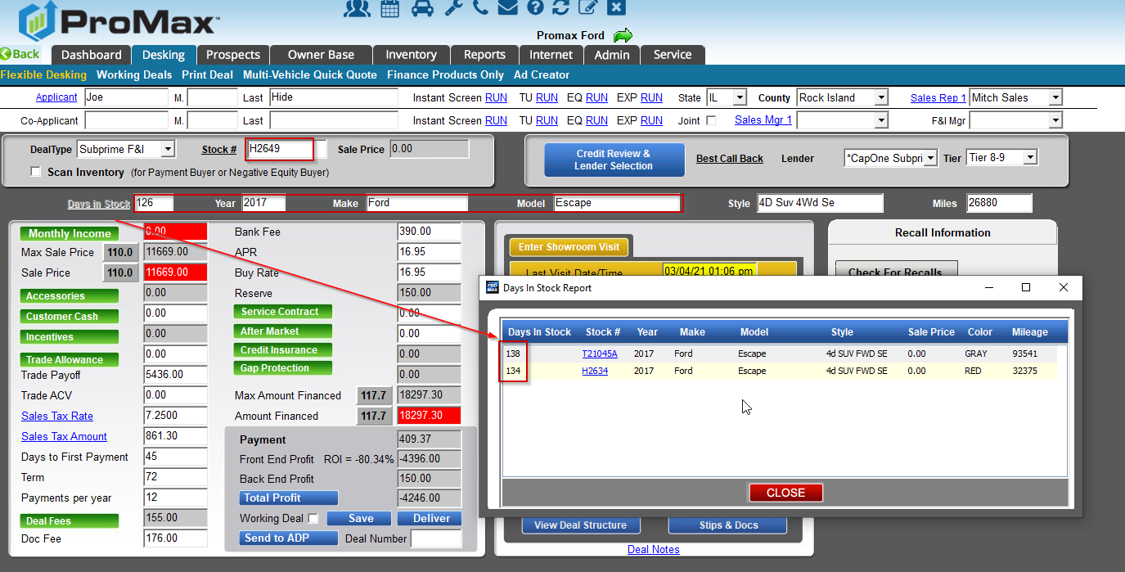
Days in Stock Report
When you are desking a deal, you can click on the “days in stock” link on the top left in order to pull up a report of similar vehicles. This way, if you have a vehicle that has a high number of days in stock that you need to move, you can make the adjustment to the deal. If you click on the stock number in the report it willupdate your deal with the new stock number for you.

Slide 5
Risk Based Pricing
We make it easy to manage your Risk Based Pricing Notices in ProMax

Slide 6
Risk Based Pricing Requirement
A Risk Based Pricing Notice shows the customer where they stand in comparison to the other adults in the United States regarding their credit score. It also proides the consumer with resources for credit counseling.
A Risk Based Pricing Notice must be given to every customer that has had a credit bureau pulled on them.
If you pull the bureau, you must provide the notice. You cannot rely on the bank. The bank’s inquiry is a separate instance requiring an additional notice.
Best practice is to print this and give it to the customer the same day that the bureau was pulled. However, some lawyers say that you have 30 days to complete this. You should check with a lawyer in your state before taking longer than 1 day to provide this notice to the customer.

Slide 7
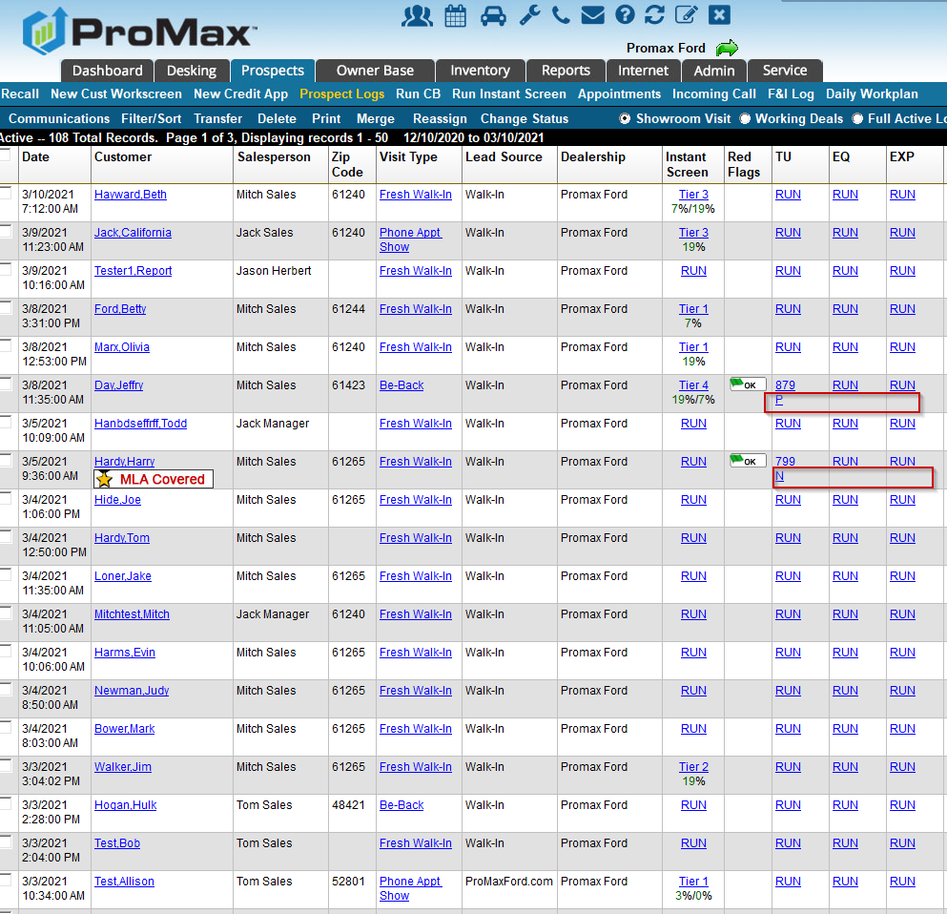
Risk Based Pricing
When you are in the Prospect Log you can easily see what customers need to have their notices printed. Underneath the credit score you will see an N, M, or P.
N= not printed
P = Printed
M = Mailed by ProMax (This will only happen if you are signed up for our fail safe)

Slide 8
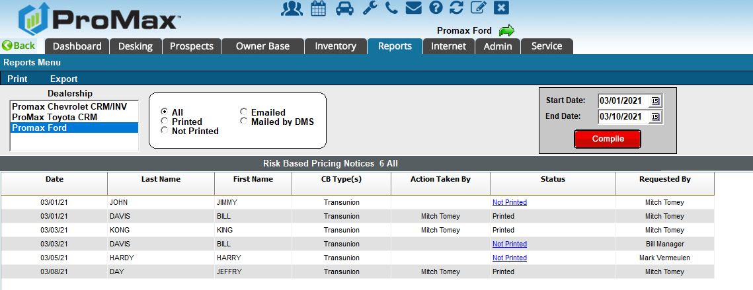
Risk Based Pricing
If you go to Reports > Risk Based Pricing Report you are able to easily see who printed notices and print the missing notices. This will also highlight if there is a particular manager that may need some training on this process.

Slide 9
Risk Based Pricing
If you were to be audited by the FTC for Risk Based Pricing Notices not being delivered to customers you can be fined $4,111 per occurrence. There is also possible jail time. Not adhering to this regulation has put dealers out of business before as well as landed Dealer Principals in jail.
We offer a fail safe service for this regulation. When dealers sign up, we will print any missed Risk Based Pricing Notices for them and mail them to the customer on their behalf. We only charge for the letters we mail and we will only print the notices that were not already printed by the dealership.

Slide 10
Adverse Action
We make it easy to manage your Adverse Action Notices in ProMax

Slide 11
Adverse Action
This requirement comes from the Fair Credit Reporting Act
With the Adverse Action rule, you must deliver a declined letter to anyone that you made an adverse credit decision for. Specifically this would be a denial or revocation of credit, a refusal to grant credit in the amount or terms requested, or a negative change in terms due to an unfavorable review of the consumer’s credit history.
There are two kinds of letters that you can print in ProMax – the standard Adverse Action Decline letter and the Incomplete Application letter
Because it takes time to make credit decisions and acquire all the information needed to make a credit decision these notices do not need to be delivered to the customers until either 7 days after you start gathering non public information on them or before 14 days have passed.

Slide 12
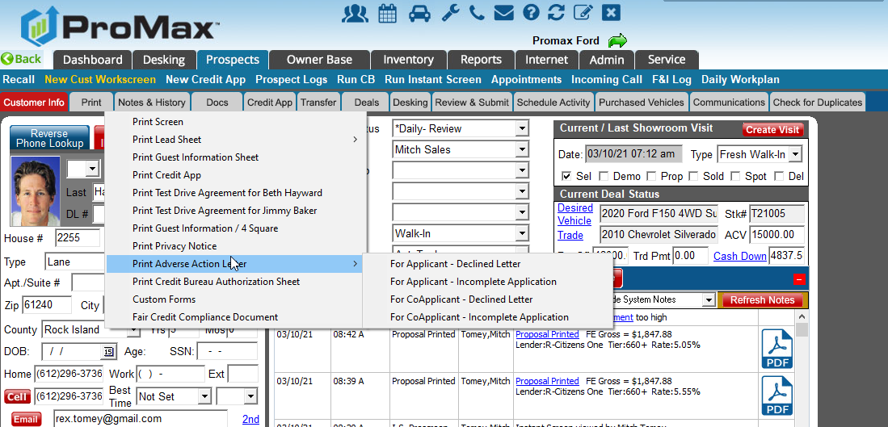
Adverse Action
In ProMax you can print the Adverse Action letters from the customer workscreen’s print tab. Don’t forget to print the co app’s notice when applicable as well.

Slide 13
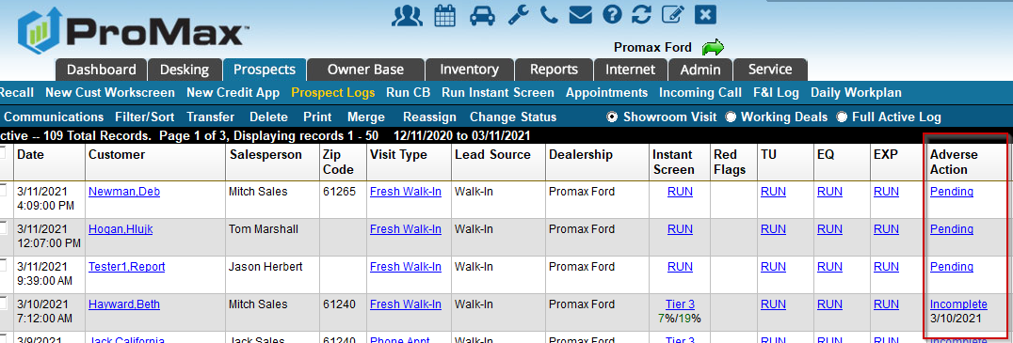
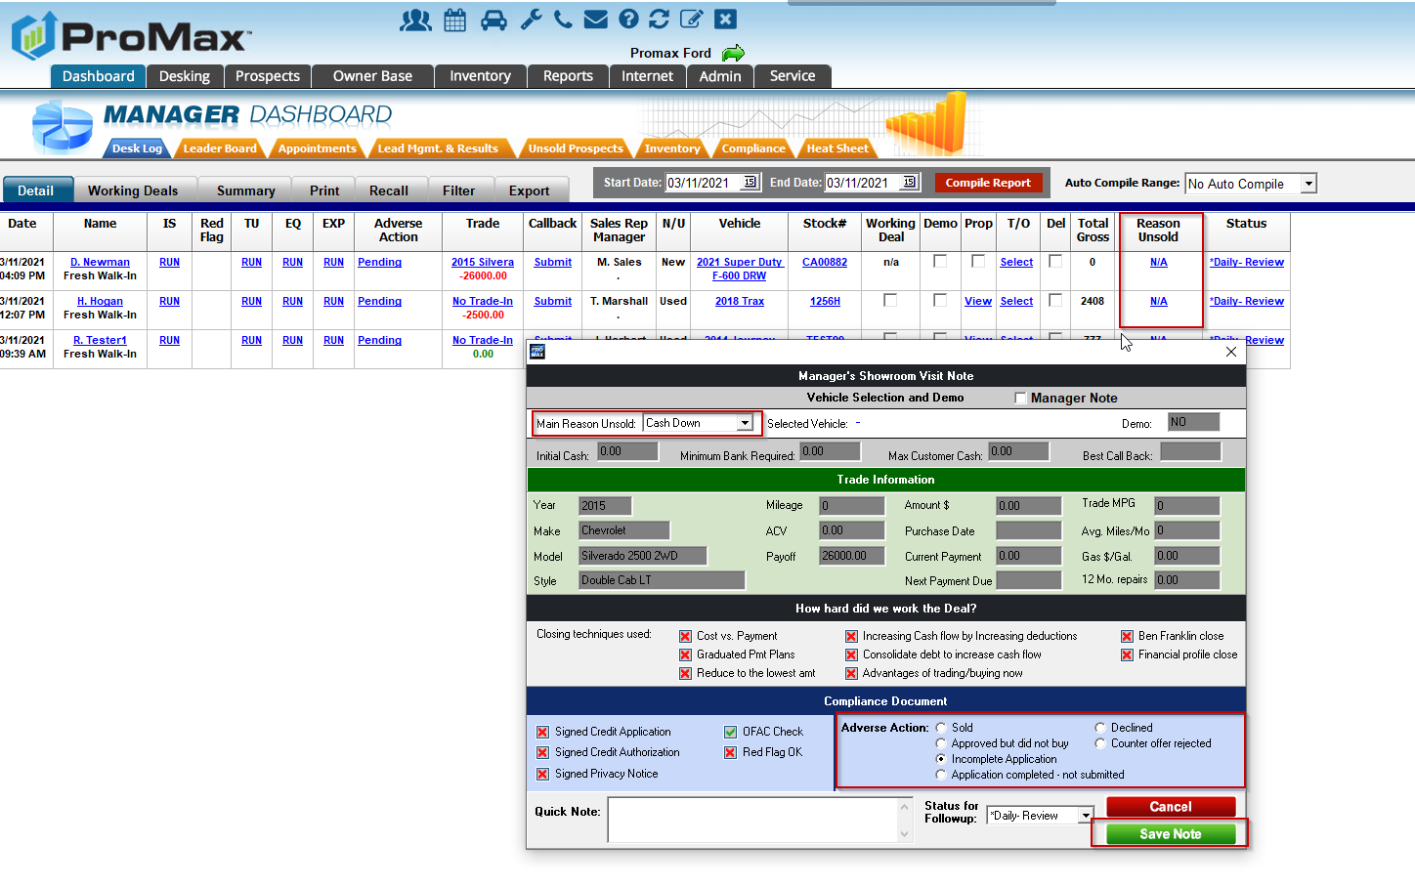
Adverse Action
In order to make sure your customer is in the correct Adverse Action status you can update this in the exit note or in the Adverse Action column on the Prospect Log.

Slide 14
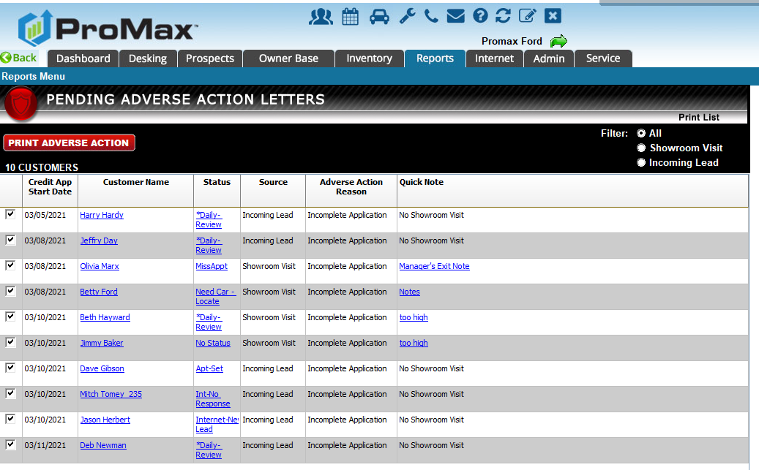
Adverse Action
Here are the different Adverse Action Statuses and the letter they trigger:
No Letter: sold or Approved but did not buy
Incomplete Letter: Incomplete Application
Decline Letter: Application completed – not submitted, Declined, Counter offer rejected
To print your letters in bulk go to Reports > Pending Adverse Action
For the fail safe we will only print customers that were on the report for AT LEAST 7 days. So, if you review and update once/week no one will the receive the letter in error.

Slide 15
Setting Up Security Questions
This is an important step to complete so that you can reset your password without assistance if you ever lock yourself out.

Slide 16
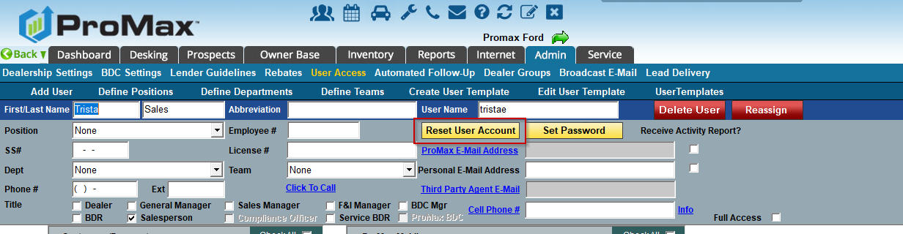
Setting up Security Questions
If you do not already have your security settings set up, you will be prompted to set them up each time you log into ProMax. Follow the instructions on the screen to walk you through the set up process. Once this is set up you will be able to use the “Forgot Password” link if you ever need it.
If you have a user that wants to re- set up their security settings, you can reset their user account in Admin > User Access to force this to pop up again.

Slide 17
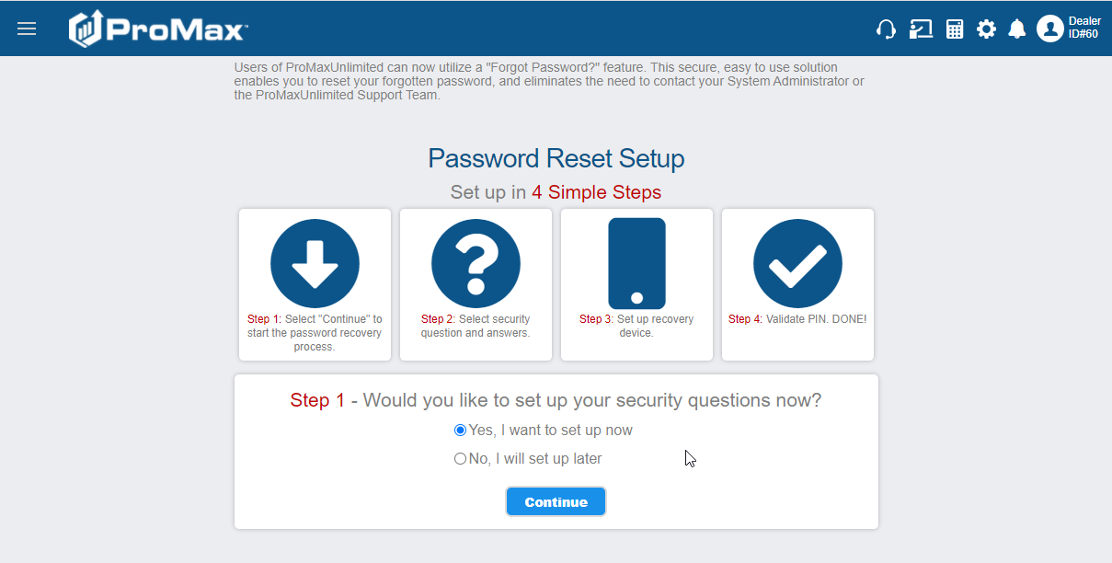
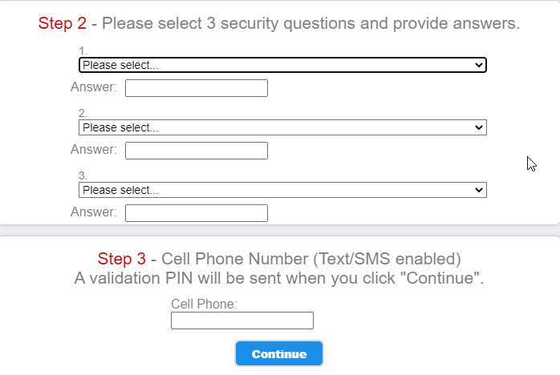
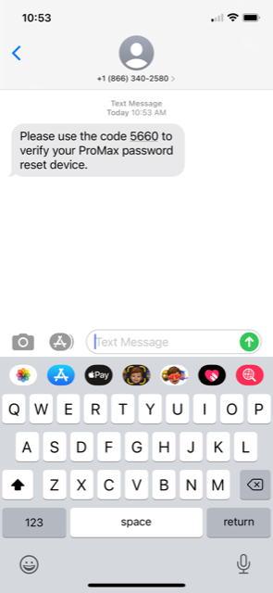
Setting Up Security Questions

Slide 18
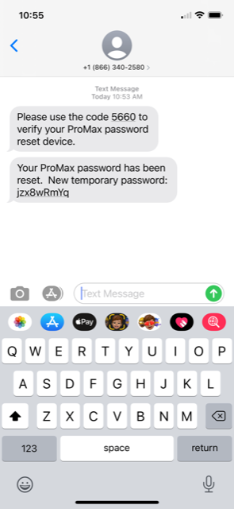
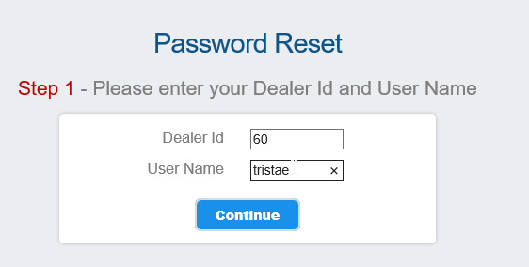
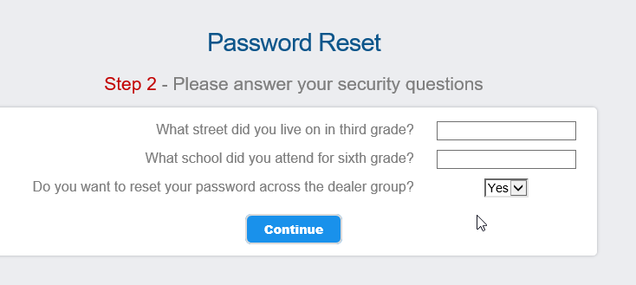
Using the “Forgot Password” option to reset

Slide 19
ProMax Mail Options
We have many different physical mail options for our Dealerships. Here are some examples.

Slide 20
Direct Mail Options
Vehicle Buyback or Auto loan preapproval credit card mailers through TU or Equifax
Highly effective and professionally designed
Can use your own data or we can prospect for you
Incredibly robust and accurate data criteria so you can target the exact consumer you can finance
Backed by a national lender and include firm offer of credit

Slide 21
Buy Back Letter
With the cost of new inventory so high at the auction, what better way to stock your lot and get some car deals in the process!

Slide 22
Market Thief (Trigger Lead)
Each day we purchase names directly from the credit bureau of consumers who had their credit pulled for the purpose of an auto loan the prior day. This service is exclusive, meaning we will only sign up 1 dealer per market
That consumer list is then scrubbed against the DNC to try and obtain as many phone numbers as possible. Any consumer that does have a phone # will be sent to your CRM daily. Remember, these #s could be bad and are only provided as a bonus. This program’s success comes primarily from the preapproval letter being sent on your behalf.
Every consumer is sent a preapproval letter on behalf of your dealership that is backed by a national lender.
Consumer can either go online and enter their PIN for a preapproval or call your dealership live so you can set an appointment. Any lead that responds by going to the website is sent to your CRM in real time as a Market Thief HOT lead

Slide 23
Questions?
Contact our Dealer Support Line at 844-322-9034
Contact me directly at 563-344-7618 or Trista@ProMaxUnlimited.com
PromaxUnlimited.com
Facebook.com/ProMaxUnlimited
Twitter.com/ProMaxUnlimited
LinkedIn.com/Company/ProMax-Automotive-Software/
DealerUpdates.TypePad.com/Blog/

