Slide 1
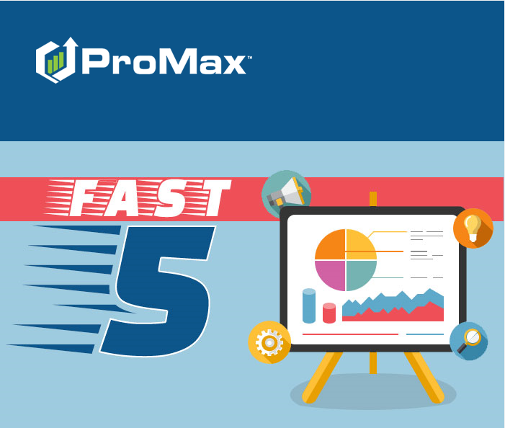
MAY

Slide 2
Agenda
Auto Responders
Ebrochures
IP Restrictions
Recall Check
Lead Delivery

Slide 3
Auto Responders
You may have recently turned off or edited your Auto Responders in order to change your messaging for the state wide shut downs. Once you reopen for business you will want to be sure to get these updated again.

Slide 4
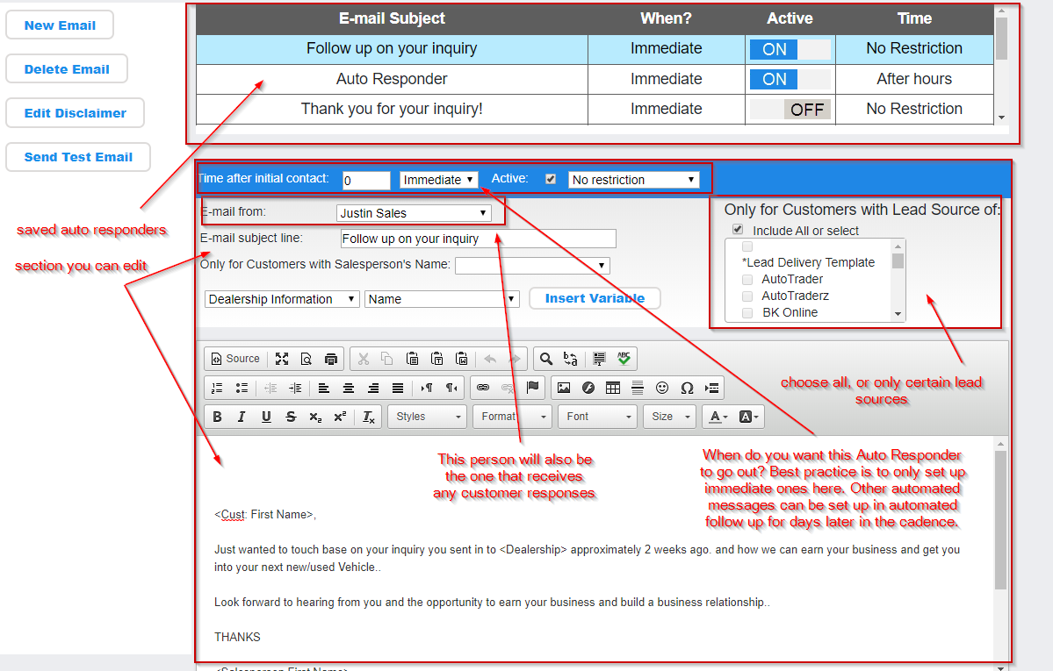
Auto Responders
Admin > Broadcast Email > Internet Lead Auto Responder Config.
A new browser window will pop up. All of your saved auto responders will be on top. You will be able to see if they are active or not from the toggle to the right of the name. Click into the Auto Responder to view or edit or hit “New Email” in order to create a new one

Slide 5
Lead Delivery
This is how you can auto assign leads as they come in, set up notifications to go out, and tell Promax how you want to handle duplicate leads.

Slide 6
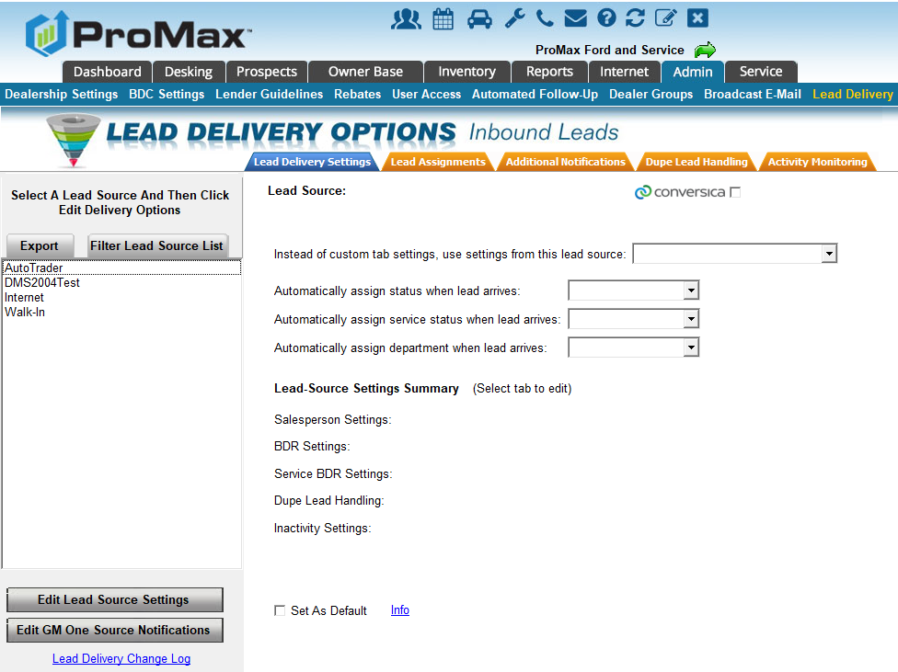
Lead Delivery
Admin > Lead Delivery > Lead Source > Edit Lead Source Settings.
You can go through each of the orange tabs at the top to customize the rules for this lead source. Hit save when complete.
First Tab: Lead Delivery Settings
This gives you an overview of what is happening with the lead source. You can also copy the settings from another lead source, set up this lead source with the Conversica integration, automatically assign the lead to a certain follow up cadence, service follow up cadence, and department.

Slide 7
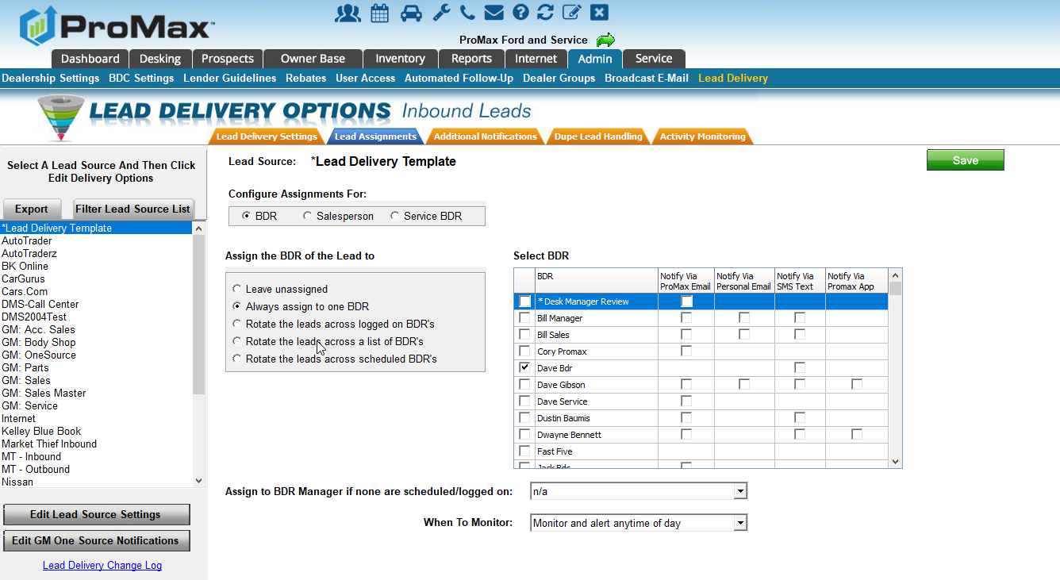
Lead Delivery
Second Tab: Lead Assignments
Use the radial buttons on the top left to choose the position you’d like to view or edit assignments for. You can choose assignments for BDR, Sales Person, and Service Advisor.
Leave unassigned – when the lead comes in, it will not be assigned to anyone
Assign to one BDR/Salesrep – each lead that comes in for this source will always be assigned to this person
Rotate across logged on – you can only get a lead if you are logged into the system. If no one is logged in at the time a lead comes in you have the ability to assign these leads to a manager.
Rotate across a list – It will always assign in a list as the leads come in.
Rotate across schedule – It will assign based on if you are scheduled that day in Admin > Dealership Settings> Employee Work Schedules
Choose the individuals that you would like to assign to in the list. Check the box to the left of their name to assign them. Choose the boxes to the right to set up notifications. These notifications will only go out for leads that are assigned to them. If an employee is missing a boix for notifications it will need to be added in Admin > User Access > User’s Profile

Slide 8
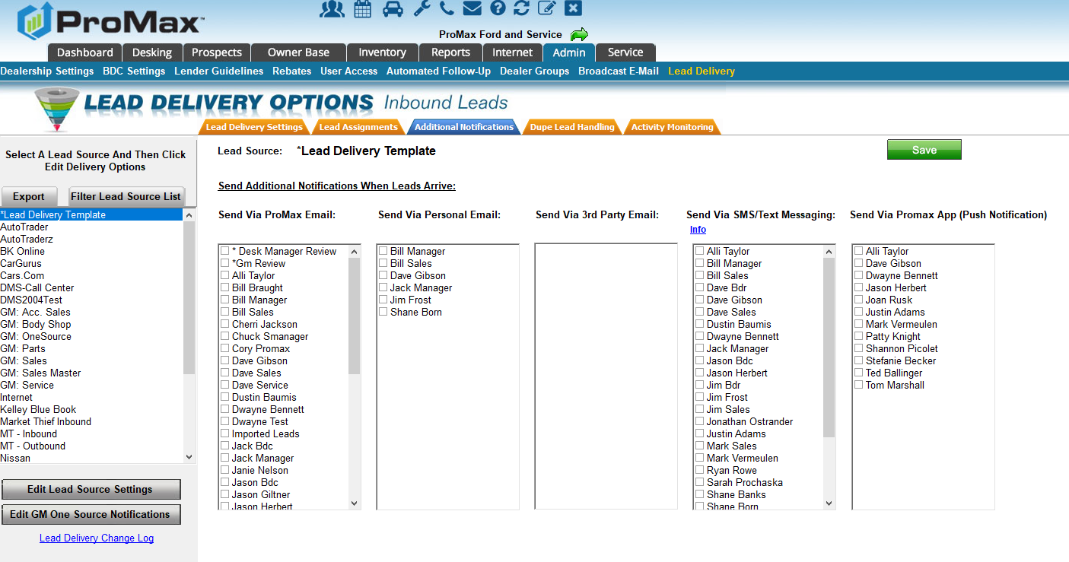
Lead Delivery
Third Tab: Additional Notifications
On the previous tab you were able to set up notification to be sent to the individual that was assigned to the lead. On this tab you have the ability to also notify manager or other staff members of lead as they are coming in regardless of who they are assigned to.
In order to have a name show up in each of these sections, the corresponding information will need to be entered in the user’s profile (Admin > User Access > User’s Name).
In order for someone’s name to show up in the push notifications section, the user will just need to have logged into the Promax app once.

Slide 9
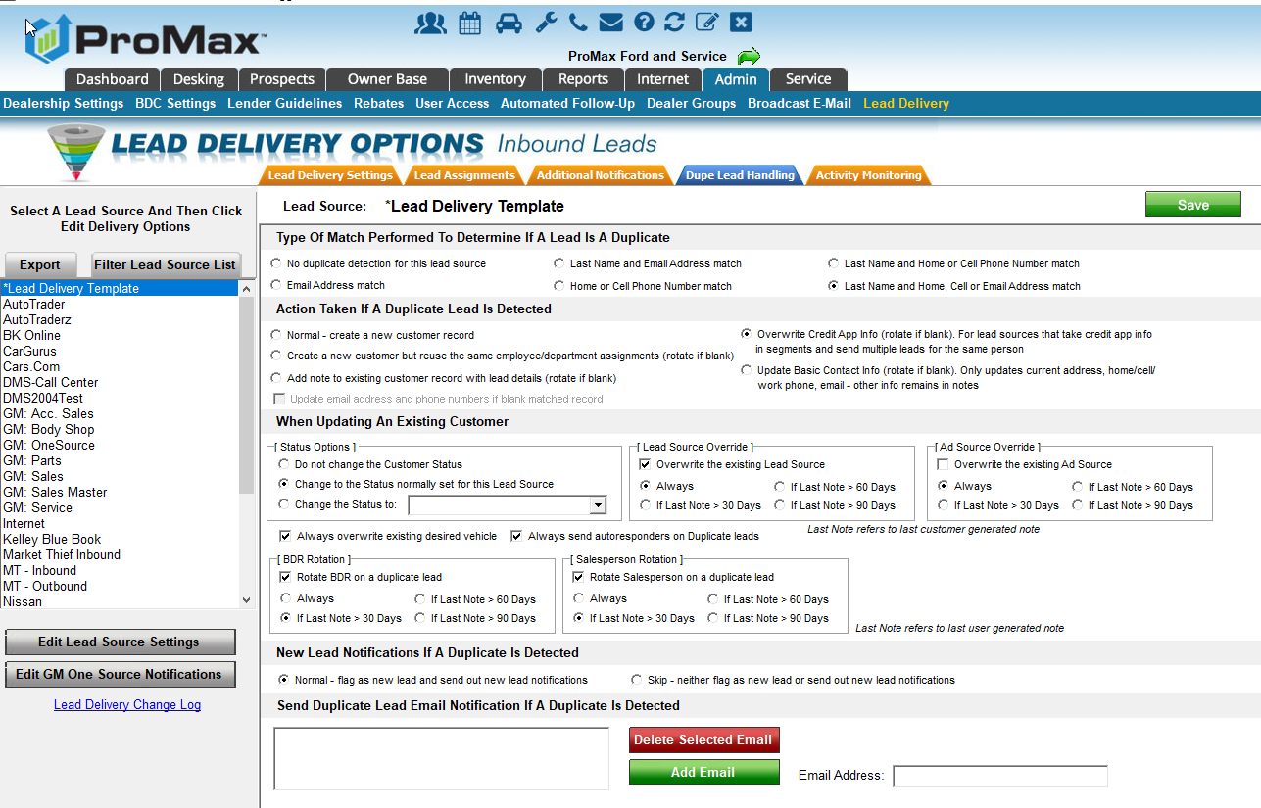
Lead Delivery
Fourth Tab: Dupe Lead Handling
Choose how you want Promax to determine if a lead is a duplicate. Our recommendation is to use “Home or Cell Phone number match” for Call manager leads and “Last name and home, cell, or email address” for internet leads.
Choose what you would like Promax to do when a duplicate is found. Our most popular option is to overwrite the credit app info.
Make any updates to the record for duplicate leads – change the status, lead source, or ad source if you want to. Adjust autoresponders and auto assignments.
New Lead Notifications – always keep this to normal so that you are notified of all dupe leads. Sometimes, the dupe could be from several years ago.

Slide 10
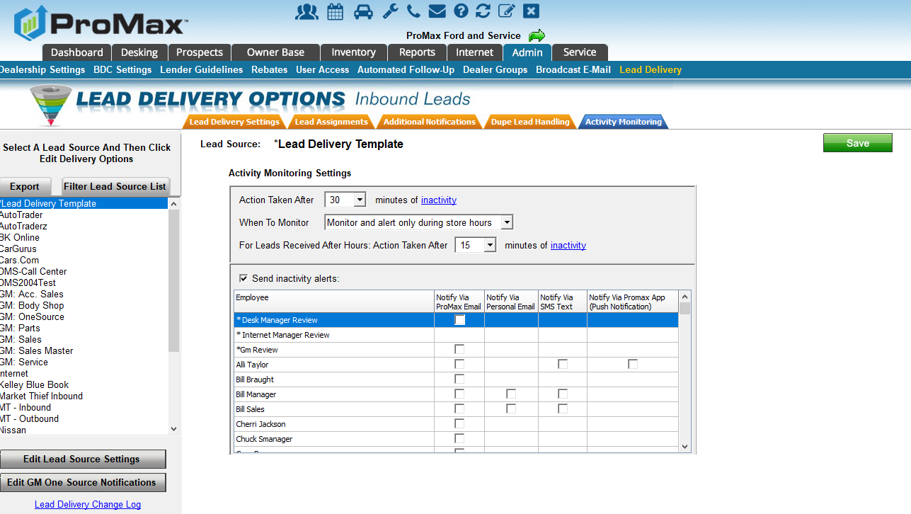
Lead Delivery
Final Tab: Activity Monitoring
This is where you can set up the notifications for leads that are not being worked within a certain time frame.
Choose when you want the alerts (ie: after 30 minutes of inactivity) and who the notifications should go to.
If there is a notification method that is not showing with a box for a particular user that will need to be adjusted in their user profile under Admin > User Access > User’s Name. For the Push Notifications they will just need to log into the app once in order for that option to display.

Slide 11
Ebrochures
An easy way to send out an attractive brochure with up to 4 vehicle options

Slide 12
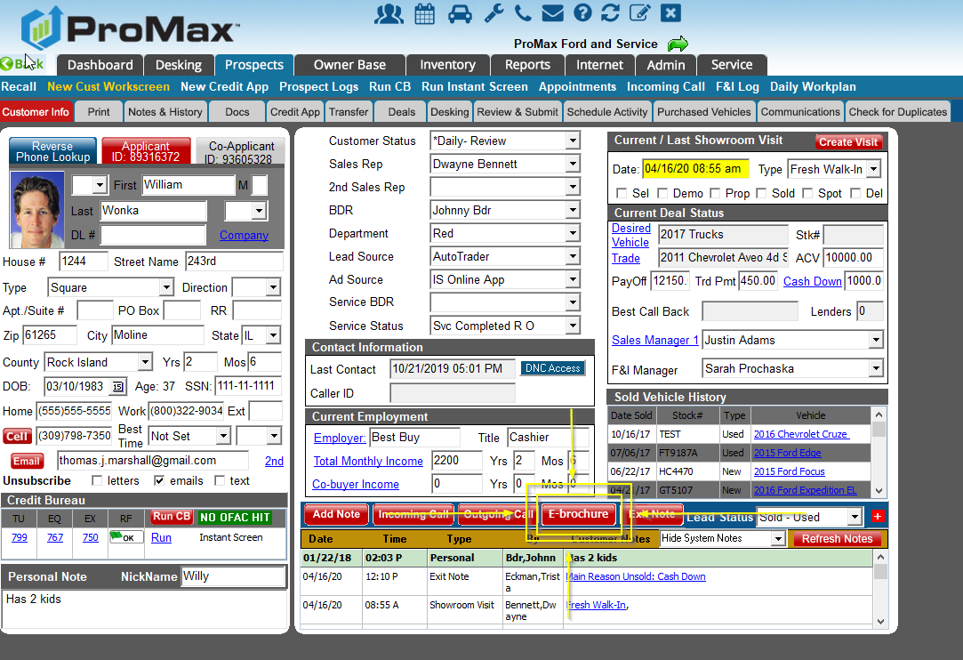
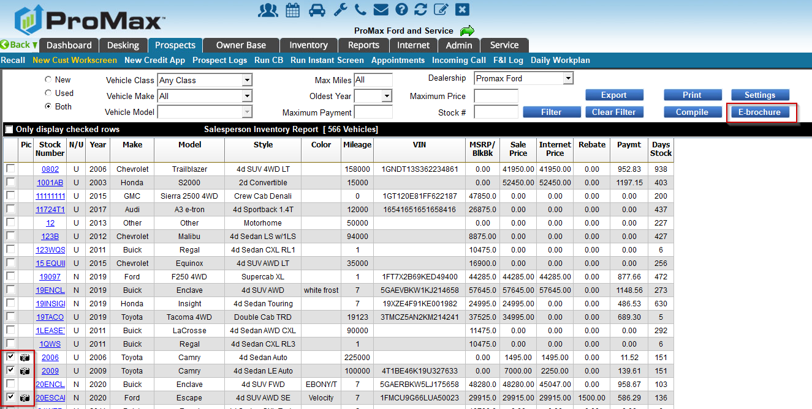
Ebrochures
From a customer workscreen click on “Ebrochure” above the notes section. Choose Salesperson Inventory. If the customer has a desired vehicle, that stock number will already be selected. You can choose up to 3 additional vehicles to display to the customer as well. Once your vehicles are selected, choose the blue Ebrochure button in the top right.

Slide 13
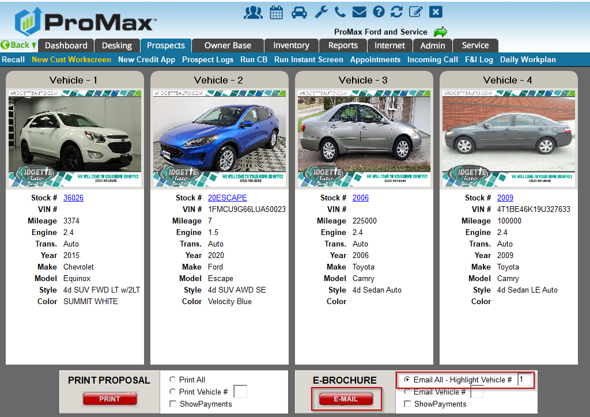
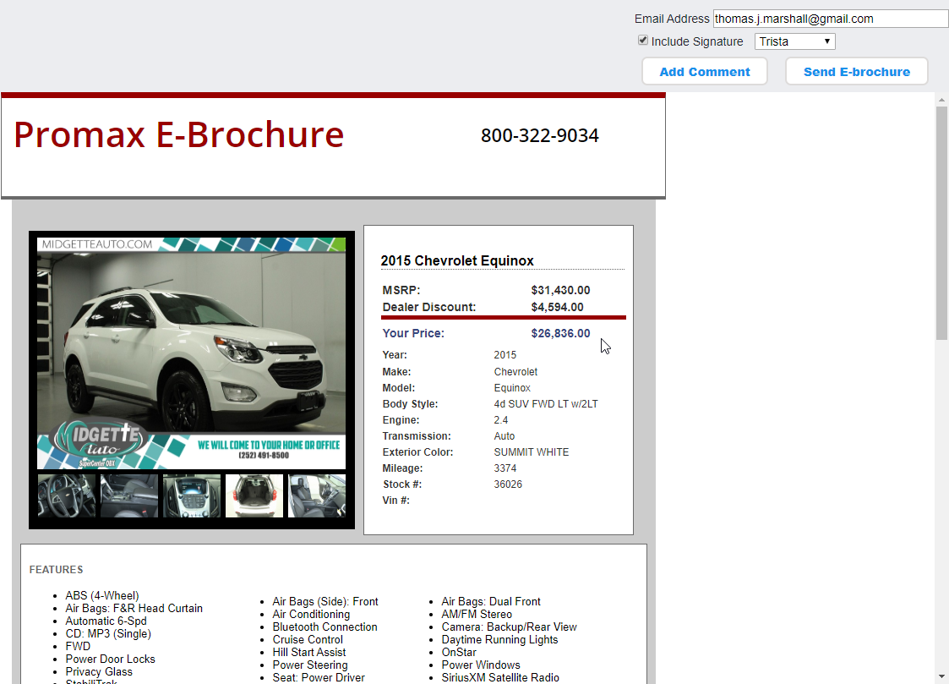
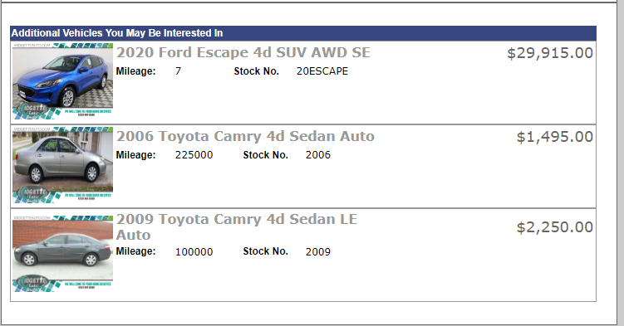
Ebrochures
You will first see the preview screen where you can choose which vehicle you would like to highlight. Once you hit email you will be able to view the preview before hitting send.

Slide 14
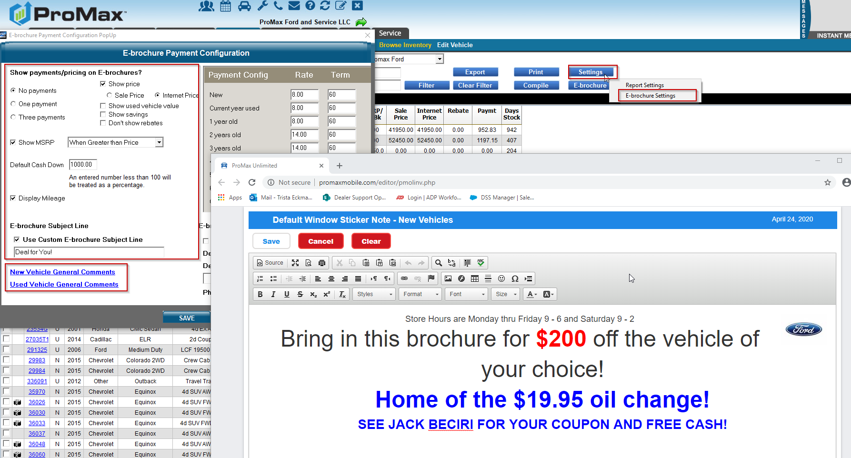
Ebrochures
There are several options to customize your ebrochures. To do this you will go to Inventory > Salesperson Inventory > Settings > Ebrochure Settings. In here you are able to choose what kind of pricing you’d like to display and choose any other kinds of changes you’d like to make to the default changes.
Under New and Used Vehicle Comments you have the ability to put in a custom message for all vehicles that will show in the middle of the ebrochure.

Slide 15
IP Restrictions
Did you recently have a lot of staff that needed to work from home? If you are back in the office now and need to make some changes to who can access your site you can manage that here.

Slide 16
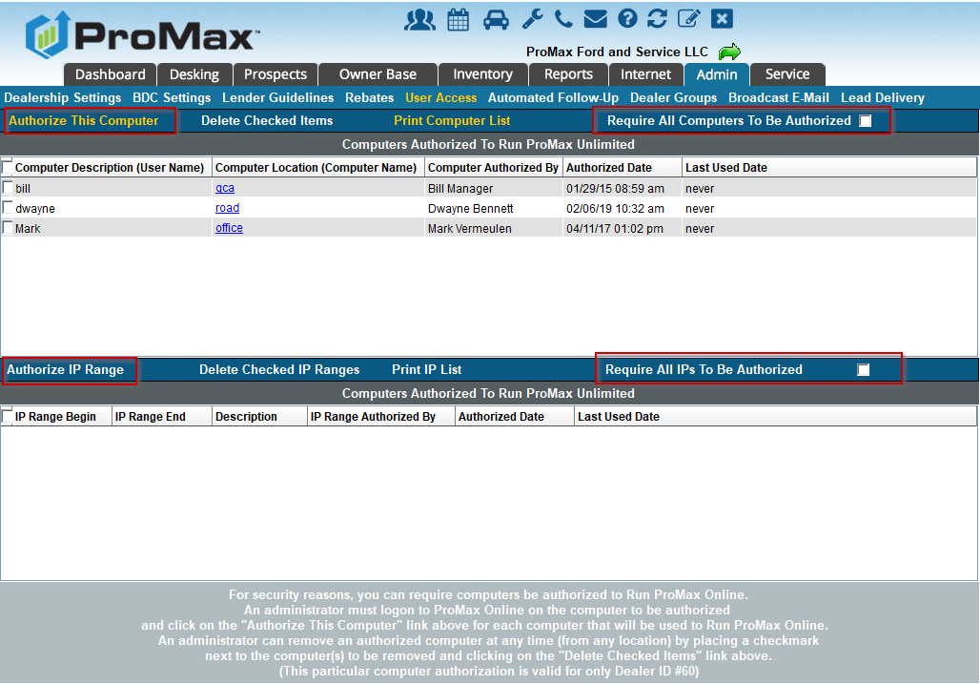
IP Restrictions
Admin > User Access > Computer Authorizations. From here you can choose which computers can run bureaus, access EZ Up, or access Promax all together.
When you click on the Promax option, you can either choose to require each computer to be authorized or you can require Ips to be authorized. Check the box on the left for the option you would like and then enter each computer or IP on the left.

Slide 17
Recall Check
Promax makes it easy to generate service revenue even if customers aren’t wanting to spend money right now.

Slide 18
Open Recalls
Different Recall Check Solutions with Promax
Recall Check – checking your inventory and trades
  This is an add on product in Promax. It has a flat monthly fee and you only pay 50 cents per VIN to have all your vehicles checked daily, as you take them in on trade, and at the time of delivery. So, if you have an average of 100 vehicles on your lot each month you will pay $50 in addition to the monthly fee for the regular checks
  We only check for safety recalls, not vanity recalls.
Open recalls at other nearby dealerships that don’t have your franchises or a service department
  Get a list of vehicles with open recalls at other dealerships so that you can help each other out during this slow period
People in a certain radius of your dealership with open recalls on vehicles
  Give us the radius you are interested in and we can give you the customers
Your sold customers driving vehicles with open recalls
  We can look at your ownerbase to see which of your current customers have an open recall now
Right now we are going through an unprecedented time. People are scared or not able to leave their homes. Taking care of open recalls in your area is a way to generate revenue without relying on the customer spending any of their money. We have several different options to help you with getting recall work in your service lane.

Slide 19
Open Recalls
Once you have the Recall Data you are wanting, we have several options on how we can help you manage those leads.
  We can simply import the leads into the Promax site for you and you can do your own follow up
  We can send out a mailer for you
  Our BDC can call the leads for you
  We can send out an email blast to these customers for you
  Any combination you would prefer
  Have another idea? I’m sure we can work it out for you!

Slide 20
Questions?
Contact our Dealer Support Line at 844-322-9034
Contact me directly at 563-344-7618 or Trista@ProMaxUnlimited.com
PromaxUnlimited.com
Facebook.com/ProMaxUnlimited
Twitter.com/ProMaxUnlimited
LinkedIn.com/Company/ProMax-Automotive-Software/
DealerUpdates.TypePad.com/Blog/

