Slide 1
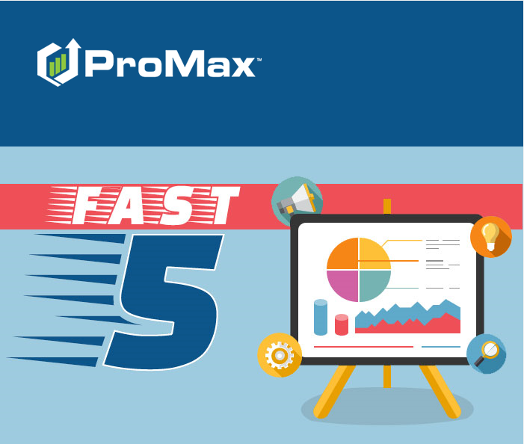
November

Slide 2
Agenda
Assigning Showroom Visits
Manager Exit Note
Unsold Prospects
Instant Screen
Deleting Showroom Visits

Slide 3
Assigning Showroom Visits
Credit for showroom visits and associated sales is given to the Sales Rep assigned to the customer record at the time the showroom visit was created.

Slide 4
Assigning Showroom Visits
Reports (such as Leaderboard) will assign credit for showroom visits and associated sales to the wrong Sales Rep IF the correct/current Sales Rep was not assigned to the customer record at the time the showroom visit was created.
This will occur if another user creates the showroom visit (ex. Receptionist at front desk scans the customer’s driver’s license prior to Sales Rep assignment) or if the Sales Rep is reassigned at any time after the showroom visit is created.
Showroom visit assignment/attachment can be changed, if needed.

Slide 5
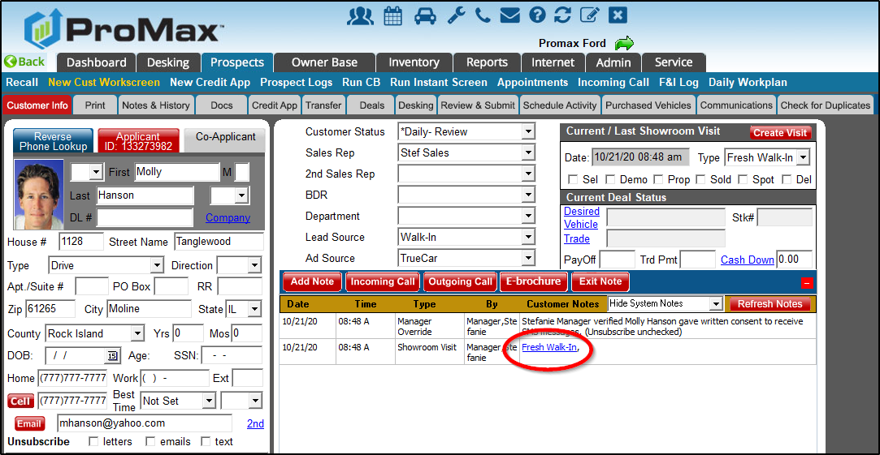
Assigning Showroom Visits
First, within the Customer Workscreen, click the showroom visit hyperlink (it may display Fresh Walk In, Be Back, Internet Appt Show, etc.).

Slide 6
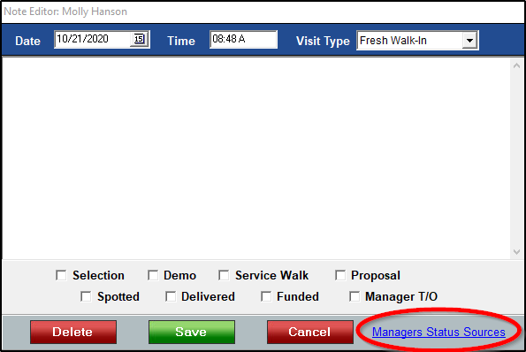
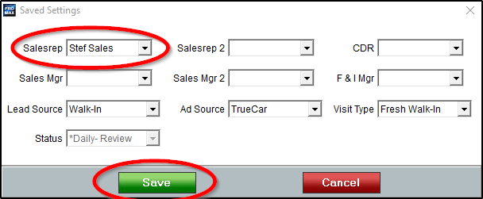
Assigning Showroom Visits
Next, click the Managers Status Sources hyperlink.
Then, change Sales Rep (or other position) assignment/attachment using drop-downs and Save.

Slide 7
Deleting Showroom Visits
Each time a customer enters the showroom, a showroom visit should be created/logged in ProMax. Sometimes, however, duplicate showroom visits (same day) are created for a customer in error.

Slide 8
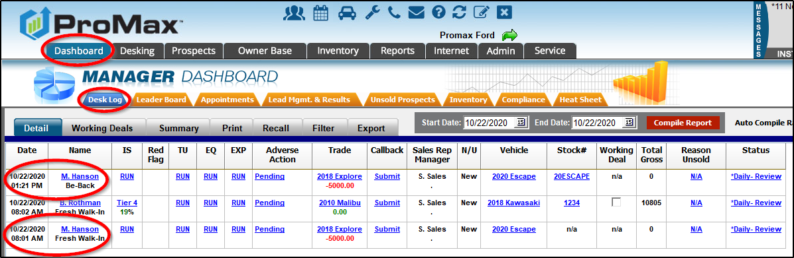
Deleting Showroom Visits
Duplicate showroom visits are most visible on the Manager Dashboard: Desk Log.
Unneeded/duplicate showroom visits can be deleted easily.

Slide 9
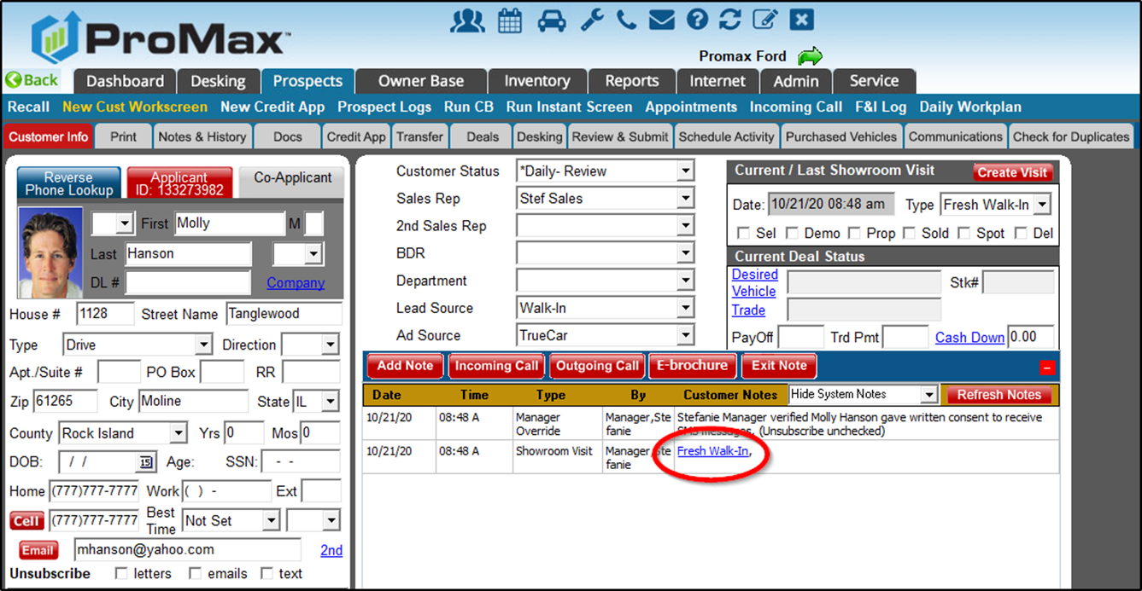
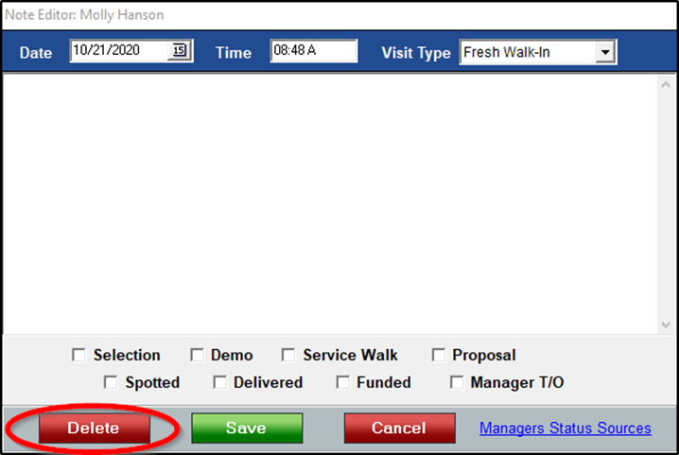
Deleting Showroom Visits
First, within the Customer Workscreen, click the showroom visit hyperlink (Fresh Walk In, Be Back, Internet Appt Show, etc.).
Then, click Delete.

Slide 10
Manager Exit Note
Manager Exit Note is a way to close out the showroom visit for unsold customers.

Slide 11
Manager Exit Note
If a customer is sold, Manager Exit Note is unnecessary.
If a customer is unsold, information should be gathered to help the dealership analyze Reason Unsold data and adjust processes, if needed.
Also, completing Manager Exit Note helps ensure Compliance requirements are met and customers receive appropriate follow up moving forward.

Slide 12
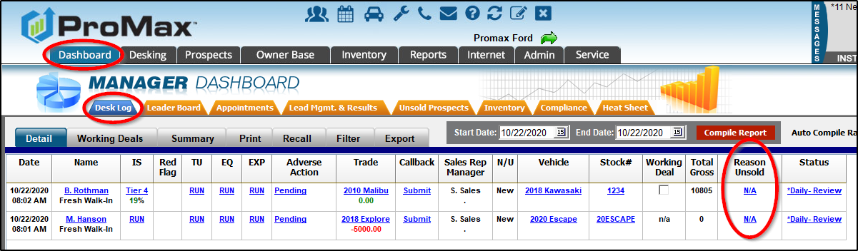
Manager Exit Note
Manager Exit Note is best accessed from the Manager Dashboard: Desk Log since showroom traffic can be easily monitored and Manager Exit Notes completed in real time.

Slide 13
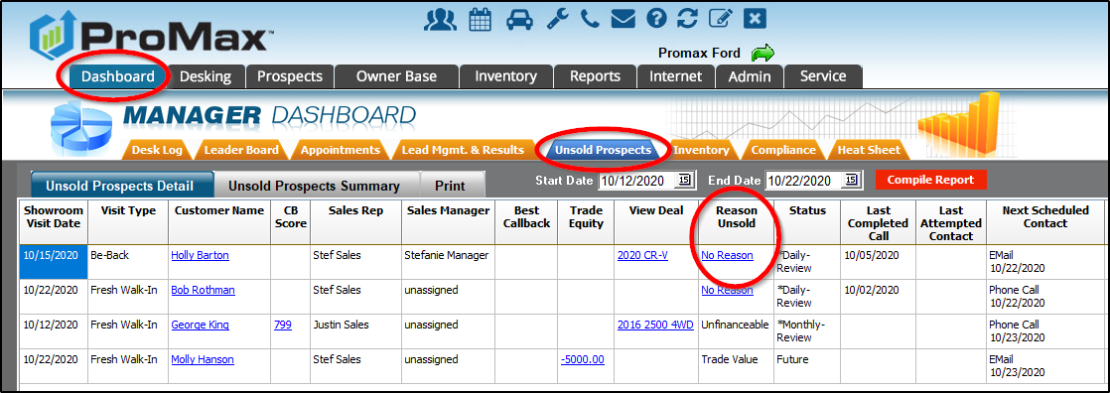
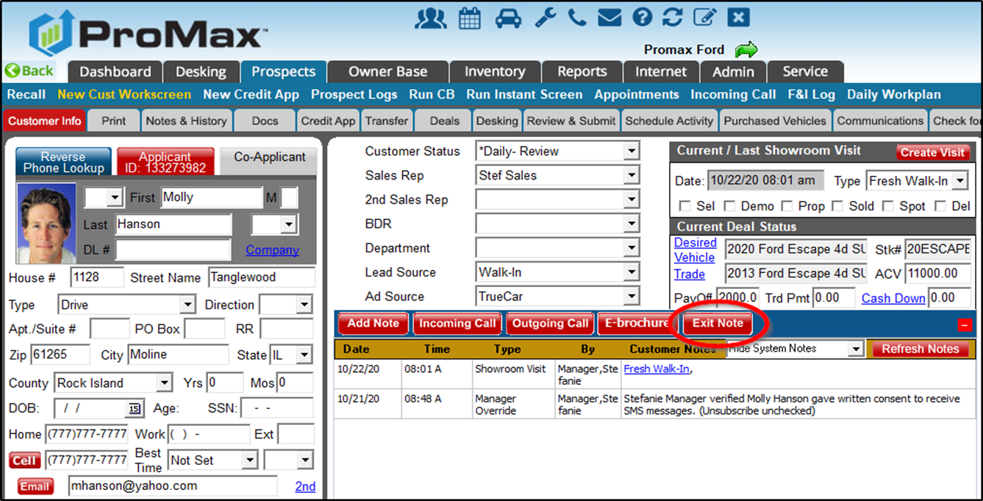
Manager Exit Note
However, the Manager Exit Note can also be accessed on the Manager Dashboard: Unsold Prospects Report, or directly within the Customer Workscreen.

Slide 14
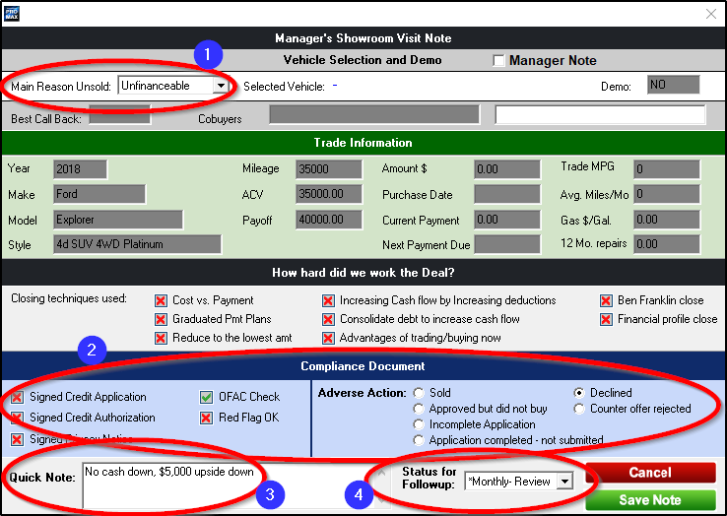
Manager Exit Note
1. Select Main Reason Unsold from drop-down.
2. Review Compliance requirements to ensure completion and select Adverse Action status.
3. Enter details about customer/deal circumstances.
4. Select an appropriate Customer Status for future follow up.

Slide 15
Unsold Prospects
Unsold Prospects is a report used to monitor/review unsold showroom traffic, enter Manager Exit Notes, if needed, and view analysis of Reasons Unsold.

Slide 16
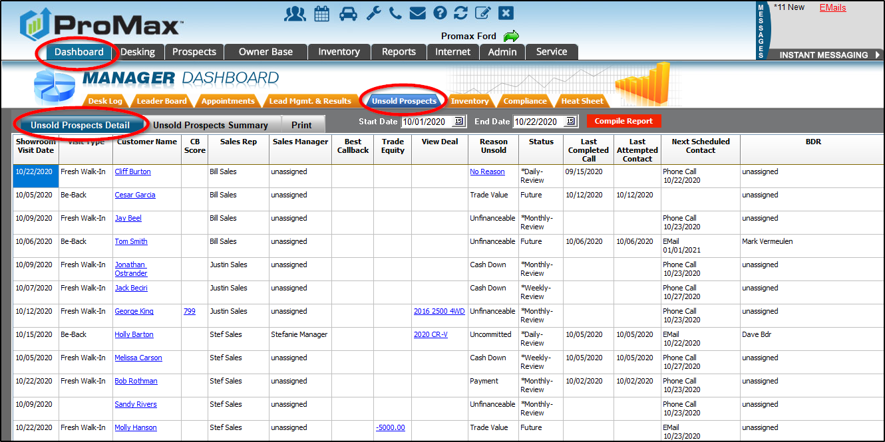
Unsold Prospects
This report is located on the Manager Dashboard: Unsold Prospects and the report displays the Detail view, by default.

Slide 17
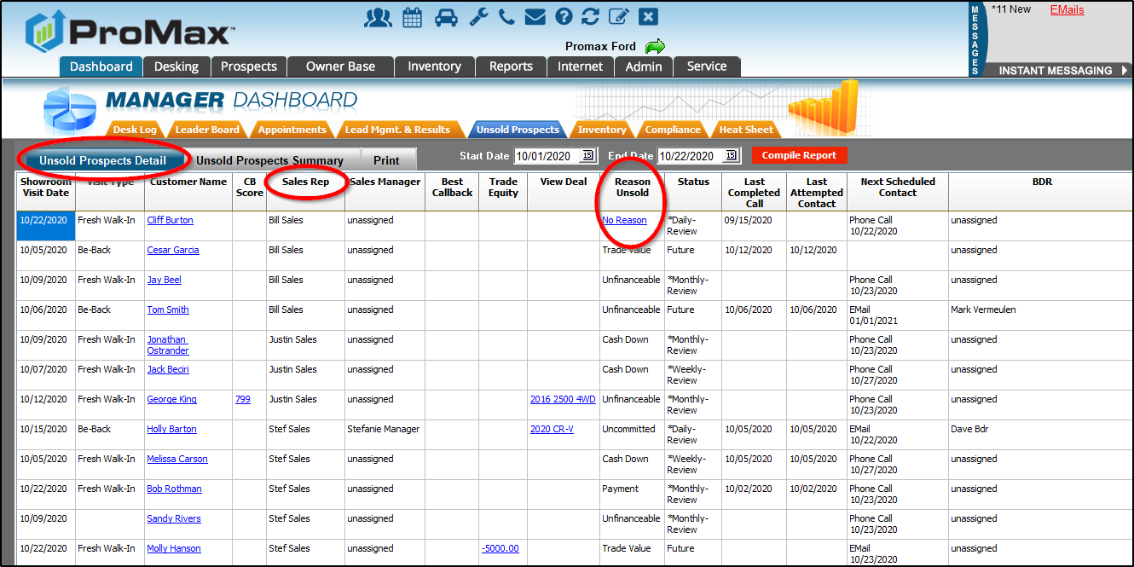
Unsold Prospects
The Detail view can be sorted by Sales Rep (by clicking the column header) and then used for one-on-ones with Sales Reps.
Managers can see CB score, trade information, and saved deals which can be used for Save-a-Deal discussions.
Managers can complete the Manager Exit Note from this report, too (if not already completed).

Slide 18
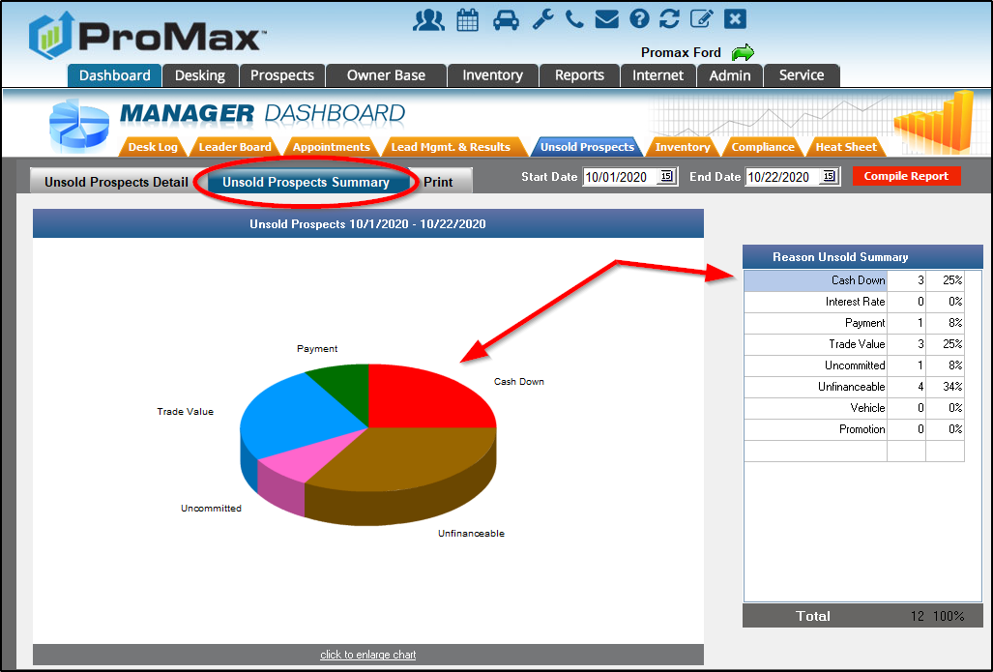
Unsold Prospects
The Summary view breaks down all Reasons Unsold in chart and graph form, allowing managers to easily identify problems with the sales process and opportunities for improvement.

Slide 19
Instant Screen
Instant Screen is a tool which allows users to see a customer’s exact credit score along with details of any open auto loans; it is a “soft pull” on the customer’s credit, not a hard inquiry, so will not appear on the customer’s credit bureau.

Slide 20
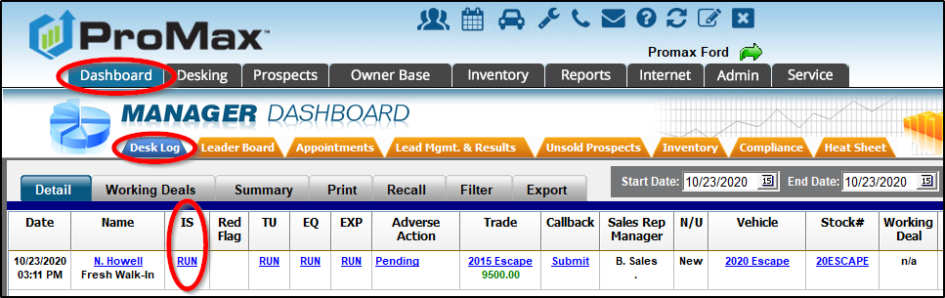
Instant Screen
Instant Screen can be accessed from several locations, one of which is the Manager Dashboard: Desk Log.
Simply click the Run hyperlink.

Slide 21
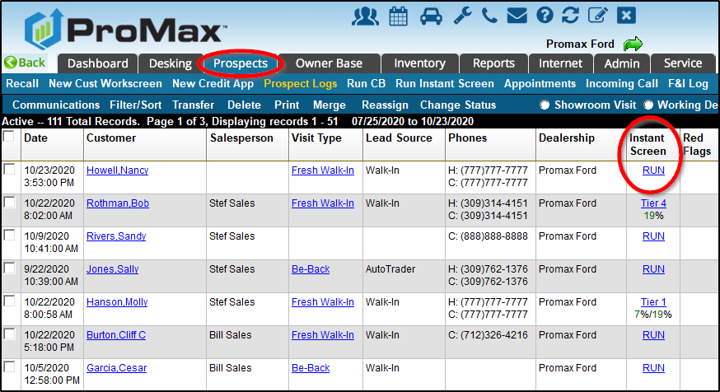
Instant Screen
Instant Screen can also be accessed from the Prospect Logs…

Slide 22
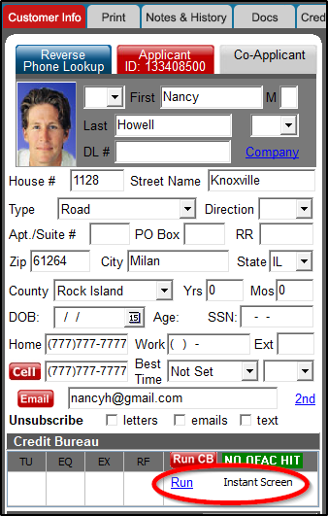
Instant Screen
…and directly within the Customer Workscreen.

Slide 23
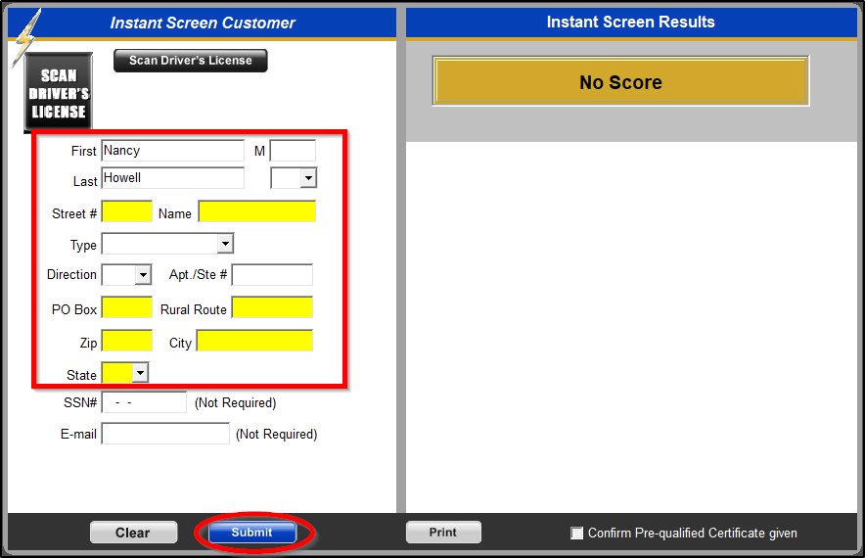
Instant Screen
Only customer name and physical address is needed, and missing fields will highlight in yellow.
NOTE: Customer social security number is NOT required, nor is customer consent.
Click Submit to run Instant Screen and view results.

Slide 24
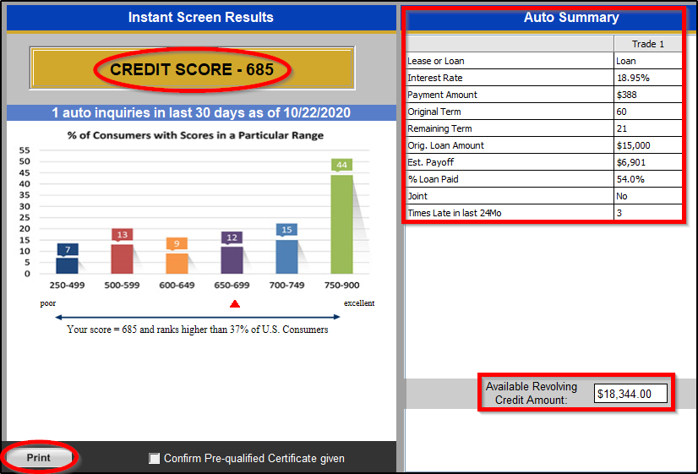
Instant Screen
Results display the customer’s exact credit score along with detailed, useful information regarding open auto loans (current interest rate, monthly payment, payoff amount, payment defaults, etc.).
Users must click Print to provide the customer with a Pre-Selected Certificate (since customer consent is not needed to run an Instant Screen, the Pre-Selected Certificate must be provided as a firm offer of credit).

Slide 25
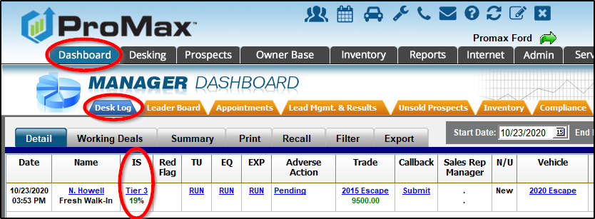
Instant Screen
Once Instant Screen has been pulled, the customer’s tier can be seen in all locations which previously offered the Run option.

Slide 26
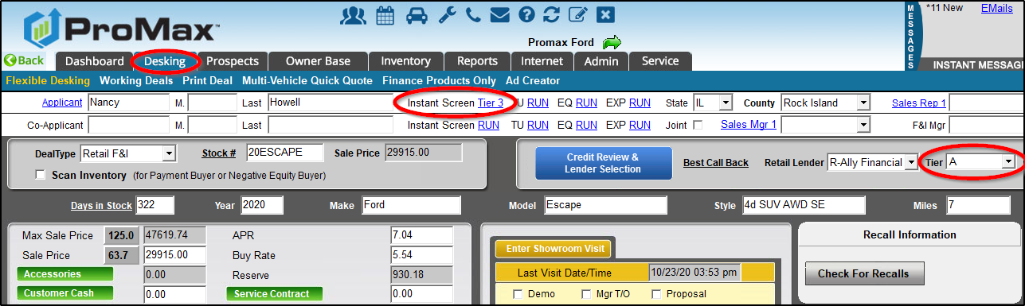
Instant Screen
Running an Instant Screen will also allow ProMax to auto-tier the customer when desking a deal (correct lender tier will chosen automatically).

Slide 27
Questions?
Contact our Dealer Support Line at 844-322-9034
Contact me directly at 563-344-7687 or Stefanie@ProMaxUnlimited.com
PromaxUnlimited.com
Facebook.com/ProMaxUnlimited
Twitter.com/ProMaxUnlimited
LinkedIn.com/Company/ProMax-Automotive-Software/
DealerUpdates.TypePad.com/Blog/

