Slide 1

October

Slide 2
Agenda
Setting Up Email
Lead Delivery Change Log
VIP Log
Equity Mining with Trade Alerts
Trusted Sites

Slide 3
Setting Up Email
ProMax allows for any email settings to be added to the system. We also provide email services if you’d prefer us to handle it for you

Slide 4
Setting up Email
Input settings from any provider, just like you would on your phone or another email client
Best practice would be to use a bulk email company, and a separate CRM email address
We offer business accounts, domain registration, and bulk email services if you’d like us to handle all of that set up for you

Slide 5
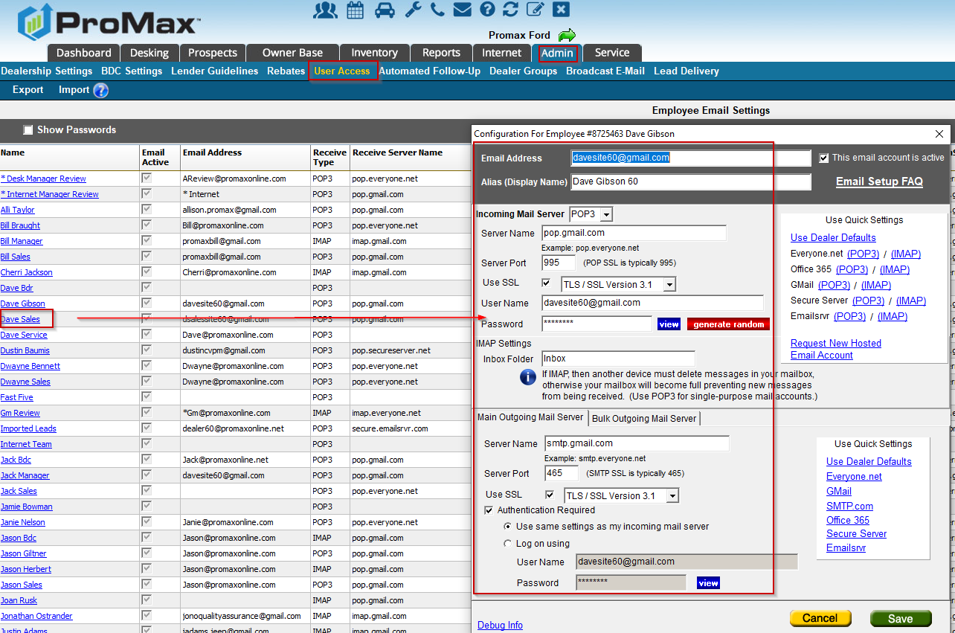
Setting up Email
In order to enter your email credentials (if you decide to manage this yourself) go to Admin > User Access > Email Settings Report. Click on the user’s name that you need to add and add the email credentials that your email provider has given you. It is important to note that the email password will need to be updated in ProMax if it is changed anywhere else.

Slide 6
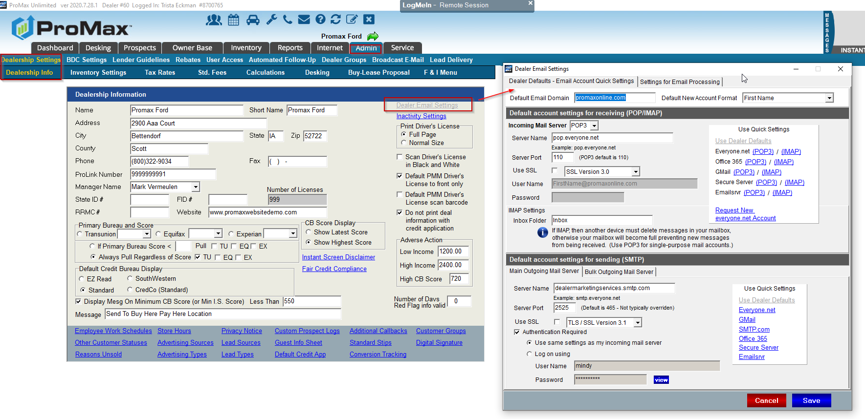
Setting up Email Defaults
Setting up how your email settings will default is very helpful. When you set this up, as long as you create emails the same way everytime, you will only need to enter the password after entering the ProMax Email Address Config screen.
Admin > Dealership Info > Default Email Settings

Slide 7
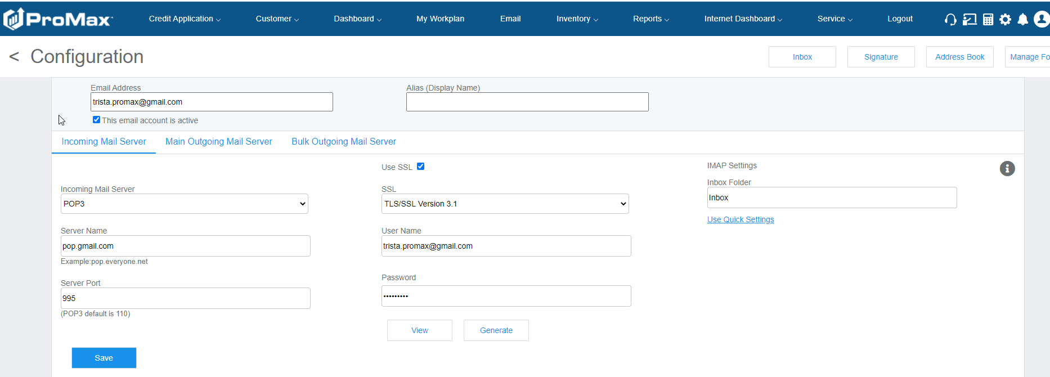
Setting up Email
You can also have your staff fill all of this out themselves. To set this up you will want to click into the email icon at the top of the ProMax screen and then select the gear icon on the top right of the email screen. Fill out all the credentials and hit save. If you have already set up the defaults for your dealership the only thing they will need to enter is their email password.

Slide 8
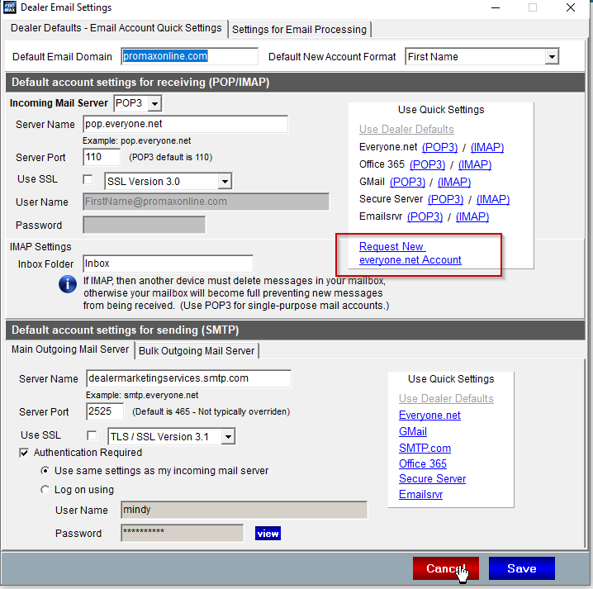
Requesting Email Set Up When ProMax Hosts Your Email
If we host email for you, you can just let us know when you need a new email address and we will create it , set it up for you, and let you know when it is ready to use. To request a new email account, you can call us, email us, or go to Admin > User Access > User’s Name > ProMax Email Address > Request new everyone.net Email Account.

Slide 9
Adding Trusted Sites
These are some settings that ensure you have the best user experience possible within ProMax

Slide 10
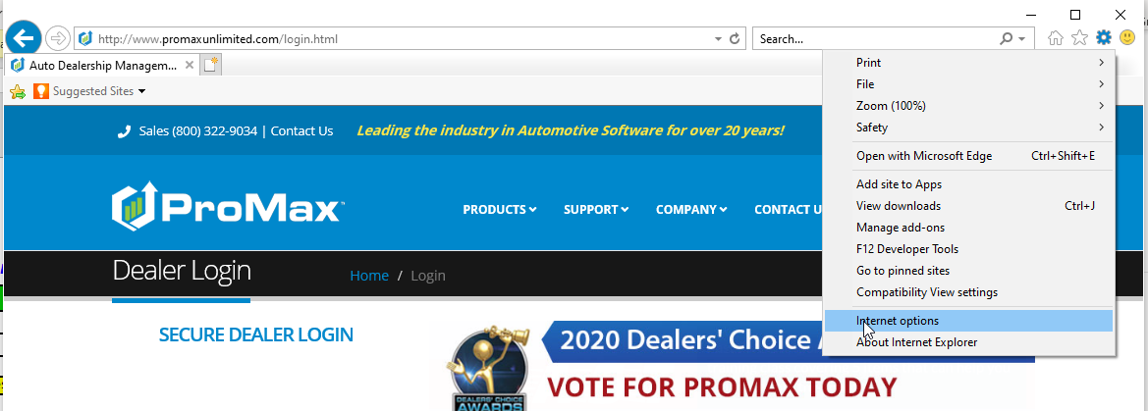
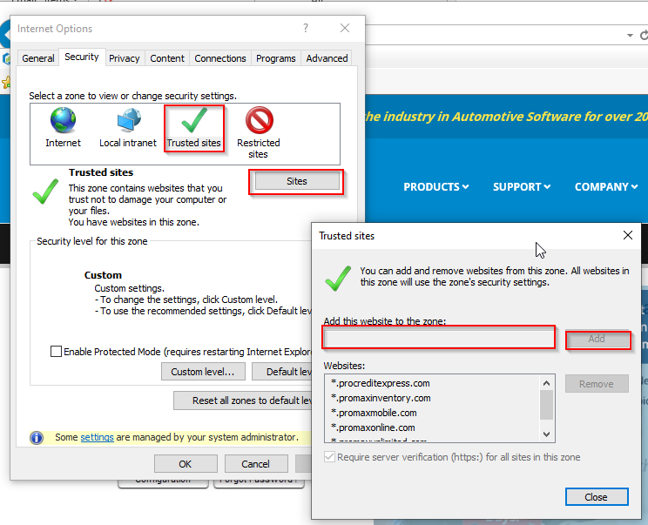
Adding Trusted Sites
Steps
In Internet Explorer click on the gear icon on the top right and choose “Internet Options.”
In the security tab, choose trusted sites and then the sites button. Add the website *.promaxunlimited.com and hit add
These are browser settings that will ensure that ProMax runs it’s best for you.
The most common issue that could come up from not having trusted sites would be not being able to launch any of the pop ups from ProMax like the Pure Lead Report or email.

Slide 11
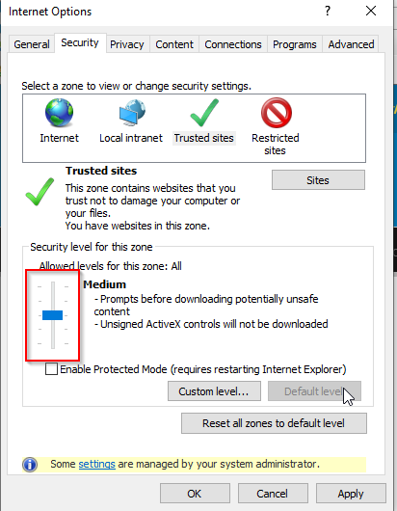
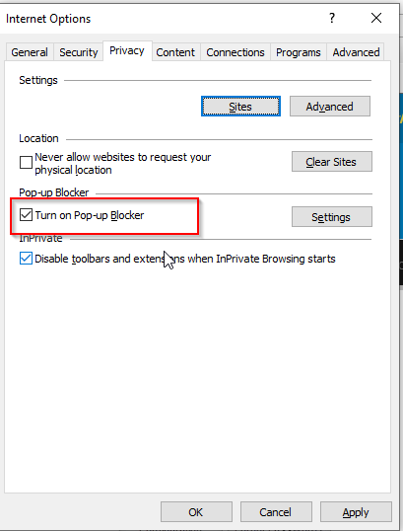
Adding Trusted Sites Continued
Steps Continued
Now go down to the section labeled “Security level for this zone” and choose “Low” with the scroll bar.
Next, click on the Privacy Tab at the top and make sure that the “Turn on Pop Up Blocker” is Unchecked.
Now hit apply and ok at the bottom.
X out of Internet Explorer completely
Go to www.promaxunlimited.com fresh (do not use a shortcut or the launcher) and log back in to see the changes.

Slide 12
Lead Delivery Change Log
This is a new feature that shows you any changes that were made to your lead settings

Slide 13
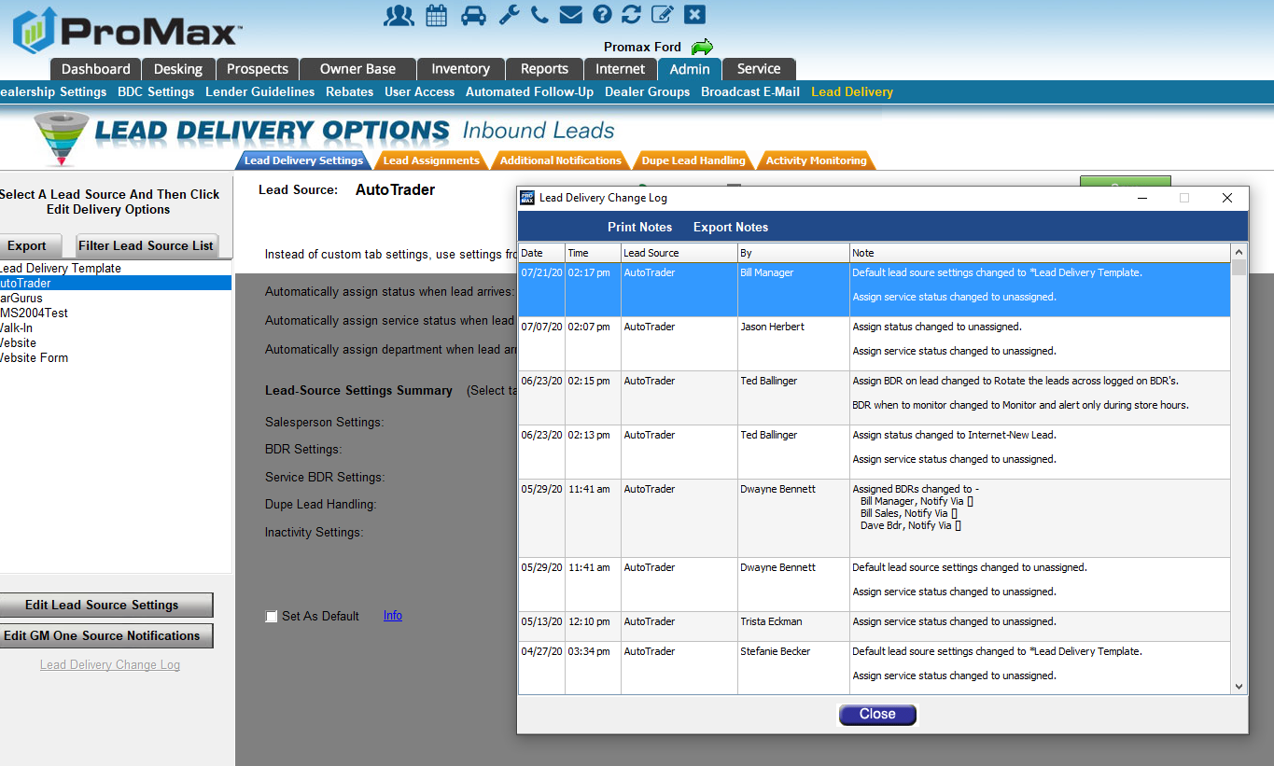
Lead Delivery Change Log
Admin > Lead Delivery. Choose a lead source on the left, hit edit lead source settings, and then hit “Lead Delivery Change Log” to see any changes that have been made to your site and who made those changes.

Slide 14
VIP Log
Here is an appointment log that will not log you out and can be displayed in your showroom

Slide 15
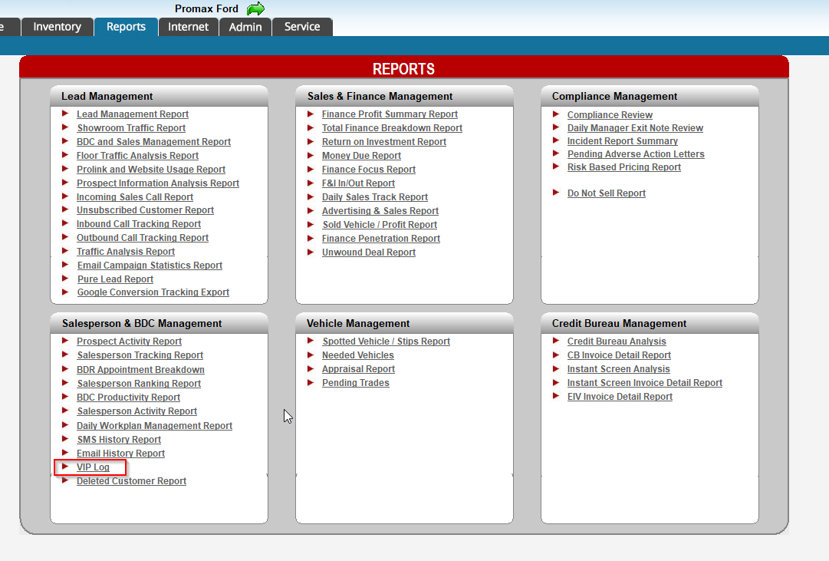
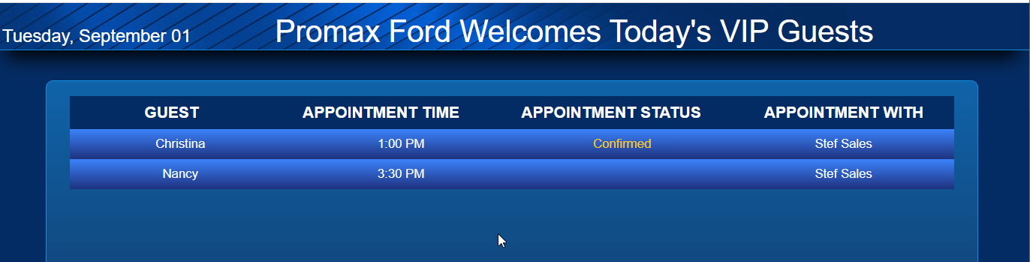
VIP Log
Reports > VIP Log
If you log into a computer in your showroom you can put this up on a TV screen. It is a version of your appointment log that your staff and customers can see.

Slide 16
Equity Mining with Trade Alerts
This is a list that will automatically show you any customers that are now in an equitable position and may be interested in trading in and trading up

Slide 17
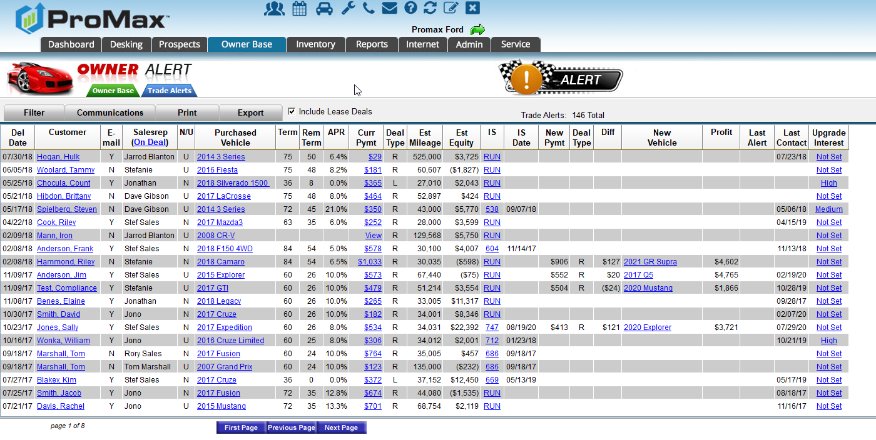
Equity Mining with Trade Alerts
When you sign up for our equity mining tool, Trade Alerts, a new tab will appear for you under “Ownerbase.” This tab automatically populates possible deals for you based on the parameters you choose.
We will show you the customer, their previously purchased vehicle, their current payment, estimated mileage and equity, and we will populate possible new deals for you and make vehicle suggestions for you.
You can work these leads directly from this screen, or we can set up automated follow up for you to direct all of this into the Daily Work Plans for you.

Slide 18
Equity Mining
Set Up
We have back end settings that we can adjust for you at anytime. This tool is very customizable, so you can play around to find your sweet spots.
Here are the parameters you can adjust for your equity list:
  Book value used for trade value
  Minimum equity required (most dealers start with a negative number)
  Minimum profit for calculated deals
  How much newer should their new suggested vehicle be? Ie. 2 years newer than current
  Max Payment Change
  Date range you’d like to look at (For example: Do not look at anything sold in the last 12 months and nothing over 72 months old)

Slide 19
Questions?
Contact our Dealer Support Line at 844-322-9034
Contact me directly at 563-344-7618 or Trista@ProMaxUnlimited.com
PromaxUnlimited.com
Facebook.com/ProMaxUnlimited
Twitter.com/ProMaxUnlimited
LinkedIn.com/Company/ProMax-Automotive-Software/
DealerUpdates.TypePad.com/Blog/

