Slide 1

September

Slide 2
Agenda
Working Deals
CarFax/AutoCheck/Manheim
Deleting Users
Employment Income Verification
Unwound Deals

Slide 3
Working Deals
This is an easy way to see all the deals that are being worked on a busy Saturday

Slide 4
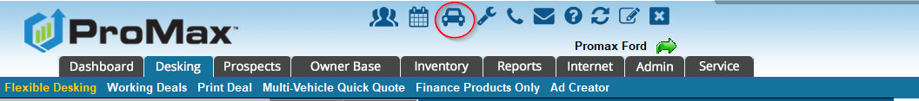
Working Deals
When you click on the car icon at the very top of your screen you will be able to see up to 8 working deals at a time. You can also edit all of these simultaneously. This feature is ideal for super busy Saturdays.

Slide 5
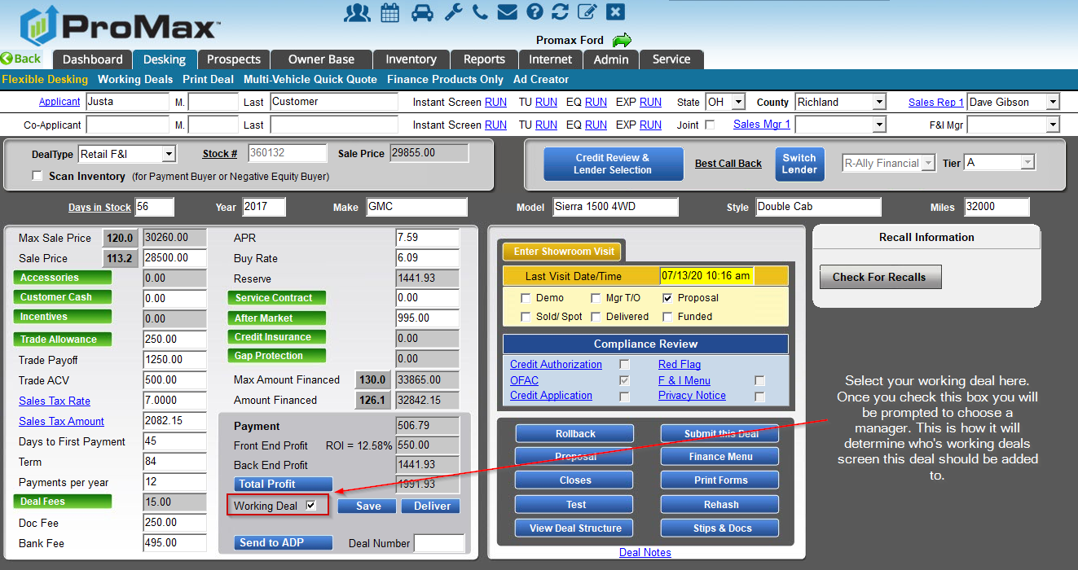
Working Deals

Slide 6
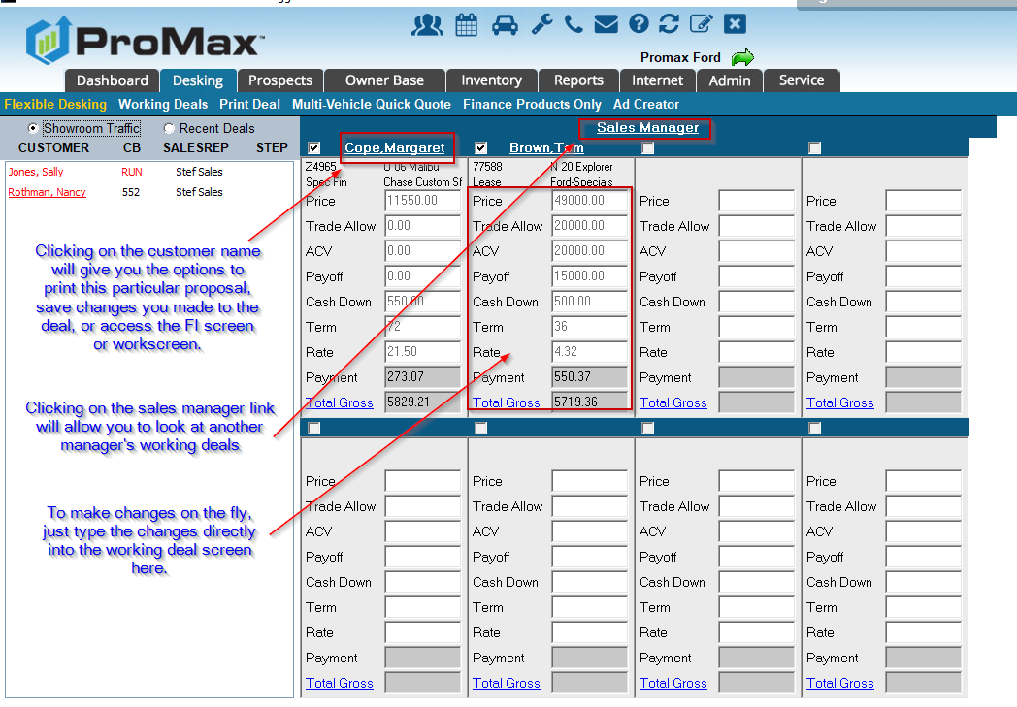
Working Deals

Slide 7
Unwound Deals
This is a report to show you any deals that were recently unwound in your system

Slide 8
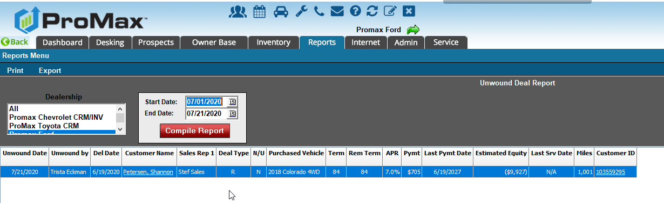
Deals that were recently unwound
Reports > Unwond Deal Report
To unwind a deal go to ownerbase > unwind > customer name > yes
To see what deals were recently unwound, go to Reports > Unwound Deal Report.

Slide 9
CarFax
AutoCheck
Manheim
We have integrations for each of these systems in ProMax so you can get this information straight from ProMax instead of having to log into another system

Slide 10
CarFax
AutoCheck
Manheim
For each of these integrations, you must already have an account with CarFax, AutoCheck, or Manheim. Through ProMax we have enabled it so that you can more easily access your existing accounts with these companies.
To set up AutoCheck – go to Admin > Inventory settings and click on the AutoCheck hyperlink. This is where you can load your credentials in order to start viewing your AutoCheck account from ProMax via the trade screen or the inventory screen.
To set up Manheim – go to Admin > Inventory Settings and type in your credentials on the top right hand side in order to start viewing Manheim data from the trade screen or inventory screen.
The CarFax integration is the only one that comes with an additional monthly fee from ProMax. To have this one set up, please contact us to have this feature enabled.
These integrations can be accessed from the Trade screen or an inventory record.

Slide 11
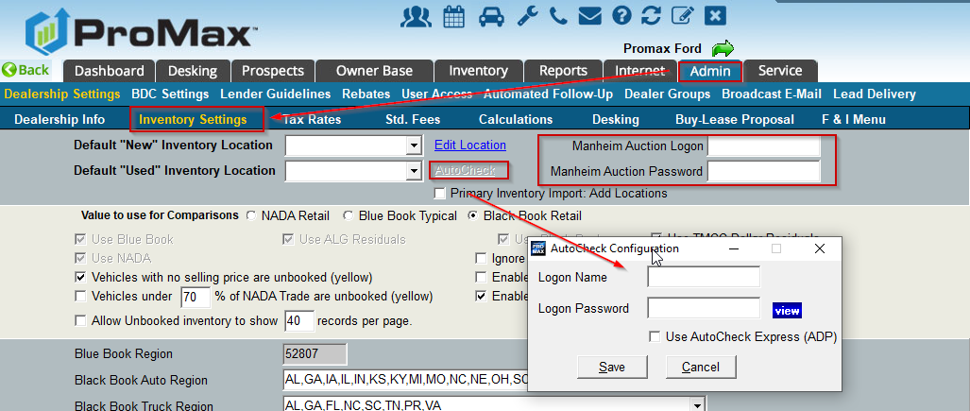
Setting up Manheim and AutoCheck
Admin > Inventory Settings

Slide 12
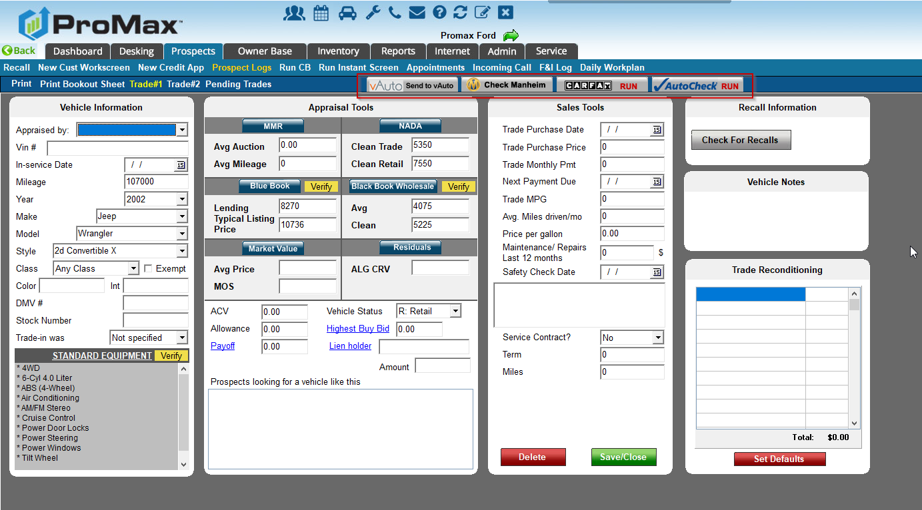
Integrations from Trade Screen

Slide 13
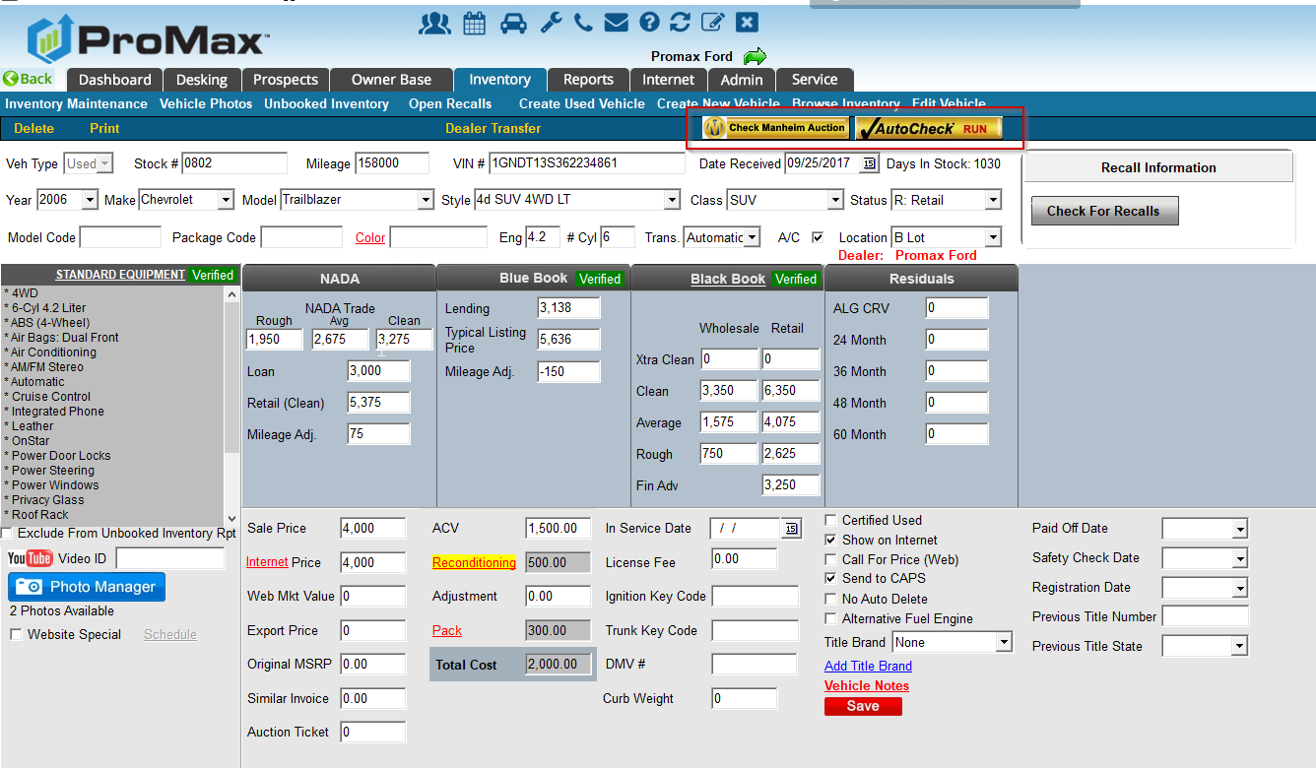
Integrations from Inventory Record
Inventory > Edit vehicle > Enter stock number > Recall
Inventory > Browse Inventory > Choose Report > click on stock number

Slide 14
Deleting Users
How to delete and reassign users in the system

Slide 15
Deleting Users
Some pointers before deleting users
  Consider using a pho user like “Orphan Orphan” to assign the individual’s leads to. This way, when you get a new rep you have a “bucket” to assign to them from.
  Do not remove their email addresses, phone numbers, or title check boxes from their record before deleting. This is needed in order to remove from lead delivery and reassign their customers.
  To block the user from accessing your site immediately – click on reset user account. This will scramble their password and undo their security questions so that they cannot log in any more.
  Consider setting up automated follow up for the event of changing a salesrep to retrigger the customer on to the new salesperson’s work plan. (Don’t worry, the follow up attached to the customer will still reassign – tis would just catch any customers that don’t have any follow up.)
  If you receive a pop up saying that you cannot delete the user because they are set up in lead delivery, please take note of the lead sources and notification types that are listed in the note. It will detail exactly what you will need to update in Admin > Lead Delivery.
To find you list of users, go to Admin > User Access. Click on the users name in order to edit or delete their access.

Slide 16
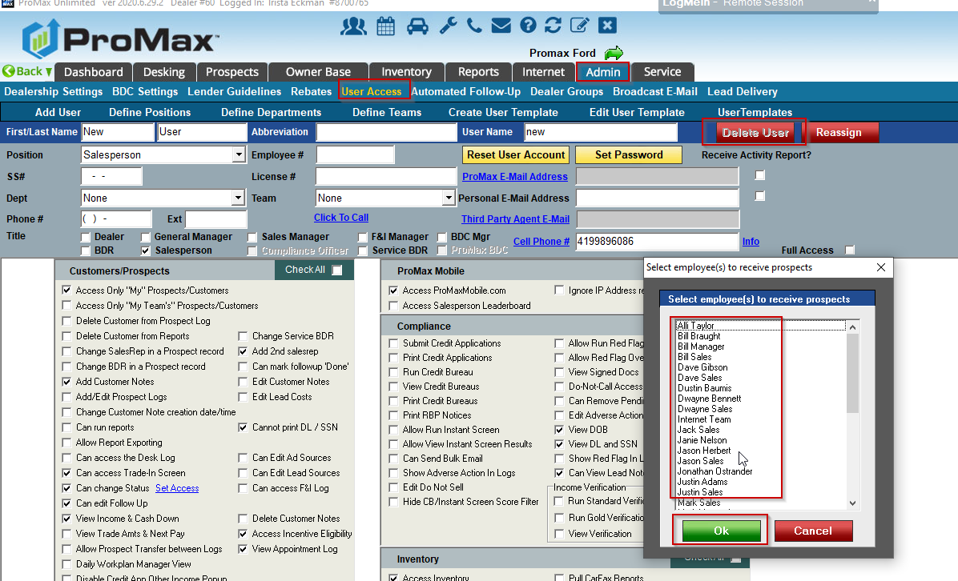
Deleting Users
Admin > User Access > User’s name > Delete
While deleting you will receive a pop up asking if you want to reassing. When you hit yes, you will get a list of people you can reassign to. Choose as many as you would like and it will round robin those customers for you.

Slide 17
Employment Income Verification
Access confirmation on a customer’s income without having them leave the showroom to get a paystub for you

Slide 18
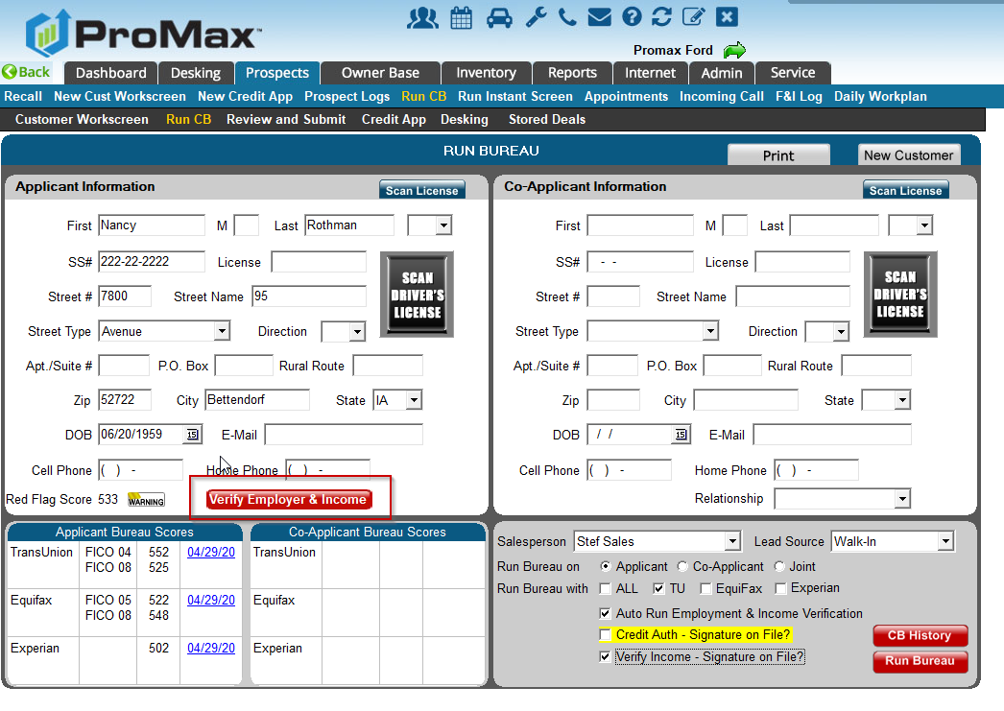
Employment Income Verification
We work with the Work Number to supply you with income information about your customers. You can also get a copy of the customer’s pay stub without having to send them home to grab it. You can print it off right from the showroom.
You can pull this information from the Run CB screen. Just click “Verify Employer Income.”

Slide 19
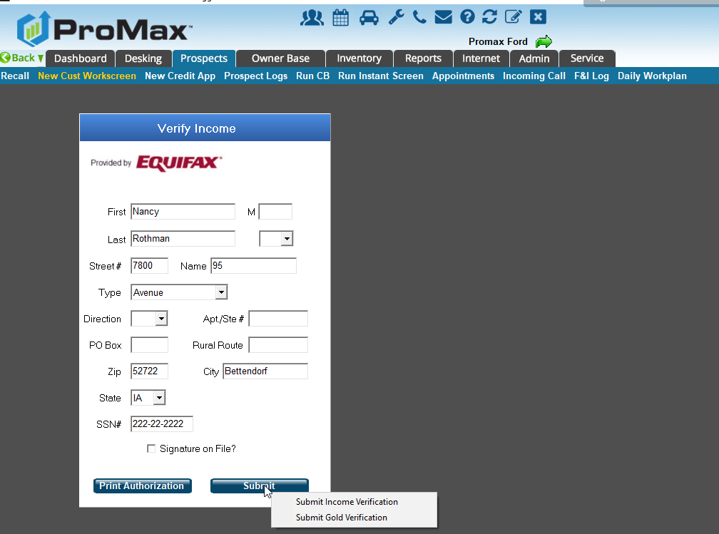
Employer Income Verification
From here you can select “ Verify Income.” You will receive two options. The silver option will just give you all the information you need while the gold option will give you the pay stub that you can use as a stip for the bank.

Slide 20
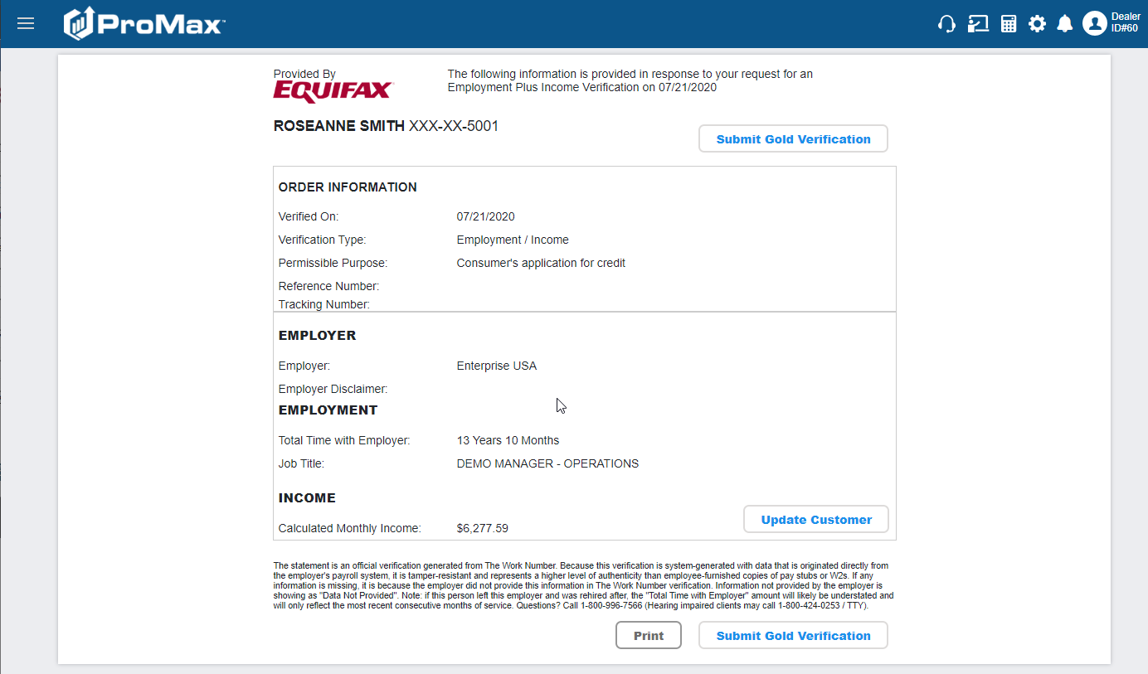
Employer Income Verification
This is what the information looks like.

Slide 21
Questions?
Contact our Dealer Support Line at 844-322-9034
Contact me directly at 563-344-7618 or Trista@ProMaxUnlimited.com
PromaxUnlimited.com
Facebook.com/ProMaxUnlimited
Twitter.com/ProMaxUnlimited
LinkedIn.com/Company/ProMax-Automotive-Software/
DealerUpdates.TypePad.com/Blog/

