Slide 1
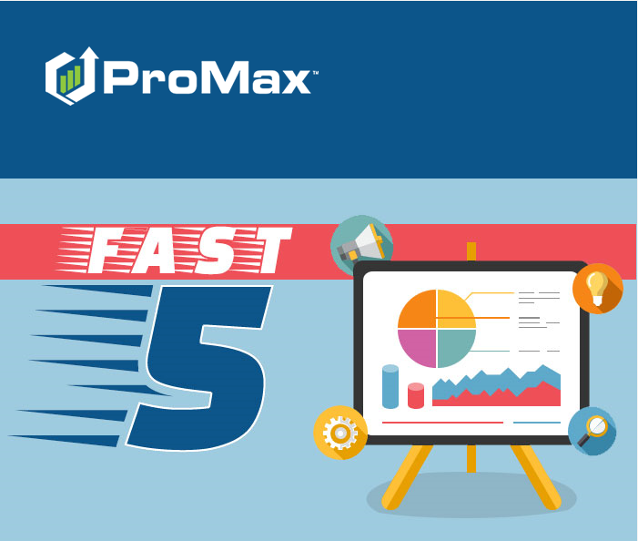
September

Slide 2
Agenda
Instant Screen
Reading a Credit Bureau
Red Flags, OFAC, Synthetic Fraud, and MLA
Risk Based Pricing and Adverse Action Fail Safes
Running Credit Bureaus

Slide 3
Instant Screen
Soft pull on a customer’s credit with the exact FICO score. You only need a customer name and address to get this information and start your deals off on the right foot.

Slide 4
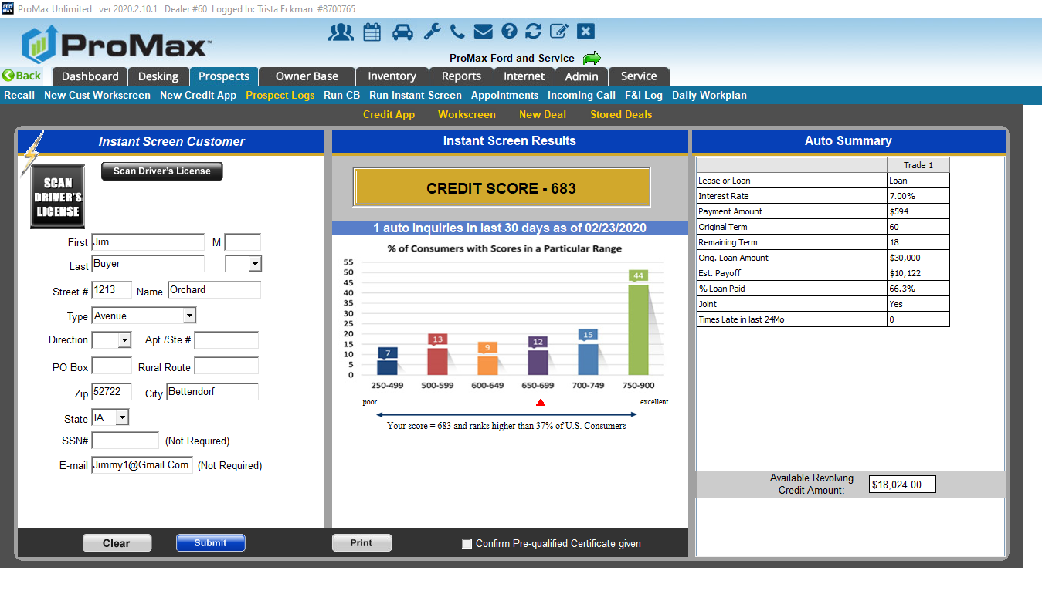
Instant Screen
To run an instant screen, you can click on the “run” hyperlink in the Instant Screen column of the prospect log or dashboard. You also have the ability to pull this directly from the customer workscreen.
The only information needed to pull this is the customer’s name and address.

Slide 5
Instant Screen
Some ways that Instant Screen helps our dealers:
Filter on Instant Screen score to do credit driven targeted email blasts
When working old leads, this is a way you can see if they have purchased or had an inquiry elsewhere
See if you can save them money on an interest rate
Know before the customer falls in love with a particular vehicle what they can and cannot afford
With subprime customers, this is an easy way to see if their score has increased since their last visit
For sold customers, this will show you who will be paying off their car soon
Special Note: You will always want to print of the pre qualification certificate, otherwise we will print it for you. There is a 99 cent fee for this service.

Slide 6
Running Credit Bureaus
Promax is a reseller of Credit Bureaus and you can pull straight out of the system

Slide 7
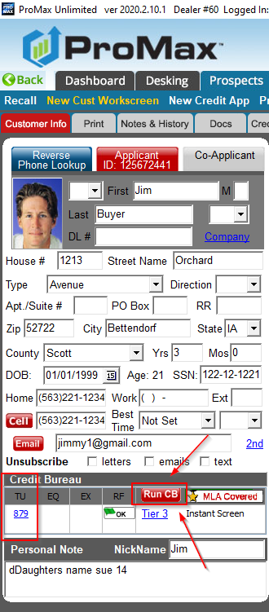
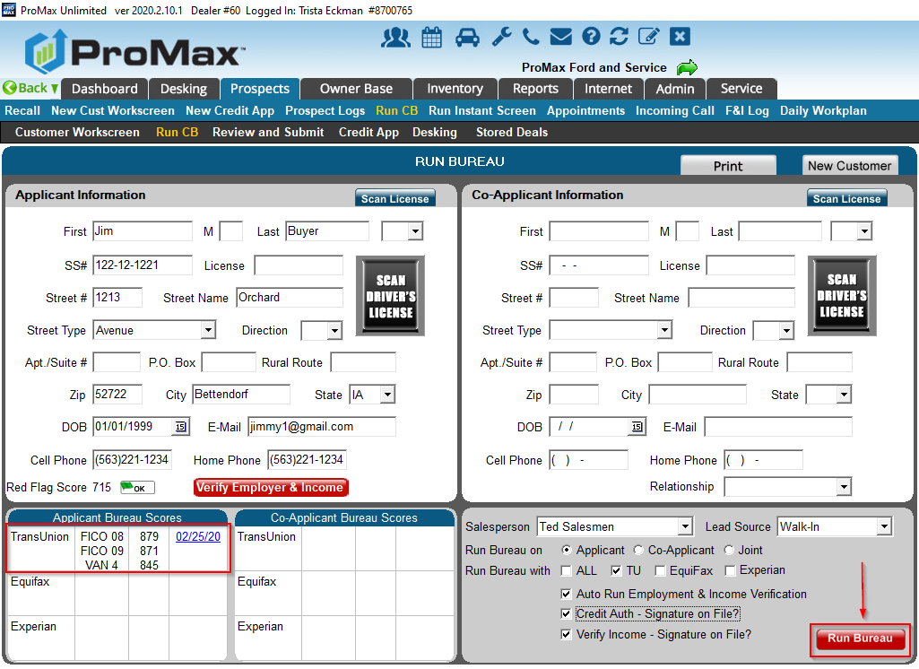
Running Bureaus
Like Instant Screen, you can run bureaus from the “run” hyperlink on the Prospect Log or Dashboard. You can also run this directly from the customer workscreen or credit app.

Slide 8
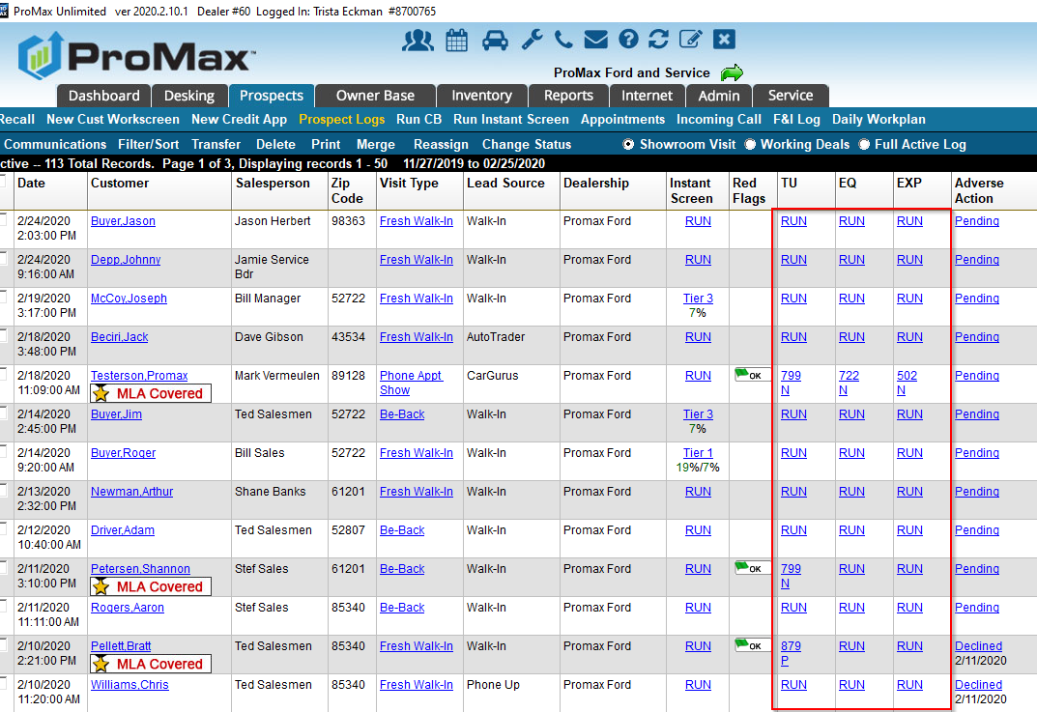
Running Bureaus

Slide 9
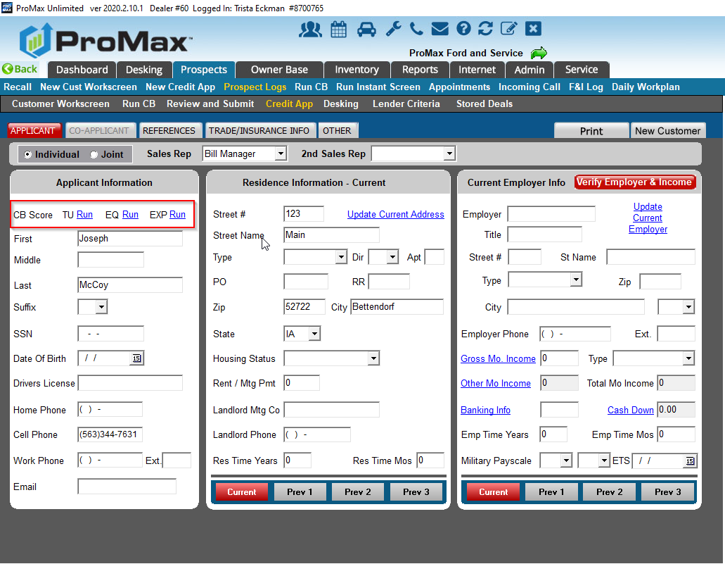
Running Bureaus

Slide 10
Credit Bureau Views

Slide 11
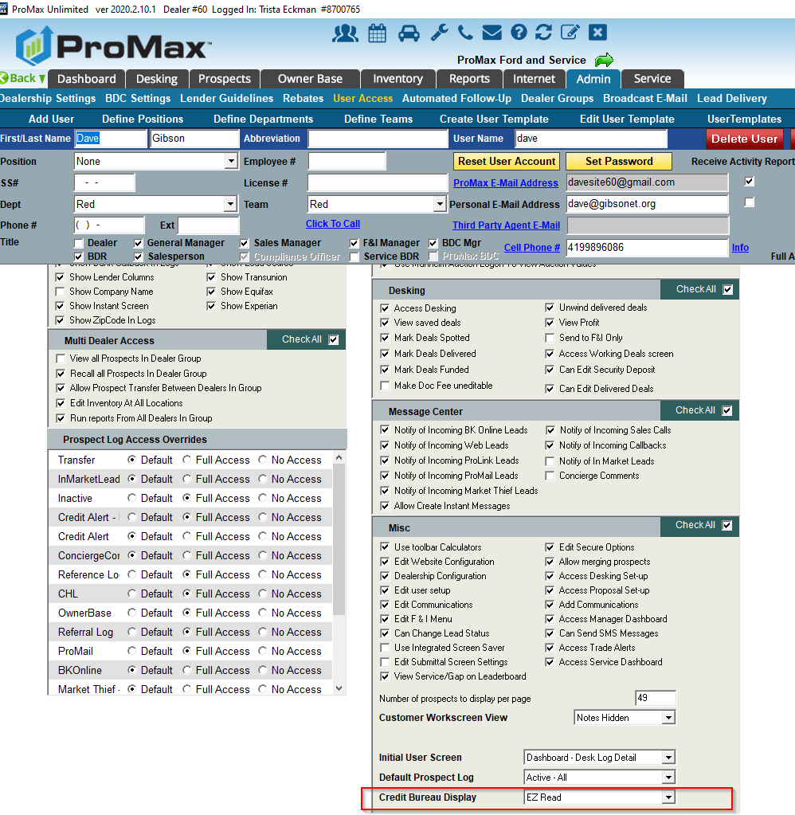
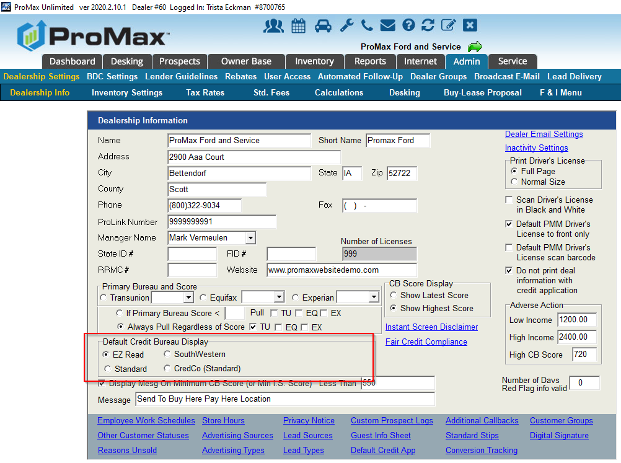
Choosing your Credit Bureau View
We have several different Credit Bureau views available in Promax. These can be changed per user.
Default view: Admin > Dealership Info
User Specific View: Admin > User Access > User’s Name. Scroll all the way down to the bottom under the Misc section to see “Credit Bureau Display.”

Slide 12
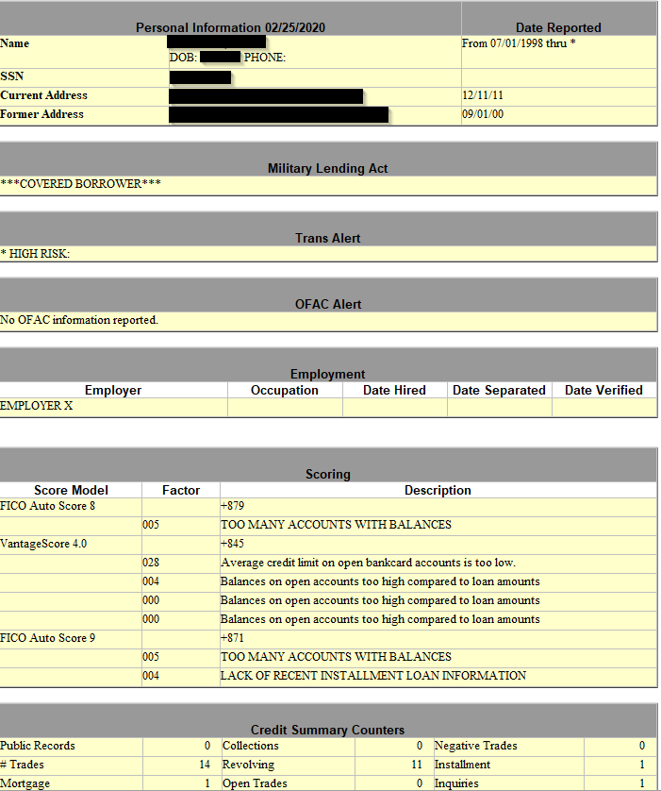
EZ Read

Slide 13
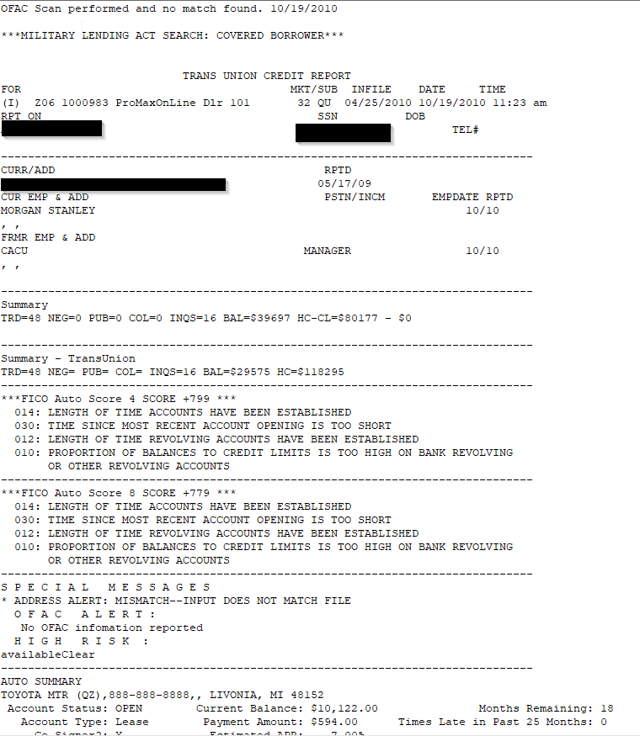
Standard

Slide 14
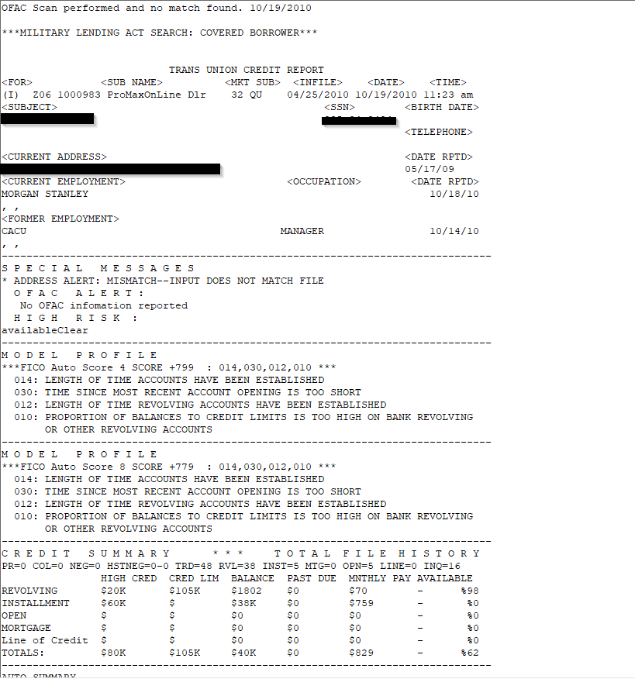
South Western

Slide 15
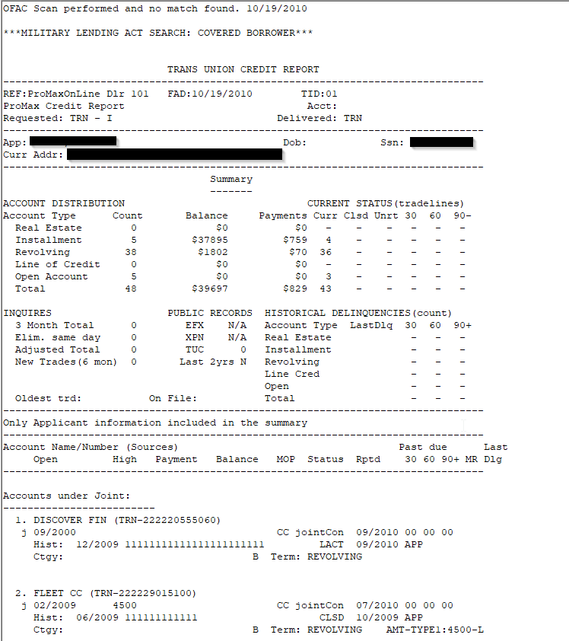
CredCo

Slide 16
How to Read a Bureau
Send me an email to Trista@promaxunlimited.com and I will forward you a cheat sheet from TransUnion, Equifax, and Experian that breaks down how to read a bureau and what the different codes mean.

Slide 17
Red Flags, Synthetic Fraud, OFAC, and MLA

Slide 18
Red Flags
Red Flags are required to protect against identity theft.
A Red Flag will run everytime a bureau is run.
If you get a Red Flag, Promax will walk you through what to do. Follow the prompts on the screen to ask out of wallet questions to confirm the person’s identity.
The Promax Red Flag exam will only populate once, so do not start it unless the customer is there.
If you accidently start the exam and are not able to complete in time before it is lost you can make up your own out of wallet questions by looking through the bureau.
Make sure you documented everything you do to prove the customer is who they say they are. If you are confident they did not steal someone’s identity, you can still sell them a car.

Slide 19
Synthetic Fraud
Similarly to Red Flags, Synthetic Fraud is a tool to help you identify people who may be using fraudulent information from stolen information.
Synthetic fraud is relatively new to the automotive world. These bad actors take pieces of information from may different people to create a complete and fake credit file. They start building credit using department store credit cards for small amounts. Once they get a good credit score, they go in for a big purchase and ghost on the payments.
In ProMax, Synthetic Fraud will show at the top of all bureau reports once you sign up for this add on feature.

Slide 20
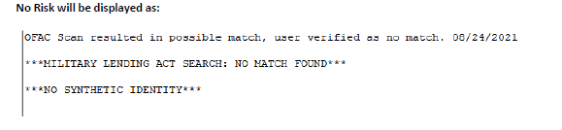
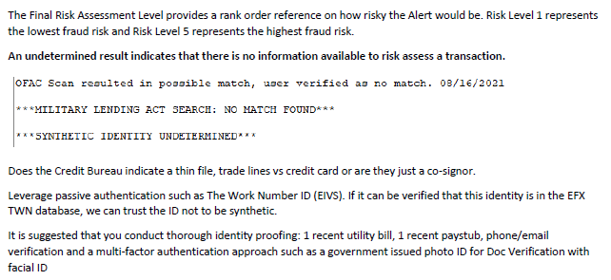
Synthetic Fraud
No Risk and Undetermined Risk

Slide 21
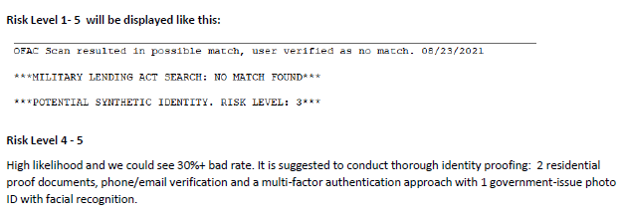
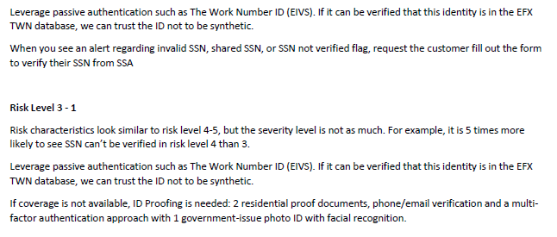
Synthetic Fraud
Risk Levels 1-5

Slide 22
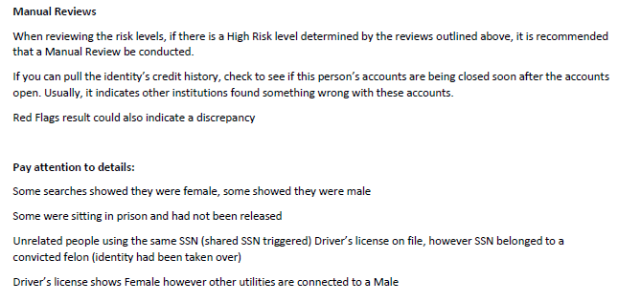
Synthetic Fraud
Doing your due diligence to confirm identity

Slide 23
OFAC
Office of Foreign Assets and Control
This will run every time you enter a customer into the workscreen.
If you get an OFAC match, follow the prompts on the screen to alert the authorities.
You CANNOT sell a vehicle to an OFAC match.

Slide 24
MLA
Military Lending Act
If someone is covered under the MLA status you must cap your rate at 36%
  As of March 2020 GAP no longer counts towards the 36% cap
We have 2 MLA Solutions, both are the same price
  Add to the bureau
  Display in Promax – Prospect Log, Workscreen, and Desking Screen

Slide 25
Risk Based Pricing and Adverse Action Fail Safes
Every dealership has the ability to print Adverse Action and Risk Based Pricing Letters out of Promax for free. However, you can also use us as your failsafe incase any letters are forgotten

Slide 26
Fail Safes
Opens up additional reporting for you
  Adds ability to print in bulk for Adverse Action
  Allows you to see who forgot to print for RBP
Only charge for the ones we print
Only print if you miss it
  RBP – we can send the following day (customizable up to 30 days)
  AA – must be on the pending AA list for a minimum of 7 days

Slide 27
Questions?
Contact our Dealer Support Line at 844-322-9034
Contact me directly at 563-344-7618 or Trista@ProMaxUnlimited.com
PromaxUnlimited.com
Facebook.com/ProMaxUnlimited
Twitter.com/ProMaxUnlimited
LinkedIn.com/Company/ProMax-Automotive-Software/
DealerUpdates.TypePad.com/Blog/

