Slide 1
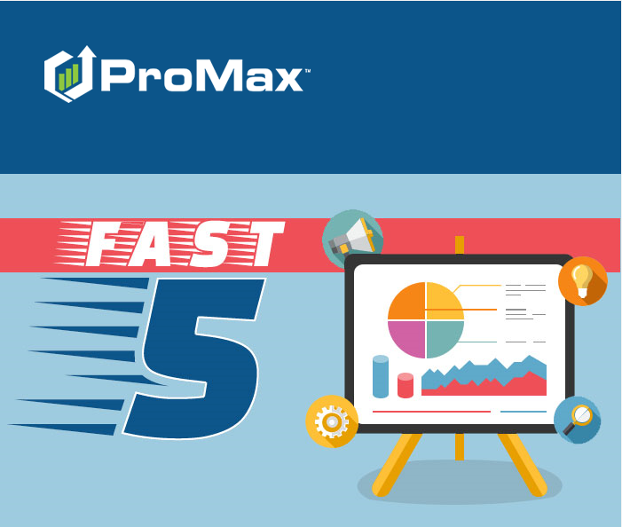
April

Slide 2
Agenda
Auto Status Change in Automated Follow Up
Editing and Adding Reasons Unsold
Car Story Integration
Call Tracking
Push Notifications for Incoming Texts and Reassignments

Slide 3
Auto Status Change
We recently added a new feature where you can automatically have a status changed to the next cadence after the first cadence is complete.

Slide 4
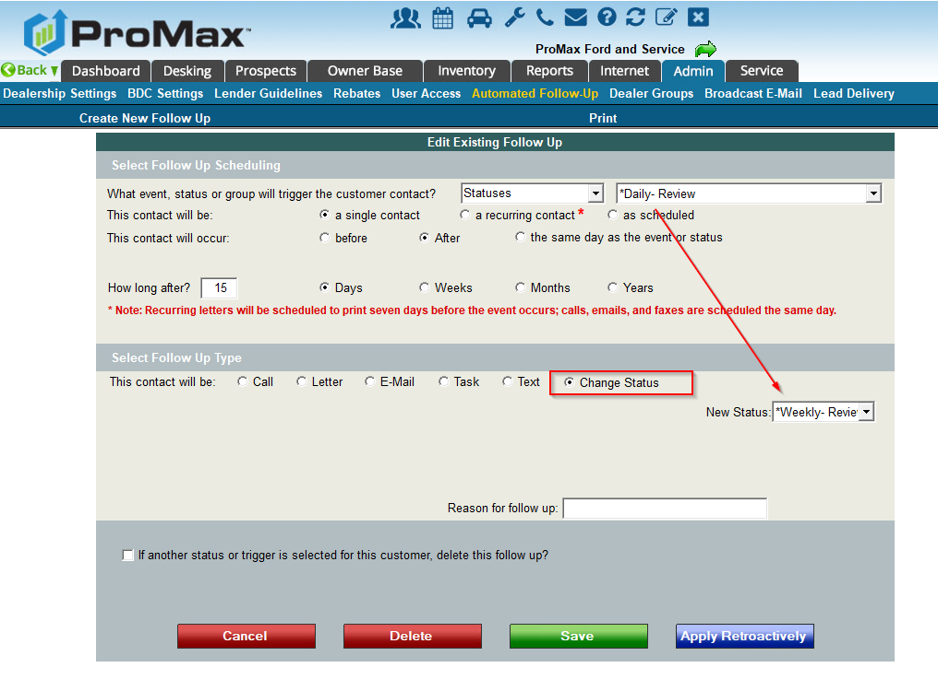
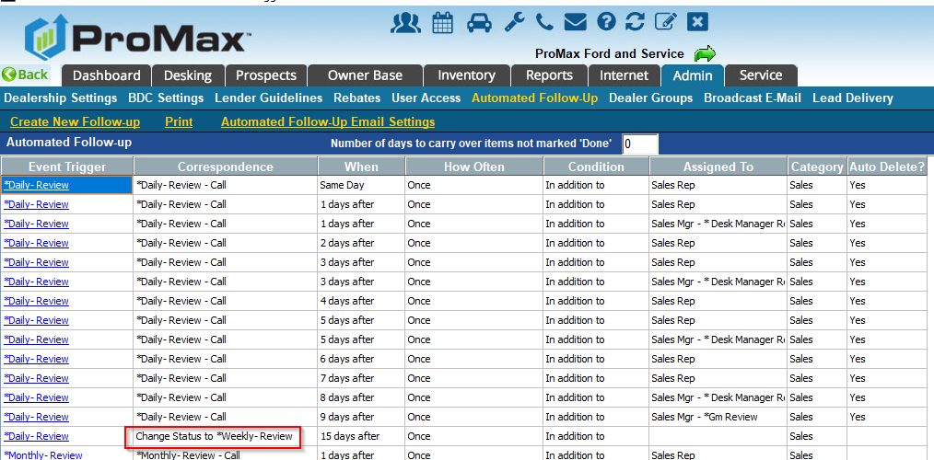
Auto Status Change
In Promax follow up can be triggered by an event in the system (like a birthday or delivery) or a status. For status driven follow up, you can now automatically have it change from a status like “daily” to a status of “weekly” to make sure a follow up cadence never falls off for your customers. This also makes less work for BDRs and Salesreps because they will no longer have to manually change the statuses once the follow up for one status is complete.
Admin > Automated Follow Up > Create New > Choose the trigger as status, and select the starting status. Then select “Change Status” as the follow up type and select your new status/cadence.

Slide 5
Push Notifications
We recently added 2 more ways that you can receive Push Notifications – for incoming texts and salesrep reassignments.

Slide 6
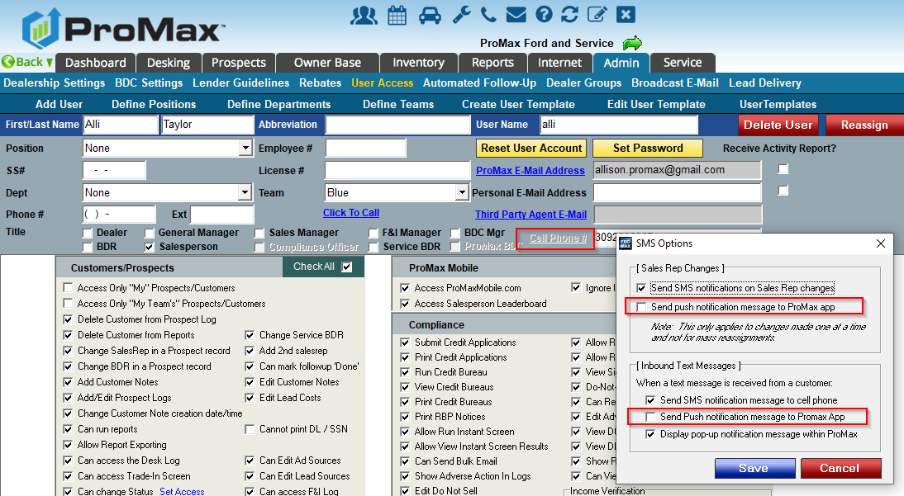
Push Notifications for Sales Rep Reassignments and Incoming Texts
You must first log into the Promax app in order to be able to start receiving push notifications.
To set this up go to Admin > User Access > Users Name > Cell Phone

Slide 7
Adding and Editing Reasons Unsold
The Reasons unsold in the manager exit note are now customizable.

Slide 8
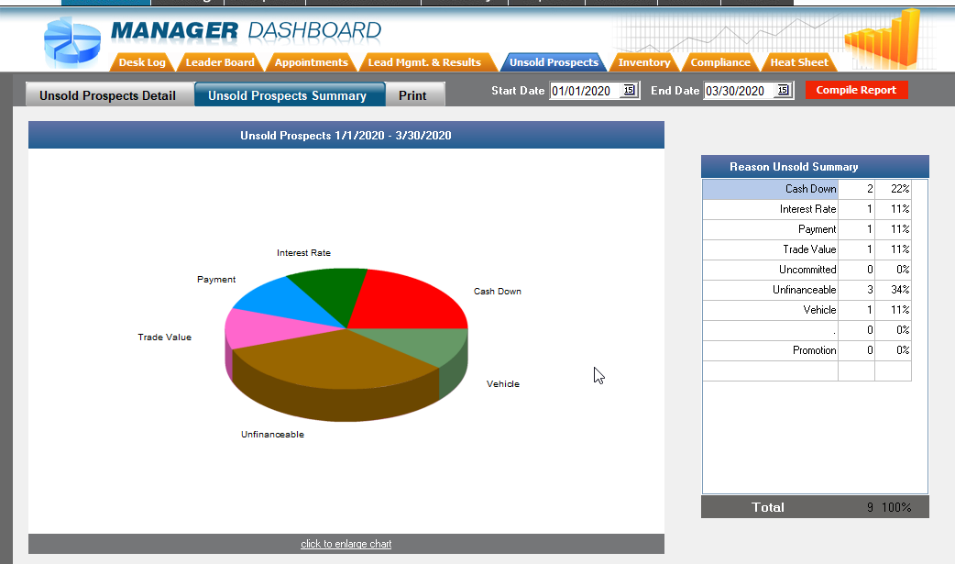
Adding and Editing Reason Unsold
Filling out your Reason Unsold on every customer that leaves your showroom without purchasing a vehicle gives you valuable insight on what you can adjust to get more deals closed.
Graph on the right shows an example of how this data is displayed in Promax when filled out regularly.

Slide 9
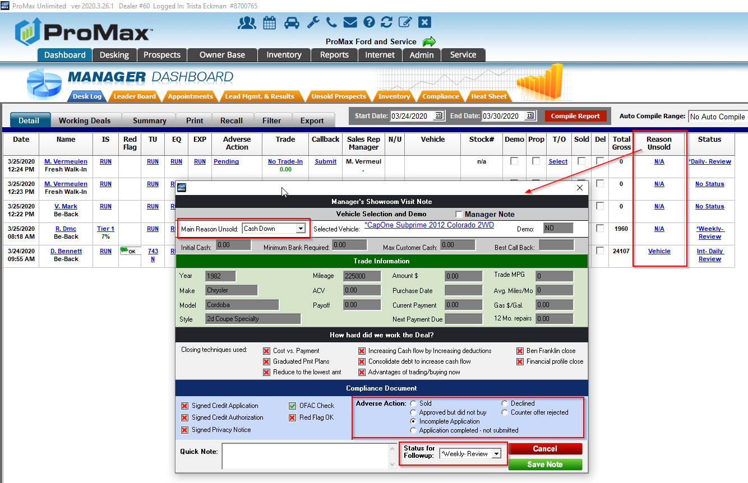
Adding and Editing Reasons Unsold
To update a reason unsold on a customer, go to Dashboard > Desk Log. Here you will see a column called Reason Unsold. If you click on the link this will open up the manager exit note where you can update the reason unsold and the Adverse Action Status. Best practice is to have a sales manager touch each of these customers every day to have this information added.

Slide 10
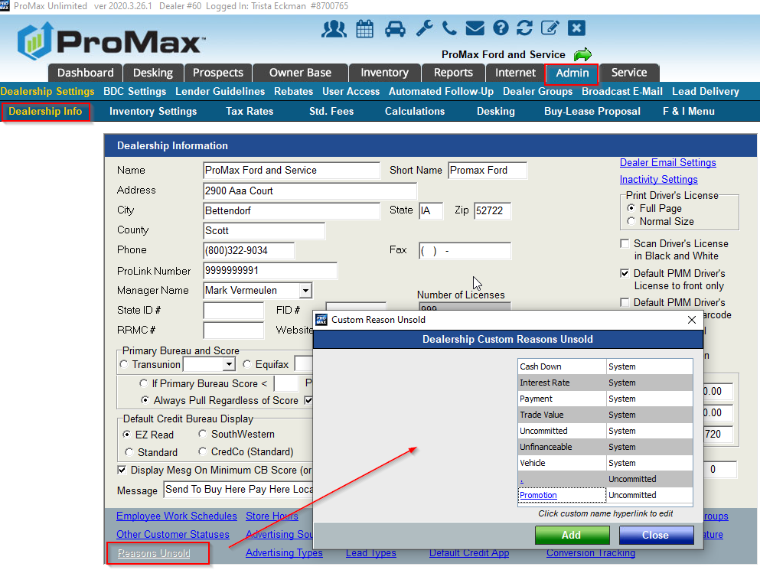
Adding and Editing Reasons Unsold
To change your reasons unsold list, go to Admin > Dealership Info > Reasons Unsold. From here you can add, edit, and delete.

Slide 11
Integration with CarStory
We now integrate with CarStory. With this integration we can push trades to CarStory and receive comments and pricing updates.

Slide 12
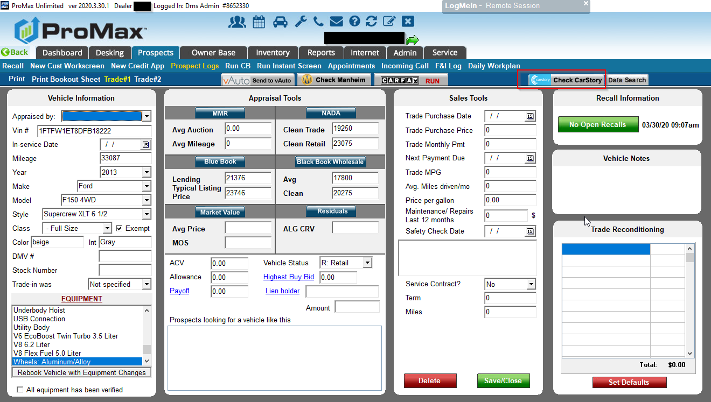
CarStory
We now integrate with CarStory. If you already have a CarStory account, just let your DSS know you’d like to be set up with the free integration. Enabling this in your site will allow you to log into your CarStory account straight from Promax from the Trade Screen. We will also send your trade information over to CarStory so you can check how this vehicle should be priced.

Slide 13
Call Tracking
Promax offers affordable incoming and outgoing call tracking solutions.

Slide 14
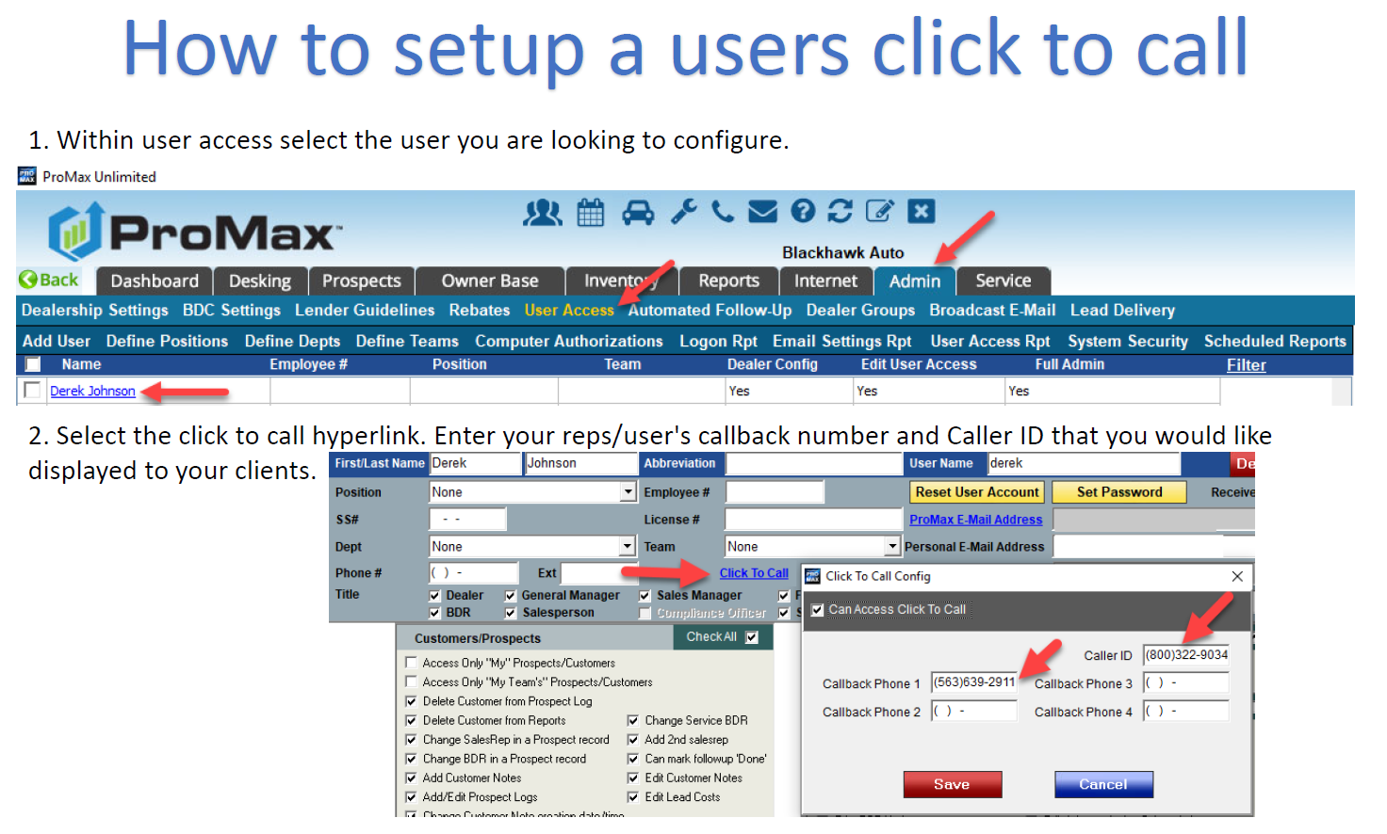

Slide 15
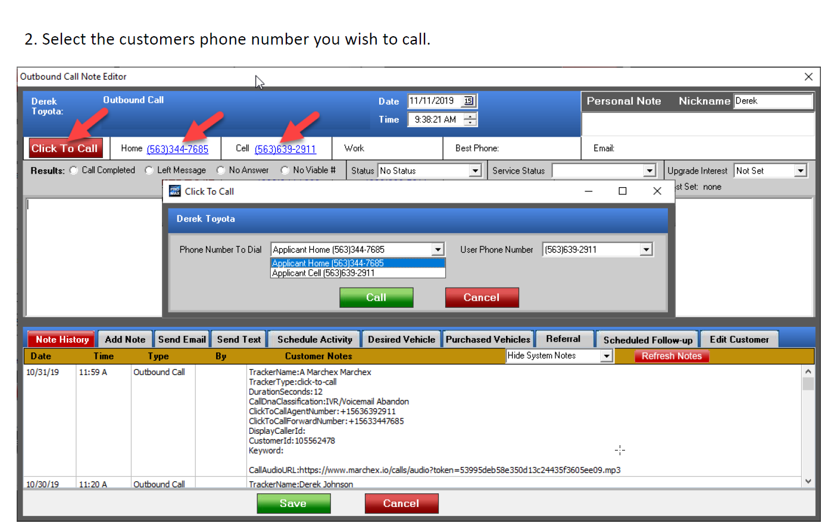

Slide 16
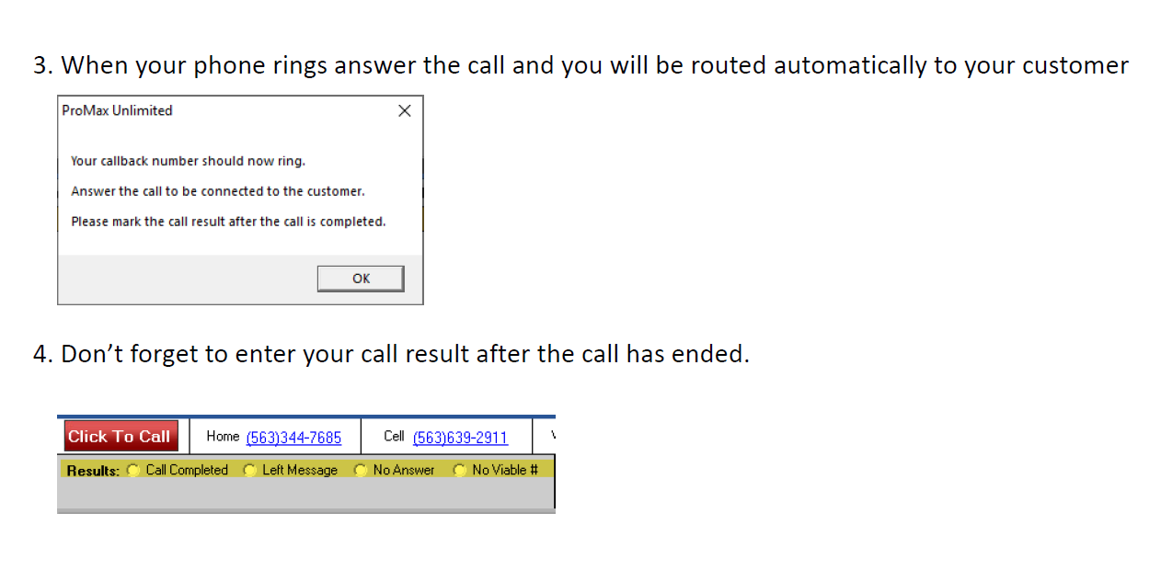

Slide 17
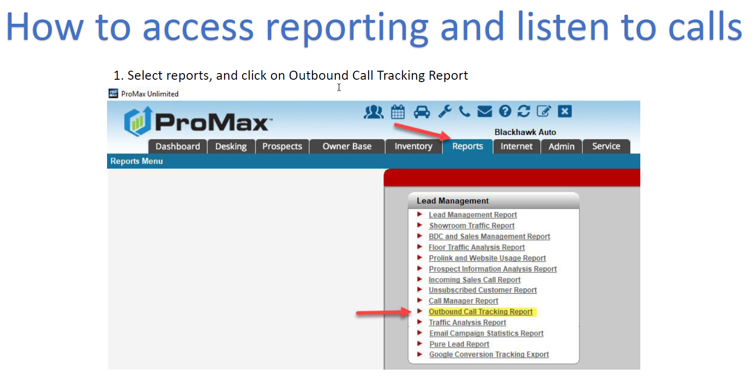

Slide 18
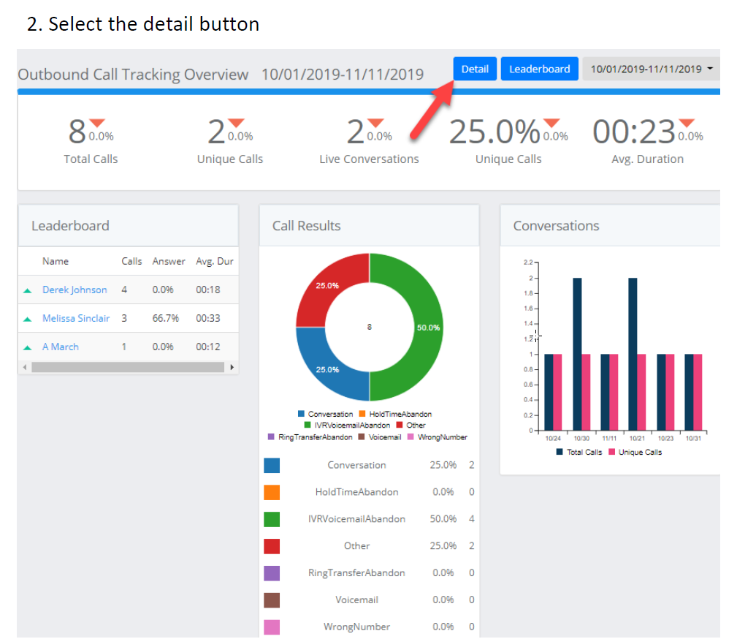

Slide 19
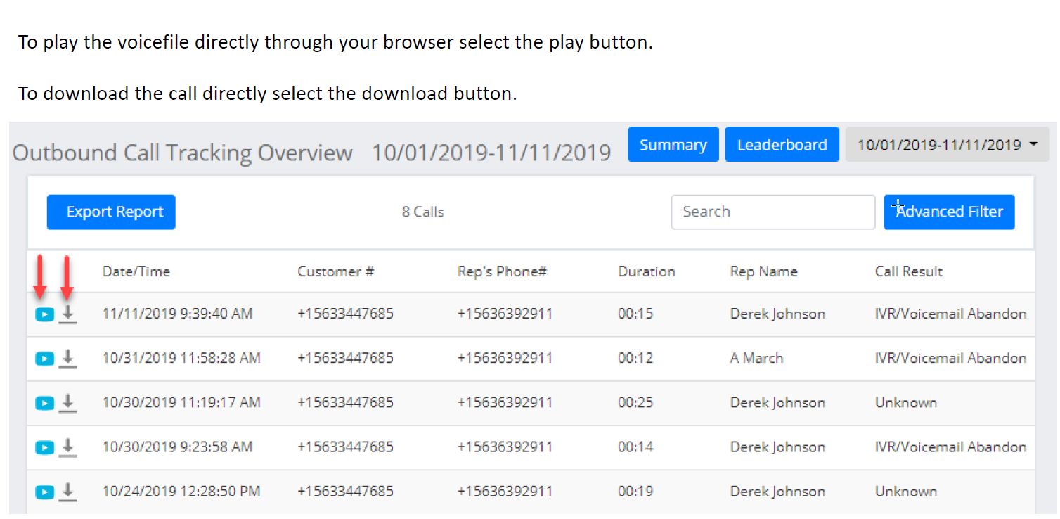

Slide 20
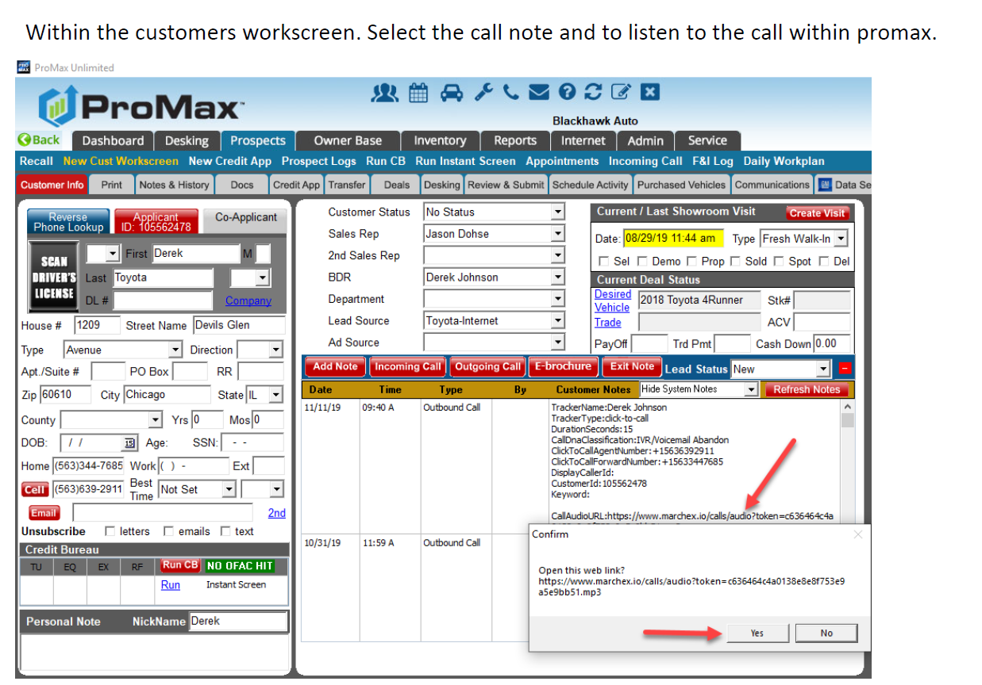

Slide 21
Questions?
Contact our Dealer Support Line at 844-322-9034
Contact me directly at 563-344-7618 or Trista@ProMaxUnlimited.com
PromaxUnlimited.com
Facebook.com/ProMaxUnlimited
Twitter.com/ProMaxUnlimited
LinkedIn.com/Company/ProMax-Automotive-Software/
DealerUpdates.TypePad.com/Blog/

