Slide 1

December

Slide 2
Agenda
Templates
Automated Follow Up
Water Report
Return on Investment Report
Statuses

Slide 3
Templates
We have several templates available for you to download in your ProMax system. You can also add any templates that you created into the system as well.

Slide 4
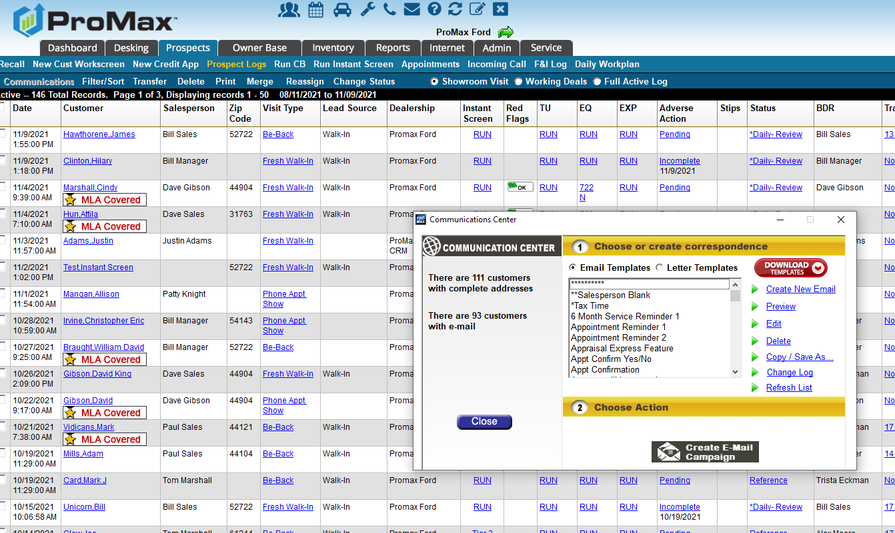
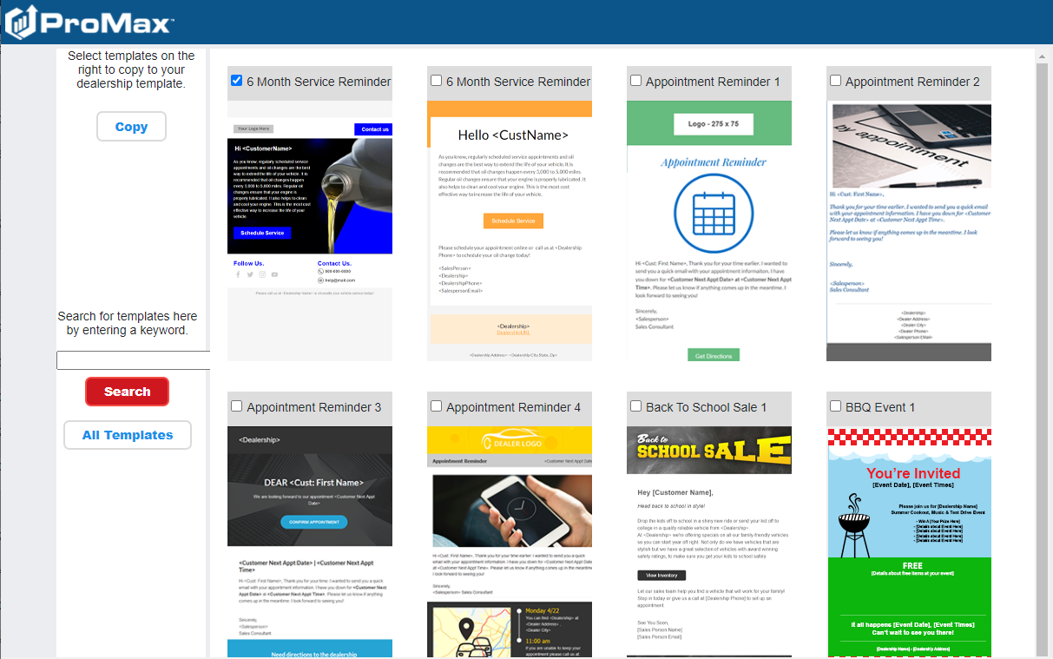
Templates
To download the templates that we have in our library go to Prospects > Communications > Download Templates. Check the box for the template you’d like to add and hit copy. This template will now be in your list of communications to choose from.

Slide 5
Statuses
In ProMax, Statuses are how you can trigger follow up with your customers.

Slide 6
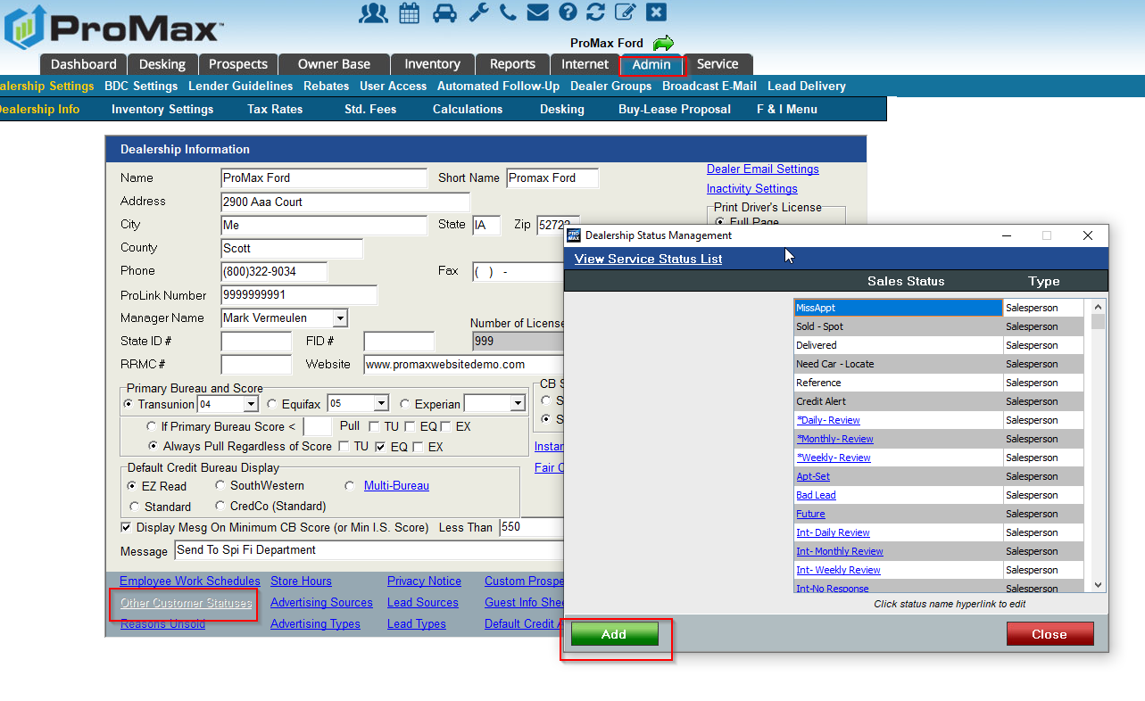
Statuses
Statuses are used in ProMax to trigger follow up.
In order to create a new status, you would go to Admin > Other Customer Statuses

Slide 7
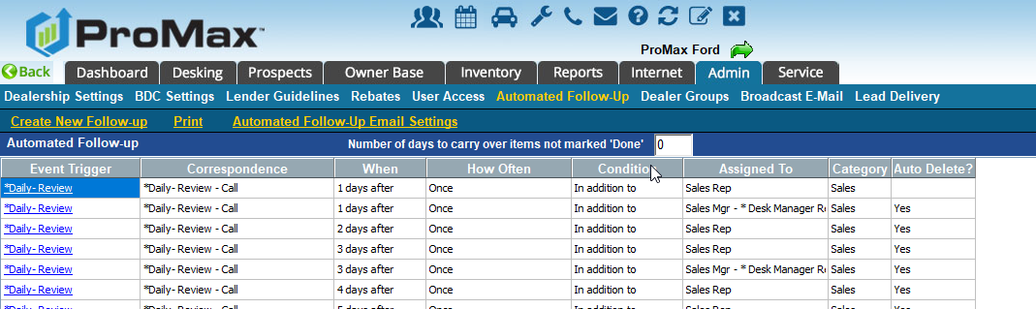
Statuses
To link statuses to follow up, go to Admin > Automated Follow Up.
Note: if your status is not linked to automated follow up, it will not trigger anything. You will want to limit your statuses with no follow up to only one or two – and be sure to make those manager only statuses!

Slide 8
Automated Follow Up
Automated Follow Up is how you tell the system what tasks to automatically schedule for your staff.

Slide 9
Automated Follow Up
To create your cadences, go to Admin > Automated Follow Up
You can see what is already scheduled from here and edit and create new.

Slide 10
Water Report
Take a look at how your inventory is performing

Slide 11
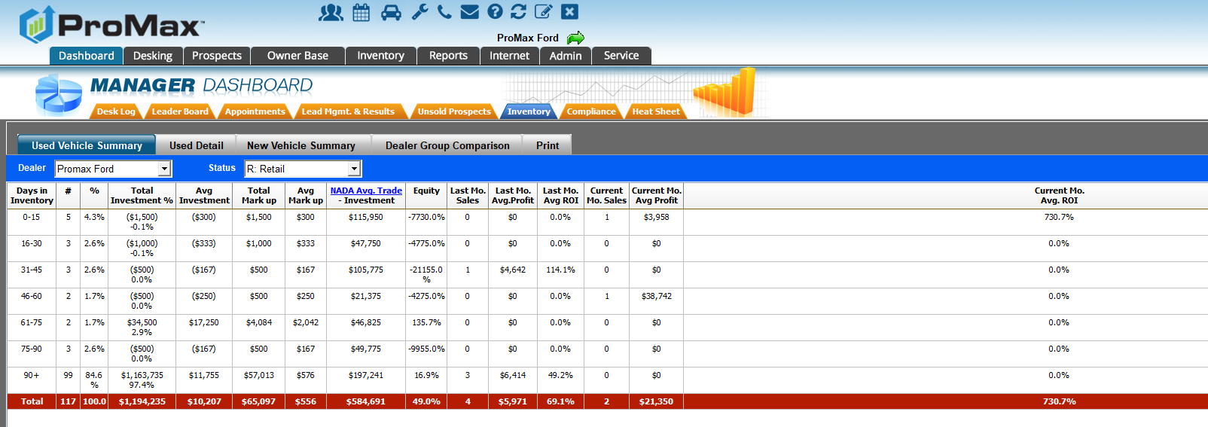
Water Report
To find this report, go to Dashboard > Inventory

Slide 12
Return On Investment Report

Slide 13
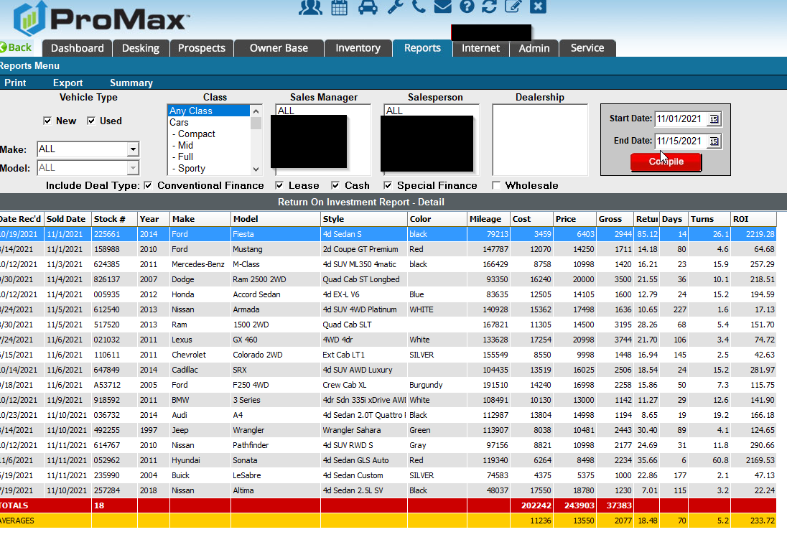
Return On Investment Report
Reports > Return On Investment Report
From here you can easily see all the details of the types of vehicles you are selling

Slide 14
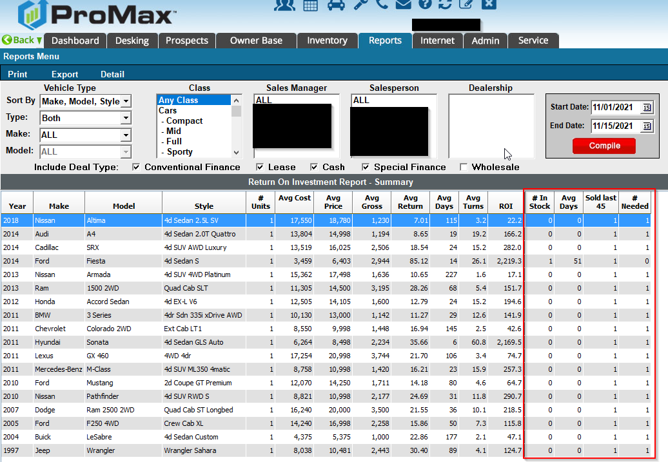
Return On Investment Report
From this same report you can take it one step further (by clicking summary) and see how many of a particular vehicle you need based off of the leads you are working now

Slide 15
Questions?
Contact our Dealer Support Line at 844-322-9034
Contact me directly at 563-344-7618 or Trista@ProMaxUnlimited.com
PromaxUnlimited.com
Facebook.com/ProMaxUnlimited
Twitter.com/ProMaxUnlimited
LinkedIn.com/Company/ProMax-Automotive-Software/
DealerUpdates.TypePad.com/Blog/

